Slide 2
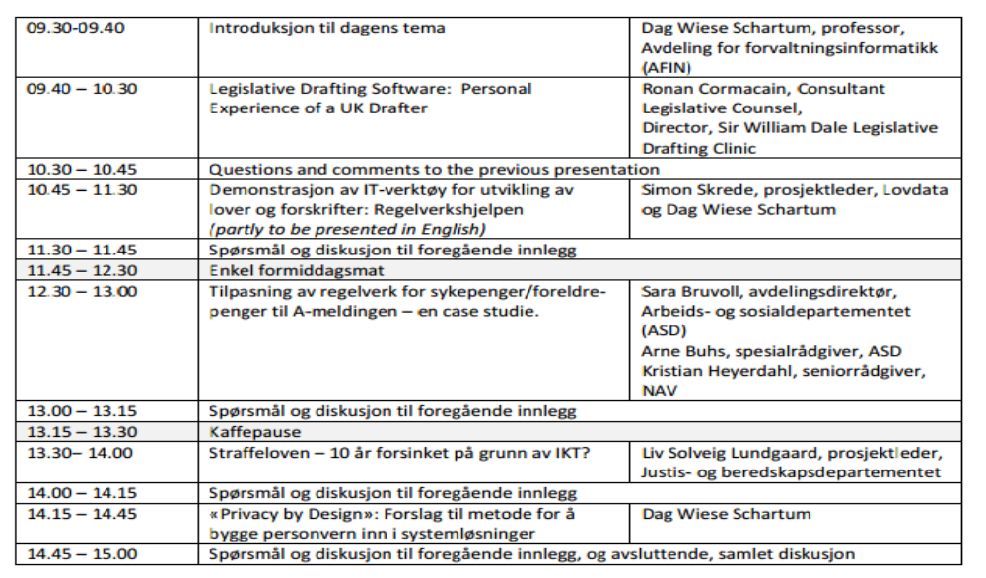
Utarbeidelse av lover i en digital forvaltning

Slide 3
Legislative Drafting and Digital Governance
- Survey of main topics
  Legal technology – ICT as tools for legislators and lawyers
    ICT drafting tools (from technical support of manual drafting to automatic support)
    ICT tools for evaluation of legislation (e.g. support evaluation from implementation)
  Transformation of law (legislation etc) to computer programmes
    Models and organisation
    Methods
    Tools
  Relationship between legislation and systems development
    Legislation → Systems development
    Systems development → amendment of legislation
    Parallell development of legislation and information systems
    Mixed processes: legislation enhanced by means of formal methods and tools (e.g. drafting tools, cf. above)
Ronan
Simon/Dag
Dag
Liv
Sara/Arne/Kristian

