Slide 1
JUS 5710/JUR 1710
International Human Rights Law:
Institutions and Procedures
Introduction:
The International Bill of Rights
Derogations and Reservations
Background

Slide 2
Today
Expectations
Introduction to human rights
Practical information – see web page
  Course content and learning outcomes
  Required readings
  Lectures and seminars
  Mock Exam and Assignments
  Exam

Slide 3
Expectations
What are your expectations?
What is your interest in human rights?
What is the background for this interest?
How can this course be useful to you?

Slide 4
Introduction to human rights
UN Charter
The International Bill of Rights
  Other International Instruments
  Obligations – implementation, monitoring and enforcement
Historical background
Sources

Slide 5
The Human Rights Project
On 10 December 1948 the General assembly proclaimed:
THIS UNIVERSAL DECLARATION OF HUMAN RIGHTS as a common standard of achievement for all peoples and all nations, to the end that every individual and every organ of society, keeping this Declaration constantly in mind, shall strive by teaching and education to promote respect for these rights and freedoms and by progressive measures, national and international, to secure their universal and effective recognition and observance, both among the peoples of Member States themselves and among the peoples of territories under their jurisdiction.

Slide 6
The Universal Declaration of Human Rights
The standard…
Article 1.
All human beings are born free and equal in dignity and rights...

Slide 7
UN Charter (1)
Article 1 of the Charter of the United Nations (1945): “
The Purposes of the United Nations are:
  1. To maintain international peace and security, and to that end: to take effective collective measures for the prevention and removal of threats to the peace, …
  2. To develop friendly relations among nations based on respect for the principle of equal rights and self-determination of peoples, and to take other appropriate measures to strengthen universal peace;
  3. To achieve international co-operation in solving international problems of an economic, social, cultural, or humanitarian character, and in promoting and encouraging respect for human rights and for fundamental freedoms for all without distinction as to race, sex, language, or religion; and
  4. To be a centre for harmonizing the actions of nations in the attainment of these common ends.

Slide 8
UN Charter (2)
Article 55
  With a view to the creation of conditions of stability and well-being,… the United Nations shall promote:
  c. universal respect for, and observance of, human rights and fundamental freedoms for all without distinction as to race, sex, language, or religion.
Article 56
  All Members pledge themselves to take joint and separate action in co-operation with the Organization for the achievement of the purposes set forth in Article 55

Slide 9
Obligations (1)
Namibia case, ICJ, Advisory Opinion, I.C.J. Reports 1971, p.57,para.131 (http://www.icj-cij.org/docket/files/53/5595.pdf)
To establish … and enforce, distinctions, exclusions, restrictions and limitations exclusively based on grounds of race, colour, descent or national or ethnic origin which constitutes a denial of fundamental human rights is a flagrant violation of the purpose and principles of the Charter.

Slide 10
International Bill of Rights
The Universal Declaration of Human Rights (UDHR) adopted on 10 December 1948
      58 member states – eight abstentions
On 16 December 1966, the text of the two international covenants were adopted:
The International Covenant on Economic, Social and Cultural Rights (ICESCR)
The International Covenant on Civil and Political Rights (ICCPR) and
        The Optional Protocol to the ICCPR

Slide 11
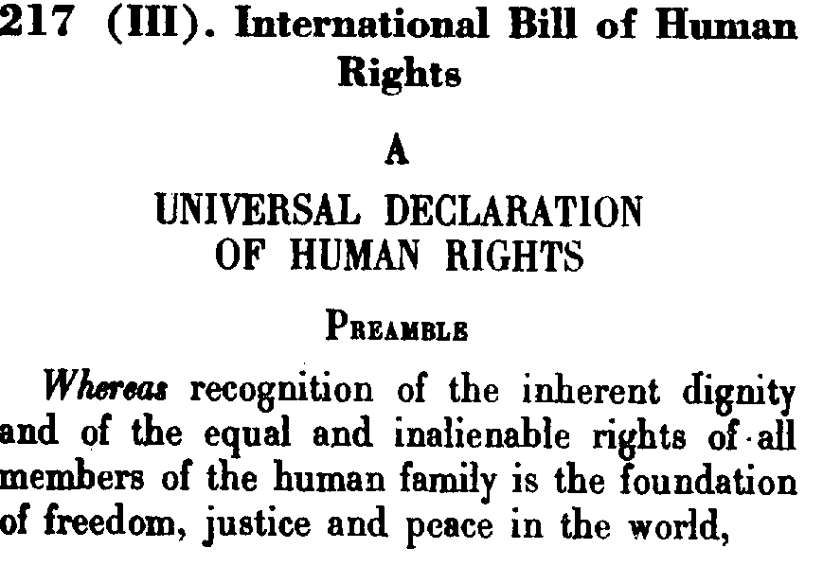
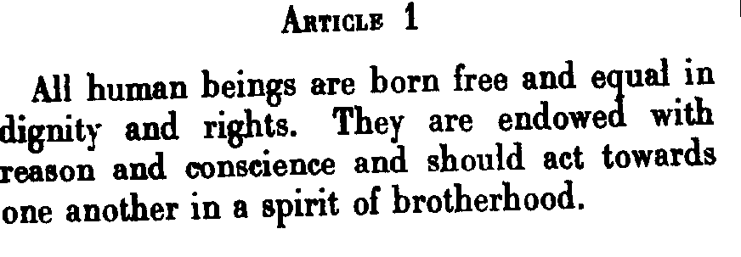
GA RES 217 (III)

Slide 12
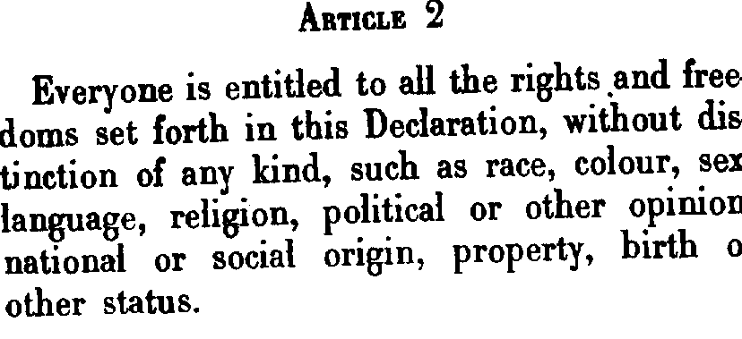
GA RES 217 (III): UDHR

Slide 13
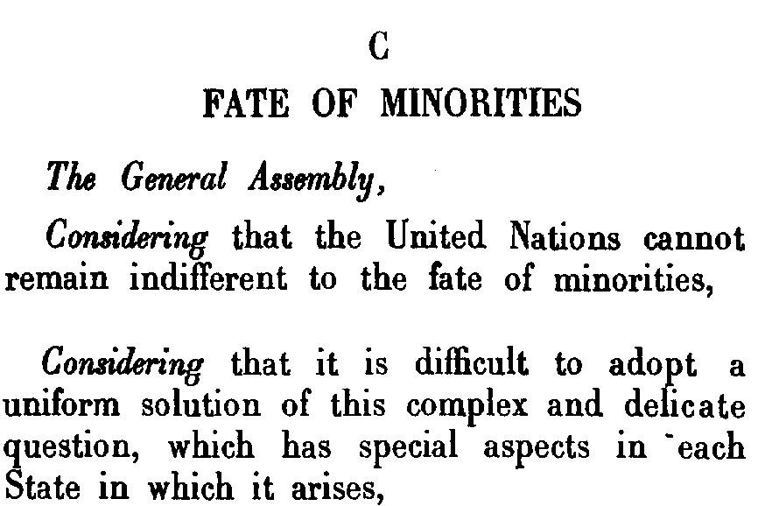
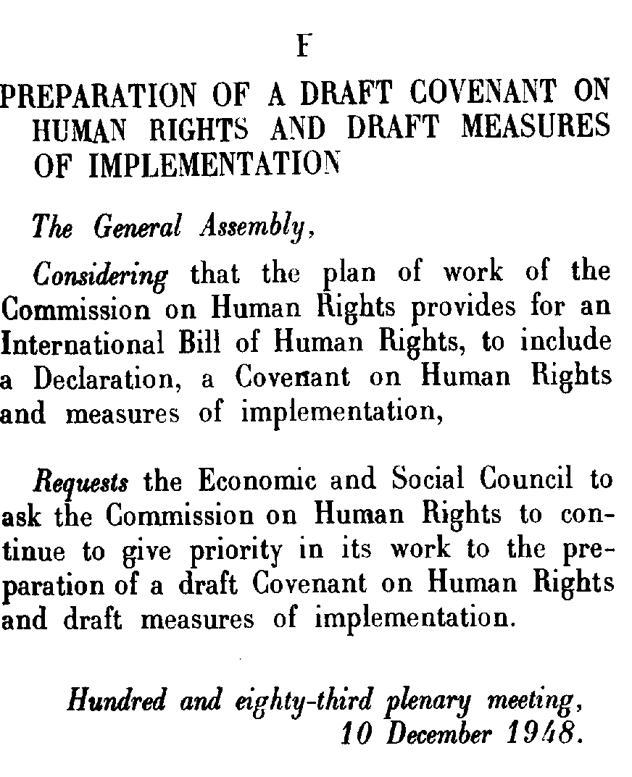
GA RES 217 (III)

Slide 14
The Universal Declaration of Human Rights
Legal status:
  A declaration by the GA – legally binding?
  General principles of law or custom?
  Customary law or not?
  Article 38.1 Statutes International Court of Justice:
    All rights?
  Jus cogens?
The Vienna Declaration and Programme of Action, Preamble:
  Emphasizing that the Universal Declaration of Human Rights, which constitutes a common standard of achievement for all peoples and all nations, is the source of inspiration and has been the basis for the United Nations in making advances in standard setting as contained in the existing international human rights instruments, in particular the International Covenant on Civil and Political Rights and the International Covenant on Economic, Social and Cultural Rights
  (adopted by the World Conference on Human Rights Conference 25 June 1993)

Slide 15
International Bill of Rights
International Covenant on Civil and Political Rights (ICCPR) – in force 1976 - 167 State parties
Optional Protocol to the ICCPR – in force 1976 - 114 State Parties
    On 15 December 1989, the text of the Second Optional Protocol to the ICCPR, aiming at the abolition of the death penalty was adopted – in force 1991 – 77 State Parties
    International Covenant on Economic, Social and Cultural Rights (ICESCR)- in force 1976 – 160 State Parties
    On 10 December 2008, the text of the Optional Protocol to the ICESCR was adopted - in force 5 May 2013- 10 State Parties

Slide 16
Universal Human Rights?
Universal Declaration of Human Rights, 10 December 1948, General Assembly adopted resolution 217 (III) entitled “International Bill of Human Rights, vote 48 to none 8 abstentions
  Interdependence of human rights
Proclamation of Teheran, Final Act of the International Conference on Human Rights, Teheran, 22 April to 13 May 1968, UN Doc. A/CONF. 32/41 (1968). (84 states)
  Since human rights and fundamental freedoms are indivisible, the full realization of civil and political rights without the enjoyment of economic, social and cultural rights is impossible. , para. 13
  Legislative phase
Vienna Declaration and Programme of Action, World Conference on Human Rights, Vienna, 14 to 25 June 1993, UN Doc. A/CONF.157/23 (1993).
(171 States)
  All human rights are universal, indivisible and interdependent and interrelated.,. and respect for cultural diversity, para. 5
  Implementation phase
    Better coordination – the UN High Commissioner for Human Rights

Slide 17
International Bill of Rights
The ICESCR and the ICCPR
Two separate treaties and optional protocols for individual complaints procedures
Differences in content –which rights?
Differences in state obligations?

Slide 18
State obligations under the two Covenants
ICCPR
ICESCR
Article 2.1
Each State Party to the present Covenant undertakes to respect and to ensure to all individuals within its territory and subject to its jurisdiction the rights recognized in the present Covenant, without distinction of any kind, such as race, colour, sex, language, religion, political or other opinion, national or social origin, property, birth or other status.
Article 2.1
1. Each State Party to the present Covenant undertakes to take steps, individually and through international assistance and co-operation, especially economic and technical, to the maximum of its available resources, with a view to achieving progressively the full realization of the rights recognized in the present Covenant by all appropriate means, including particularly the adoption of legislative measures.

Slide 19
Compare with the ECHR
Article 1 of ”European Convention of Human Rights”:
The High Contracting Parties shall secure to everyone within their jurisdiction the rights and freedoms defined in Section 1 of this Convention

Slide 20
State obligations - ICESCR
The obligations under the ICESCR have been interpreted to include:
  obligations to respect, to protect and to fulfil (including to facilitate and to provide)
  see General Comment 12: The right to adequate food (Art.11) (U.N. Doc. E/C.12/1999/5, paras. 14 and 15 . See also General Comment No. 3 (1990).
The principal obligation is to take steps to achieve progressively the full realization of the right to adequate food. This imposes an obligation to move as expeditiously as possible towards that goal. Every State is obliged to ensure for everyone under its jurisdiction access to the minimum essential food which is sufficient, nutritionally adequate and safe, to ensure their freedom from hunger.
General Comment 12: The right to adequate food (Art.11) (U.N. Doc. E/C.12/1999/5, para. 14

Slide 21
Respect, Protect and Fulfil
The right to adequate food, like any other human right, imposes three types or levels of obligations on States parties:
The obligation to respect existing access to adequate food requires States parties not to take any measures that result in preventing such access.
The obligation to protect requires measures by the State to ensure that enterprises or individuals do not deprive individuals of their access to adequate food.
The obligation to fulfil (facilitate) means the State must proactively engage in activities intended to strengthen people’s access to and utilization of resources and means to ensure their livelihood, including food security.
Finally, whenever an individual or group is unable, for reasons beyond their control, to enjoy the right to adequate food by the means at their disposal, States have the obligation to fulfil (provide) that right directly. This obligation also applies for persons who are victims of natural or other disasters.
General Comment 12: The right to adequate food (Art.11) (U.N. Doc. E/C.12/1999/5, para. 15

Slide 22
Indivisibility and Interdependence
  5. All human rights are universal, indivisible and interdependent and interrelated. The international community must treat human rights globally in a fair and equal manner, on the same footing, and with the same emphasis. …it is the duty of States, regardless of their political, economic and cultural systems, to promote and protect all human rights and fundamental freedoms.
  See The Vienna Declaration and Programme of Action, World Conference on Human Rights (1993), (U.N. Doc. A/CONF.157/24 (Part I) at 20 (1993))

Slide 23
Major human rights treaties (1)
Ten major treaties are included in the UN treaty system and “treaty bodies” monitor their implementation:
In addition to the ICCPR and the ICESCR and the optional protocols, the major human rights treaties address either specific groups or categories of persons, or specific issues:
Convention on the Elimination of All Forms of Discrimination against Women (CEDAW)
Convention on the Rights of the Child (CRC)
International Convention on the Protection of the Rights of All Migrant Workers and Members of Their Families (MWC).
Convention on the Rights of Persons with Disabilities (CRPD)

Slide 24
Major human rights treaties (2)
International Convention on the Elimination of All Forms of Racial Discrimination (CERD)
Convention against Torture and Other Cruel, Inhuman or Degrading Treatment or Punishment (CAT)
Optional Protocol to the Convention against Torture and other Cruel, Inhuman or Degrading Treatment or Punishment (OP-CAT)
International Convention for the Protection of All Persons from Enforced Disappearance (CPED) (in force 23 Dec 2010)

Slide 25
Monitoring, implementing and enforcing human rights
Procedures in UN system
  Charter based
  Treaty based
  Actors involved
    States
    Individuals
    NGOs
    National Institutions

Slide 26
The methods
The treaty bodies use a number of methods to monitor the State compliance with the treaties:
A. State reporting
B. Interstate communications
C. Individual Communications
D. Investigative mechanisms

Slide 27
Historical background and international law
Traditionally a law among nations
  Only states were subjects of the law, having rights and obligations
  The treatment of individuals was within the domestic jurisdiction of the State
Exceptions:
  Humanitarian intervention
  Minorities
  Slaves
  Workers
  International humanitarian law
  Aliens
  Diplomats

Slide 28
Historical background
The law on aliens
To facilitate international travel, trade and economy
The individuals as part of the state
A violation of rights a wrongful act against the state
Contemporary instruments:
  The Declaration on the Rights of Individuals Who Are Not Nationals of the Country in Which They Live (1985)
  International Convention on the Protection of the Rights of All Migrant Workers and Members of Their Families (1990)
  See also general comments by treaty bodies

Slide 29
Early examples of protection of individuals or groups
  Humanitarian intervention
    17th century
    The use of force to stop the maltreatment by a state of its own nationals
    Maltreatment shocking the community of nations
  Art. 4.h. of the Constitutive Act of the African Union (2000)
    The right of the Union to intervene in a Member State pursuant to a decision of the Assembly in respect of grave circumstances, namely war crimes, genocide and crimes against humanity;
  Slaves/slavery
    19th century
    From the prohibition of slave trade to slavery
  Art. 8 ICCPR
  1. No one shall be held in slavery; slavery and the slave-trade in all their forms shall be prohibited.
  2. No one shall be held in servitude.
  3.(a) No one shall be required to perform forced or compulsory labour…;

Slide 30
Historical basis
From 17th century in Europe: minority rights were part of different peace settlements.
The League of Nations - minority protection became the compensation for those groups which were not granted national self-determination and independent statehood
States were forced to accept separate treaties (or unilateral documents) for specific minorities as part of the peace settlement by the victorious powers.
  See Treaty between the Principal Allied Powers and Poland, 29 June 1919.

Slide 31
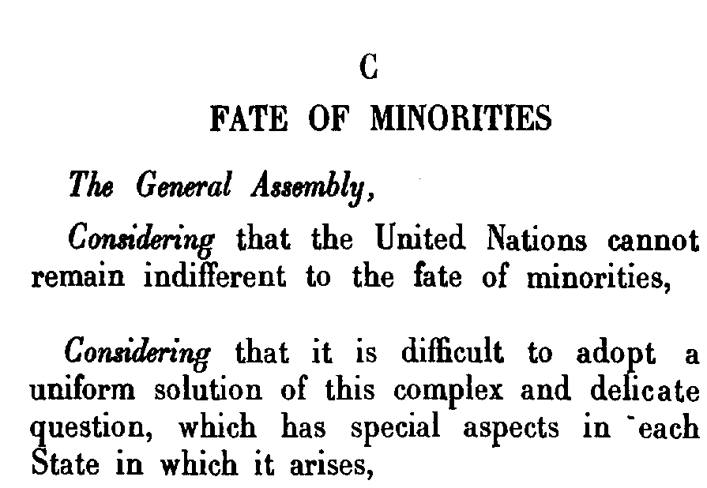
GA RES 217 (III) C
1948

Slide 32
Universal Declaration of Human Rights
Non-discrimination
  Article 2: Everyone is entitled to all the rights and freedoms set forth in this Declaration, without distinction of any kind, such as race, colour, sex, language, religion, political or other opinion, national or social origin, property, birth or other status.
Rights to participate in cultural life
  Article 27(1) Everyone has the right freely to participate in the cultural life of the community, to enjoy the arts and to share in scientific advancement and its benefits.

Slide 33
Article 27 ICCPR
In those States in which ethnic, religious or linguistic minorities exist, persons belonging to such minorities shall not be denied the right, in community with other members of their group, to enjoy their own culture, to profess and practice their own religion, or to use their own language
Key words:
Exist
Ethnic, religious or linguistic minorities
Shall not be denied
Individual rights but to be enjoyed in community with other members of the group
Enjoy, profess and practice and/or use

Slide 34
Reservations, Limitations and Derogations
In accordance with international human rights law there are essentially three ways in which the State may limit or restrict the scope of its obligations:
Reservations to treaties
Express limitations to rights
Derogations from rights

Slide 35
Reservations, Limitations and Derogations
A balance of interests
  Society v. individual
Universality of human rights?
  Which universality?

Slide 36
UDHR
Article 29.
(2) In the exercise of his rights and freedoms, everyone shall be subject only to such limitations as are determined by law solely for the purpose of securing due recognition and respect for the rights and freedoms of others and of meeting the just requirements of morality, public order and the general welfare in a democratic society.

Slide 37
Reservations (1)
International law:
Article 19 of the Vienna Convention on the Law of Treaties (VCLT)
ICCPR – no provision
  Therefore – Art. 19 © VCLT ”object and purpose of the treaty”
Art. 2 Second Optional Protocol
  Death penalty in time of war

Slide 38
Article 19 VCLT –
Formulation of reservations
A State may, when signing, ratifying, accepting, approving or acceding to a treaty, formulate a reservation unless:
  (a) the reservation is prohibited by the treaty;
  (b) the treaty provides that only specified reservations, which do not include the reservation in question, may be made; or
  (c) in cases not failing under subparagraphs (a) and (b), the reservation is incompatible with the object and purpose of the treaty.

Slide 39
Reservations (2)
Art. 57 ECHR
  Only if law in force is not in conformity with the ECHR
  Only if not of a general character
  and
  Only if a short description of the law is provided
  Only if it is made at time of signature or depositing the ratification

Slide 40
Criteria under Art. 57 ECHR
A reservation may not be ”general” (see Belilos v. Switzerland, Judgment 29 April 1988, ser. A, No.132, p. 26, para.55):
“By “reservation of a general character” ... is meant in particular a reservation couched in terms that are too vague or broad for it to be possible to determine their exact meaning and scope. ... Article 64§1 requires precision and clarity.”
A short description of the law is required it contributes to “legal certainty”
The “brief statement of the law concerned” both constitutes an evidential factor and contributes to legal certainty. The purpose of Article 64 § 2 is to provide a guarantee ... that a reservation does not go beyond the provisions expressly excluded by the State concerned.( Belilos, para. 59)
  Cf. Chorherr v. Austria (Application no. 13308/87), Judgment 23 August 1993, Ser. A., No. 266-B – not necessary to state the law- a reference was made to the Federal Official Gazette

Slide 41
Criteria for incompatibility with the ICCPR
Art. 19.(c) VCLT
The reservation is incompatible with the object and purpose of the treaty.
Offending peremptory norms (customary)
  Ex: torture; thought, conscience and religion; denial of minority rights to culture, language or religion… self-determination
However, not necessary non-derogable
No reservation to Art. 2.3 or 40 ICCPR
Not widely formulated reservations which essentially render ineffective all Covenant rights
(CCPR General Comment 24, paras. 8-12)

Slide 42
State of emergency
Permissible to restrict the application of human rights when a threat to the nation exists
A derogation from their obligations under the treaty
Express provisions in the ICCPR and the ECHR
Armed conflict or other exceptional situation
States must act according to their constitution and other relevant domestic law

Slide 43
Derogations
ECHR
Art 15:
War or other public emergency threatening the life of the nation
Strictly required in the situation
Comply with other obligations under int. law
Non-derogable rights: Arts. 2 (exception for lawful acts of war), 3, 4.1, 7
Prohibition of death penalty: Art. 3 of protocol 6, and protocol 13 (no derogation)
Procedure: Inform SG of C of E
ICCPR
Art. 4:
Public emergency threatening the life of the nation
Strictly required in the situation
Comply with other obligations under int. law
Officially proclaimed
No discrimination solely on enumerated grounds
Non-derogable rights: Arts. 6, 7, 8.1 and 8.2,, 11, 15, 16, 18
Prohibition of death penalty: Art. 6 2nd optional protocol (no derogation)
Procedure: Inform other state parties through SG of the UN

Slide 44
Derogations
Which are the differences in the wording between Art. 15 ECHR and Art. 4 ICCPR?
What could be the consequences of such differences?

Slide 45
Derogations
In accordance with the principles of legality and rule of law
  In accordance with constitution and other domestic laws
  Not in violation with international legal obligations
Art. 53 ECHR: Safeguard for existing human rights
  Nothing in this Convention shall be construed as limiting or derogating from any of the human rights and fundamental freedoms which may be ensured under the laws of any High Contracting party or under any other agreement to which it is a Party
Art. 5.2 of the ICCPR:
  There shall be no restriction upon or derogation from any of the fundamental human rights recognized or existing in any State Party to the present Covenant pursuant to law, conventions, regulations or custom on the pretext that the present Covenant does not recognize such rights or that it recognizes them to a lesser extent.

Slide 46
Substantive requirements
Public emergency:
“an exceptional situation of crisis or emergency which affects the whole population and constitutes a threat to organised life in the community of which the State is composed” (Lawless v. Ireland, ser. A. No. 1-3, Judgment of 1 July 1961, para. 28)
Margin of appreciation (ECHR) -The State is in the position to determine: the presence of such situation and what is necessary to avert it (Aksoy v. Turkey (Appl. 219877/93), Judgment of 2 November 2004, para. 69)

Slide 47
Non-derogable rights
Listed in Art. 4 ICCPR and Art. 15 ECHR
In addition:
The protocols to the conventions
Jus cogens/peremtory norms of international law (VCLT Art. 53)
The HRCmmttee (Gen. Comment 29, para 13-14, 16):
  Certain rights have non-derogable elements or dimensions :
  The right to non-discrimination (Gen. Comment 29, para 7)
  Deprivation of liberty – humanity and respect for inherent dignity
  Prohibition of taking of hostages, abduction or unacknowledged detention, as part of general international law
  Rights of persons belonging to minorities
  Deportation or forcible transfer of population without grounds permitted under int. law (see also ICC statutes) (cf. Art. 12 ICCPR)
  Propaganda of war or advocacy of national, racial or religious hatred inciting discrimination, hostility or violence (cf. Art. 20 ICCPR)
  Remedies for any violation of the ICCPR (see Art. 2.3 ICCPR)
  Fair trial (as guaranteed under int. humanitarian law)

Slide 48
Procedural requirements
Official proclamation (Art. 4 ICCPR, but only implicit in Art. 15 ECHR)
Notification, both start and end
Within time – immediate (Art. 4.3 ICCPR)
Full information about the measures taken
A clear explanation of the reasons

Slide 49
Sources (1)
Article 38.1 Statutes International Court of Justice:
The Court, whose function is to decide in accordance with international law such disputes as are submitted to it, shall apply:
  a. international conventions, whether general or particular, establishing rules expressly recognized by the contesting states;
  b. international custom, as evidence of a general practice accepted as law;
  c. the general principles of law recognized by civilized nations;
  d. subject to the provisions of Article 59, judicial decisions and the teachings of the most highly qualified publicists of the various nations, as subsidiary means for the determination of rules of law.

Slide 50
Sources (2)
Art. 53 Vienna Convention on the Law of Treaties (1969): Treaties conflicting with a peremptory norm of general international law (“jus cogens”)
A treaty is void if, at the time of its conclusion, it conflicts with a peremptory norm of general international law.
A peremptory norm of general international law is a norm accepted and recognized by the international community of States as a whole as a norm from which no derogation is permitted and which can be modified only by a subsequent norm of general international law having the same character.

Slide 51
Sources (3)
Acts of international organizations
Binding or non-binding?
UN Charter in Chapter VII:
  Threats to the peace, breaches of the peace and acts of aggression
  The decisions by the Security Council are binding upon the Member States (Article 25)
Declaration and resolutions etc, ”Soft law”?
  New non-binding concerns of int.org
    Building-blocks for customary law ?
  The UDHR

Slide 52
Exam
27 November at 10:00
Written 4 hours
Two parts: Short questions and essay questions
Announcement of results: 18 December 2014
Mock Exam posted on the webpage/Fronter
Handed in on 24 October 2014 in Fronter
Discussed in class 11 November 2014

Slide 53
Course content and learning outcomes
Learning outcomes
a good understanding of different aspects the institutions and procedures at universal and regional levels,
giving you the ability to describe and critically analyze the achievements and shortcomings of the international protection of human rights.
You will be familiar with and able to use “views” and “judgments” from international organs in making your legal arguments.
Course content
Focus on the institutions, treaties and practices of intergovernmental organisations, in addition to international criminal tribunals
Provide a perspective of both the normative standards defining international human rights and the means by which they are monitored and implemented.

Slide 54
Readings
Three books:
  Burgenthal, Thomas et.al, International Human Rights in a Nutshell, 4th.ed. (2009)
  Economic, Social and Cultural Rights. A Textbook. Second Revised Edition, Asbjørn Eide, et.al.(eds.), (2001)
  Smith, Rhona, Textbook on International Human Rights, 5th. Ed. (2012)
  Articles and reports
UN and regional treaties, UN and regional documents, relevant decisions and cases to support the text books
Recommended readings

Slide 55
Lectures and seminars
Lectures:
The United Nations
Regional systems, in particular Europe
Selected rights: Self-determination, Right to life and Freedom from torture, Freedom of Expression, Minority rights and Indigenous Peoples’ rights, the right to Development and briefly Economic, Social and Cultural Rights
International Humanitarian Law and International Criminal Tribunals briefly
Seminars and guest lectures:
Rainforest Foundation Norway (NGO): The Rights of Indigenous Peoples and the Environment/Climate Change
Odd Isungset (NRK): Case study on Norway: Freedom of expression and its regulation - From Rushdie to Mohammed

Slide 56
Lecturers and Administration
Maria Lundberg
  Associate Professor, Norwegian Centre for Human Rights
  maria.lundberg@nchr.uio.no
  Reception hrs: Monday 9-10 (and upon request (22842014/91577418))
Petter Wille
  Ambassador
  Special Envoy for Minorities, Royal Norwegian Ministry of Foreign Affairs
  Contact
  Administration:
  Elisabeth Reien
  elisabeth.reien@jus.uio.no

