Slide 1
Data Communication:
Routing algorithms
IN2140:
Introduction to Operating Systems and Data Communication
Wednesday, April 3, 2019

Slide 2
Adaptive Routing
Distributed Routing
Distance Vector

Slide 3
Distance Vector Routing
Principle
every IS maintains a table (i.e., vector) stating
  best known distance to destinations
  and line to be used
ISes update tables
  by exchanging routing information with their neighbors

Slide 4
Distance Vector Routing
Each IS
  maintains routing table with one entry per router in the subnet
  is assumed to know the distances to each neighbor
  sends list with estimated distances to each destination periodically to its neighbors
X receives list E(Z) from neighbor Y
  Distance X to Y: e
  Distance Y to Z: E(Z)
  Distance X to Z via Y: E(Z)+e
IS computes new routing table from the received lists
containing
  Destination IS
  Preferred outgoing path
  Distance

Slide 5
Distance Vector Routing
A
B
C
D
A
I
H
K
line
A
0
24
20
21
8
A
B
12
36
31
28
20
A
G
C
25
18
19
36
28
I
E
H
F
D
40
27
8
24
20
H
E
14
7
30
22
17
I
F
23
20
19
40
30
I
I
J
K
L
G
18
31
6
31
18
H
H
17
20
0
19
12
H
I
21
0
14
22
10
I
J
9
11
7
10
0
-
K
24
22
22
0
6
K
L
29
33
9
9
15
K
delay
JA
8
JI
10
JH
12
JK
6
Previous routing table will not be taken into account
  Reaction to deteriorations

Slide 6
Distance Vector Routing
Fast route improvement
Fast distribution of information about new short paths (with few hops)
Example
  initially A unknown
  later: A connected with distance 1 to B, this will be announced
  Distribution proportional to topological spread
  Synchronous (stepwise) update is a simplification
A
B
C
D
E
∞
∞
∞
∞
1
∞
∞
∞
1
2
∞
∞
1
2
3
∞
1
2
3
4

Slide 7
Distance Vector Routing
Slow distribution of information about new long paths (with many hops)
“Count to Infinity” problem of DVR
Example: deterioration
  Here: connection destroyed
  A was previously known, but is now detached
  The values are derived from (incorrect) connections of distant IS
Comment
  Limit "infinite" to a finite value, depending on the metrics, e.g.
    ‘infinite’ = maximum path length+1
A
B
C
D
E
1
2
3
4
3
2
3
4
3
4
3
4
5
4
5
6
5
6
5
6
7
6
7
6
7
8
7
8
∞
∞
∞
∞

Slide 8
Distance Vector Routing
Variant: ‘Split Horizon Algorithm’
Objective: improve the "count to infinity" problem
Principle
  In general, to publicize the "distance" to each neighbour
  If neighbor Y exists on the reported route, X reports the response "false" to Y
    distance X (via Y) according to arbitrary i: ∞
A
B
C
D
E
1
2
3
4
Example: deterioration (connection destroyed)
  B to C: A = ∞ (real),
  C to B: A = ∞ (because A is on path), ...
But: still poor, depending on topology, example
  Connection CD is removed
  A receives "false information" via B
  B receives "false information" via A
    Slow distribution (just as before)
∞
2
3
4
∞
∞
3
4
∞
∞
∞
4
∞
∞
∞
∞
A
C
D
B

Slide 9
Adaptive Routing
Distributed Routing
Link State Routing

Slide 10
Link State Routing
A very frequently use routing protocol
  IS-IS (Intermediate System-Intermediate System)
  OSPF (Open Shortest Path First)
Basic principle
  IS measures the "distance" to the directly adjacent IS
  Distributes information
  Calculates the ideal route
Procedure
  Determine the address of adjacent IS
  Measure the "distance" (delay, ...) to neighbouring IS
  Organize the local link state information in a packet
  Distribute the information to all IS
  Calculate the route based on the information of all IS

Slide 11
Link State Routing
1. Phase: gather information about the adjacent intermediate systems
H
H
D
E
G
D
E
G
B
I
B
I
A
C
F
A
C
F
LAN

Slide 12
Link State Routing
1. Phase: gather information about the adjacent intermediate systems
H
H
D
E
G
D
E
G
B
I
B
I
A
C
F
A
C
F
LAN
N
Initialization procedure
New IS
  Sends a HELLO message over each L2 channel
Adjacent IS
  Responds with its own address, unique within the network

Slide 13
Link State Routing
2. Phase: measure the "distance"
Definition of distance needed
  Usually delay
  Where to measure?
Topology, link utilization, etc.
information
Router
Routing
Process
desti-
nation
link
Routing
table
When to start timer?
A
0
Fills & Updates
B
3
C
1
Uses & Looks up
D
4
Data packets
Queues
ECHO
Forwarding
Process
HELLO
Incoming
lines
Outgoing
lines

Slide 14
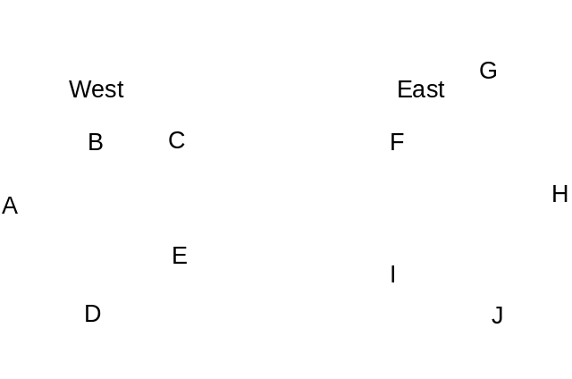
Link State Routing
2. Phase: measure the "distance“
Queuing delay
  Measuring without does not take load into account
  Measuring with does ⇒ usually better
But
  Possibility for oscillations (route flapping)
  Once per routing table update

Slide 15
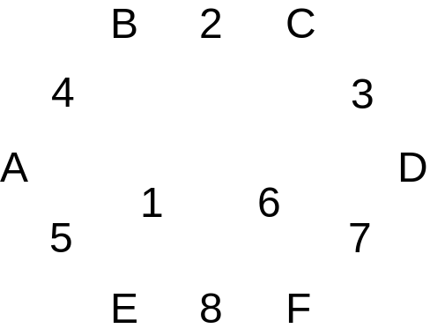
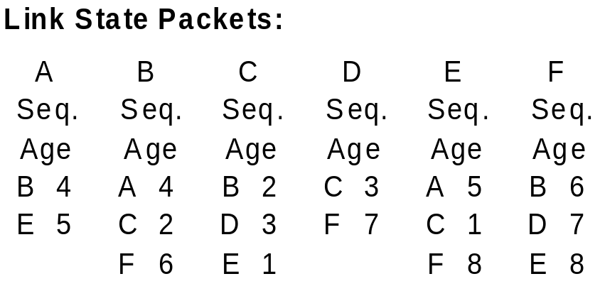
Link State Routing
3. Phase: organizing the information as link state packet
Including own address, sequence number, age, "distance"
Timing problems: validity and time of sending
  Periodically
  In case of major changes

Slide 16
Link State Routing
4. Distributing the local information to all IS
By applying the flooding procedure (very robust)
  Therefore sequence number in packets
Problem: inconsistency
  Varying states simultaneously available in the network
  Indicate and limit the age of packet,
  i. e. IS removes packets that are too old
5. Computing new routes
Each IS for itself
Possibly larger amount of data available

