Slide 1
Network layer
IN2140:
Introduction to Operating Systems and Data Communication
Distributed Routing:
Link State Routing

Slide 2
Link State Routing
A very frequently use routing protocol
  IS-IS (Intermediate System-Intermediate System)
  OSPF (Open Shortest Path First)
Basic principle
  IS measures the "distance" to the directly adjacent IS
  Distributes information
  Calculates the ideal route
Procedure
  Determine the address of adjacent IS
  Measure the "distance" (delay, ...) to neighbouring IS
  Organize the local link state information in a packet
  Distribute the information to all IS
  Calculate the route based on the information of all IS

Slide 3
Link State Routing
1. Phase: gather information about the adjacent intermediate systems
H
H
D
E
G
D
E
G
B
I
B
I
A
C
F
A
C
F
LAN

Slide 4
Link State Routing
1. Phase: gather information about the adjacent intermediate systems
H
H
D
E
G
D
E
G
B
I
B
I
A
C
F
A
C
F
LAN
N
Initialization procedure
New IS
  Sends a HELLO message over each L2 channel
Adjacent IS
  Responds with its own address, unique within the network

Slide 5
Link State Routing
2. Phase: measure the "distance"
Definition of distance needed
  Usually delay
  Where to measure?
Topology, link utilization, etc.
information
Router
Routing
Process
desti-
nation
link
Routing
table
When to start timer?
A
0
Fills & Updates
B
3
C
1
Uses & Looks up
D
4
Data packets
Queues
ECHO
Forwarding
Process
HELLO
Incoming
lines
Outgoing
lines

Slide 6
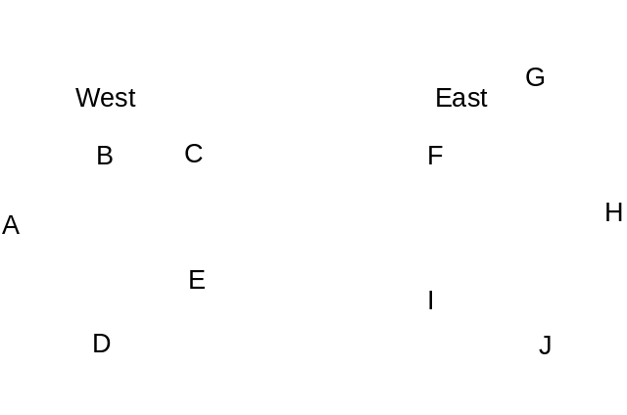
Link State Routing
2. Phase: measure the "distance“
Queuing delay
  Measuring without does not take load into account
  Measuring with does ⇒ usually better
But
  Possibility for oscillations (route flapping)
  Once per routing table update

Slide 7
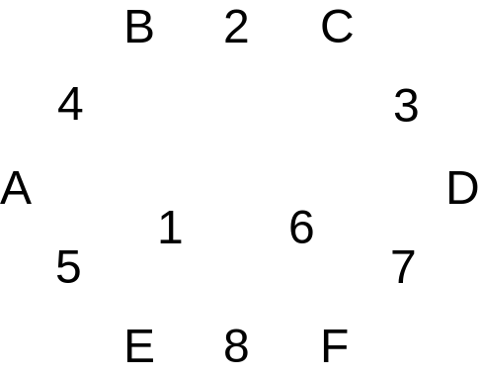
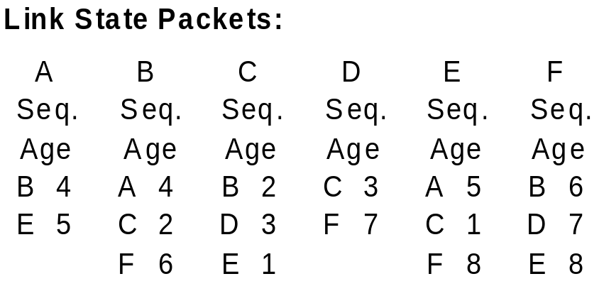
Link State Routing
3. Phase: organizing the information as link state packet
Including own address, sequence number, age, "distance"
Timing problems: validity and time of sending
  Periodically
  In case of major changes

Slide 8
Link State Routing
4. Distributing the local information to all IS
By applying the flooding procedure (very robust)
  Therefore sequence number in packets
Problem: inconsistency
  Varying states simultaneously available in the network
  Indicate and limit the age of packet,
  i. e. IS removes packets that are too old
5. Computing new routes
Each IS for itself
Possibly larger amount of data available

