Slide 1

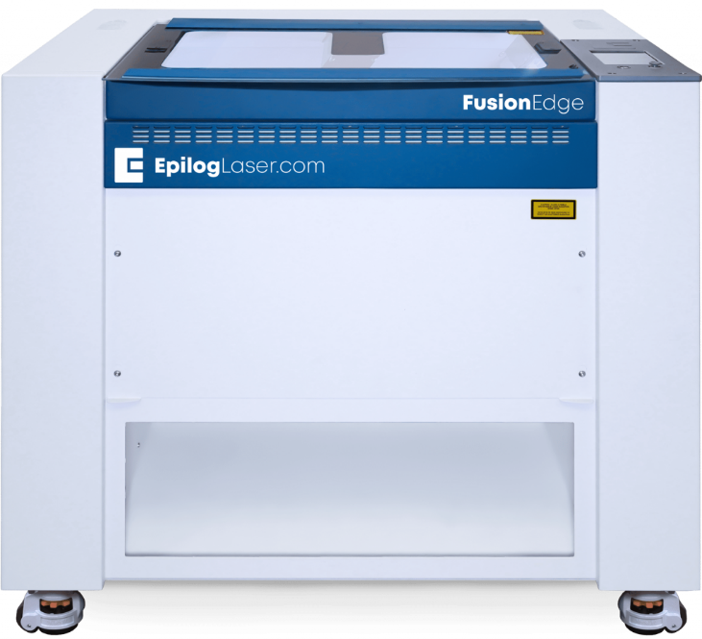
Laser cutting 101
It’s not science fiction

Slide 2
Contents
What is Sonen?
How does it work?
When should I consider laser cutting?
What are the dangers when laser cutting?
What materials can i use?
How do I use the laser cutter?
Is it really that easy?

Slide 3
What is Sonen
3D-printing
Laser cutting
Electronics
CAD
Arduino and Raspberry PI
Textiles
Repair

Slide 4
When should I consider laser cutting?
Great for making large things very quickly
3D prints takes hours and days.
Laser cutting takes seconds and minutes.
Prototyping using cheap materials
Great for creating signs

Slide 5
How does it work?
Mirror
Laser tube
Work area
Laser head

Slide 6
How does it work?
Cutting
Engraving

Slide 7

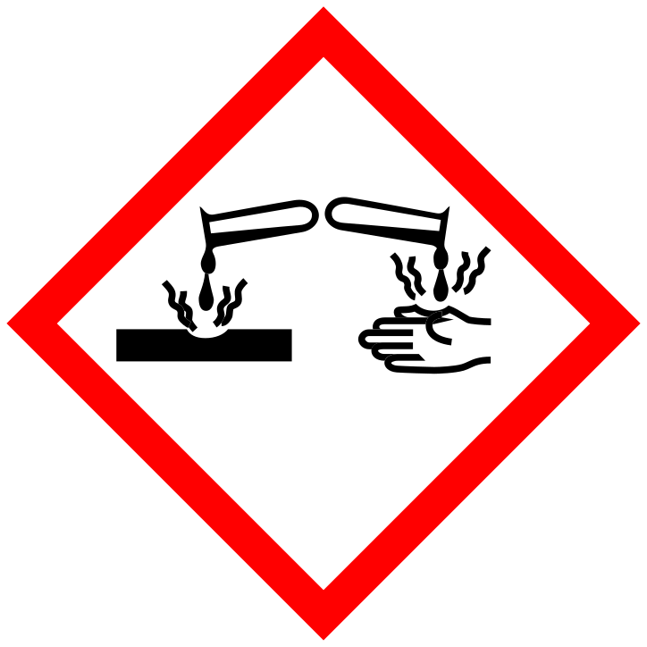

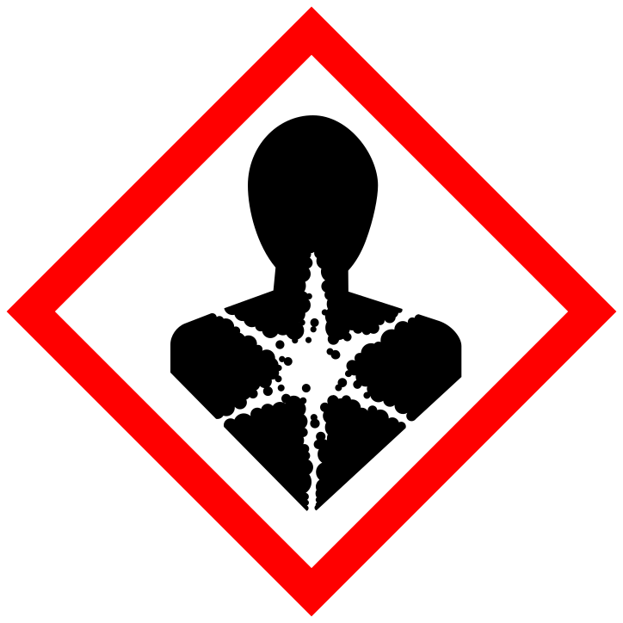



What are the dangers when laser cutting?

Slide 8
QUIZ!

Slide 9
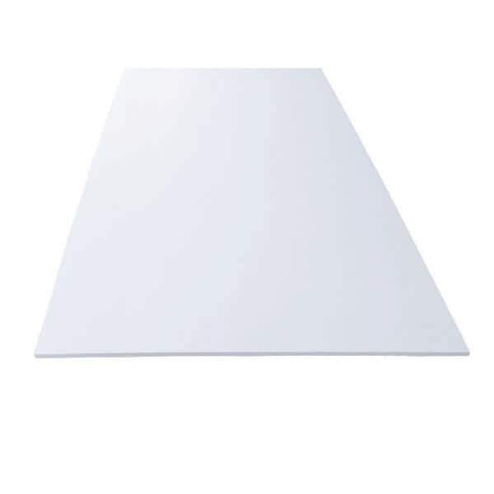
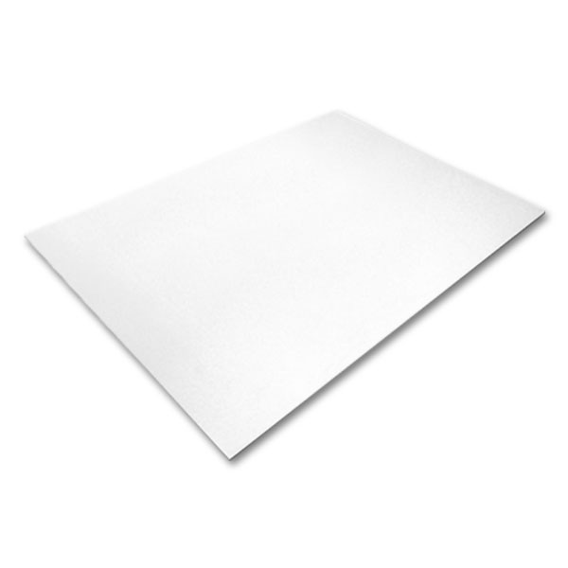
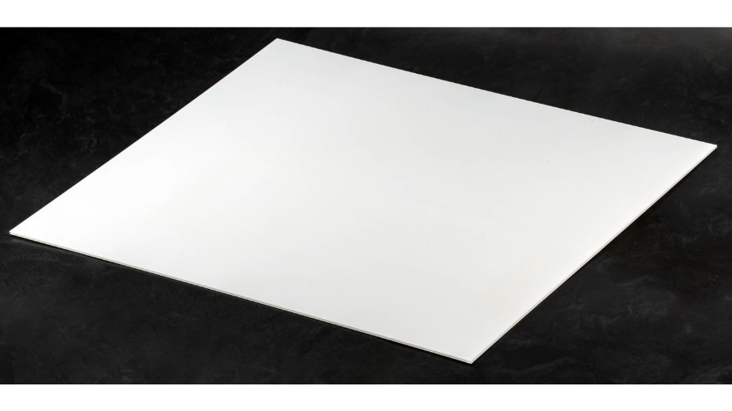
Plastic sheets
1
2
3
PCV
Acrylic
ABS
Chlorine gass
Cyanide gass

Slide 10
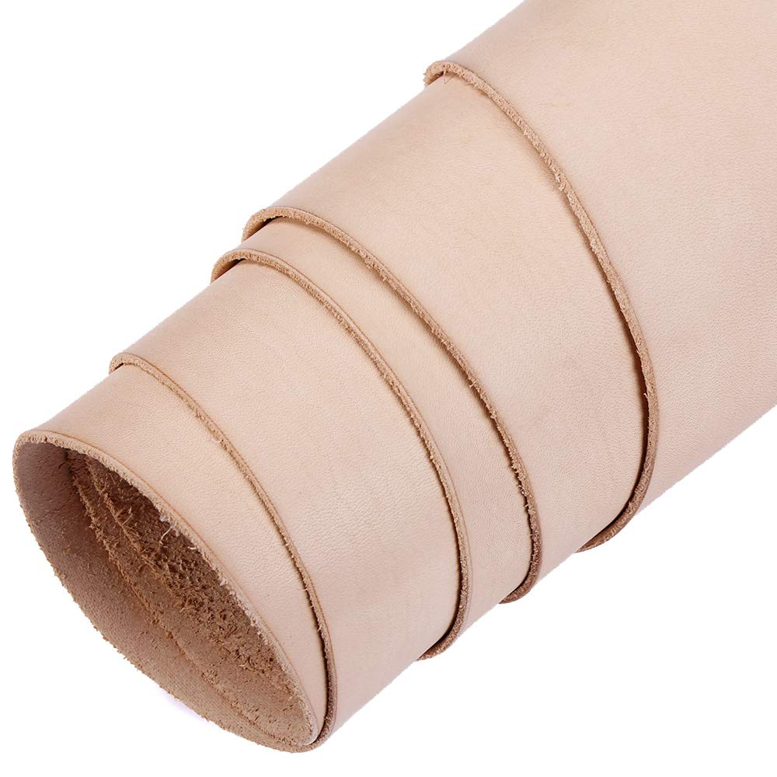
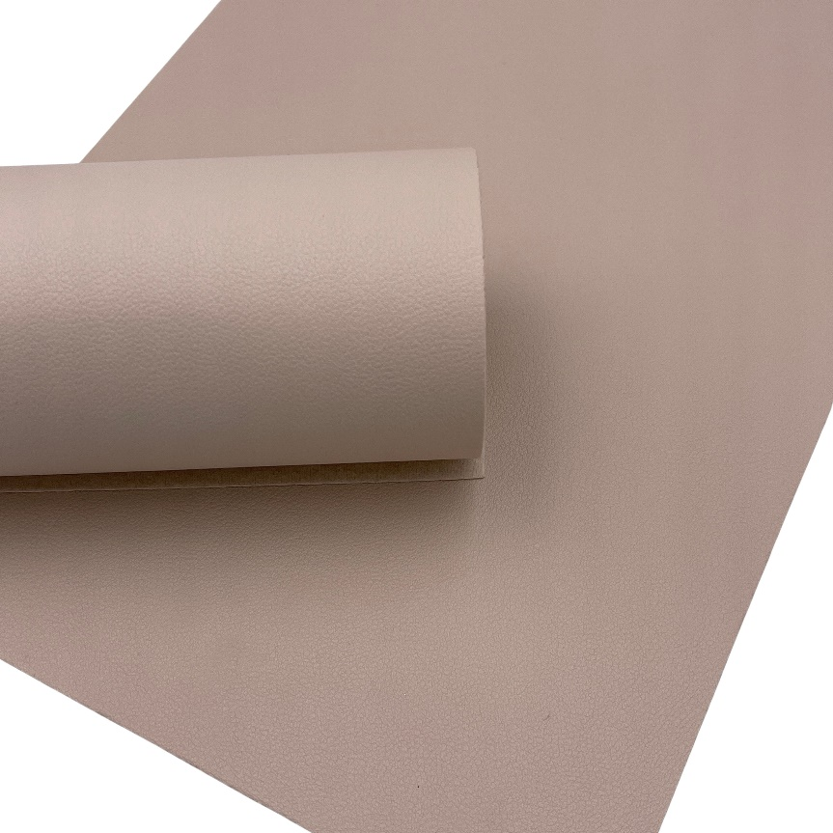
Leather
1
2
Natural
Faux
Chlorine gass

Slide 11
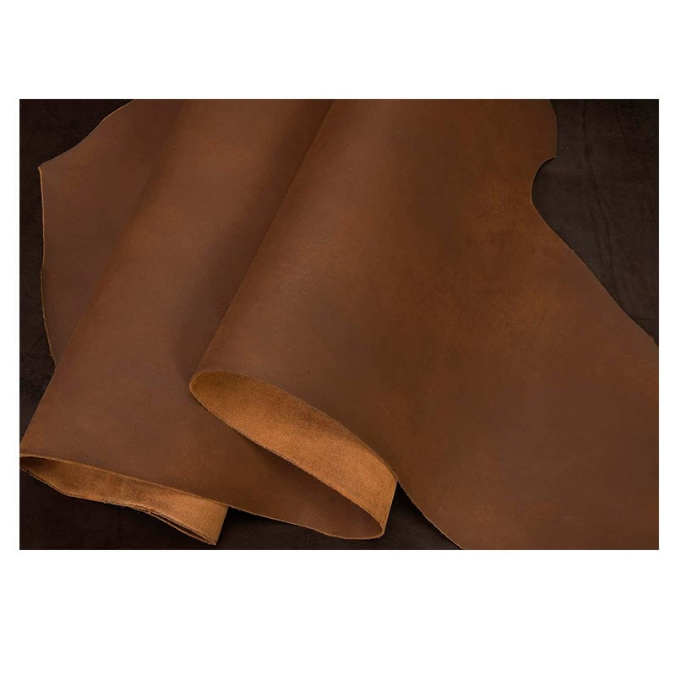
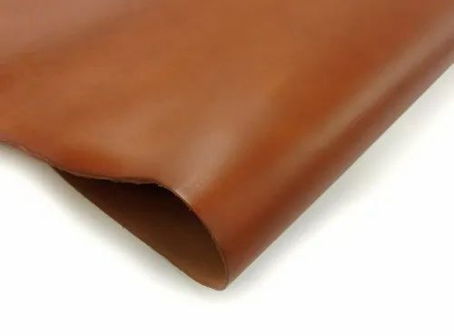
tanned natural leather
1
Chrome tanned
2
Vegtable tanned
Cyanide gass

Slide 12
KNOW YOUR MATERIAL!!

Slide 13
What materials can i use?
Organic materials
Wood
Plywood
Cardboard
Natural Leather
Acryllic PMMA
If you are uncertain if your material is suitable for laser cutting DO NOT PROCEED. Ask Sonen or ROBIN engineering staff

Slide 14
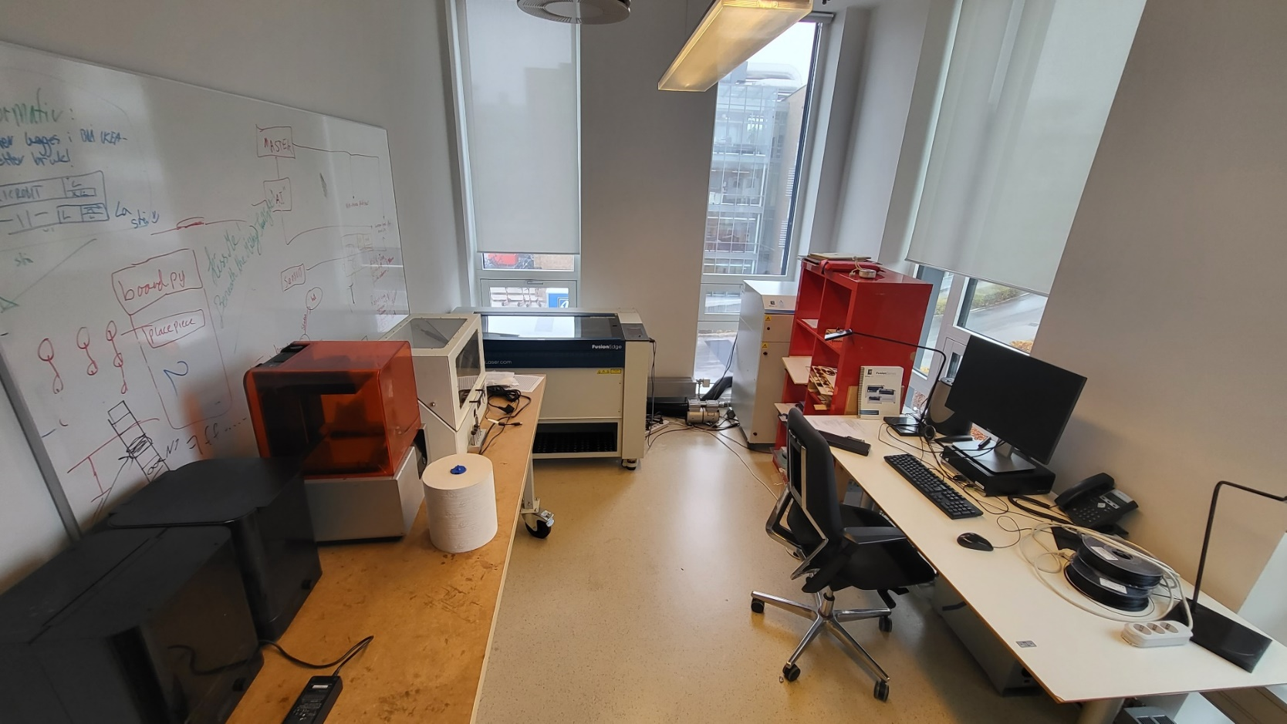
How do I use the laser cutter?
https://wiki.uio.no/ifi/sonen/index.php/Main_Page
https://makerdesignlab.com/tutorials-tips/laser-cutting-beginners-guide/

Slide 15
Is it really that simple?
Kinda…

