Slide 1
Adaptive Networked Governance of e-health Standards
IN5430
10.04.2019
Kristoffer Fossum

Slide 2
Theme – Governing standards in complex organizations
Goals for the lecture
  Present a case from the Norwegian healthcare sector (specifically the South East Health Region) about change from a top-down to a networked regime for e-health standards governance.
  Show how this change enables the region to handle complexity in standards governance better than before
Learning outcome:
  Insight in standardization challenges in complex organizations
  How one health region in Norway tries to deal with its complexity

Slide 3
Agenda
Introduction to the
  Norwegian healthcare sector
  The South East Health Region
  The complexity of hospitals
  The consequences of local autonomy in relation to complexity
Regional programs to improve IT portfolios
  Top-down
New governance structures and processes
  Networked

Slide 4
So, what is an e-health standard?
“Syntactic, semantic and functional standards, implemented in healthcare IT solutions. These allow healthcare personnel to capture, store, process and share information based on clinical practice needs.”
  or
Standards in IT systems that are directly related to clinical practice in healthcare service provision.

Slide 5
The Norwegian healthcare sector
Around 17 000 autonomous enterprises in the Norwegian healthcare sector
  Each enterprise is responsible for quality and safety of care
  Each enterprise has their own responsibility to establish their own patient journal systems according to Norwegian law (pasientjournallovens §8).
    Procurement of IT systems is the enterprise’s responsibility
    Adoption of e-health standards is up to each enterprise
  Each enterprise is responsible for information security

Slide 6
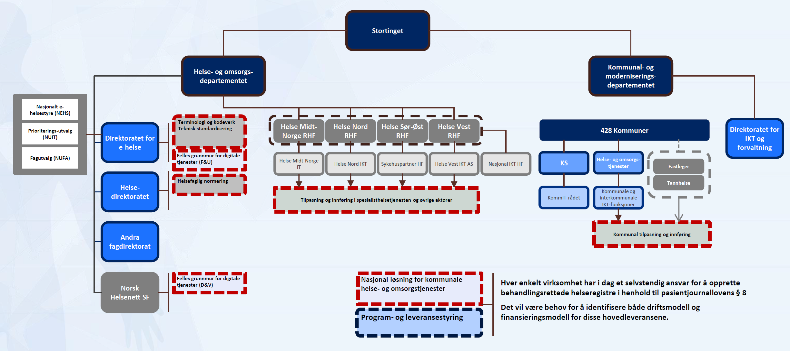
National governance structure

Slide 7
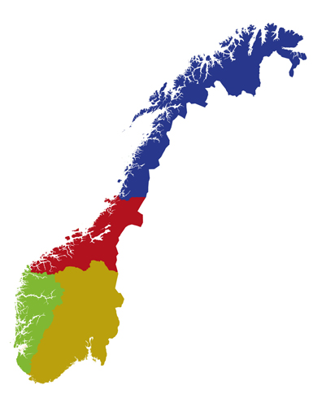
The South East Health Region
Responsible for hospital healthcare for approx. 2.9 million of the Norwegian population
100% state-owned
80 000 employees
Annual budget: 80 billion NOK
11 health trusts
Ministry of H and C.
Regional health trust
Hospitals
Hospitals
Hospitals
Sykehuspartner
Hospitals

Slide 8
The South East Health Region
Each hospital trust is an autonomous enterprise
  Information security
  Quality and safety of care
  Own patient journal systems
  -> Consensus-based agreements across enterprises
  Decades of implementation of IT systems has led to a plethora of systems that are not well integrated with each other
  High variation in e-health standards in the systems

Slide 9
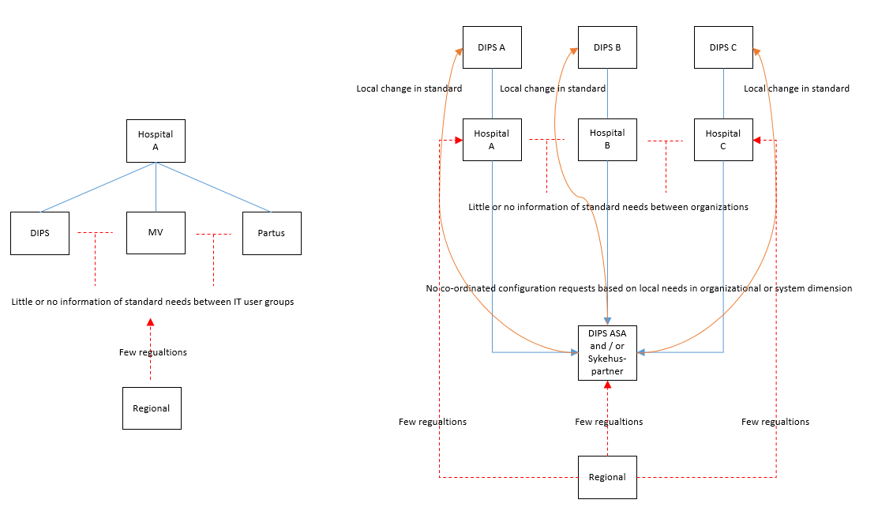
Traditional governance processes, local and regional projects

Slide 10
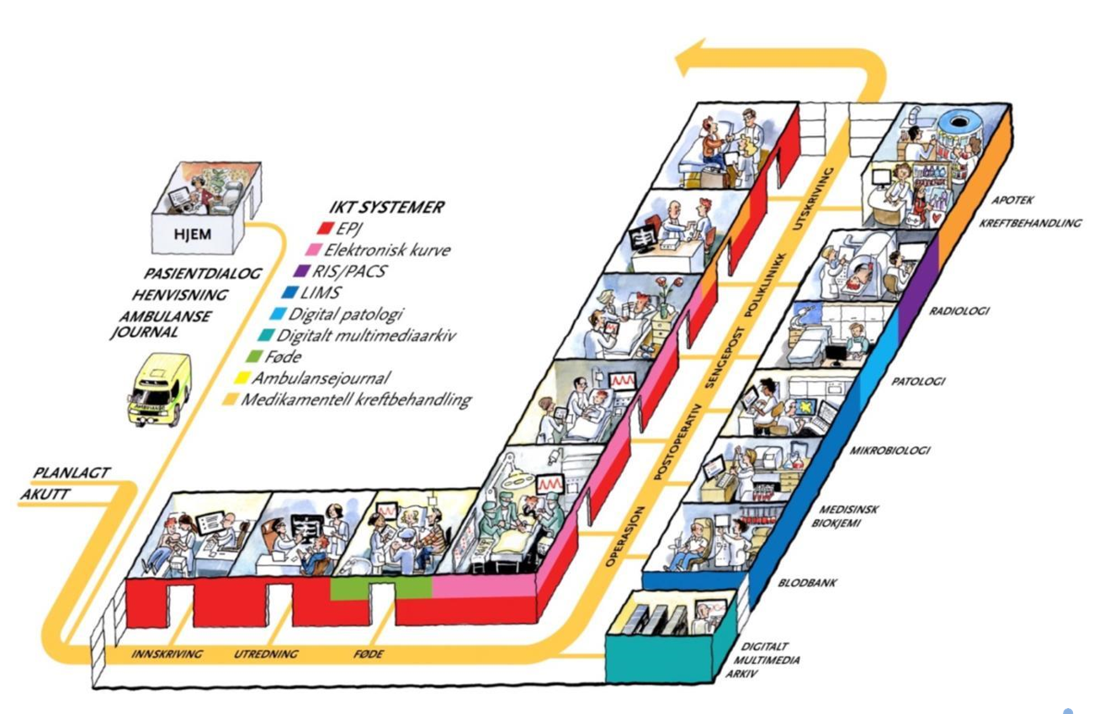
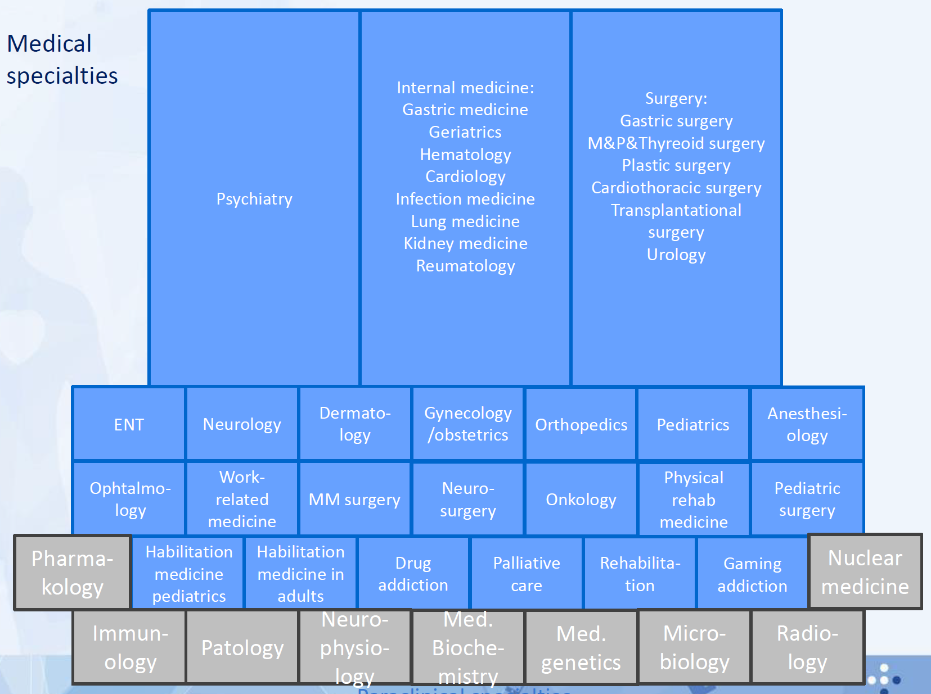
Support patient treatment and flow

Slide 11
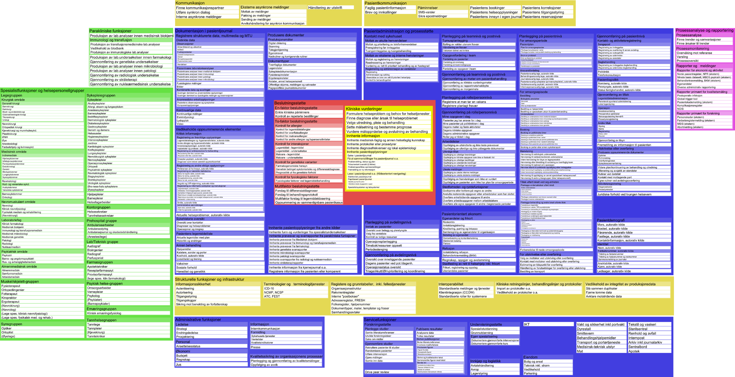
IT systems support many functions

Slide 12
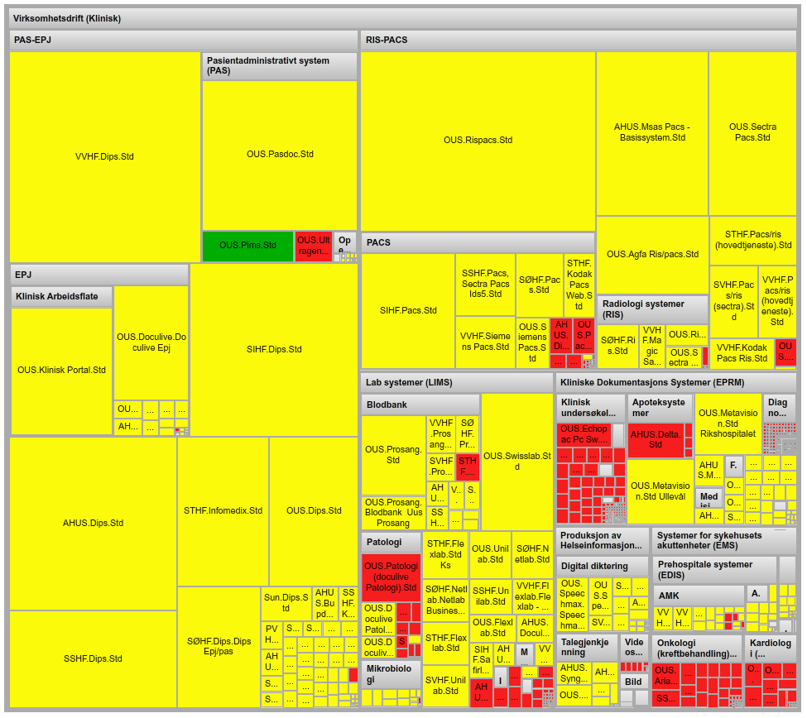
Many IT systems to support hospital operations
Approx. 5700 IT applications
  More than 1200 directly involved in clinical work
  Administrative systems
  Etc.
Unknown number of local «under the radar» systems

Slide 13
Many different IT systems for the same functions
 | PAS/EPJ | RIS/PACS |  | LAB- Medisinsk biokjemi | LAB-Mikro-biologi | LAB - Patologi | LAB- Blodbank | Kurve og medikasjon | Multi-media | Medika-mentell kreft-behandling |  | Ambulanse-journal | Føde-journal
Oslo universitets-sykehus | PasDoc | Siemens |  | Flexlab | Swisslab | DocuLive Patologi | Prosang | MetaVision | Diverse | Cyto-dose | Cyto-dose |  | Papir
 | DocuLive |  |  | Swisslab
 |  |  |  |  |  |  |  | Papir |  |  |  |  | Obstetrix
 |  | Agfa | Sectra | Unilab | Unilab
Akershus universitets-sykehus | DIPS | Siemens |  | Analytix | Analytix | DocuLive Patologi | LabCraft | MetaVision | Diverse | Cytodose |  |  | Partus
 |  |  |  |  |  |  |  | DIPS
Sunnaas sykehus | DIPS |  |  | DIPS Lab |  |  |  | Papir | Diverse
Vestre Viken | DIPS | Carestream |  | Flexlab | Miclis | Sympathy | LabCraft | DIPS | Diverse | Papir |  | Mobimed | Partus (flere installasjoner)
 |  |  |  |  |  |  |  | Papir
 |  | Siemens |  | Analytix |  |  | Prosang
Sykehuset Innlandet | DIPS | Siemens |  | Analytix | Analytix | Sympathy | LabCraft | Papir | Diverse | Cytodose |  |  | Partus
 |  |  |  |  |  |  |  |  |  | Papir
Sykehuset Østfold | DIPS | Sectra |  | Netlab | Miclis | Sympathy | Prosang | Papir | Diverse | Papir |  |  | Partus
Sykehuset i Vestfold | DIPS | Sectra |  | Unilab | Miclis | DocuLive Patologi | Prosang | PICIS | Diverse | Papir |  |  | Partus
 | PAPS |  |  |  |  |  |  | PAPS
 |  |  |  |  |  |  |  | Papir
Sykehuset Telemark | IMx | Agfa |  | Flexlab |  | Sympathy | LabCraft | Papir | Diverse | Cytodose |  |  | Partus
Sørlandet sykehus | DIPS | DIPS RIS | Sectra | Unilab | Miclis | Sympathy | Prosang | Papir | Diverse | Papir |  |  | Partus (flere installasjoner)

Slide 14
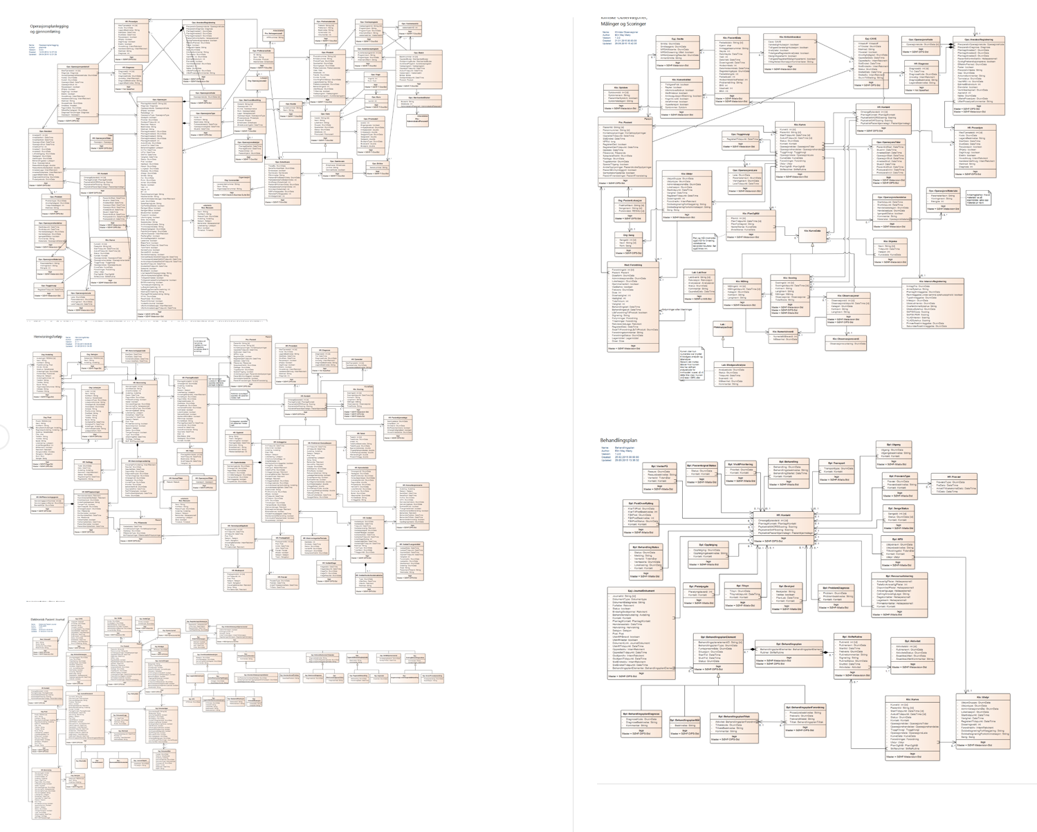
Information in the DIPS application

Slide 15
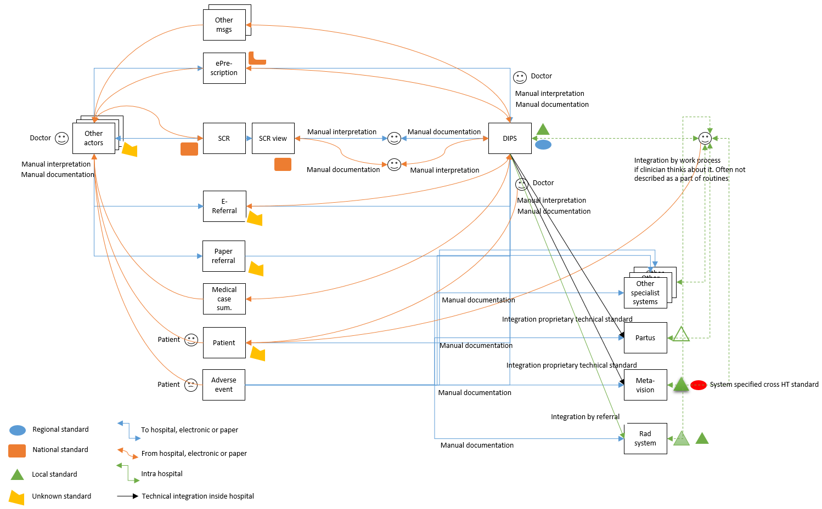
Flow of one type of information in the information systems in one hospital

Slide 16
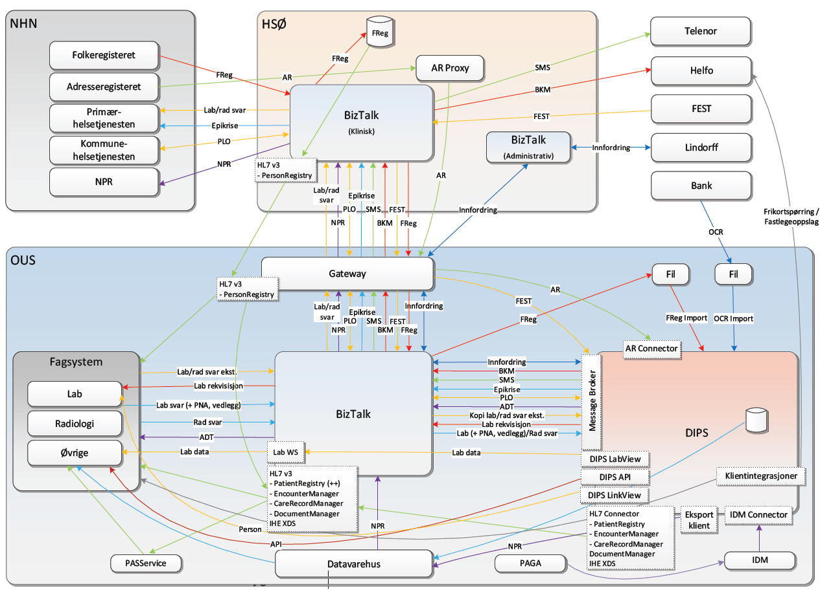
DIPS integration overview for one hospital

Slide 17
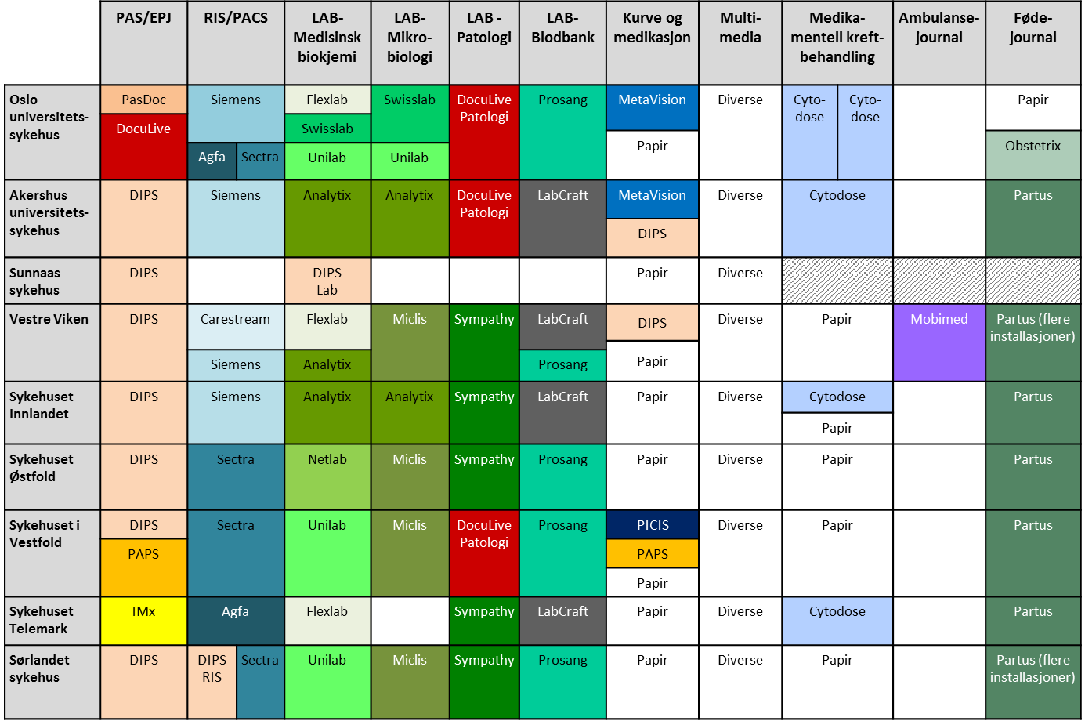
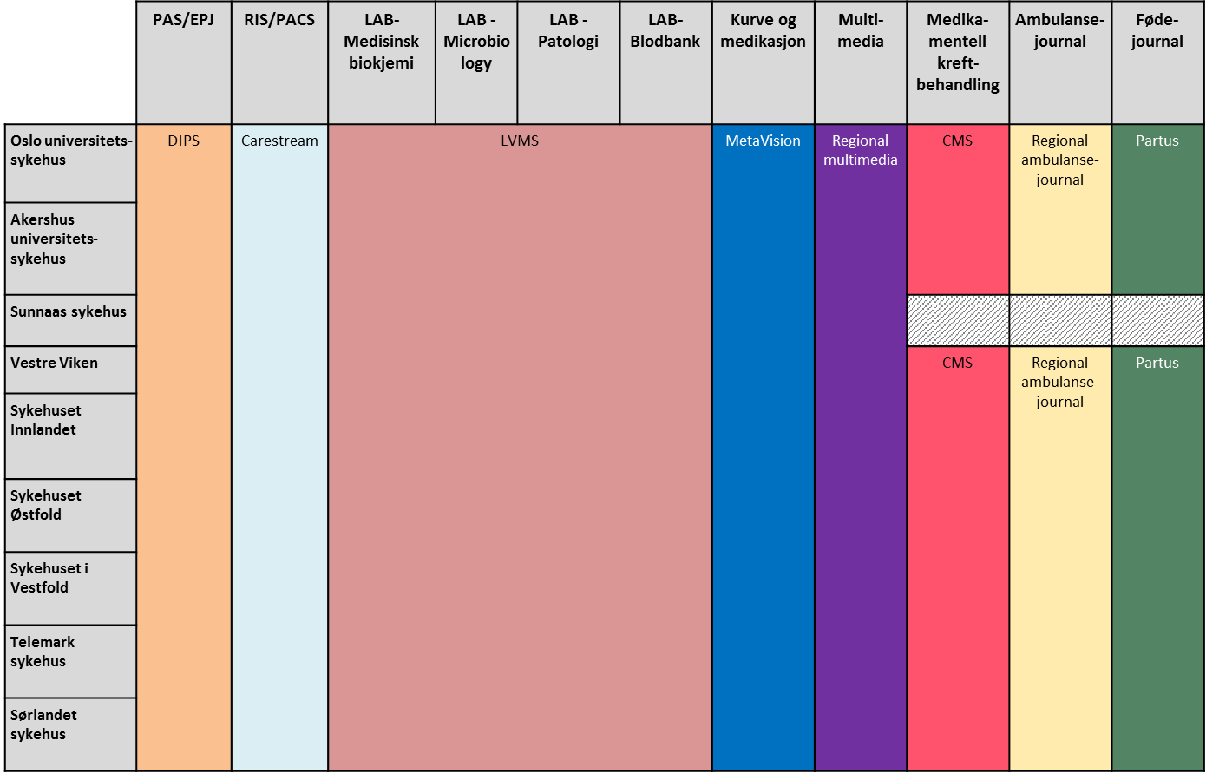
From 2012: New regional strategy – cleaning the IT “mess”
Large investment programs to standardize and consolidate the largest IT systems
2012
2024

Slide 18
From 2012: Governance
Styret i Helse Sør-Øst
AD Helse Sør-Øst RHF
Programkontor
REGIONAL PROGRAMS
Regional
klinisk løsning
Virksomhets-styring
Regional IKT for forskning
Prosjekter
Prosjekter
Prosjekter

Slide 19
From 2012: Governance
Programledelse
Arkitektur og design
Medikamentell kreftbehandling
Programkontor
Test & release
Regional EPJ Standardisering
Regional radiologi
Regional Lab
Interaktiv henvisning og rekvirering
Regional kurve og medikasjon
Regional multimedia
Automatisk tildeling av fødselsnummer
Sykehuset Innlandet radiologi
Digitale innbyggertjenester i Helse Sør-Øst
Regional EPJ Konsolidering
HF-HF kommunikasjon
Kommunikasjon
Regional ambulansejournal
Regional EPJ Modernisering (FRAM)

Slide 20
Challenges
Typically one IT system per project
  Decision making structures for each project
  Standardization looked upon from an IT perspective
  Project tries to decide upon standards – far away from clinical practice
  Assistance from clinical experts, but unclear decision making power
Many dependencies - projects - IT systems - clinical practice
  For instance 91 IT systems involved in medication management
No defined line management that has owership to standards
Outcome
  Relatively poor anchoring of standards locally at hospitals
  Unrealized plans for standardization and consolidation

Slide 21


New governance structures – Regional Centre
Other health
regions
Configuration
requests
Experience/
knowledge
Regional Centre Representatives
(coordination)
Hospital Partner
Implementing
changes
Regional projects
Feedback/
suggestions
Experience/knowledge
training
Hospital reception
projects/line org
National
functions
Regional network groups

Slide 22
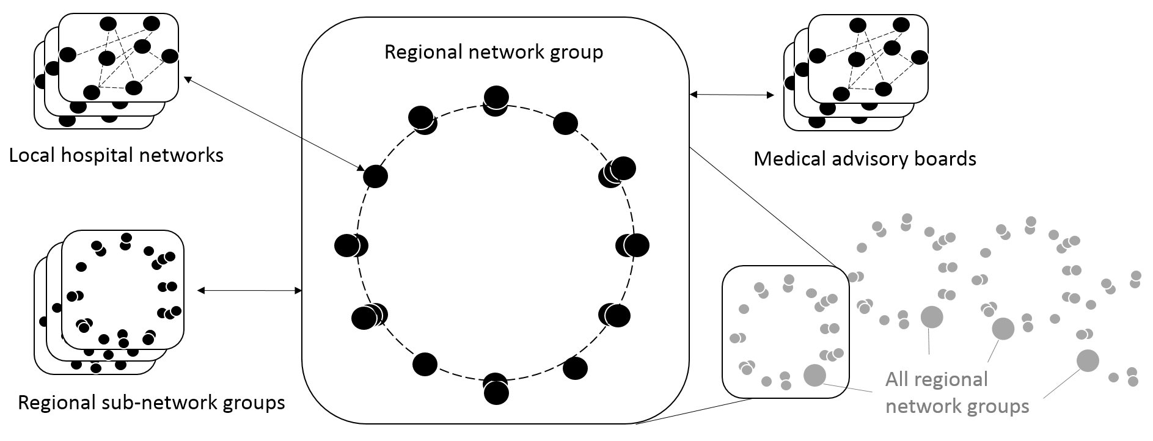
New governance structures – regional network groups

Slide 23
New governance processes
Three ways of initiating a process
  Locally originated suggestions for change/improvement
  Regional projects in need for standards assessment and development
  Regional governance coordinators initiating on own initiative
Daily meetings in the regional centre
Weekly meetings locally in hospitals
Bi-weekly meetings in the regional network groups
Continuous access to information and participation in discussions via the governance platform

Slide 24
New governance platform
Web-based platform that all relevant actors across hospitals and projects may read, discuss, and follow up suggestions for change, and trace actual changes.
Creating transparency in processes before decisions
Creating transparency in made decisions.

Slide 25
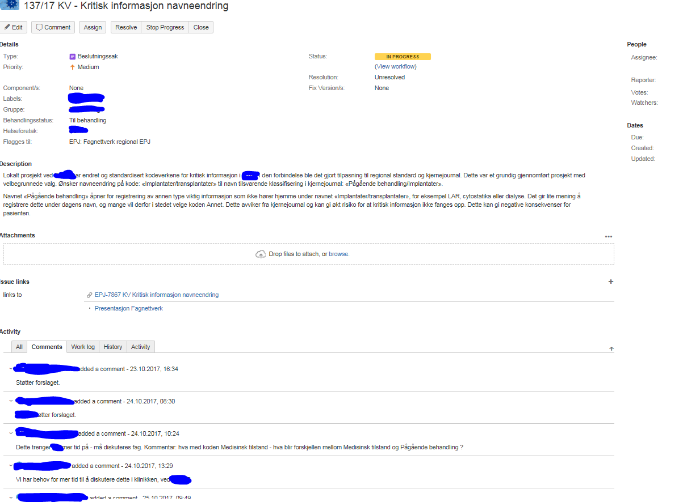
New governance platform

Slide 26
Challenges and opportunities with new governance model
Advantages:
  Systematic case handling
  Fast dissemination of knowledge and information
  Transparency in decision processes among all involved parts
  Decisions become locally anchored
  Decisions are already anchored when IT systems change
  Systematic training and sharing of experience
  Streamlined handling of change requests and exceptions
Potential challenges:
  Still a consensus-based power structure – hospitals may say no to a suggested standard
    Live with deviations and variations
  The network structure itself becomes a heavy bureaucracy
    slower to move
  Can it handle major changes?

Slide 27
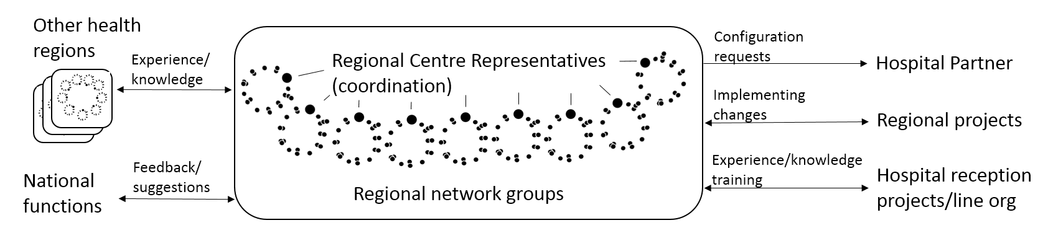
A combination enables change
Network orchestration,
Adaptive co-management
Governance platform
Goal-directed network

Slide 28
Contributions
The analytical lens contribute to understanding governance standards
Top-down vs bottom-up governance
  Both at the same time, but in different parts of the governance network
Being explicit on governance of standards in complex information infrastructures

