Slide 1
IN5430 - Seminar
Feb. 12
2019
Enterprise Architecture and Operating models

Slide 2
Upcoming Key Dates
Item | Date
Deadline for securing organization | Today
Notes:
All students must participate in a project assignment
There will be 2 group deliverables and 1 individual assignment.

Slide 3
Group work: Enterprise Architecture
Discuss in groups of 3-5 (5 + 5):
  What is enterprise architecture?
  What is the aim of enterprise architecture?
Notes:
“EA is the fundamental organization of a system embodied in its components, their relationship to each other, and to the environment, & the principles guiding its design and evolution” (IEEE)
How to translate IT strategy into digital transformation or information infrastructure
How to build on the foundation for execution
To guide future action
To move from silo applications that address immediate local business needs to integrated solutions and building IT capabilities

Slide 4
Enterprise Architecture
What is enterprise architecture?
  “the organizing logic for business process and IT infrastructure, reflecting the integration and standardization requirements of the company’s operating model” (Ross et al., 2006, p.9)
  the definition and representation of a high-level view of an enterprise‘s business processes and IT systems,
  their interrelationships,
  and the extent to which these processes and systems are shared by different parts of the enterprise. (Tamm et al)
What is the aim of enterprise architecture?
  Digitize the core to make it reusable & reliable
  Manage complexity
  Provide a long-term view of an enterprise’s processes, systems, & technologies
  Increase value from IT proactively and not just fulfil immediate local business needs
Notes:
“EA is the fundamental organization of a system embodied in its components, their relationship to each other, and to the environment, & the principles guiding its design and evolution” (IEEE)
How to translate IT strategy into digital transformation or information infrastructure
How to build on the foundation for execution
To guide future action
To move from silo applications that address immediate local business needs to integrated solutions and building IT capabilities

Slide 5
Operating Model
Discuss in groups of 3-5 (5 + 5):
  What is an operating model?
  What are the key dimensions of an operating model?
Notes:
how an organization operates across a range of domains in order to accomplish its function
The level of business process integration and standardization for delivering goods or services to customers
Standardization: of business processes and related systems refers to how a process will be executed regardless of who or where the process is completed (benefits: efficiency and predictability)
Integration: linking of organization units through shared data. This sharing of data can be between processes or across processes. (benefits: efficiency, coordination, transparency)
a business model describes how an organization creates, delivers and captures value and sustains itself in the process

Slide 6
Operating Model
What is an operating model?
  how an organization operates in order to accomplish its main function
  “The level of business process integration and standardization for delivering goods or services to customers.” (Ross et al., 2006, p. 25)
What are the key dimensions of an operating model?
  Standardization
  Integration
Notes:
how an organization operates across a range of domains in order to accomplish its function
The level of business process integration and standardization for delivering goods or services to customers
Standardization: of business processes and related systems refers to how a process will be executed regardless of who or where the process is completed (benefits: efficiency and predictability)
Integration: linking of organization units through shared data. This sharing of data can be between processes or across processes. (benefits: efficiency, coordination, transparency)
a business model describes how an organization creates, delivers and captures value and sustains itself in the process

Slide 7
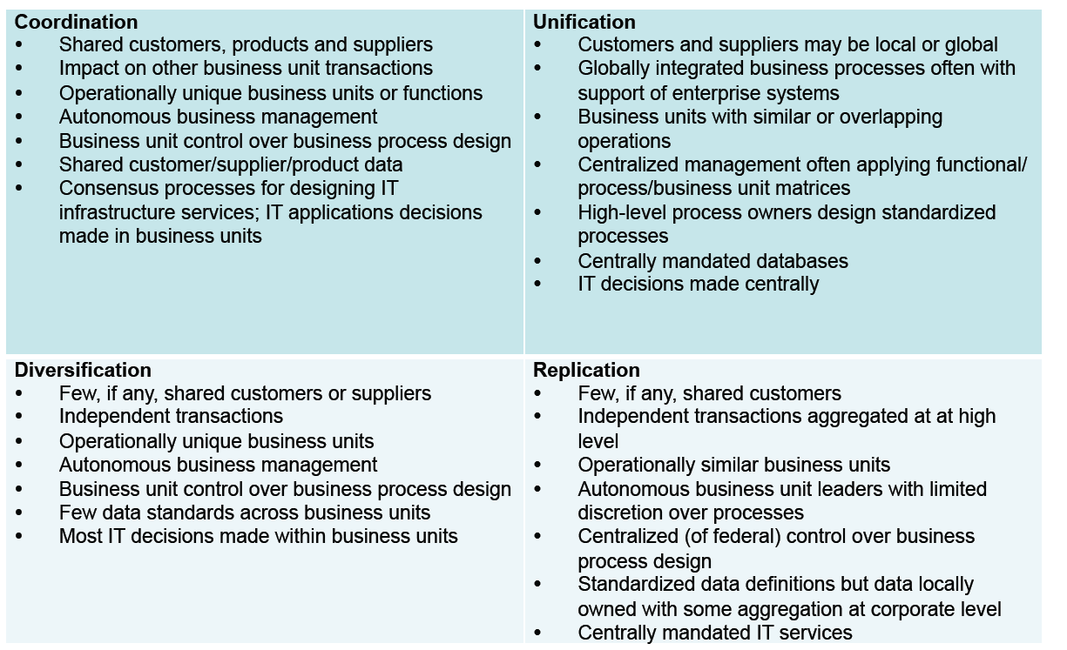
Operating models

Slide 8
Group Exercise
In groups: 20 min
Identify actual companies that could fit under each of the four operating models (for instance, UiO, Posten (mail services), McDonalds) (Fig. 2-1, p. 29), and why.
Identify at least one advantage the operating model offers the organization.
The group shares the findings
Notes:
Diversification is effectively "independence with shared services."
Coordination is "seamless access to shared data."
Replication is "standardized independence.“
Unification is "standardized, integrated processes."
How can you determine your organizations operating model?
Determine to what extent the completion of one business unit’s transaction depends on other business units’ data? (level of integration)
Determine to what extent the company benefits by having business units run their operations in the same way? (level of standardization)

Slide 9
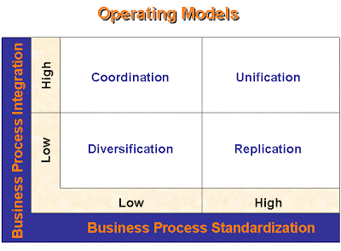

Slide 10
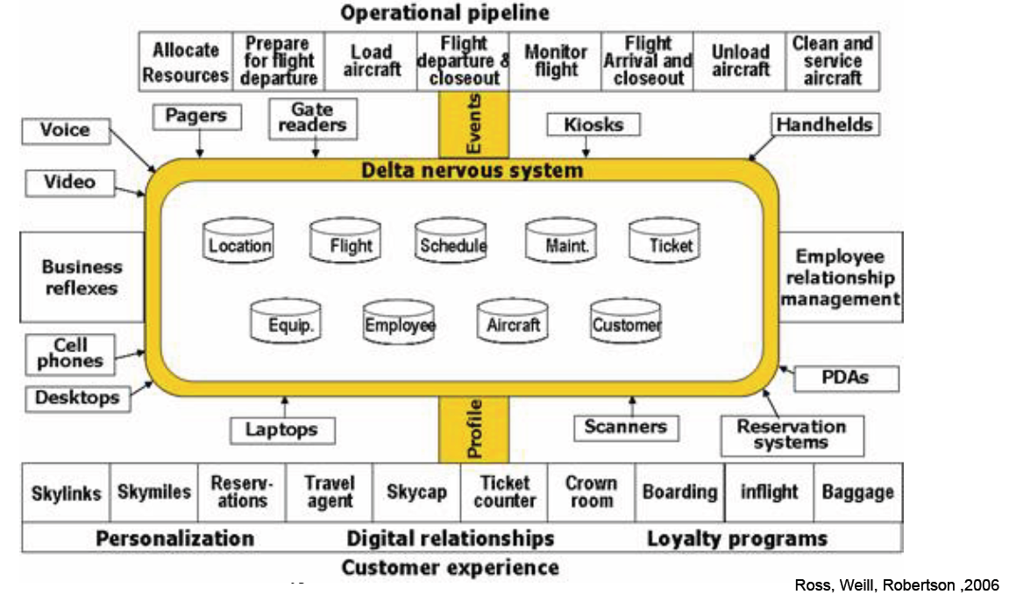
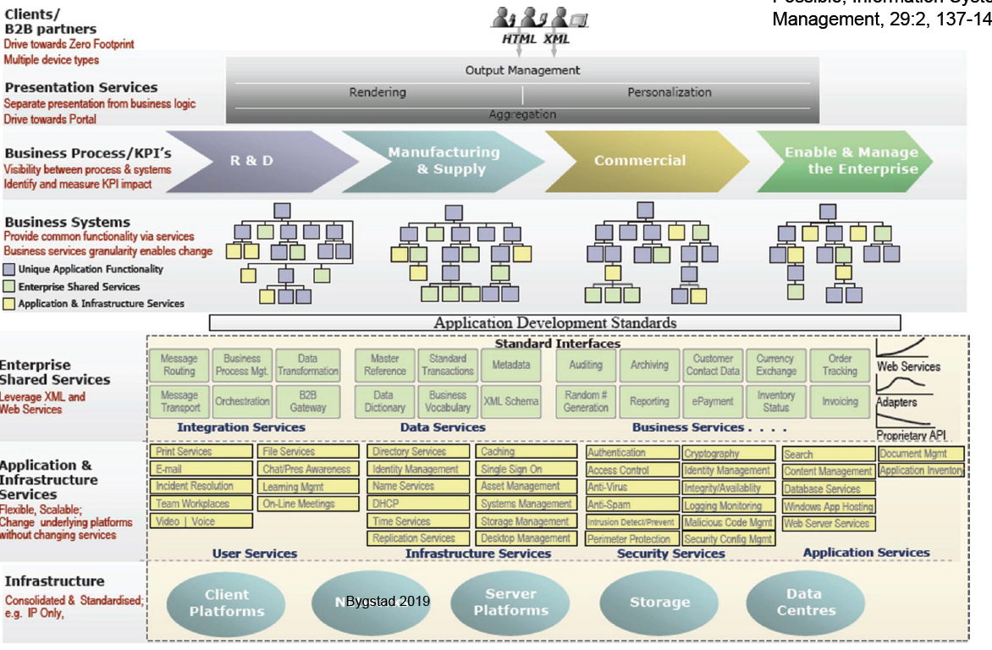
Group Exercise: Enterprise Architecture
In groups (25min):
Choose one of your companies from the previous exercise:
  Draw a core diagram for the company (main business processes, related IT and their interrelations, users/customers)
  Discuss how the core diagram relates to the operating model that you found for that company.
    Why should it look like it does (as you imagine it)
Notes:
Diversification is effectively "independence with shared services."
Coordination is "seamless access to shared data."
Replication is "standardized independence.“
Unification is "standardized, integrated processes."
How can you determine your organizations operating model?
Determine to what extent the completion of one business unit’s transaction depends on other business units’ data? (level of integration)
Determine to what extent the company benefits by having business units run their operations in the same way? (level of standardization)

