Slide 1
IN5430
Seminar 12.2.20
Generativity
Platforms and infrastructures

Slide 2

Exercise 1 (7min+8min)
What is generativity?
What do we mean that digital technology is generative?
  Discuss and give example of generative technology
Notes:
Ikke generativt --> trenger mer ressurser for å lage nye ting
Generativt --> digital technology. Kreves ikke ressurser for å lage flere / ny extensions
Generativity depends on human and institutions as well as technology. It is a relationship (human+tech+org)
Generativ tech -> internett, android, iOS, data plattforms
Generativitet → linker ulike aktører sammen
Important enabler for innovation
Generative relationships (Zittrain): aligned directedness, heterogeneity, mutual directedness, permissions structures, action opportunities

Slide 3
Exercise 2 (7min+8min)
What is an information infrastructure?
What is the difference between an information infrastructure and a platform?
  Discuss and provide examples
Notes:
Infrastruktur er den underliggende strukturen som trengs for å få samfunnet til å fungere mer eller mindre effektivt.
Hanseth and Lyytinen (2010) - “as a shared, open (and unbounded), heterogeneous and evolving socio-technical system (which we call installed base) consisting of a set of IT capabilities and their user, operations and design communities.” (IT cap = possibility / right of the user / community to perform a set of action → text editor is a capability)
Network effects (or externalities) creating self-reinforcing processes are widely held to be at the centre of infrastructure evolution.
II is shared by all members of a community.
Equal access rights
Platforms may become infrastructures (Google, Facebook, etc.)
Platform: business model/strategy/organizing principle
Platform ecosystems have a lot in common with infrastructures (Tilson et al. 2010). Involve large number of technological and organizational elements, they evolve and grow over long time. They both focus on how evolution is driven by tensions..
What sets them apart/make them different is that platforms are based on a specific architecture/governance config. (stable core, platform, that is controlled by a single organization, and a dynamic periphery consisting of a large number of «apps»).
Platform research focus only on single platforms, in isolation from other platforms.
If tranditional IT solution at trad.organizations want to change to platform, we will get huge number of platforms integrated with each other.
Co-evolution of a multiplicity of platforms within an orgnaization → platform oriented corporate II.

Slide 4

Exercise 3 (5min+5min)
How is the infrastructure enabling the platforms’ business operations and goals?
Notes:
A key feature of platform-oriented infrastructures is the fact that they are composed of a multiplicity of traditional applications sharing information.
Infrastruktur er den underliggende strukturen som trengs for å få samfunnet til å fungere mer eller mindre effektivt.
Plattform (Helse-Norge, Finn, etc.) men er fortsatt avhengig av mange andre elementer som må fungere for at din plattform skal kunne levere sine tjenester.
Eks. Helse-Norge: bestille time / kjernejournal / etc., men trenger mange andre tjenester for å samle informasjon i plattformen.
Man må ha mange elementer for at min enkle plattformtjeneste skal fungere. (Netflix → må ha TV, mobiltelefon, nettbrett eller noe sånt for å se på, internett)
Uber → må ha telefon, 4G nett, ++

Slide 5
Break!

Slide 6
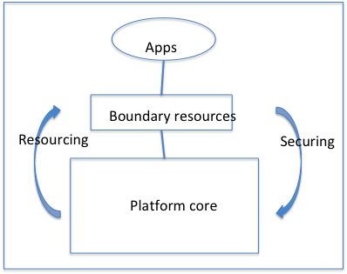
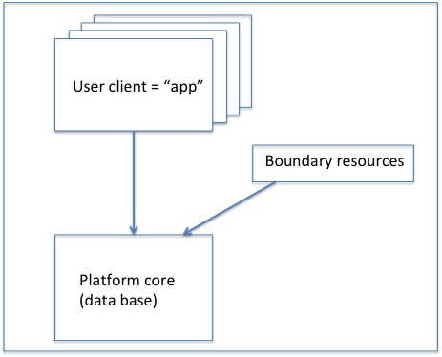
Platforms and infrastructures (Hanseth & Bygstad)

Slide 7
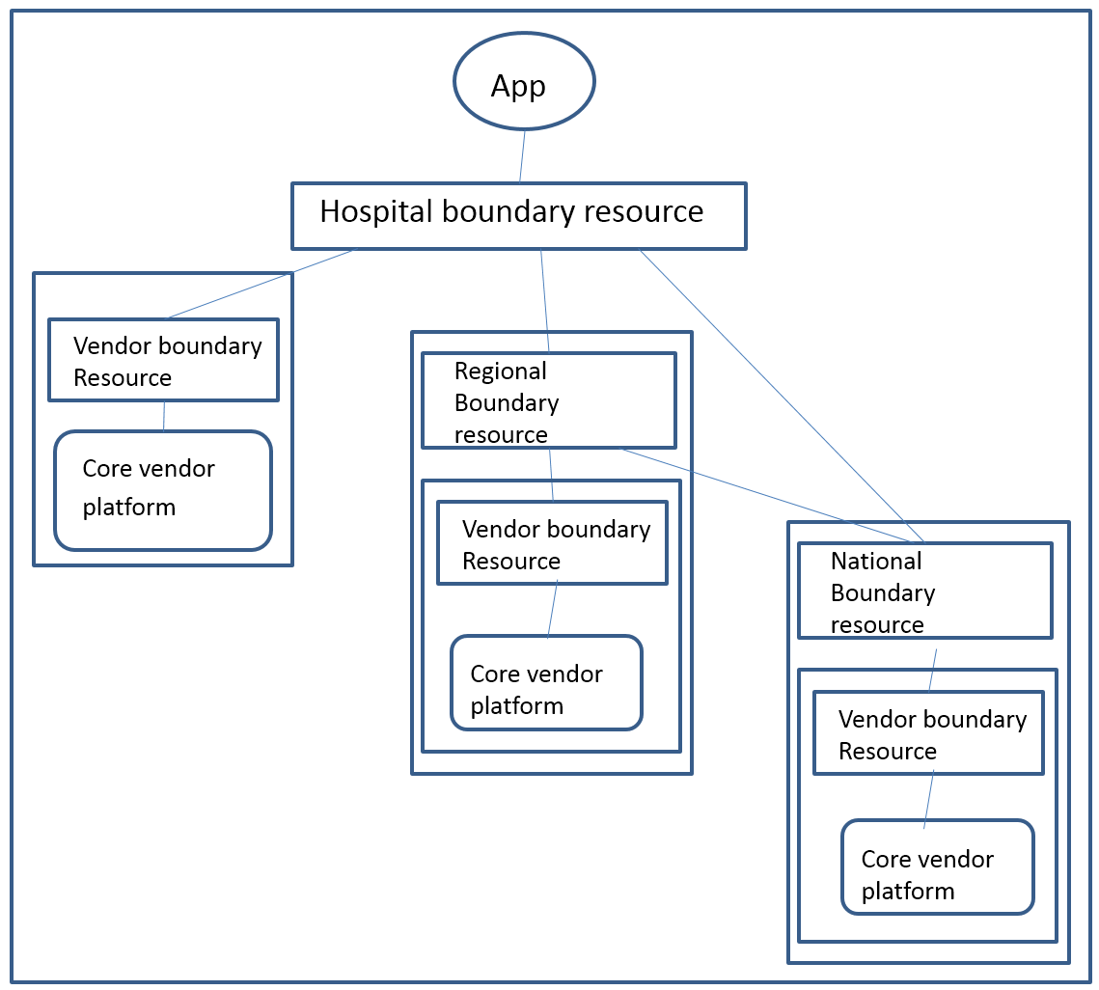
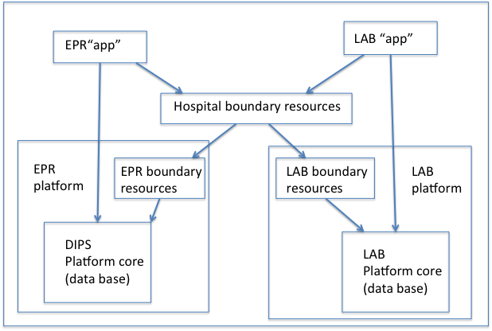
Platforms and infrastructures
Notes:
A key feature of platform-oriented infrastructures is the fact that they are composed of a multiplicity of traditional applications sharing information.

Slide 8
Find your mobile phones (finally)!
We want your feedback about us and what we discuss!
Please help us to improve, and answer the following questions at menti.com
Code: 192592

