Slide 1


AI & Learning
Iteration 1

Slide 2
Group members
Ragnhild : Master: Informatics - Programming and Systems Architecture
Somayeh : Master: Informatics - Programming and Systems Architecture
Nora : Master: Informatics - Language Technology
Abdirahman : Master: Informatics - Programming and Systems Architecture

Slide 3

Exploring student use of generative AI in academic work

Slide 4
Topic
Use of generative AI tools (ChatGPT, Gemini, etc.) in student assignments.
Benefits: creativity, saving time
Challenges: plagiarism, trust, overreliance

Slide 5

User Group & Context
Target group: University students.
Use case: Working on assignments to be delivered.
Focus on both experiences and reflections.

Slide 6

Research Questions
1. How do students use generative AI in academic assignments?
2. What are the benefits and challenges?
3. How does AI affect students’ perception of learning and authorship?

Slide 7
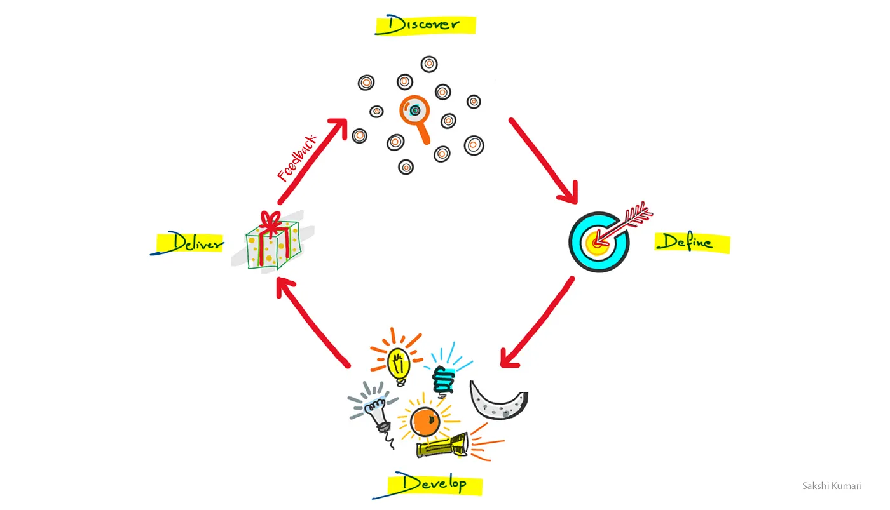
Methods
Literature review .
Interviews: semi-structured, open-ended questions.
Double Diamond framework: discover → define → develop → deliver.

Slide 8
Our Use of AI
So far: no AI tools used.
Possible later: UiO GPT to structure interview findings.
Important: anonymity and data protection.

Slide 9
Conclusion
Goal: Understand how AI shapes student learning practices.
Next steps: Conduct interviews and analyze findings.
Closing question: How would you use AI in your own academic work?

Slide 10


Thank you

