Slide 1
AI-Conic Duo
Liza & Sara
Notes:
(Liza)

Slide 2
Use of AI in Master Application Processes
Notes:
Evryone who sits here, have at some poin applied for a mastersdegree. This application process can easy without too much hassle, especially if you have studied at IFI before. But if you have a backround from another university, the process might not be as smooth, as some degrees requires specific courses from its own institute. And with a bachelor from a different institute or university the applicant needs to manually document and summarize the courses they have taken and argue why the courses they have taken are similar or overlap with the curriculum/courses needed to enter the master.
This document are then read by the application staff and procced, and based your argumentation skills and their knowedlge you either get approved or not.
This process involves a lot of manual labour for every party involved, and with AI taking bigger part in everyday operations within many firmsof AI, we believe AI can aid in this process aswell
Thus our projecttopic is the use of AI in the master application processes

Slide 3



To what extent can Artificial Intelligence enhance decision making and operational efficiency of the master application process?
Research Question
Notes:
The topic of our project is about the use of AI in the master application process.

Slide 4




Sub-research questions:
1. How is the master’s admission process structured from the perspective of the user groups and what tools are being used?
2. What challenges arise during the master’s admission process for the user groups?
3. How could artificial intelligence be applied to enhance the efficiency and fairness of the process?
Notes:
In order to answer these questions, we have defined om sub questions to help us answer the main question and give us good insights into the problem, so that we can develop a good solution.
These questions are:
How is the master’s admission process structured from the perspective of the user groups and what tools are being used?
What challenges arise during the master’s admission process for the user groups?
3. How could artificial intelligence be applied to enhance the efficiency and fairness of the process?

Slide 5
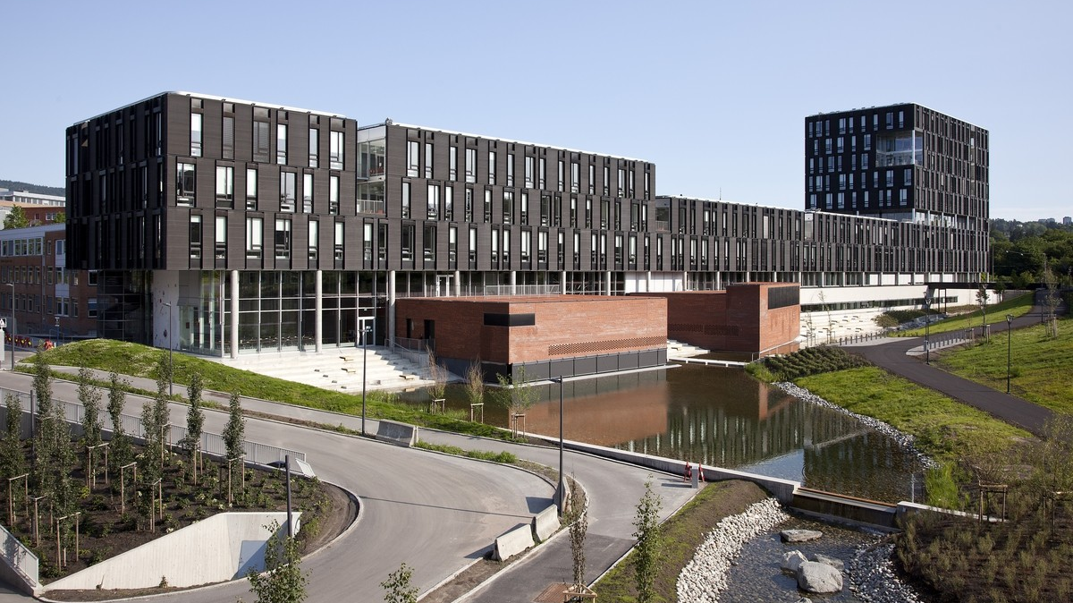
Scope
Notes:
To better investigate the problem, develop and test the solution we limited the scope to:
Master programs
IFI

Slide 6
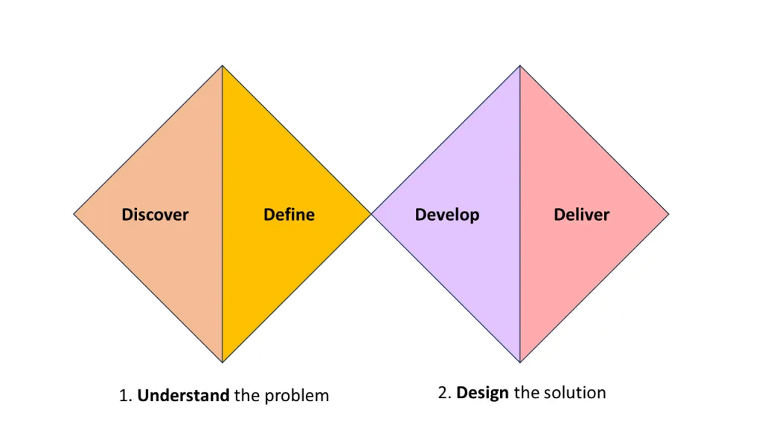
RoadMap
Notes:
Liza:
Currently we are still at the discovery stage where we are planning on conducting interviews with the users - study administration and students who were involved in the process.
We will move to the definition by analyzing the responses to the interviews.
Then we are planning on developing a prototype of an AI and testing it afterwards.

