Slide 1


INTERACTION WITH AI and autonomous systems – MoDULE 2
Session 1, 2025
Asbjørn Følstad, SINTEF

Slide 2
Learn about design for human-AI interactions
Aims for module 2
Explore how AI can support design in HCI - opportunities
Critically reflect on AI as design support – limitations

Slide 3
Four sessions
Sept. 12: Discover
[Sept. 19: Module 1 presentations]
Sept. 26: Define
[Oct. 3: Jo’s lecture]
Oct 10: Develop
Oct 17: Deliver
Interaction with AI – module 2

Slide 4
Amershi, S., Weld, D., Vorvoreanu, M., Fourney, A., Nushi, B., Collisson, P., ... & Teevan, J. (2019). Guidelines for human-AI interaction. In Proceedings of the 2019 CHI Conference on Human Factors in Computing Systems (paper no. 3). ACM.
Bender, E. M., Gebru, T., McMillan-Major, A., & Mitchell, M. (2021). On the dangers of stochastic parrots: Can language models be too big?. In Proceedings of the 2021 ACM Conference on Fairness, Accountability, and Transparency (pp. 610-623). ACM
Kocielnik, R., Amershi, S., & Bennett, P. N. (2019). Will you accept an imperfect AI?: Exploring designs for adjusting end-user expectations of AI systems. In Proceedings of the 2019 CHI Conference on Human Factors in Computing Systems (paper no. 411). ACM.
Yang, Q., Steinfeld, A., Rosé, C., & Zimmerman, J. (2020). Re-examining whether, why, and how Human-AI Interaction is uniquely difficult to design. In Proceedings of the 2020 CHI conference on human factors in computing systems (Paper no. 164).
Tholander, J., & Jonsson, M. (2023). Design ideation with AI-sketching, thinking and talking with generative machine learning models. In Proceedings of the 2023 ACM designing interactive systems conference – DIS ‘23 (pp. 1930-1940). New York, NY: ACM
Zamfirescu-Pereira, J. D., Wei, H., Xiao, A., Gu, K., Jung, G., Lee, M. G., ... & Yang, Q. (2023, July). Herding AI cats: Lessons from designing a chatbot by prompting GPT-3. In Proceedings of the 2023 ACM Designing Interactive Systems Conference (pp. 2206-2220).
Skjuve, M., Brandtzaeg, P. B., Følstad, A. (2024) Why do people use ChatGPT. First Monday.
Bommasani, R. et al. (2021). On the opportunities and risks of foundation models. arXiv preprint arXiv:2108.07258.
Skjuve, M., Følstad, A., Fostervold, K. I., & Brandtzaeg, P. B. (2021). My chatbot companion-a study of human-chatbot relationships. International Journal of Human-Computer Studies, 149, 102601.
Brandtzaeg, P. B., Skjuve, M., & Følstad, A. (2025). Understanding model power in social AI. AI & SOCIETY, 40(4), 2839-2849.
Literature

Slide 5
Individual assignment
Building on and extending the individual assignment in Module 1. Startup today – finish October 16)
Interim reports
(Oct. 16)
Building on and extending the group assignment in Module 1. Startup today – finish October 16)
+ Design task (startup today – present October 16, include in mid-term report as Appendix 1)
Group assignment

Slide 6
Interim report - individual assignment
Three topics:
Characteristics of AI-infused systems.
Human-AI interaction design.
Conversational user interfaces to large language models
Language: English or Norwegian.
Target length for module 2 content: 5-6 pages
Min. articles referenced: 4.
Aim to address these three topics in the lectures

Slide 7
Interim report – group assignment
Content (target total length: 7-10 pages)
(New) Front page
A description of the group, who you are - names.
A description of the topic of “interaction with AI” you are interested in.
A description of the user group and context of use you are interested in.
(new) Background section: Position your work relative to existing knowledge and practice
The 1-3 questions that you want to address (can change and evolve)
(updated) Method section – overall approach / process, data collection methods
(new) Findings (progress, initial outcomes)
(updated) Minimum six references to literature.
Appendix – approx. 1 page
Appendix 1: Module 2 design task – briefly describe the process and outcome. Detail reflections and lessons learnt.
Can be closely associated with module 2 design task (next)

Slide 8
Module 2 design task
Sept 12
Sept 26
Oct 10
Design prototype AI system, relevant for your groupwork topic.
… using the double diamond design process
… and any AI support of your choice
At all but the last lecture of Module 2, you will receive tips and guidance for your process
At each lecture, you will be asked to share your experiences so far
At the final lecture, you will present your prototype.
Oct 17
Discover
Define
Develop
Deliver

Slide 9

Module 2 design task – AI support
Process support
General purpose LLMs
AI-powered …
  UI development
  Prototype development (POC/MVP)
  Code generation
… for ideation, detailing, implementation
Implementation support
Configurable LLM service
  Google AI Studio / chat
  OpenAI GPT (subscription required)
Clickable prototype
  Google AI Studio / build
  ChatGPT
  Lovable?
  Replit?
Chatbot platforms
  BotPress
Any other method or platform

Slide 10
Module 2 design task – AI support
Process support
General purpose LLMs
AI-powered …
  UI development
  Prototype development (POC/MVP)
  Code generation
… for ideation, detailing, implementation
Implementation support
Configurable LLM service
  Google AI Studio / chat
  OpenAI GPT (subscription required)
Clickable prototype
  Google AI Studio / build
  ChatGPT
  Lovable?
  Replit?
Chatbot platforms
  BotPress
Any other method or platform
First week: Discover
Use ChatGPT or Google Gemini for brainstorming and ideation
Identify one or more possible platforms for implementation support and try these out
Next Module 2 session, we set aside time to reflect on your first week outcomes.

Slide 11
Module 2 design task – AI support
Process support
General purpose LLMs
AI-powered …
  UI development
  Prototype development (POC/MVP)
  Code generation
… for ideation, detailing, implementation
Implementation support
Configurable LLM service
  Google AI Studio / chat
  OpenAI GPT (subscription required)
Clickable prototype
  Google AI Studio / build
  ChatGPT
  Lovable?
  Replit?
Chatbot platforms
  BotPress
Any other method or platform
Some words on the motivation for the task and the suggested AI support
Task is exploratory. The objective is to learn about opportunities and limitations of AI support while designing for AI.
You will learn and I will learn. None of us knows the available tools well. We help each other explore and improve.
Tools may be early, limited, and immature. Be cautions in use as you would be with any unfamiliar online services.

Slide 12
Module 2 design task:
Example based on
topic from a 2024 course group
- a student organizer

Slide 13
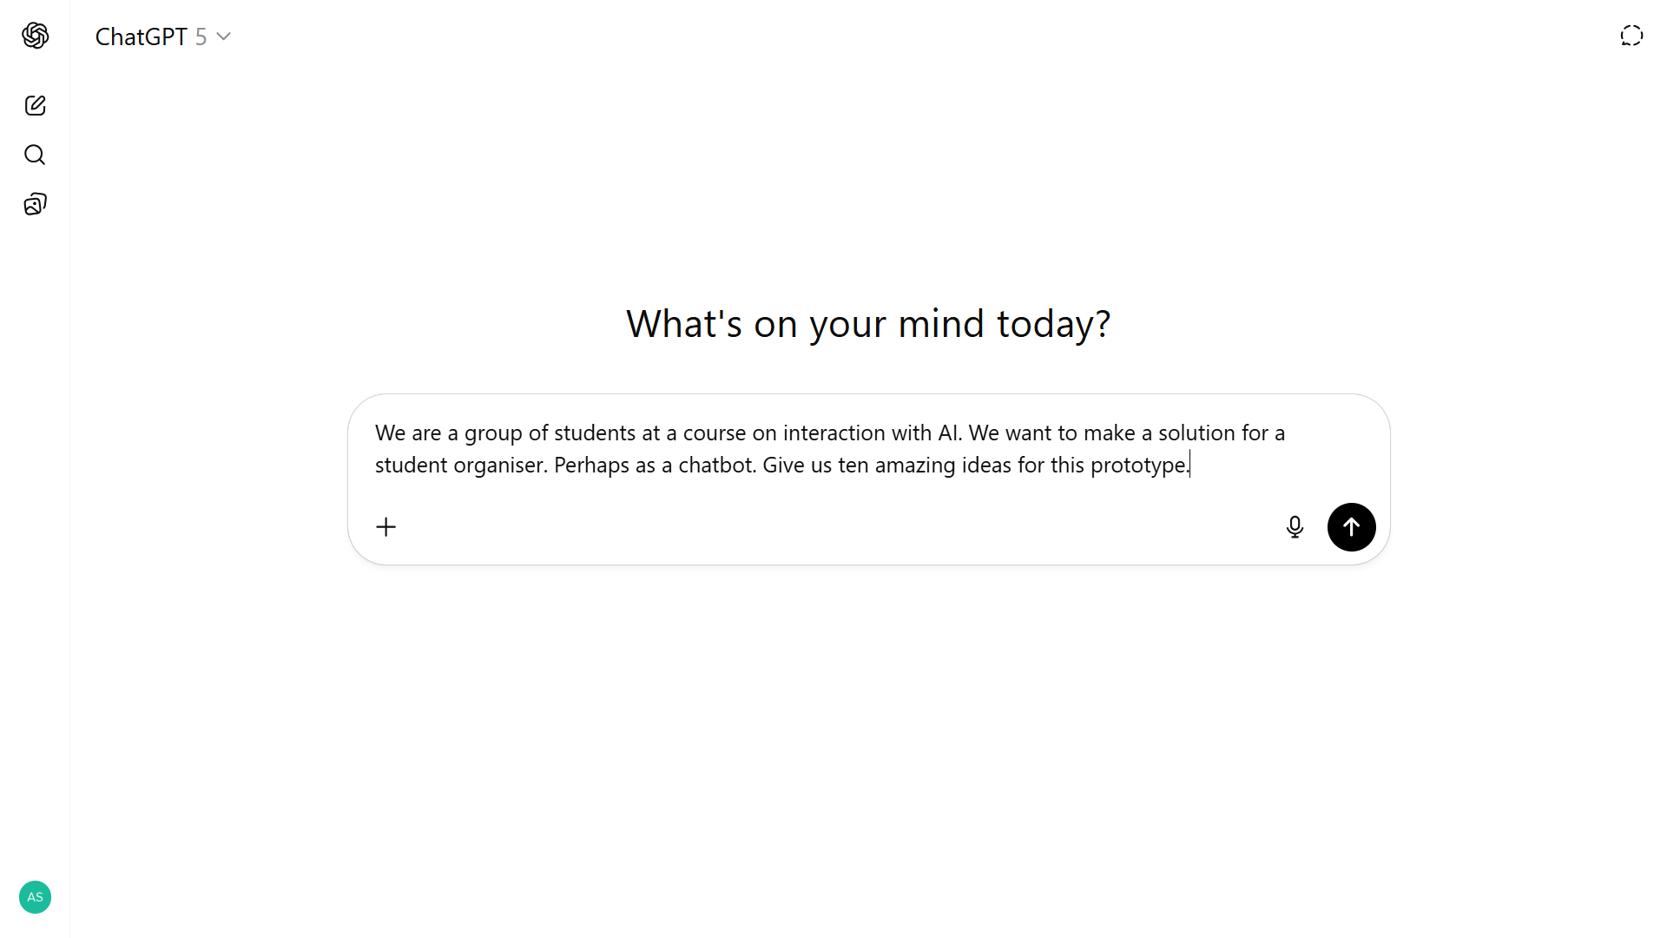

Slide 14
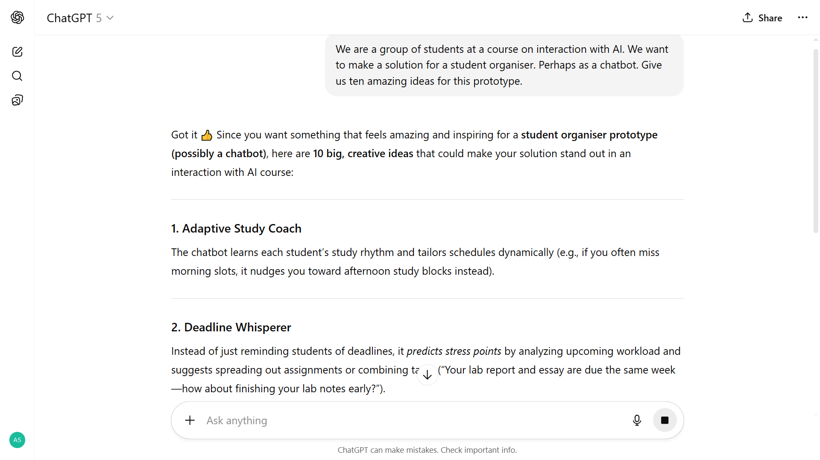

Slide 15
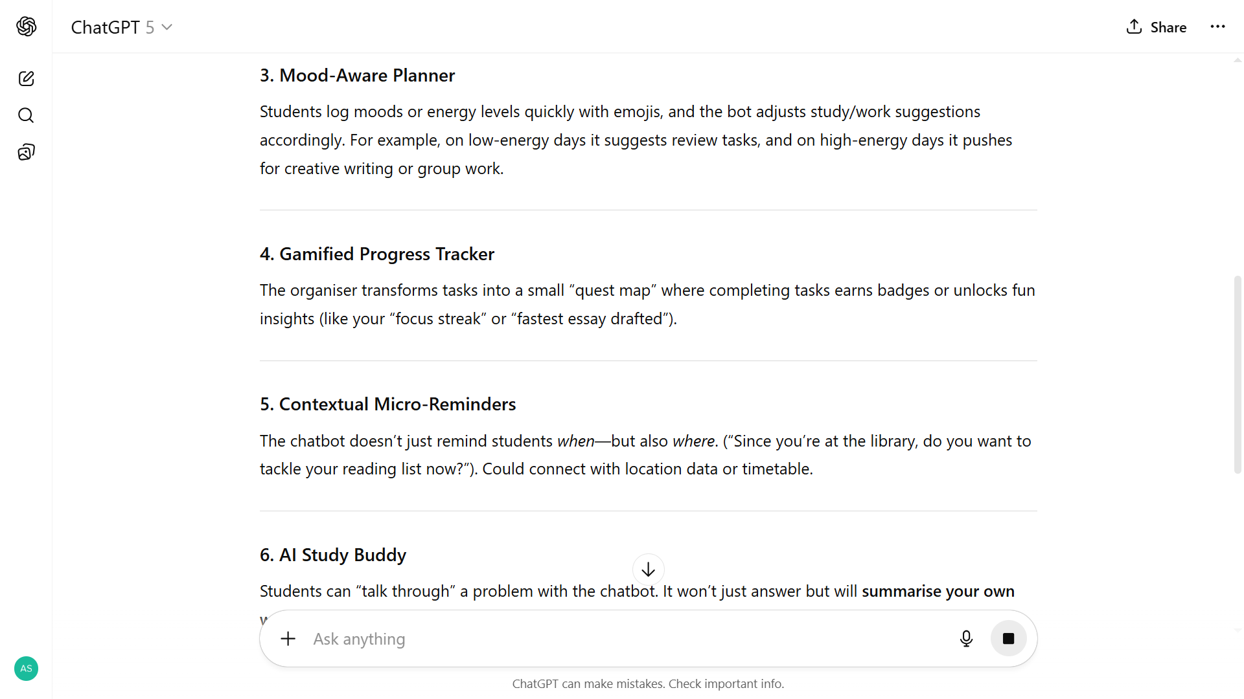

Slide 16
Now it is your turn!
Find your group …
Use ChatGPT or Google Gemini for brainstorming and ideation
Your reflections?

Slide 17
Creativity support from
large language models –
what to expect and how to benefit

Slide 18
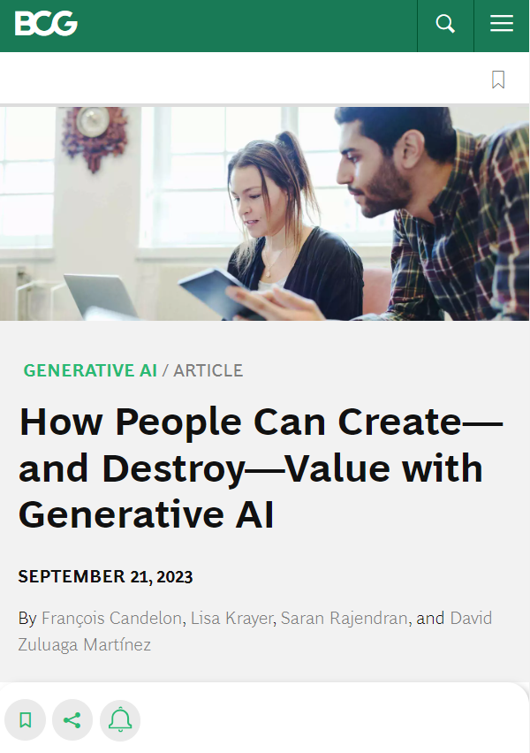
Study: Generative AI to support creativity and business problem solving
>750 junior consultants
Two types of task:
- Creative (i.e. creative product innovation) – scored 1-10.
- Business problem solving (e.g. business decision) – scored 0 or 1
Three conditions
- Use ChatGPT after 30 minute training
- Use ChatGPT after no training
- Not use ChatGPT
All also conduct introductory benchmark task
https://www.bcg.com/publications/2023/how-people-create-and-destroy-value-with-gen-ai
Notes:
Creative:
You are working for a footwear company in the unit developing new products. Generate ideas for a new shoe aimed at a specific market or sport that is underserved. Be creative and give at least ten ideas.
Come up with a list of steps needed to launch the product. Be concise but comprehensive.
Use your best knowledge to segment the footwear market by users. Develop a marketing slogan for each segment you are targeting.
Suggest three ways of testing whether your marketing slogan works well with the customers you have identified.
Write marketing copy for a press release of the product.
Business problem solving:
The CEO, Harold Van Muylders, of Kleding (a fictitious company) would like to understand the performance of the company’s three brands (Kleding Man, Kleding Woman, and Kleding Kids) to uncover deeper issues. Please find attached interviews from company insiders. In addition, the attached excel sheet provides financial data broken down by brands.
Using this information, if the CEO must pick one brand to focus on and invest in to drive revenue growth in the company, what brand should that be? What is the rationale for this choice? Please support your views with data and/or interview quotations

Slide 19
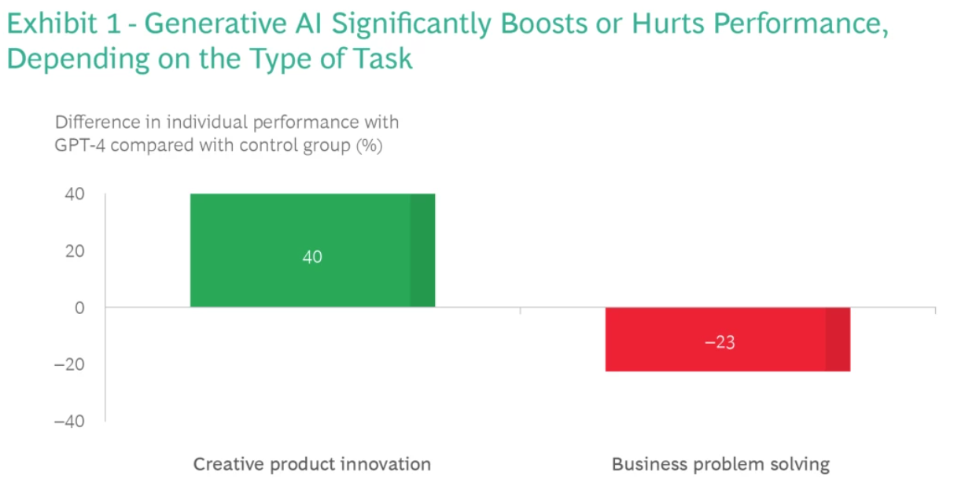
https://www.bcg.com/publications/2023/how-people-create-and-destroy-value-with-gen-ai

Slide 20
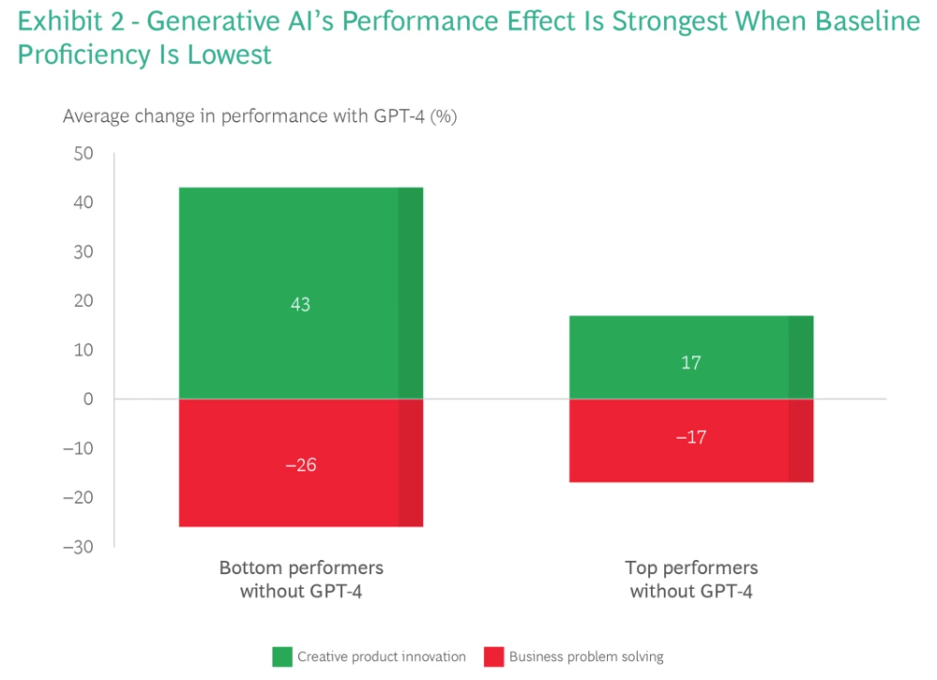
https://www.bcg.com/publications/2023/how-people-create-and-destroy-value-with-gen-ai

Slide 21
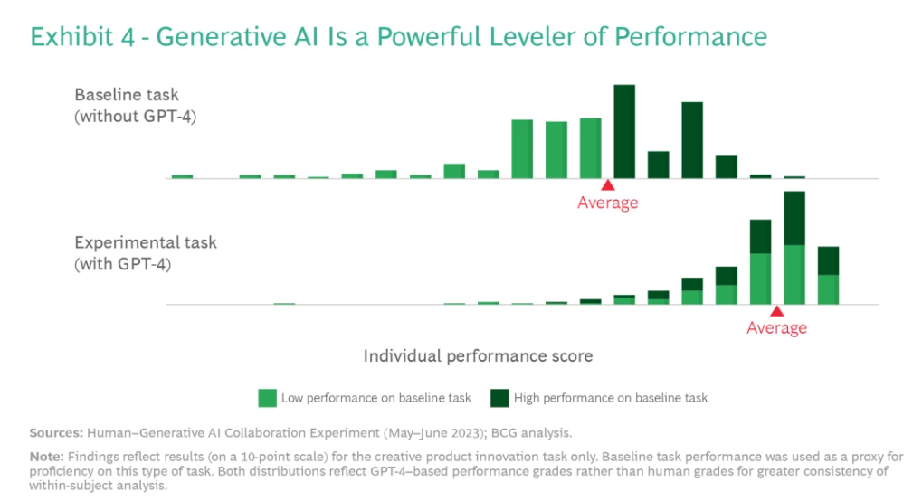
https://www.bcg.com/publications/2023/how-people-create-and-destroy-value-with-gen-ai

Slide 22
A seeming creativity boost! Any challenges or limitations?
https://www.bcg.com/publications/2023/how-people-create-and-destroy-value-with-gen-ai

Slide 23
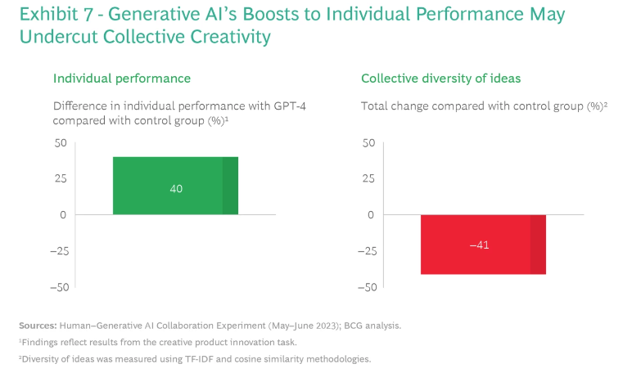
https://www.bcg.com/publications/2023/how-people-create-and-destroy-value-with-gen-ai

Slide 24
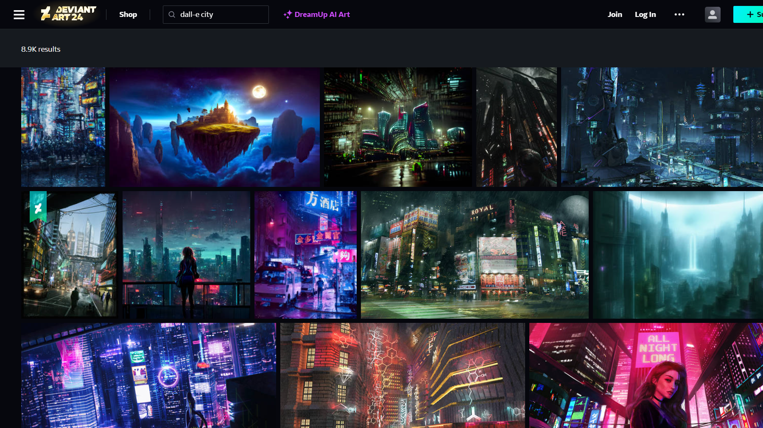
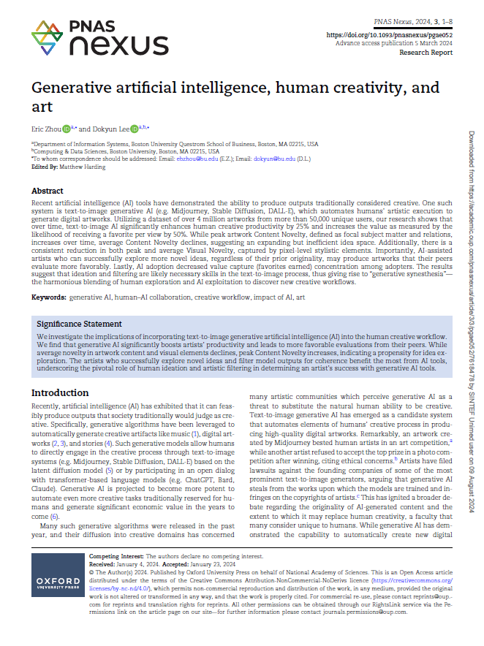
Studie av 4M kunstverk av 50K kunstnere, på nettsted tilsvarende DeviantArt
Fokus på kunstnere som tar i bruk GenAI – identifisert ved tags (5,8 K av 50K kunstnere)
Resultater:
Økt produktivitet
Økt sannsynlighet for favoritt
Innholdsmessig nyhetsverdi: Økt toppnivå, redusert gjennomsnitt
Visuell nyhetsverdi: Redusert toppnivå og gjennomsnitt
Konklusjon: Evne til ideskaping og filtrering viktig for vellykket menneske-maskin samarbeid for visuell kunst -> behov for nye kreative arbeidsprosesser
Diskusjon 1
24
Zhou, E., & Lee, D. (2023). Generative ai, human creativity, and art. PNAS Nexus, 3(3) https://doi.org/10.1093/pnasnexus/pgae052

Slide 25
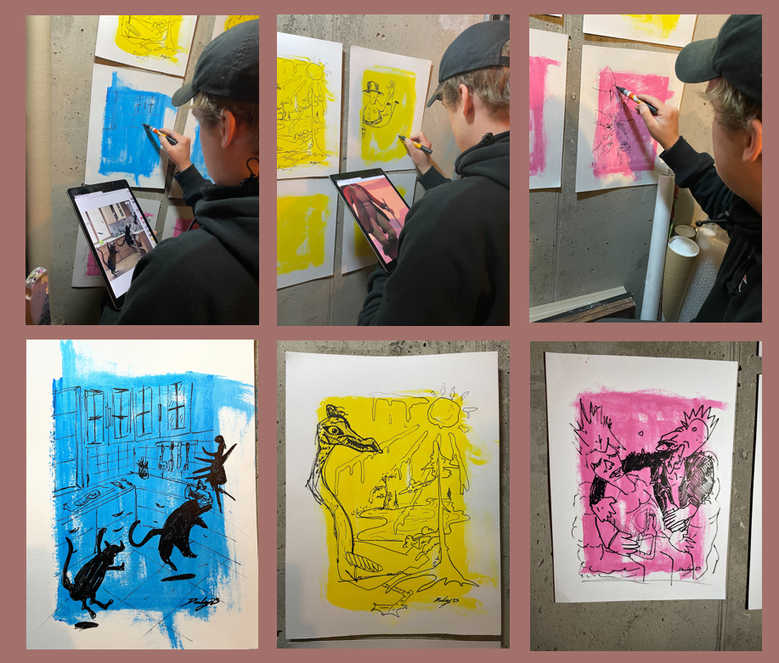
Sustainable creativity boost seems to require human-machine collaboration – with the machine inspiring and supporting engaged and creative humans.
From UiO Honours student project, by Søren Hunskaar, Fartein Badhwar Valen-Sendstad, Benedict Leander Skålevik Parton, Sol Strøm Jensen

Slide 26
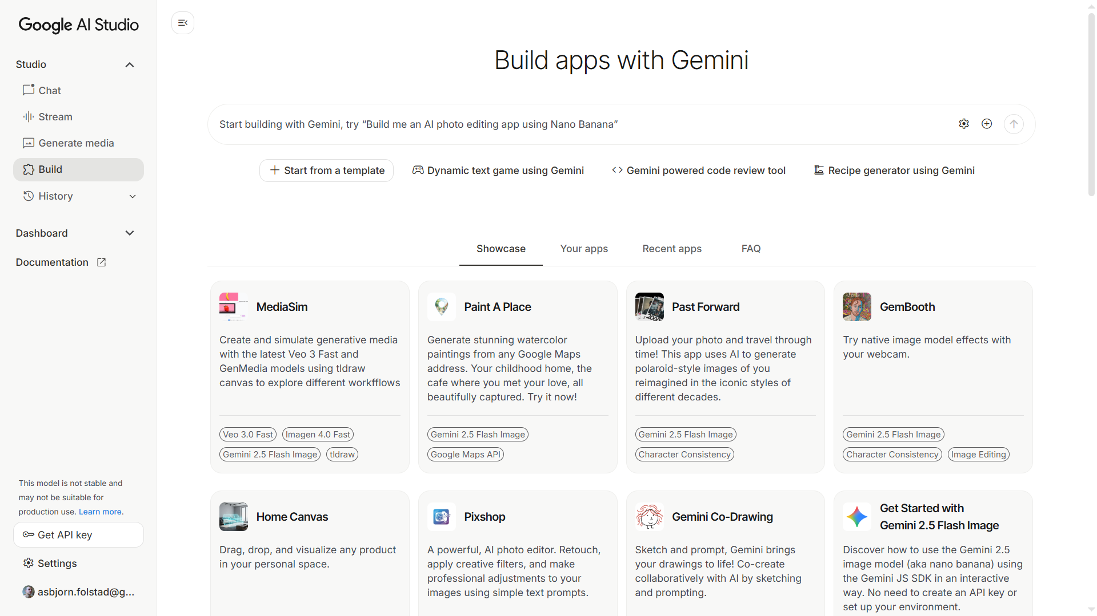
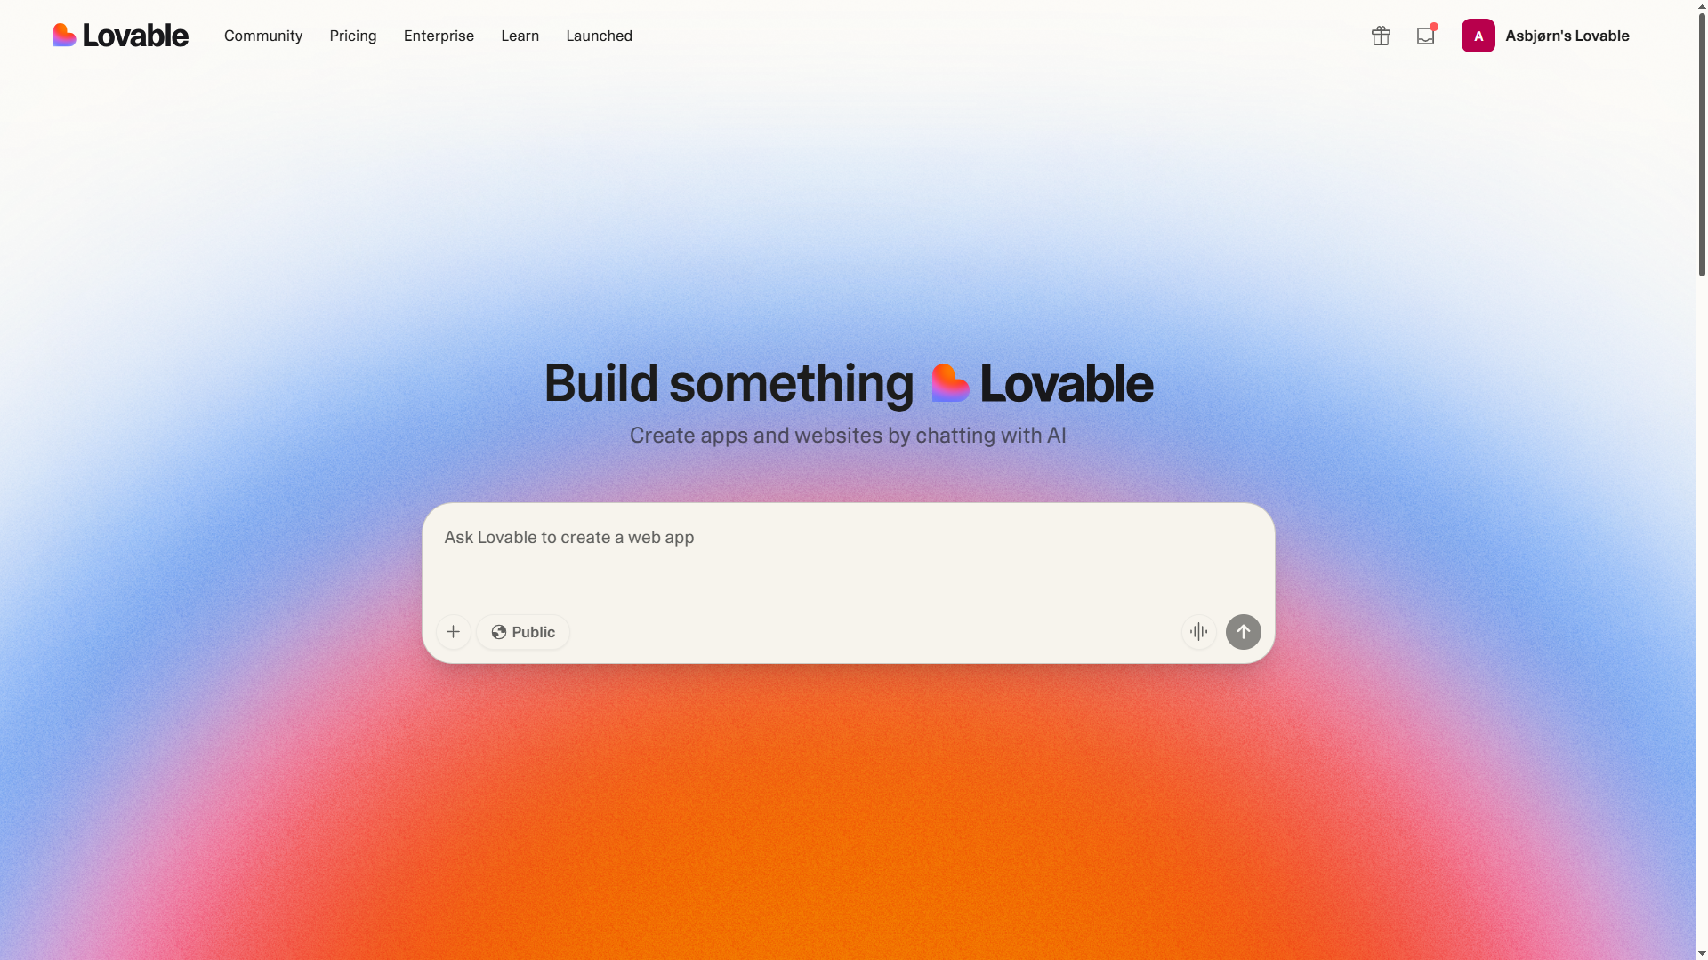
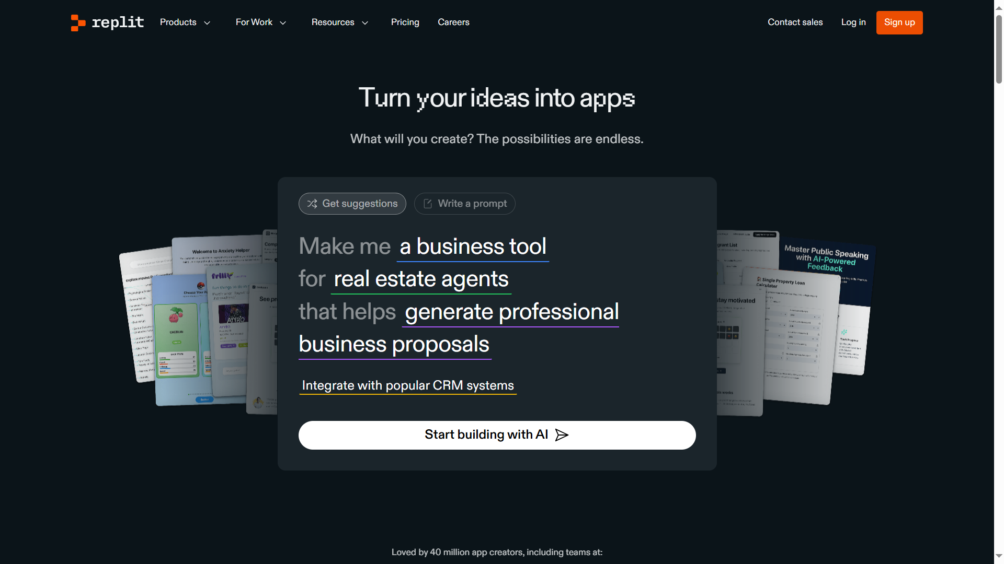
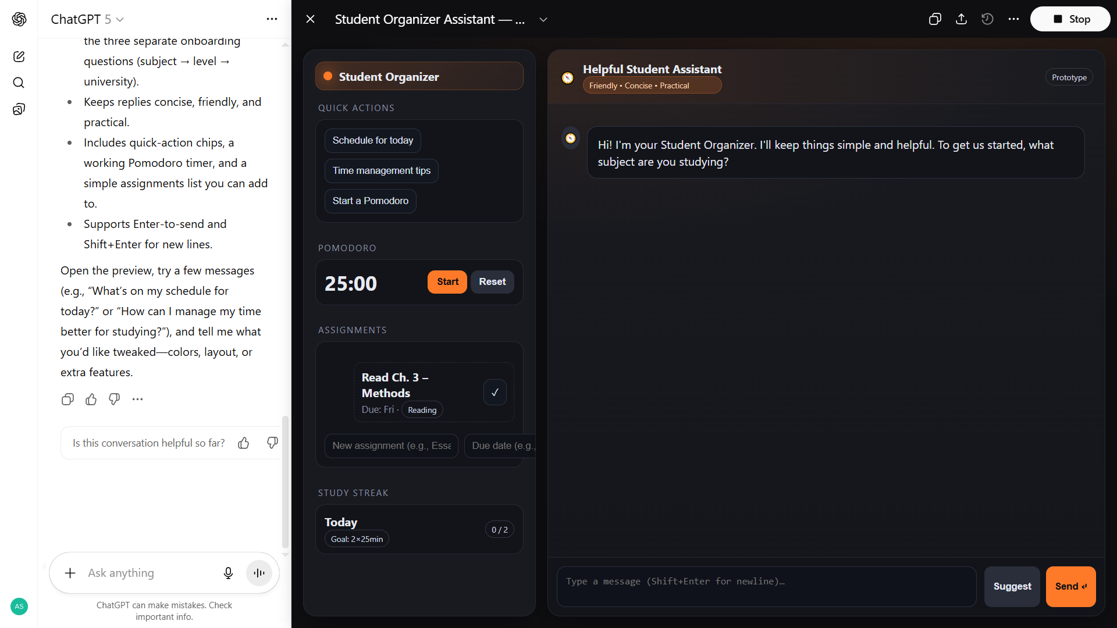
What will happen when you make use of AI support in your design task?

Slide 27
Module 2 design task – AI support
Process support
General purpose LLMs
AI-powered …
  UI development
  Prototype development (POC/MVP)
  Code generation
… for ideation, detailing, implementation
Implementation support
Configurable LLM service
  Google AI Studio / chat
  OpenAI GPT (subscription required)
Clickable prototype
  Google AI Studio / build
  Lovable?
  Replit?
Chatbot platforms
  BotPress
Any other method or platform
First week: Discover
Use ChatGPT or Google Gemini for brainstorming and ideation
Identify one or more possible platforms for implementation support and try these out
Next Module 2 session, we set aside time to reflect on your first week outcomes.
Need 3-4 groups to volunteer for telling about your progress, and your experiences with one or more AI platforms for implementation support

Slide 28
End 1

