Slide 1
Operating Systems:
Memory
INF1060:
Introduction to Operating Systems and Data Communication
Tuesday 26 September 17

Slide 2
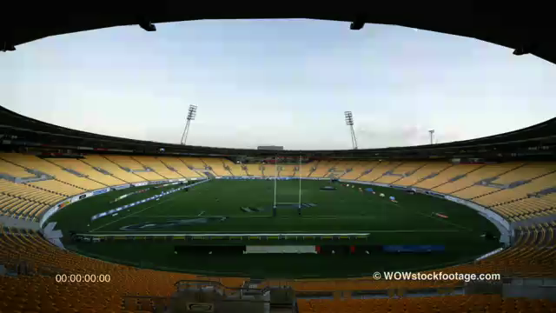
Challenge – managing memory
How to…
see which seats are available
allocate a seat
find one particular person
…

Slide 3
Overview
Hierarchies
Multiprogramming and memory management
Addressing
A process’ memory
Partitioning
Paging and Segmentation
Virtual memory
Page replacement algorithms
Paging example in IA32

Slide 4
Memory Management
Memory management is concerned with managing
the systems’ memory resources
  allocate space to processes
  protect the memory regions
  provide a virtual view of memory giving the impression
  of having more than the number of available bytes
  control different levels of memory in a hierarchy

Slide 5
Memory Hierarchies
A process typically needs a lot of memory:
We can’t access the disk every time we need data
Typical computer systems therefore have several different components where data may be stored
  different capacities
  different speeds
  less capacity gives faster access
  and higher cost per byte
Lower levels have a copy of
data in higher levels
A typical memory hierarchy:
tertiary storage (tapes)
speed
price
secondary storage (disks)
10⁷x
main memory
100x
capacity
2x
cache(s)

Slide 6




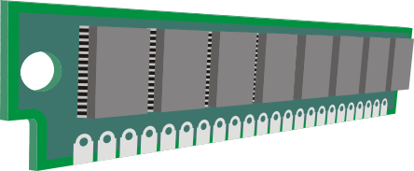




Memory Hierarchies
For handouts
tertiary storage (tapes)
secondary storage (disks)
5 ms
3.5 months
50 ns
main memory
1.5 minutes
On die memory - 1 ns
cache(s)
2 s
0.3 ns
< 1 s
Notes:
CPU / 0.5 ns -- desk
Cache / 1 ns -- shelf above (1 second)
Memory / 50 ns – library one floor up (1.5 minutes), if you really run
Disk / 5 ms – US, NASA, Moon (3.5 mnds)
Sony announced in 2014 that they had developed a tape storage technology with the highest reported magnetic tape data density, 148 Gbit/in² (23 Gbit/cm²), potentially allowing tape capacity of 185 TB
→

Slide 7

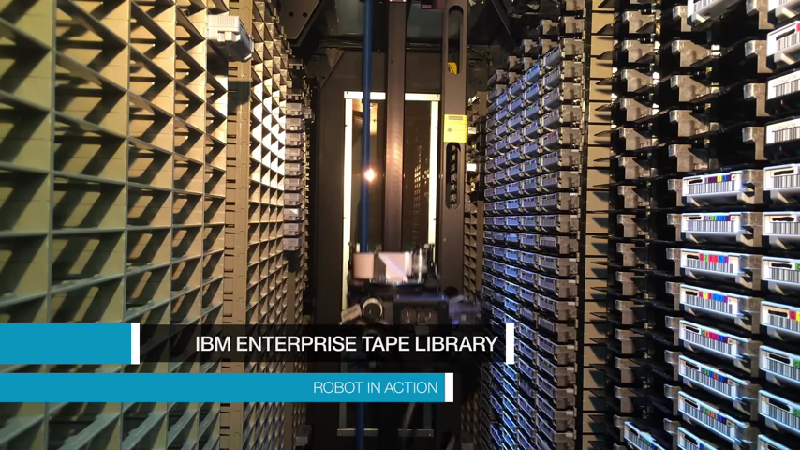


Memory Hierarchies
Tapes? Well, they …
store a LOOOT of data
(IBM TS3500 Tape Library: 2.25 exabytes)
are SLOOOOOOOW…
(seconds → minutes → hours)
→ Going to other far away galaxies…
→ “5 sec ≈ ~290 years”
?
tertiary storage (tapes)
So, use your memory efficiently….!
5 ms
3.5 months
secondary storage (disks)
50 ns
1.5 minutes
On die memory - 1 ns
2 s
main memory
~0.3 ns
< 1 s
cache(s)
Notes:
CPU / 0.5 ns -- desk
Cache / 1 ns -- shelf above (1 second)
Memory / 50 ns – library one floor up (1.5 minutes), if you really run
Disk / 5 ms – US, NASA, Moon (3.5 mnds)
Tapes / seconds++ -- 100s of years
exabyte 10**18 (GIGA **9, Tera **12, Peta **15, EXA **18)
Per tape: Sony 2014 : 185 TB

Slide 8
Storage Costs: Access Time vs Capacity
offline
tape
10¹⁵
10¹³
magnetic
disks
10¹¹
typical capacity (bytes)
online
tape
10⁹
main
memory
10⁷
10⁵
cache
10⁻⁹
10⁻⁶
10⁻³
10
10³
access time (sec)
from Gray & Reuter

Slide 9
Storage Costs: Access Time vs Price
10⁴
cache
10²
main
memory
online
tape
dollars/Mbytes
magnetic
disks
10⁰
10⁻²
offline
tape
10⁻⁹
10⁻⁶
10⁻³
10
10³
access time (sec)
from Gray & Reuter

Slide 10
Absolute and Relative Addressing
Hardware often uses absolute addressing
  reserved memory regions
  reading data by referencing the
  byte numbers in memory
  read absolute byte 0x000000ff
  fast!!!
What about software?
  read absolute byte 0x000fffff (process A)
  result dependent of a process' physical location
  absolute addressing not convenient
  but, addressing within a process is determined during programming!!??
Relative addressing
  independent of process position in memory
  address is expressed relative to some base location
  dynamic address translation – find absolute address during run-time adding the relative and base addresses
0x000…
offset from memory’s start address
offset from process’ start address
process A
process A
0xfff…

Slide 11
Processes’ Memory Layout
On most architectures, a process partitions its available memory (address space), but for what?
  a text (code) segment
    read from program file
    for example by exec
    usually read-only
    can be shared
  a data segment
    global variables
    static variables (BSS segment)
    heap
      dynamic memory, e.g., allocated using malloc
      grows against higher addresses
  a stack segment
    stores parameters/variables in a function
    stores register states (e.g., calling function’s EIP)
    grows against lower addresses
  system data segment (PCB)
    segment pointers
    pid
    program and stack pointers
    …
  possibly more stacks for threads
  command line arguments and
  environment variables at highest addresses
low address
system data segment (PCB)
…
...
…
…
8048314 <add>:
8048314: push %ebp
8048315: mov %esp,%ebp
8048317: mov 0xc(%ebp),%eax
804831a: add 0x8(%ebp),%eax
804831d: pop %ebp
804831e: ret
804831f <main>:
804831f: push %ebp
8048320: mov %esp,%ebp
8048322: sub $0x18,%esp
8048325: and $0xfffffff0,%esp
8048328: mov $0x0,%eax
804832d: sub %eax,%esp
804832f: movl $0x0,0xfffffffc(%ebp)
8048336: movl $0x2,0x4(%esp,1)
804833e: movl $0x4,(%esp,1)
8048345: call 8048314 <add>
804834a: mov %eax,0xfffffffc(%ebp)
804834d: leave
804834e: ret
804834f: nop
code segment
global variables
static variables
data segment
data segment
process A
heap
“unused” memory
stack
possible thread stacks,
arguments
high address

Slide 12
Processes’ Memory Layout
For handouts
On most architectures, a task partitions its available memory (address space), but for what?
  a text (code) segment
    read from program file
    for example by exec
    usually read-only
    can be shared
  a data segment
    global variables
    static variables
    heap
      dynamic memory, e.g., allocated using malloc
      grows against higher addresses
  a stack segment
    variables in a function
    stored register states (e.g., calling function’s EIP)
    grows against lower addresses
  system data segment (PCB)
    segment pointers
    pid
    program and stack pointers
    …
  possibly more stacks for threads
  command line arguments and
  environment variables at highest addresses
low address
system data segment (PCB)
code segment
global variables
static variables
data segment
data segment
process A
heap
“unused” memory
stack
possible thread stacks, arguments
high address

Slide 13
Global Memory Layout
Memory is usually divided into regions
  operating system occupies low memory
    system control
    resident routines
  the remaining area is used for transient operating system routines and application programs
How to assign memory to concurrent processes?
0x000…
system control information
resident operating system
(kernel)
transient area
(application programs – and
transient operating system routines)
0xfff…

Slide 14
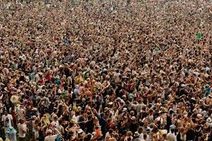


The Challenge of Multiprogramming
Many “tasks” require memory
  several processes concurrently
  loaded into memory
  memory is needed for
  different tasks within a process
  process memory demand may
  change over time
  OS must arrange (dynamic) memory sharing

Slide 15
Memory Management for Multiprogramming
Use of secondary storage
  keeping all programs and their data in memory may be impossible
  move (parts of) a process from memory
Swapping: remove a process from memory
  with all of its state and data
  store it on a secondary medium
  (disk, flash RAM, … , historically also tape)
Overlays: manually replace parts of code and data
  programmer’s rather than OS’s work
  only for very old and memory-scarce systems
Segmentation/paging: remove parts of a process from memory
  store it on a secondary medium
  sizes of such parts are usually fixed

Slide 16
Fixed Partitioning
Divide memory into static partitions
at system initialization time
(boot or earlier)
Advantages
  easy to implement
  can support swapping process
Equal-size partitions
  large programs cannot be executed
  (unless parts of a program are loaded from disk)
  small programs don't use the entire partition
  (problem called “internal fragmentation”)
Unequal-size partitions
  large programs can be loaded at once
  less internal fragmentation
  require assignment of jobs to partitions
  one queue or one queue per partition
  …but, what if only small or large processes?
Equal sized:
Unequal sized:
Operating system
8MB
Operating system
8MB
8MB
2MB
4MB
8MB
6MB
8MB
8MB
8MB
8MB
12MB
8MB
8MB
16MB
8MB

Slide 17
Dynamic Partitioning
Divide memory at run-time
  partitions are created dynamically
  removed after jobs are finished
External fragmentation increases with system running time
Operating system
8MB
56MB free
Process 1
20MB
20MB free
Process 5
14MB
External
fragmentation
6MB free
36MB free
Process 2
14MB
14MB free
Process 4
8MB
6MB free
22MB free
Process 3
18MB
4MB free

Slide 18
Dynamic Partitioning
Divide memory at run-time
  partitions are created dynamically
  removed after jobs are finished
External fragmentation increases with system running time
Operating system
8MB
Process 5
14MB
Process 4
8MB
6MB
Compaction removes fragments by moving
data in memory
  takes time
  consumes processing resources
Proper placement algorithm might reduce
need for compaction
  first fit – simplest, fastest, typically the best
  next fit – problems with large segments
  best fit – slowest, lots of small fragments,
  therefore often worst
Process 4
8MB
6MB free
Process 3
18MB
6MB free
Process 3
18MB
6MB free
16MB free
6MB free
4MB free

Slide 19
The Buddy System
Process
128kB
Process
256kB
Process 32kB
Mix of fixed and dynamic partitioning
  partitions have sizes 2^{k}, L ≤ k ≤ U
Maintain a list of holes with sizes
Assigning memory to a process:
  find the smallest k so that the process fits into 2^{k}
  find a hole of size 2^{k}
  if not available, split the smallest hole larger than 2^{k}
  recursively into halves
Merge partitions if possible when released
… but what if I now got a 513kB process?
… do we really need the process in continuous memory?
1MB
512kB
256kB
128kB
Process
128kB
128kB
64kB
32kB
Process 32kB
32kB
64kB
256kB
Process
256kB
512kB
256kB
Process
256kB
256kB
Notes:
1 KB → k = 10
32 KB → k = 15
128 KB → k = 17
1MB → k = 20

Slide 20
Segmentation
Requiring that a process is placed in contiguous memory gives much fragmentation (and memory compaction is expensive)
Segmentation
  different lengths
  determined by programmer
  memory frames
Programmer (or compiler tool-chain) organizes program in parts
  move control
  needs awareness of possible segment size limits
Pros and Cons
  principle as in dynamic partitioning – can have different sizes
  no internal fragmentation
  less external fragmentation because on average smaller segments
  adds a step to address translation

Slide 21
Segmentation
find segment table
address in register
extract segment number from address
find segment address using segment number as index to segment table
find absolute address within segment using relative address
operating system
other regions/programs
address
process A, segment 0
other regions/programs
segment number | offset
process A, segment 1
segment table with segment
start addresses
other regions/programs
+
0x…a…
0x…b…
0x…c…
…
process A, segment 2
other regions/programs

Slide 22
Paging
Paging
  equal lengths determined
  by processor
  one page moved into
  one page (memory) frame
Process is loaded into several frames
(not necessarily consecutive)
Fragmentation
  no external fragmentation
  little internal fragmentation (depends on frame size)
Addresses are dynamically translated during run-time
(similar to segmentation)
Can combine segmentation and paging
Process 6
Process 7
Process 1
Process 2
Process 3
Process 4
Process 5
Process 1
?

Slide 23
Virtual Memory
The described partitioning schemes may be used in applications, but a modern OS also uses virtual memory:
  early attempt to give a programmer more memory than physically available
    older computers had relatively little main memory
    but still today, all instructions do not have to be in memory before execution starts
      break program into smaller independent parts
      load currently active parts
      when a program is finished with one part a new can be loaded
  memory is divided into equal-sized frames often called pages
  some pages reside in physical memory, others are stored on disk and retrieved if needed
  virtual addresses are translated to physical addresses (in the MMU) using a page table
  both Linux and Windows implement a flat linear 32-bit (4 GB) memory model on IA-32
    Windows: 2 GB (high addresses) kernel, 2 GB (low addresses) user mode threads
    Linux: 1 GB (high addresses) kernel, 3 GB (low addresses) user mode threads

Slide 24
Virtual Memory
virtual address space
1
2
3
4
5
6
7
8
9
10
11
12
13
14
15
16
17
18
Memory lookup???
physical memory
7
1
5
4
13
2
3
18
3
Notes:
Shows pages 1 – 4, 3 goes to disk

Slide 25
Memory Lookup
present
bit
Outgoing physical address
Page table
15
000
0
1
1
0
The memory lookup can be for almost anything:
8048314 <add>:
8048314: push %ebp
8048315: mov %esp,%ebp
8048317: mov 0xc(%ebp),%eax
804831a: add 0x8(%ebp),%eax
804831d: pop %ebp
804831e: ret
804831f <main>:
804831f: push %ebp
8048320: mov %esp,%ebp
8048322: sub $0x18,%esp
8048325: and $0xfffffff0,%esp
8048328: mov $0x0,%eax
804832d: sub %eax,%esp
804832f: movl $0x0,0xfffffffc(%ebp)
8048336: movl $0x2,0x4(%esp,1)
804833e: movl $0x4,(%esp,1)
8048345: call 8048314 <add>
804834a: mov %eax,0xfffffffc(%ebp)
804834d: leave
804834e: ret
14
000
0
(0x6004, 24580)
13
000
0
12
000
0
11
111
1
Example:
4 KB pages (12-bit offsets within page)
16 bit virtual address space → 16 pages (4-bit index)
8 physical pages (3-bit index)
10
000
0
9
101
1
8
000
0
7
000
0
6
000
0
5
011
1
4
100
1
3
000
1
2
110
1
1
001
1
4-bit index
into page table
virtual page = 0010 = 2
0
010
1
12-bit offset
Incoming virtual address
(0x2004, 8196)
0
0
0
0
0
0
0
0
1
1
1
1
0
0
0
0
0
0
0
0
0
0
0
0
0
0
0
0
0
0
0
0
0
0
0
0
0
0
0
0
0
0
0
1
1
1
0
0
0
0
0
0

Slide 26
Memory Lookup
present
bit
Outgoing physical address
Page table
15
000
0
14
000
0
13
000
0
12
000
0
11
111
1
10
000
0
PAGE FAULT
9
101
1
8
000
0
7
000
0
6
000
0
5
011
1
4
100
1
3
000
1
2
110
0
1
001
1
4-bit index
into page table
virtual page = 0010 = 2
0
010
1
12-bit offset
Incoming virtual address
(0x2004, 8196)
0
0
0
0
0
0
0
0
1
1
1
1
0
0
0
0
0
0
0
0
0
0
0
0
0
0
0
0
0
0
0
0
0
0
1
1
0
0
0
0

Slide 27
Page Fault Handling
Hardware traps to the kernel saving program counter and process state information
Save general registers and other volatile information
OS discovers the page fault and determines which virtual page is requested
OS checks if the virtual page is valid and if protection is consistent with access
Select a page to be replaced
Check if selected page frame is ”dirty”, i.e., updated. If so, write back to disk, otherwise, just overwrite
When selected page frame is ready, the OS finds the disk address where the needed data is located and schedules a disk operation to bring in into memory
A disk interrupt is executed indicating that the disk I/O operation is finished, the page tables are updated, and the page frame is marked ”normal state”
Faulting instruction is backed up and the program counter is reset
Faulting process is scheduled, and OS returns to the routine that made the trap to the kernel
The registers and other volatile information are restored, and control is returned to user space to continue execution as no page fault had occured

Slide 28
Page Replacement Algorithms
Page fault → OS has to select a page for replacement
How do we decide which page to replace?
→ determined by the page replacement algorithm
→ several algorithms exist:
    Random
    Other algorithms take into account usage, age, etc.
    (e.g., FIFO, not recently used, least recently used, second chance, clock, …)
    which is best???

Slide 29
First In First Out (FIFO)
All pages in memory are maintained in a list sorted by age
FIFO replaces the oldest page, i.e., the first in the list
Reference string: A B C D A E F G H I A J
Now the buffer is full, next page fault results in a replacement
No change in the FIFO chain
A
C
B
E
F
G
D
D
B
A
D
E
F
C
C
A
C
D
E
B
B
B
C
D
A
A
A
B
C
A
I
B
A
A
J
H
H
I
A
G
G
H
I
F
F
G
H
E
E
F
G
D
D
E
F
C
C
D
E
B
B
C
D
A
Page most
recently loaded
Page first loaded, i.e.,
FIRST REPLACED
Low overhead
Non-optimal replacement (and disc accesses are EXPENSIVE)
FIFO is rarely used in its pure form

Slide 30
Second Chance
Modification of FIFO
R bit: when a page is referenced again, the R bit is set,
and the page will be treated as a newly loaded page
Reference string: A B C D A E F G H I
Page B’s R-bit = 0 → page out, shift chain left, and insert I last in the chain
Page I will be inserted, find a page to page out by looking at the first page loaded:
-if R-bit = 0 → replace
-if R-bit = 1 → clear R-bit, move page last, and finally look at the new first page
Page A’s R-bit = 1 → move last in chain and clear R-bit, look at new first page (B)
Now the buffer is full, next page fault results in a replacement
The R-bit for page A is set
E
0
G
0
D
0
F
0
D
0
F
0
C
0
E
0
C
0
E
0
B
0
D
0
B
0
D
0
A
1
C
0
A
1
C
0
B
0
B
0
I
0
A
0
H
0
G
0
F
0
A
1
A
1
D
0
C
0
B
0
A
0
E
0
D
0
C
0
H
0
A
0
G
0
H
0
F
0
G
0
E
0
F
0
D
0
E
0
C
0
D
0
B
0
C
0
A
1
H
0
G
0
F
0
E
0
D
0
C
0
B
0
B
0
A
1
R-bit
Page most
recently loaded
Page first
loaded
Second chance is a reasonable algorithm,
but inefficient because it is moving pages around the list

Slide 31
Clock
More efficient implemention Second Chance
Circular list in form of a clock
Pointer to the oldest page:
  R-bit = 0 → replace and advance pointer
  R-bit = 1 → set R-bit to 0, advance pointer until R-bit = 0, replace and advance pointer
Reference string: A B C D A E F G H I
A
0
A
1
H
0
B
0
I
0
G
0
C
0
F
0
D
0
E
0

Slide 32
Least Recently Used (LRU)
Replace the page that has the longest time since last reference
Based on the observation that
pages that was heavily used in the last few
instructions will probably be used again in
the next few instructions
Several ways to implement this algorithm

Slide 33
Least Recently Used (LRU)
LRU as a linked list:
Reference string: A B C D A E F G H A C I
Now the buffer is full, next page fault results in a replacement
Page fault, replace LRU (B) with I
Move A last in the chain (most recently used)
Move C last in the chain
(most recently used)
Move A last in the chain
(most recently used)
E
F
G
A
A
E
F
D
D
A
E
B
C
D
A
C
B
C
D
B
D
C
B
A
C
B
H
I
A
C
G
C
H
A
F
A
G
H
E
H
F
G
A
G
E
F
D
F
D
E
C
E
C
D
B
D
B
B
Page most
recently used
Page least
recently used
Saves (usually) a lot of disk accesses
Expensive - maintaining an ordered list of all pages in memory:
  most recently used at front, least at rear
  update this list every memory reference !!
Many other approaches: using aging and counters (e.g., Working Set and WSClock)

Slide 34
Need For Application-Specific Algorithms?
In this case, LRU replaces
the next needed frame. So
the answer is in many cases
YES…
Most existing systems use an LRU-variant
  keep a sorted list (most recently used at the head)
  replace last element in list
  insert new data elements at the head
  if a data element is re-accessed, move back to the end of the list
Extreme example – video frame playout:
shortest time
since access
longest time
since access
LRU buffer
play video (7 frames):
1
2
3
4
5
6
7
rewind and restart playout at 1:
1
7
6
5
4
3
2
playout 2:
2
1
7
6
5
4
3
playout 3:
3
2
1
7
6
5
4
playout 4:
4
3
2
1
7
6
5

Slide 35
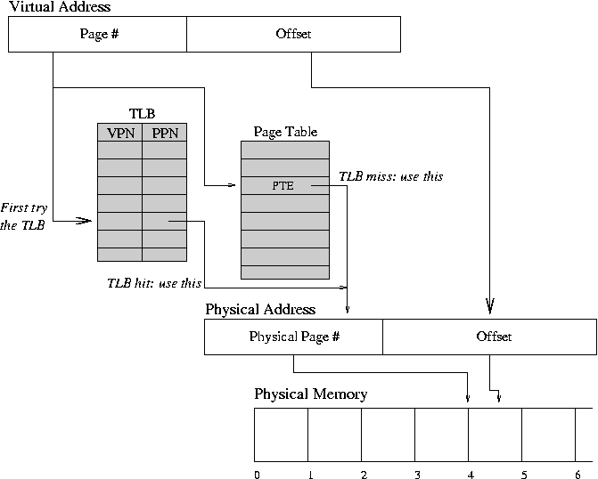
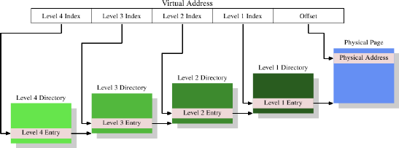
Speeding up paging…
Every memory reference needs a virtual-to-physical mapping
Each process has its own virtual address space (an own page table)
Large tables:
  32-bit addresses, 4 KB pages → 1.048.576 entries
  64-bit addresses, 4 KB pages → 4.503.599.627.370.496 entries
Translation lookaside buffers (aka associative memory)
  hardware "cache" for the page table
  a fixed number of slots containing
  the last page table entries
Page size:
larger page sizes reduce number of pages
Multi-level page tables
Notes:
VPN = virtual page number
PPN = physical page number

Slide 36
Speeding up paging…
For handouts
Every memory reference needs a virtual-to-physical mapping
Each process has its own virtual address space (an own table)
Large tables:
  32-bit addresses, 4 KB pages → 1.048.576 entries
  64-bit addresses, 4 KB pages → 4.503.599.627.370.496 entries
Translation lookaside buffers (aka associative memory)
  hardware "cache" for the page table
  a fixed number of slots containing the last page table entries
Page size:
larger page sizes reduce number of pages
Multi-level page tables

Slide 37
Many Design Issues
Replacement policies:
  Reference locality in time and space
  Local vs. global
  Algorithm complexity
Free block management: bitmaps vs. linked lists
Demand paging vs. pre-paging
Allocation policies: equal share vs. proportional share
…

Slide 38
Allocation Policies
Page fault frequency (PFF):
Usually, more page frames → fewer page faults
PFF is unacceptable high
→ process needs more memory
PFF:
page faults/sec
PFF might be too low
→ process may have too
much memory!!!??????
# page frames assigned
If the system experience too many page faults, what should we do?
Reduce number of processes competing for memory
  reassign a page frame
  swap one or more to disk, divide up pages they held
  reconsider degree of multiprogramming

Slide 39
Multi-level paging example:
32-bit (Pentium)

Slide 40
Paging on Pentium
The executing process has a 4 GB address space (2³²) –
viewed as 1M (2²⁰) 4 KB (2¹²) pages
  The 4 GB address space is divided into 1 K page groups
  (pointed to by the 1 level table – page directory)
  Each page group has 1 K 4 KB pages
  (pointed to by the 2 level tables – page tables)
Mass storage space is also divided into 4 KB blocks of information
Uses control registers for paging information

Slide 41
Control Registers used for Paging on Pentium
Control register 0 (CR0):
Control register 1 (CR1) – does not exist, returns only zero
Control register 2 (CR2)
  only used if CR0[PG]=1 & CR0[PE]=1
31 | 30 | 29 |  |  |  |  |  |  |  |  |  |  |  |  | 16 |  |  |  |  |  |  |  |  |  |  |  |  |  |  |  | 0
PG | CD | NW |  |  |  |  |  |  |  |  |  |  |  |  | WP |  |  |  |  |  |  |  |  |  |  |  |  |  |  |  | PE
Not-Write-Through and Cache Disable:
used to control internal cache
Write-Protect: If CR0[WP] = 1,
only OS may write to read-only pages
Paging Enable:
OS enables paging by setting CR0[PG] = 1
Protected Mode Enable: If CR0[PE] = 1,
the processor is in protected mode
31 |  |  |  |  |  |  |  |  |  |  |  |  |  |  |  |  |  |  |  |  |  |  |  |  |  |  |  |  |  |  | 0
Page Fault Linear Address

Slide 42
Control Registers used for Paging on Pentium
Control register 3 (CR3) – page directory base address:
  only used if CR0[PG]=1 & CR0[PE]=1
Control register 4 (CR4):
31 |  |  |  |  |  |  |  |  |  |  |  |  |  |  |  |  |  |  |  | 11 |  |  |  |  |  |  | 4 | 3 |  |  | 0
Page Directory Base Address |  |  |  |  |  |  |  |  |  |  |  |  |  |  |  |  |  |  |  |  |  |  |  |  |  |  | PCD | PWT
Page Cache Disable:
If CR3[PCD] = 1, caching is turned off
A 4KB-aligned physical base
address of the page directory
Page Write-Through:
If CR3[PWT] = 1, use write-through updates
31 |  |  |  |  |  |  |  |  |  |  |  |  |  |  |  |  |  |  |  |  |  |  |  |  |  |  | 4 |  |  |  | 0
 |  |  |  |  |  |  |  |  |  |  |  |  |  |  |  |  |  |  |  |  |  |  |  |  |  |  | PSE
Page Size Extension: If CR4[PSE] = 1,
the OS designer may designate some pages as 4 MB

Slide 43
Pentium Memory Lookup
Incoming virtual address (CR2)
(0x1802038, 20979768)
31 |  |  |  |  |  |  |  |  | 22 | 21 |  |  |  |  |  |  |  |  | 12 | 11 |  |  |  |  |  |  |  |  |  |  | 0
0 | 0 | 0 | 0 | 0 | 0 | 0 | 1 | 1 | 0 | 0 | 0 | 0 | 0 | 0 | 0 | 0 | 0 | 1 | 0 | 0 | 0 | 0 | 0 | 0 | 0 | 1 | 1 | 1 | 0 | 0 | 0
Page directory:
31 |  |  | 12 |  |  |  | 7 | 6 | 5 | 4 | 3 | 2 | 1 | 0
PT base address |  |  |  | ... |  |  | PS |  | A |  |  | U | W | P
physical base
address of the
page table
page
size
accessed
present
allowed to write
user access allowed

Slide 44
Pentium Memory Lookup
Incoming virtual address (CR2)
(0x1802038, 20979768)
31 |  |  |  |  |  |  |  |  | 22 | 21 |  |  |  |  |  |  |  |  | 12 | 11 |  |  |  |  |  |  |  |  |  |  | 0
0 | 0 | 0 | 0 | 0 | 0 | 0 | 1 | 1 | 0 | 0 | 0 | 0 | 0 | 0 | 0 | 0 | 0 | 1 | 0 | 0 | 0 | 0 | 0 | 0 | 0 | 1 | 1 | 1 | 0 | 0 | 0
Index to page directory
(0x6, 6)
31 |  |  | 12 |  |  |  | 7 | 6 | 5 | 4 | 3 | 2 | 1 | 0
0...01010101111 |  |  |  | ... |  |  |  |  |  |  |  |  |  | 1
Page table PF:
Save pointer to instruction
Move linear address to CR2
Generate a PF exception – jump to handler
Programmer reads CR2 address
Upper 10 CR2 bits identify needed PT
Page directory entry is really a mass
storage address
Allocate a new page – write back if dirty
Read page from storage device
Insert new PT base address into
page directory entry
Return and restore faulting instruction
Resume operation reading the same
page directory entry again – now P = 1
0...01111111000 | ... |  |  |  |  |  |  |  | 0
0...01110000111 | ... |  |  |  |  |  |  |  | 0
0...00001010101 | ... |  |  |  |  |  |  |  | 1
0...01111000101 | ... |  |  |  |  |  |  |  | 0
0...00000000100 | ... |  |  |  |  |  |  |  | 0
......
CR3:
Page Directory Base Address

Slide 45
Pentium Memory Lookup
Incoming virtual address (CR2)
(0x1802038, 20979768)
Page frame PF:
Save pointer to instruction
Move linear address to CR2
Generate a PF exception – jump to handler
Programmer reads CR2 address
Upper 10 CR2 bits identify needed PT
Use middle 10 CR2 bit to determine entry
in PT – holds a mass storage address
Allocate a new page – write back if dirty
Read page from storage device
Insert new page frame base address into
page table entry
Return and restore faulting instruction
Resume operation reading the same
page directory entry and page table entry
again – both now P = 1
31 |  |  |  |  |  |  |  |  | 22 | 21 |  |  |  |  |  |  |  |  | 12 | 11 |  |  |  |  |  |  |  |  |  |  | 0
0 | 0 | 0 | 0 | 0 | 0 | 0 | 1 | 1 | 0 | 0 | 0 | 0 | 0 | 0 | 0 | 0 | 0 | 1 | 0 | 0 | 0 | 0 | 0 | 0 | 0 | 1 | 1 | 1 | 0 | 0 | 0
Index to page directory
(0x6, 6)
Index to page table
(0x2, 2)
31 |  |  | 12 |  |  |  | 7 | 6 | 5 | 4 | 3 | 2 | 1 | 0
0...01010101111 |  |  |  | ... |  |  |  |  |  |  |  |  |  | 1
0...01111111000 | ... |  |  |  |  |  |  |  | 0
0...01110000111 | ... |  |  |  |  |  |  |  | 0
0...00001010101 | ... |  |  |  |  |  |  |  | 1
0...01111000101 | ... |  |  |  |  |  |  |  | 0
0...00000000100 | ... |  |  |  |  |  |  |  | 1
......
Page table:
CR3:
31 |  |  | 12 |  |  |  | 7 | 6 | 5 | 4 | 3 | 2 | 1 | 0
0...01010101111 |  |  |  | ... |  |  |  |  |  |  |  |  |  | 1
0...01010100000 |  |  |  |  |  |  |  |  |  |  |  |  |  | 0
0...01100110011 |  |  |  |  |  |  |  |  |  |  |  |  |  | 1
0...00010000100 |  |  |  |  |  |  |  |  |  |  |  |  |  | 1
......
Page Directory Base Address

Slide 46
Pentium Memory Lookup
Incoming virtual address (CR2)
(0x1802038, 20979768)
31 |  |  |  |  |  |  |  |  | 22 | 21 |  |  |  |  |  |  |  |  | 12 | 11 |  |  |  |  |  |  |  |  |  |  | 0
0 | 0 | 0 | 0 | 0 | 0 | 0 | 1 | 1 | 0 | 0 | 0 | 0 | 0 | 0 | 0 | 0 | 0 | 1 | 0 | 0 | 0 | 0 | 0 | 0 | 0 | 1 | 1 | 1 | 0 | 0 | 0
Index to page directory
(0x6, 6)
Index to page table
(0x2, 2)
Page:
31 |  |  | 12 |  |  |  | 7 | 6 | 5 | 4 | 3 | 2 | 1 | 0
0...01010101111 |  |  |  | ... |  |  |  |  |  |  |  |  |  | 1
Page offset
(0x38, 56)
0...01111111000 | ... |  |  |  |  |  |  |  | 0
0...01110000111 | ... |  |  |  |  |  |  |  | 0
0...00001010101 | ... |  |  |  |  |  |  |  | 1
0...01111000101 | ... |  |  |  |  |  |  |  | 0
0...00000000100 | ... |  |  |  |  |  |  |  | 1
......
requested data
CR3:
31 |  |  | 12 |  |  |  | 7 | 6 | 5 | 4 | 3 | 2 | 1 | 0
0...01010101111 |  |  |  | ... |  |  |  |  |  |  |  |  |  | 1
0...01010100000 |  |  |  |  |  |  |  |  |  |  |  |  |  | 1
0...01100110011 |  |  |  |  |  |  |  |  |  |  |  |  |  | 1
0...00010000100 |  |  |  |  |  |  |  |  |  |  |  |  |  | 1
......
Page Directory Base Address

Slide 47
Pentium Page Fault Causes
Page directory entry’s P-bit = 0:
page group’s directory (page table) not in memory
Page table entry’s P-bit = 0:
requested page not in memory
Attempt to write to a read-only page
Insufficient page-level privilege to access page table or frame
One of the reserved bits are set in the page directory or
table entry

Slide 48
32-bit (protected/compatibility mode) vs. 64-bit (long mode)
Virtual address space could in theory be 64-bit (16 EB)
Processors allow addressing of only a portion of that
Most common processor implementations allow 48-bit (256 TB)
An address is now 8 bytes (64-bit)
Each 4-KB page can hold 2⁹ (vs. 2¹⁰ for 32-bit),
need 9 bit index for each level
Virtual address:
63-48 | 47-39 | 38-30 | 29-21 | 20-12 | 11-0
unused | page map level 4 | page directory pointer index | page directory index | page table index | page offset

Slide 49
Summary
Memory management is concerned with managing the systems’ memory resources
  allocating space to processes
  protecting the memory regions
  in the real world
    programs are loaded dynamically
    physical addresses are not known to program – dynamic address translation
    program size at run-time is not known to kernel
Each process usually has text, data and stack segments
Systems like Windows and Unix use virtual memory with paging
Many issues when designing a memory component

