Slide 1
BibApp
A library application for the students
Android application
Participatory design
Search for available syllabus
Social features

Slide 2
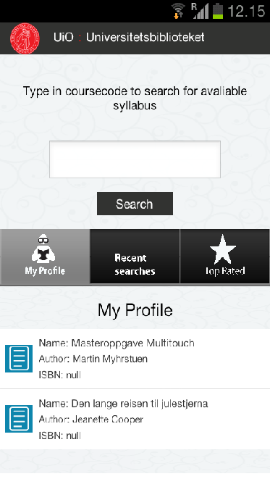
Page 1

Slide 3
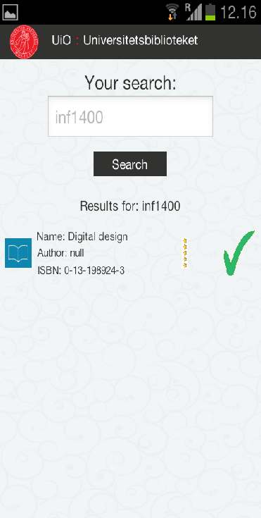
Page 2

Slide 4
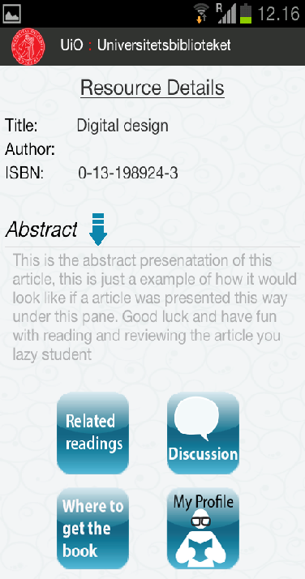
Page 3

