Slide 1
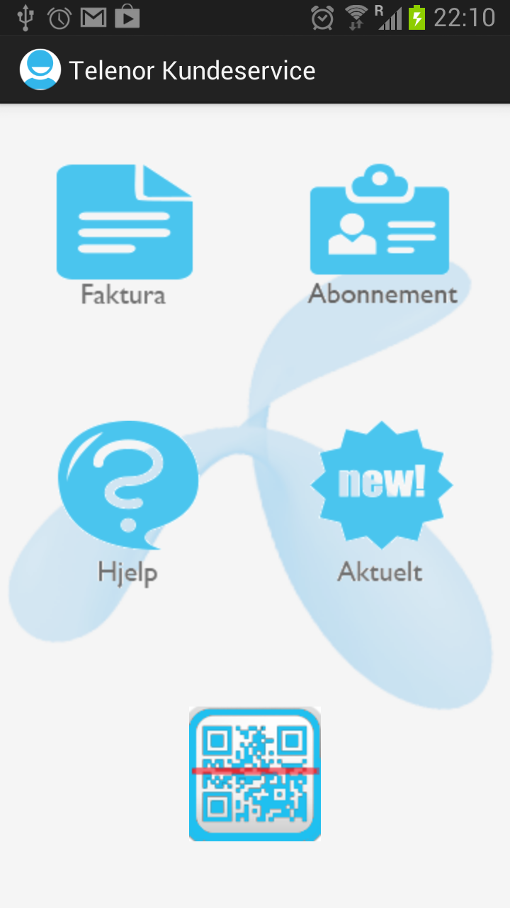
InTouch
Customer
Service

Slide 2
About our project:
- Android-based mobile application
- Major focus on customer
- "Simple and elegant" principle
- New innovative functions as:
- QR-code scanner for paying invoices
- "Analyze expenses" function

Slide 3
InTouch in action:
Attention to the screen please...

Slide 4
Final results:
- "Akkurat det man trenger og ikke noe mer"
- "Analyze expenses" function is highly appreciated by users
- QR-code functionality is difficult to implement being a group of students
- Still room for improvement and further development

