Slide 1
INF3110 Group 2
Exam 2013 solutions and hints

Slide 2
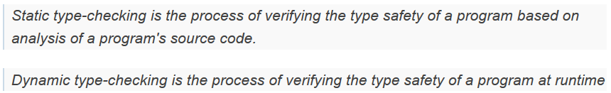
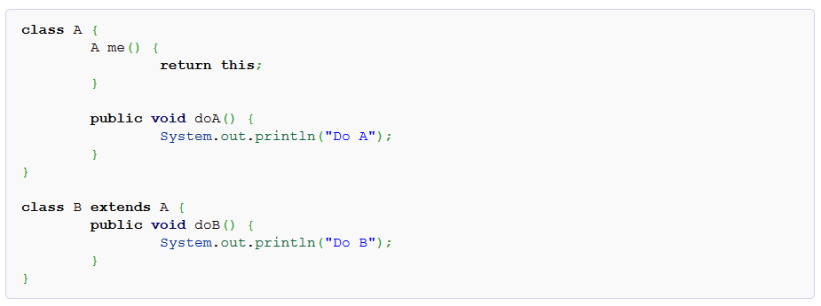
But first, an example of compile-time and run-time type checking
Are there any potential problems with this?
So, static is compile-time and dynamic is run-time. In this example (Java)
will try to figure out the types of all «elements», in an effort to prevent bad
things from happening.
Since the compiler thinks it’s an A object,
and B extends A, inheriting methods, this
line is legal: new B().me().doA();
Imagine we have the following code.
What would be returned by «new B().me()»?
An A object? A B object?
But it’s actually a B object, so:
new B().me().doB(); should be legal too?
But it’s not. The compiler can’t figure
out that this should be legal. So we have
to cast the object to a B object:
((B) new B().me().doB();
The compiler then «trusts» the programmer
and lets it pass without it being able to verify
that is actually is ok.
The compiler only «sees» an A object being returned,
but the object is actually a B object.
Full example can be found at http://www.programcreek.com/2011/12/an-example-of-java-static-type-checking/

Slide 3
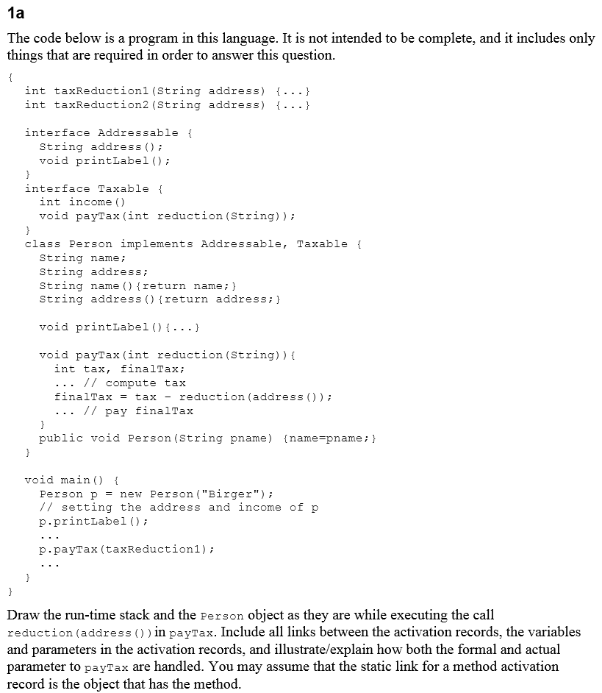
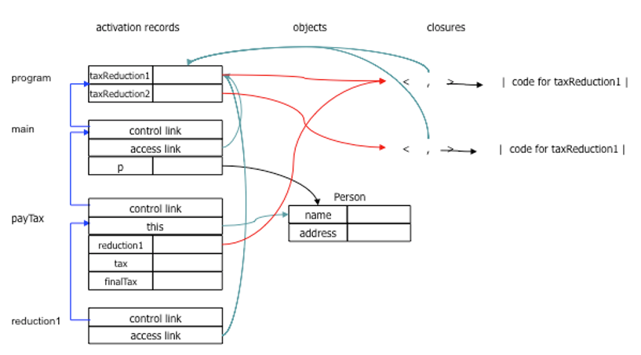
So we’re to draw the run-time stack
while executing reduction(address())
Yes, we did this exact exercise a couple of weeks ago
So, how do we start?

Slide 4
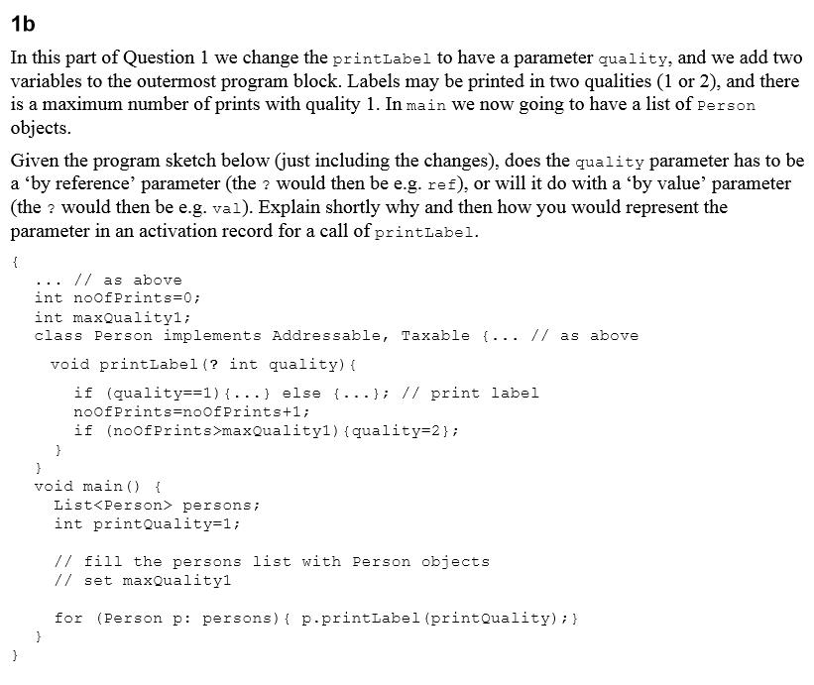
So, we want to figure out
if quality should be called
with value or by reference

Slide 5
So, we want to figure out
if quality should be called
with value or by reference
What would the different effects be?
So in conclusion?
By reference so the printLabel
method has access to change
the value in printQuality

Slide 6
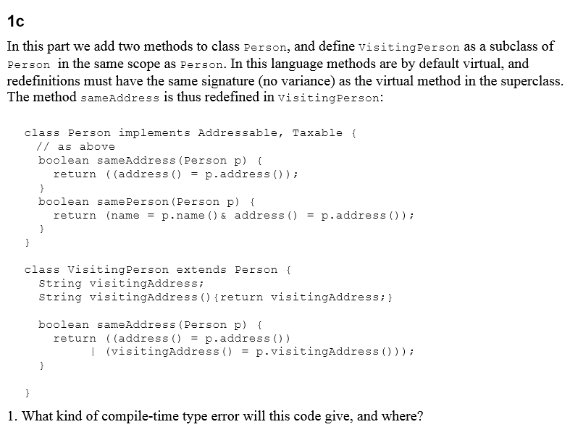
A person does not define a «visitingAddress» method
Can avoid the type error by casting p to VisitingPerson
But is this actually safe? Why or why not?

Slide 7
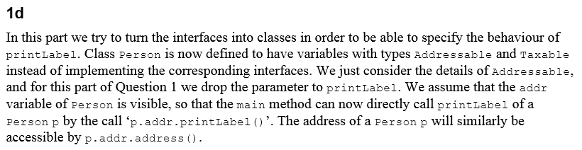
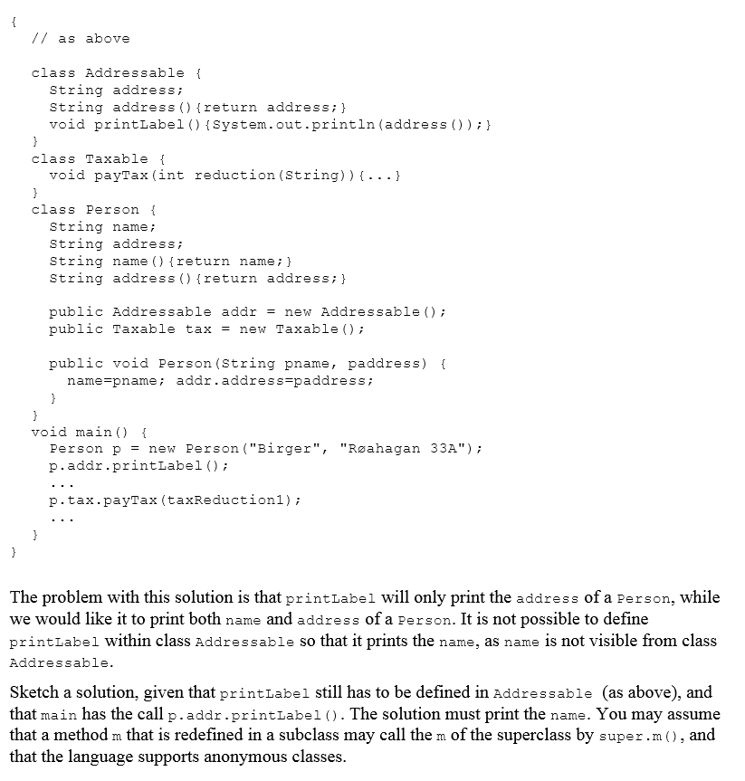
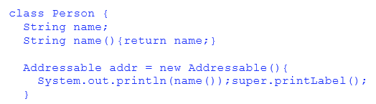
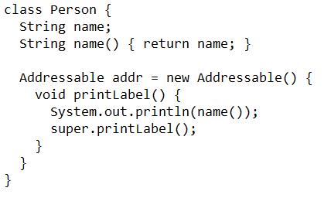
So, we want to print the name
as well when calling upon printLabel.
At the same time we wish to preserve
the call, so it should still be p.addr.printLabel();
The given hints here are what you may assume.
So we have calls to superclasses using super.x()
and we have support for anonymous classes.
The solution given is this, but someone more awake
than me pointed me to a problem with this solution
So this would probably make more sense
If you get something similar and
you are completly stuck, work
around the problem. It’s better
to solve the problem is a «bad»
way than do nothing. Any ideas
on how to work around this problem?

Slide 8
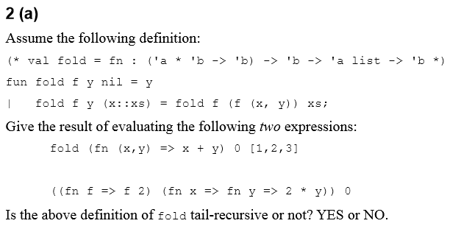
So, we’re started of nice and easy
once again.
What does fold actually do?
So fold is a curried function, recurses
over a list, producing a value passed
on as ‘y’ by calling a given function
on the first element and the ‘y’ given.
So the first result is (((0+1)+2)+3) = 6
The second expression is to mess with
your heads. But ok, what is happening?
So inside the paranthesis, we have an
anonymous function that takes a function
as a parameter and calls that function with
the number 2. The function it’s given, returns
a new anonymous function that takes a
parameter y, and calculates 2 * y. I’ll have to
draw this to make it into something more
sensible probably.
So the result of the second is 2 * 0 = 0

Slide 9
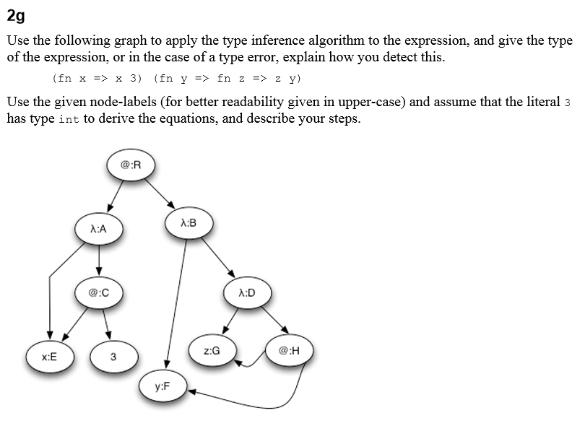
The b, c, d, e and f excersises are quite advanced, with a LOT of text and they
are also quite tied together. To be able to go through the rest of the exam, I’ve
decided to skip them. But they are a great way to challenge yourself when
studing for the final exam, so highly recommended to try and understand them.
Let’s do something scary and do it together, live.
If you want the steps, you can find them on the
solutions for 2013 in the course page for 2014.

Slide 10
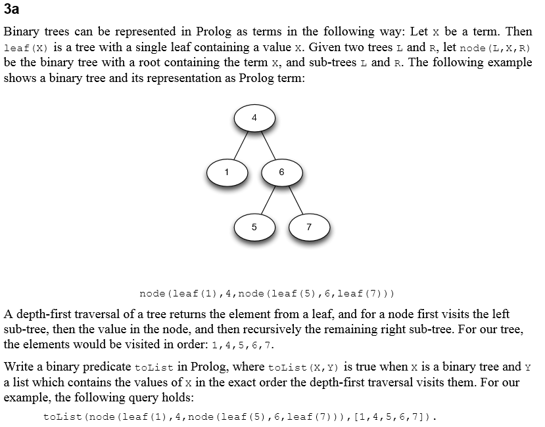

So we want a predicate to convert
a tree into a depth-first traversed list
and we’re given a hint saying we can
use the predicate append/3.
So how should we solve problems like this?
Let’s start with the base case, what is the
base case in this scenario?
So, having gotten the base case, what
needs to happen in the other nodes?

Slide 11
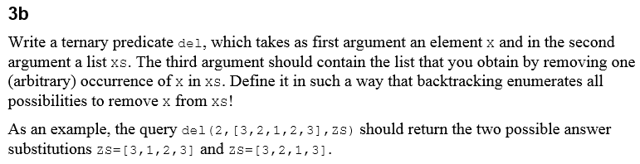
Ok, we want to be able to remove ONE instance of a given value from a list.
We should get multiple «hits» if the variable occurs multiple times in the list.
So, let’s once again start with the base case. When do we want to «stop»?
For the non base case, when do we want to continue then?
And that’s it, but…
… considering we are using recursion,
why can’t we have a base case something like: ‘del(_, [], []).’ ?

Slide 12
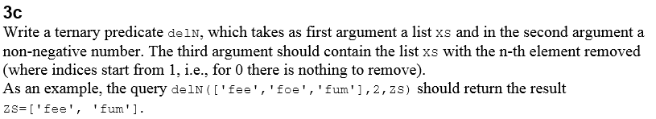

So, for the last excersise we want to remove a given index in a list.
They provide us a couple of hints, like if we get 0 as index, we shouldn’t remove anything,
so maybe we need multiple base cases this time?
So what would the base case(s) be?
So what do we want to do if none of the base cases are true?
Remember that we have to «force» prolog to calculate values.
Yes, there is a paranthesis and a . missing in the solution ;)

Slide 13
Thanks for coming to the group lectures. I’ve learned a lot from all
of you and have enjoyed spending this time with you.
I hope you have learned something from these sessions, and
wish you all the best of luck for the exam.
Oh, and btw, I found the exam given last year, send me a mail at
runejen@ifi.uio.no if you want me to send it to you. I can’t promise
it’s relevant, and I also can’t provide a solution, but you can take
a look if you want.

