Slide 1


INF3110: Mandatory 1 and Exercises Part 1
Comments and Solutions

Slide 2

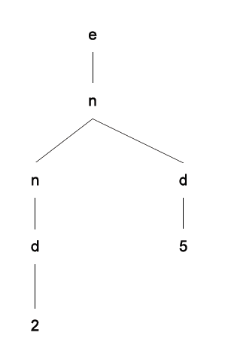
Problem 1
4.1 Draw the parse tree for the derivation of the expression 25 given in Subsection 4.1.2. Is there another derivation for 25? Is there another parse tree?
Grammar:
Derivation: e → n → nd → dd → 2d → 25
Another derivation: e → n → nd → n5 → d5 → 25
Notes:
Answer: new derivation, but same parse tree
A sequence of replacement steps resulting in a string of terminals is called a derivation
The nonterminnals are symbols that are used to write out the grammar, and the terminals are symbols that appear in the language generated by grammar.
For above, e is the start symbol. Symbols e, n, and d are nonterminals. Non

Slide 3
Problem 1
4.2 Draw parse trees for the following expressions, assuming the grammar and precedence described in Example 4.2:
  1 - 1 * 1
  1 – 1 + 1
  1 – 1 + 1 – 1 + 1 , if we give + higher precedence than -
  The corresponding grammar:
  e ::= 0| 1| e+e | e-e | e*e
  Precedence , highest to lowest :
  *, - , +

Slide 4
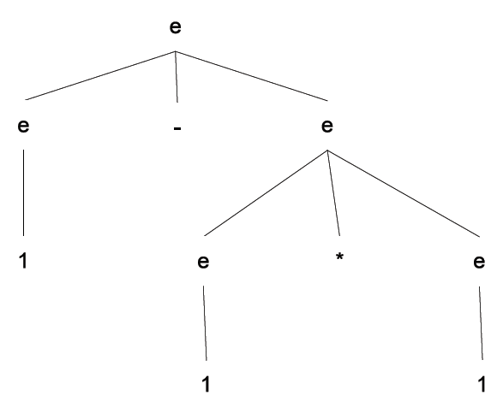
Problem 1
  1 - 1 * 1
  The corresponding grammar:
  e ::= 0| 1| e+e | e-e | e*e

Slide 5
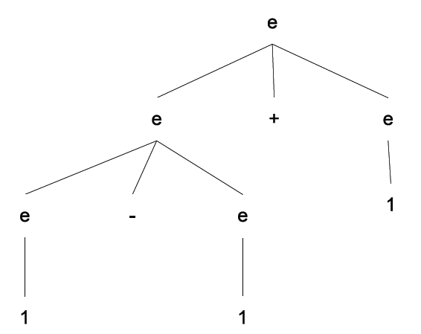
Problem 1
  The corresponding grammar:
  e ::= 0| 1| e+e | e-e | e*e
  b) 1 – 1 + 1

Slide 6
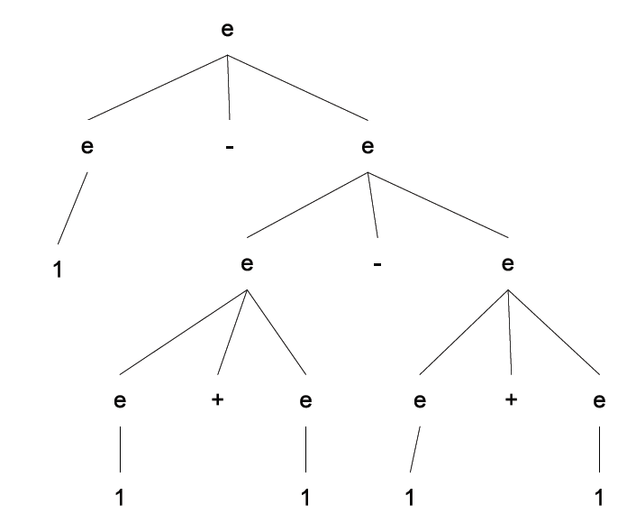
Problem 1
  c) 1 – 1 + 1 – 1 + 1 , if we give + higher precedence than -
  The corresponding grammar:
  e ::= 0| 1| e+e | e-e | e*e

Slide 7
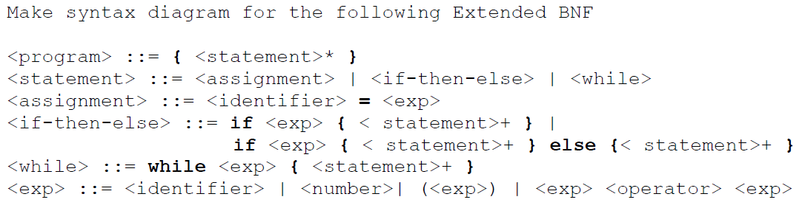
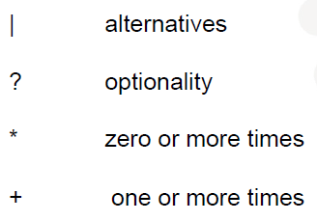
Problem 2
Notes:
In computer science, BNF (Backus Normal Form or Backus–Naur Form) is one of the two ^{[1]} main notation techniques for context-free grammars, often used to describe the syntax of languages used in computing, such as computer programming languages, document formats, instruction sets and communication protocol; the other main technique for writing context-free grammars is the van Wijngaarden form. They are applied wherever exact descriptions of languages are needed: for instance, in official language specifications, in manuals, and in textbooks on programming language theory.

Slide 8

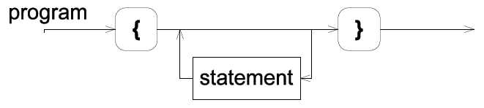
Problem 2
Notes:
:: is the metasymbol
{} curly brackets or braces 大括号

Slide 10

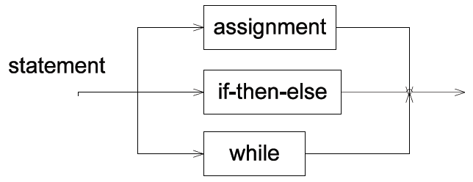
Problem 2

Slide 11
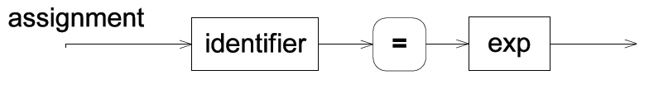
Problem 2

Slide 12

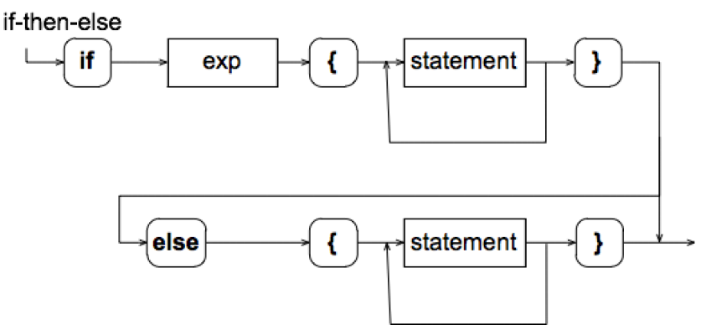
Problem 2

Slide 13
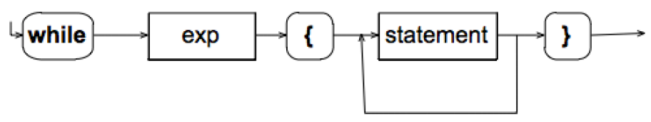
Problem 2

Slide 14
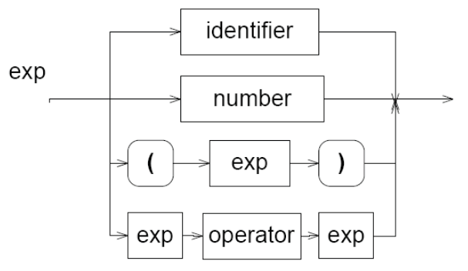
Problem 2

Slide 15
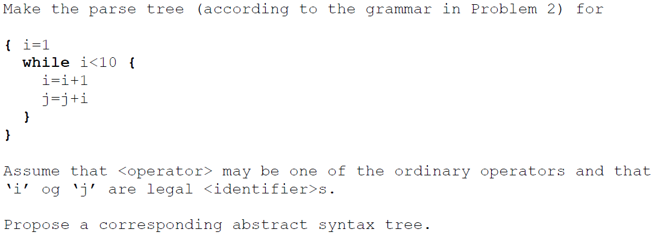
Problem 3

Slide 16
Difference between Parse Tree and Abstract Syntax Tree
A parse tree is a concrete syntax tree.
The parse tree contains all the artifacts (parenthesis, brackets, etc.) from the original document you parse
An AST describes the source code conceptually
  doesn't need to contain all the syntactical elements required to parse (curly braces, keywords, parenthesis etc.).
  It only contains all 'useful' elements that will be used for further processing

Slide 17
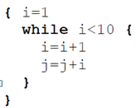
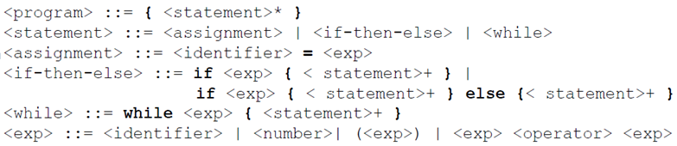
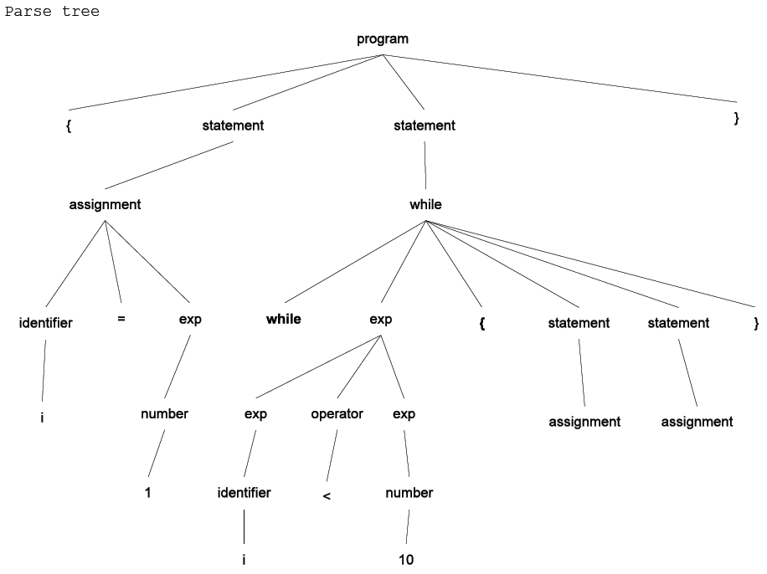
Notes:
学生问题：两个while有什么不同？

Slide 18
program
assignment
whileStmt
identifier
numberExp
boolExp
i
1
identifier
operator
numberExp
assignment
assignment
…
…
i
<
10
Notes:
Question to student:为什么while可以在这边没掉一个？而不是全没？

Slide 19
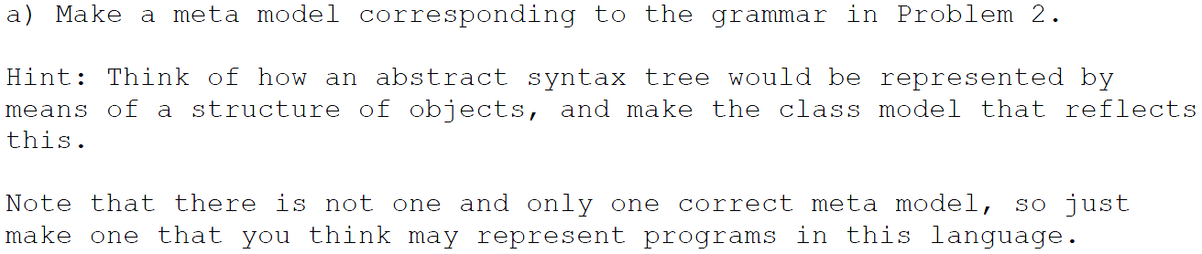
Problem 4

Slide 20
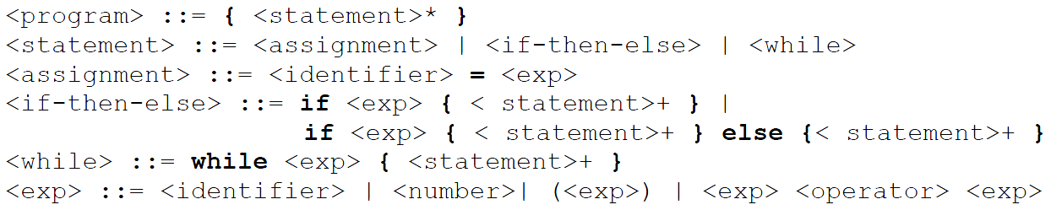
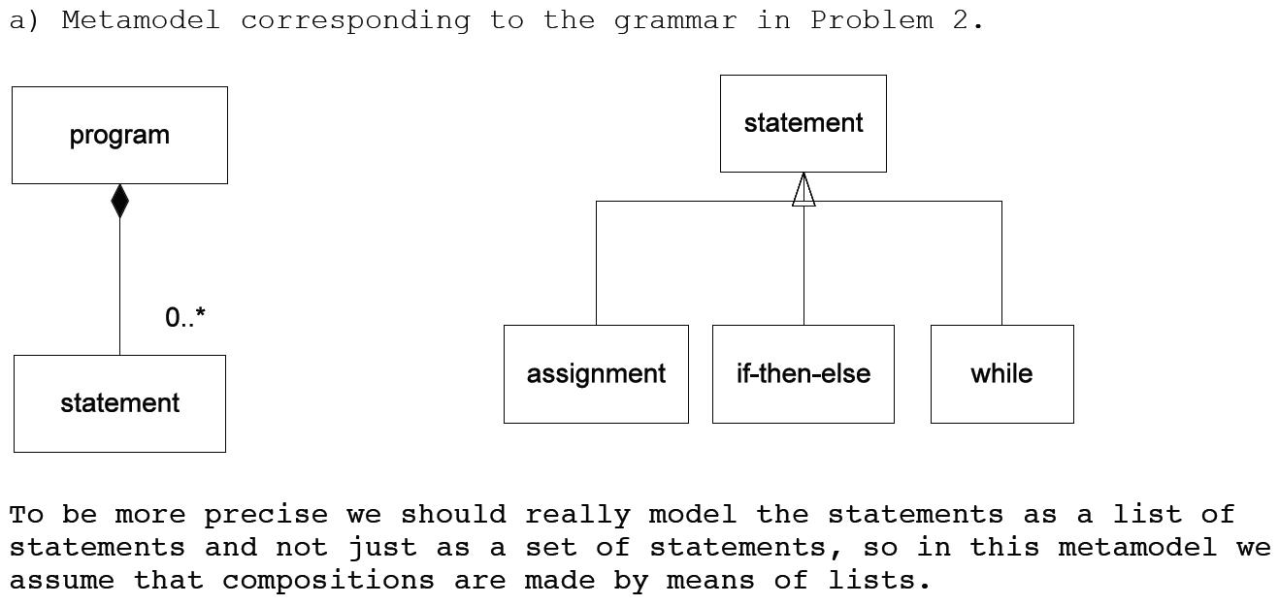


Generalization: “Is-a” relationship;
Composition: “Has-a” relationship
Notes:
Set: without order
List: with order
We need orders for the programm(顺序)

Slide 21
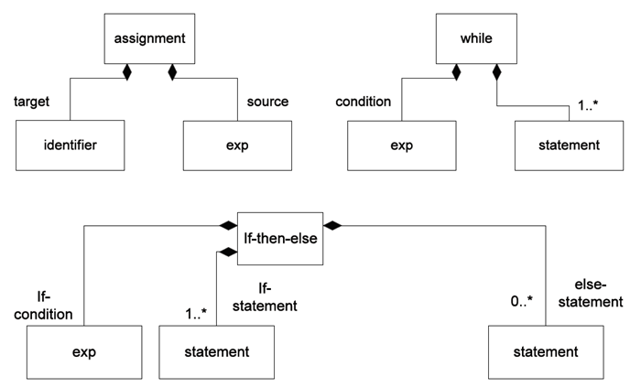

Slide 22
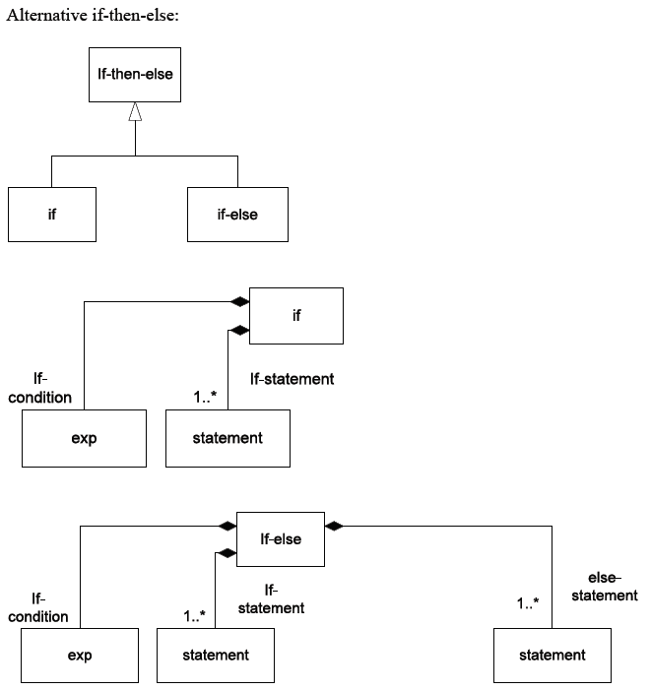

Slide 23
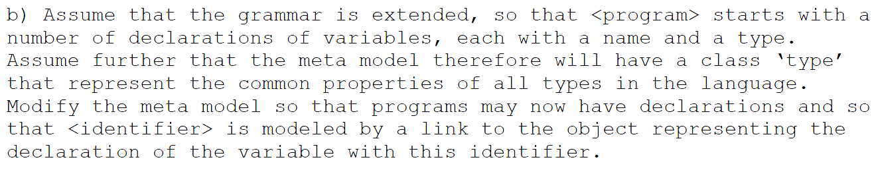
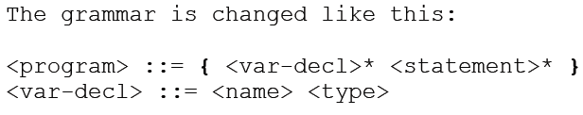
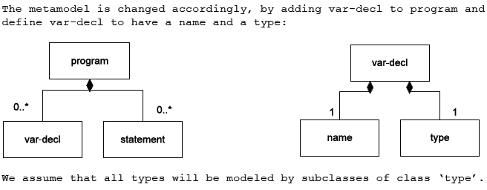
Problem 4

Slide 24
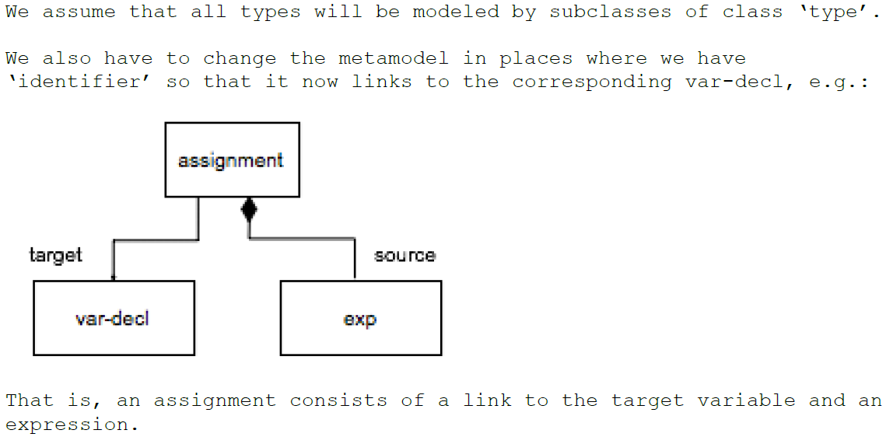

Slide 25
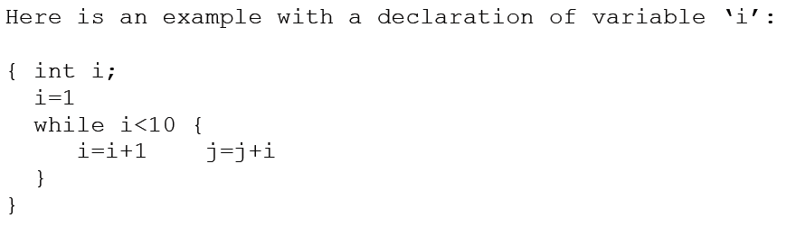
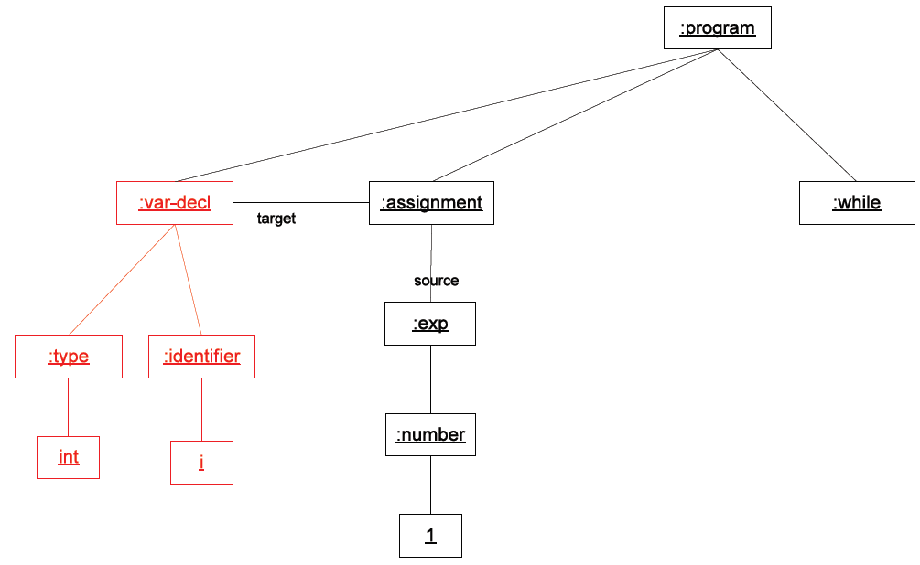

Slide 26
A sneak peak at the upcoming lecture : Types <3
Static typing
  Type checking is done at compile time
Dynamic typing
  Type checking is done at run-time
Languages?
Pros of static typing?
Cons?

Slide 27
Pros:
Gets rid of a lot of errors and bugs
Good and correct! documentation
Safer refactoring
Better tooling / IDE support because of better static analysis capabilities
If the type system is good enough, you can sometimes reduce a lot of boilerplate
Compiler optimization => faster code
Cons:
Simple type systems reduces expressiveness and needs a lot of boilerplate
Expressive type systems can be hard to learn
Can lead to more verbose code (at least without type inference)
There are a lot of bugs that the type checker does not find
Possibly slow compilation

Slide 28
«Fun» extra reading
Let’s stop copying C
https://eev.ee/blog/2016/12/01/lets-stop-copying-c/
An interesting blog post that compares the syntax and other aspects of a lot of programming languages

Slide 29
Kahoot
A short kahoot : ~5 minutes
https://play.kahoot.it/#/k/9aefdb6c-f715-430e-b807-1d04f05eac7c

