Slide 1
Intel IA32 OS Support
-Refresh
Tore Larsen

Slide 2
We need to …
Allow OS to control system
Allow OS to interact with I/O
Allow other parts to request OS services
Protect OS from other parts of system
Protect user processes from each other
Protect I/O devices from access by other parts
Key resources
  CPU, Memory, I/O devices

Slide 3
Areas of OS Support
Memory management
Protection of SW modules
Multitasking
Exception & interrupt handling
Multiprocessing
Cache management
Hardware resource & power management
Debugging, performance monitoring

Slide 4
Fundamental Concepts
Privilege levels
HW-level exceptional control flow
  Interrupts
  Traps

Slide 5
Privilege Levels
An fundamental concept for protection
Intel offers four levels of privilege (0—3), at any instant in time, the processor is logically at exactly one level
Many OS’es use only the highest (0), and the lowest (3) levels
  Classic UNIX position. Portability reasons
High privilege
  You can do anything
  Used for the OS kernel
Low privilege
  You can do less
  Used for application programs
  Used to protect other modules and the kernel from the application programs
Privilege levels are applied by other system mechanisms
How about privilege levels when executing more than one instruction at any time?

Slide 6
Protecting Instructions
Privileged instructions are legal only when processor is the corresponding privilege level
If the processor is not at a sufficiently high privilege level, the instruction faults, and the OS is invoked and notified that an illegal instruction was issued

Slide 7
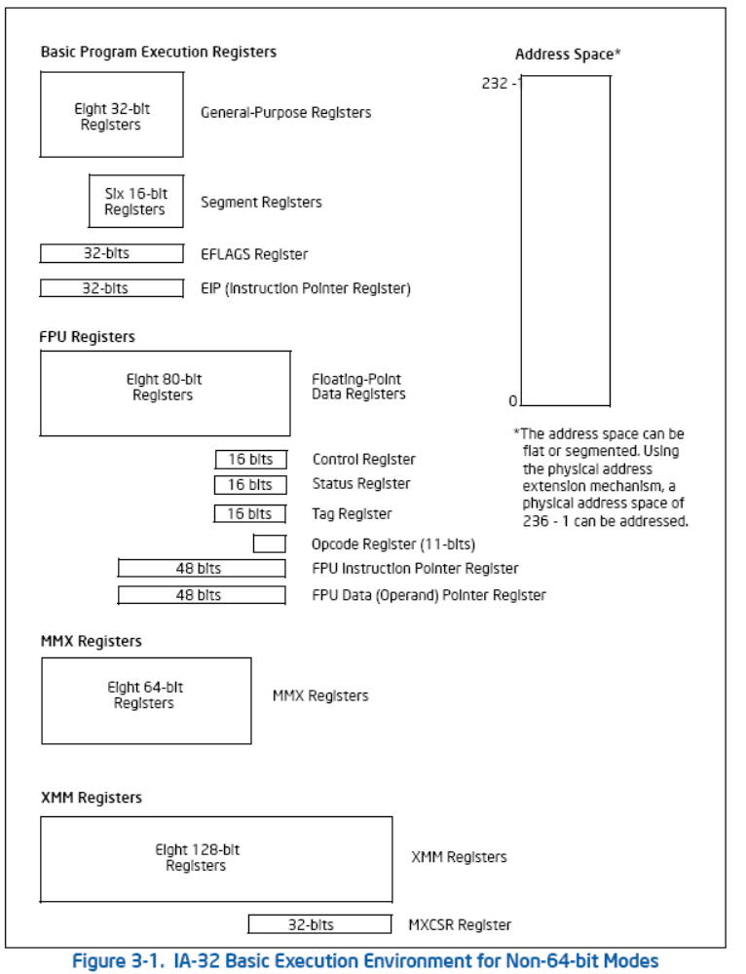

Slide 8
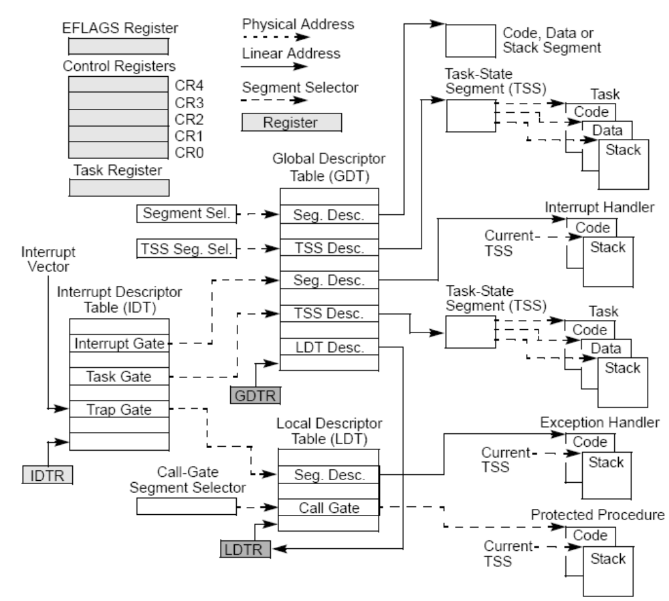

Slide 9
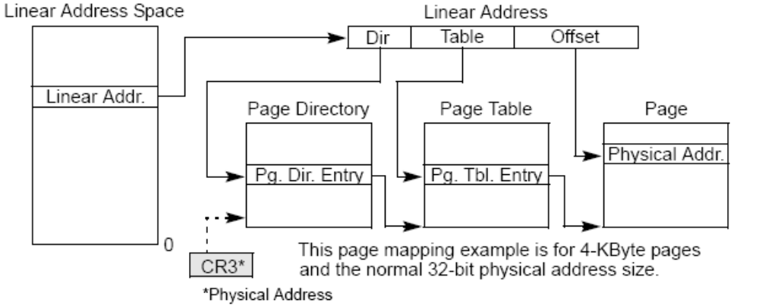
System Level Registers & Data Structures (ii)

Slide 10
Example Privileged Registers
  Flag register, EFLAG
    Processor state indicator bits
  Control registers
    CR0 System control flags
    CR2 Page fault linear address
    CR3 Page directory base
    CR4 Extensions
  Instruction pointer register, EIP

Slide 11
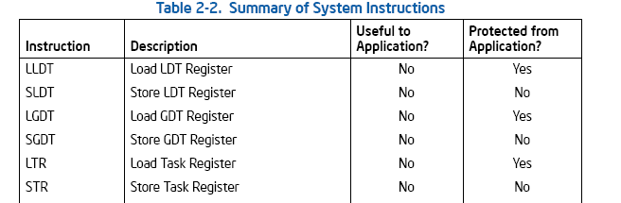
Example System Instructions

Slide 12
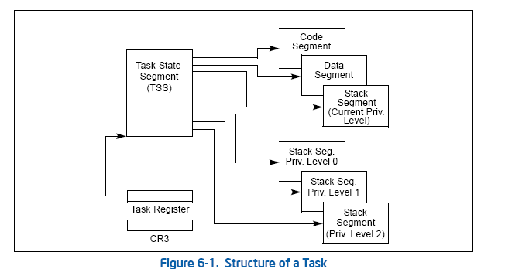
Tasks

Slide 13
Transferring Control Across Privilege Levels
Gates
  Call gates
  Trap gates
  Interrupt gates
  Task gates
Sysenter/sysexit

Slide 14
HW Level Exceptional Control Flow
(Intel Terminology)
Interrupt
  Asynchronous event, typically triggered by an I/O device
  Pending interrupts checked (and handled) before each instruction fetch
  Eventually resumes at next instruction
Exception
  Synchronous event, triggered by the processing of an instruction
Three classes of exceptions
  Trap
    Intentional. Resumes at next instruction
  Fault
    Error conditions that may be handled by handler. Re-executes faulting instruction if doable, otherwise makes sure faulting process is aborted
  Abort
    Unrecoverable, fatal error. Terminates process, …possibly also system
IA-32 supports precise interrupts
Notes:
Interrupts and exceptions are conceptually similar,
Interrupts happen at any time, asynchronous to the execution of instructions
The occurrence of an interrupt is registered as a “pending interrupt”
Before fetching the next instruction, the processor control section checks for pending interrupts
In effect, pending interrupts are ignored until the processor is ready to fetch a new instruction
Exceptions may occur at most phases of the instruction cycle; i.e.. Fetch, Decode, Execute, Memory, Write Back
Faults must be handled in ways that allow re-executing the faulting instruction when appropiate

Slide 15
Actions taken on interrupt/exception
Processor pushes status information (SS, EFLAGS register, CS (code segment register), and return address (EIP) onto stack
Pushes error code (if appropriate) onto stack
Service routine executed
Return from interrupt instruction restores state of interrupted process

Slide 16
Interrupt Description Table (IDT)
Used to locate appropriate service routine for each interrupt type
Used similarly for interrupts and exceptions
IDTR register specifies base address & length of IDT
Intel uses vectored interrupts. The vector is a number provided by the interrupting unit that identifies the interrupt type. The vector (scaled by eight) is used to index into the IDT
Each entry in IDT is an eight-byte descriptor which contains a segment selector for the handler’s code segment, an offset within the code segment, and access rights information

Slide 17
IDT entries
Max 256 entries
0—31: Architecture-defined, or reserved by Intel for future use
32—255: ”User defined,” i.e. OS-defined

Slide 18
Interrupt priorities
Simultaneous exceptions and interrupts are prioritized in eight classes
Highest class (1)
  Hardware reset, machine check
Lowest class (8)
  Faults on executing an instruction

Slide 19
Masking
IF- and RF-flags in the EFLAGS register may be used to inhibit the generation of some interrupts

Slide 20
Some interrupt handling instructions
LIDT
  Load IDTR register (32 bit) from memory. Privileged instruction (CPL = 0)
SIDT
  Store IDTR register (32 bit) to memory. Non-privileged instruction
INT
  Explicit call to any specific exception
INTO, INT 3, BOUND
  Allow SW exception checking. Respectively Overflow, Breakpoint, and Range
CLI, STI
  Clear/Set Interrupt Enable Flag
PUSHF, POPF
  Push/pop Flags on/off stack
IRET
  Return from interrupt

Slide 21
Virtual memory support
(Providing and Protecting Memory)
Segmentation and paging
Basic flat memory model
  Contiguous unsegmented address space
  Set up (at least) one code and one data segment that both map entire address space
Protected flat memory model
  As above except segment limits set to match physical memory present
Multi segment model
  Each process is given its own table of segment descriptors and its own segments
Works intimately with privilege level and access control
Let’s skip the grimy details for now

Slide 22
Virtual memory support ii
Segment registers contain segment selectors (14 bit)
Segment selectors index into one of two (GDT/LDT) descriptor tables, containing segment descriptors
Segment descriptors contain page directory base address and limit, ++

Slide 23
System Level Registers & Data Structures (ii)

Slide 24
Cache support
Cache policy set through CD and NW bits in CR3 (bits 4 and 3)
  Write back
  Write through
  Cache disabled
INVD, Invalidate internal caches
WBINVD, Write back, and invalidate internal caches

Slide 25
I/O support
See foils on I/O
Special instructions
Memory mapped I/O
Interrupts
Polling

Slide 26
Virtual Machine Extensions
Support for running several virtual machines concurrently on single physical processor
Virtual Machine Monitors (VMM)
Guest software
Important resurface of technology similar to IBM/VM
However, not a core issue on this course now

Slide 27
Multiprocessor support
Multiple processors
Single “hyperthreaded” processor
Single “multi-core” processor chip
Combinations of above
Some issues
  Distribution of tasks among processors
  Distribution of interrupts among processors
  Ensuring memory consistency and cache coherence

Slide 28
Literature
Randal E. Bryant and David O’Hallaron, Computer Systems: A Programmer’s Perspective, Prentice-Hall, 2003. Chapter Eight, pp. 585-648.
  http://csapp.cs.cmu.edu/
Intel® 64 and IA-32 Architectures Software Developer’s Manual, Volume 1: Basic Architecture
        http://www.intel.com/design/processor/manuals/253665.pdf
Intel® 64 and IA-32 Architectures Software Developer’s Manual Volume 3A: System Programming Guide, Part 1
        http://www.intel.com/design/processor/manuals/253668.pdf
Intel® 64 and IA-32 Architectures Software Developer’s Manual Volume 3B: System Programming Guide, Part 2
        http://www.intel.com/design/processor/manuals/253669.pdf

