Slide 1
Deadlocks
Tore Larsen
With slides from T. Plagemann, C. Griwodz, K. Li,
A. Tanenbaum and M. van Steen

Slide 2
Resources
Resource allocation is a central OS concern
Examples of computer resources
  CPU
  Memory
  Disk drive
  Tape drives
  Printers
  Plotter
  Loudspeaker

Slide 3
OS Resource allocation
Want to uphold some policies
  Effective use
  Fairness
  If possible, allow processes to complete
    Want to avoid deadlocks
Topics
  Modeling resource allocation
  Conditions for deadlocks
  Strategies to deal with deadlocks

Slide 4
Resources
Processes
  Need access to resources in reasonable order
Typical way to use a resource
  Request
  Use
  Release
Suppose a process holds resource A and requests resource B
  At same time another process holds B and requests A
  Both are blocked and remain so

Slide 5
Resources
Active resource
  Provides a service
  E.g. CPU, network adaptor
Passive resource
  System capabilities that are required by active resources
  E.g. memory, network bandwidth
Exclusive resource
  Only one process at a time can use it
  E.g. loudspeaker, processor
Shared resource
  Can be used by multiple processes
  E.g. memory, bandwidth

Slide 6
Resources
Single resource
  Exists only once in the system
  E.g. loudspeaker
Multiple resource
  Exists several time in the system
  E.g. processor in a multiprocessor system
Preemptable resource
  Resource that can be taken away from a process
  E.g. CPU can be taken away from processes in user space
Non-preemptable resource
  Taking it away will cause processes to fail
  E.g. Disk, files

Slide 7
Resources
Process must wait if request is denied
  Requesting process may be blocked
  May fail with error code
Deadlocks
  Occur only when
  processes are granted exclusive access to resources
acquire
block
use
acquire
use

Slide 8
Deadlocks
Formal definition :
A set of processes is deadlocked
if each process in the set is waiting for an event
that only another process in the set can cause
Usually the event is release of a currently held resource
None of the processes can …
  Run
  Release resources
  Be awakened
Notes:
Event - hendelse

Slide 9
Four Conditions for Deadlock
Mutual exclusion condition
  Each resource is either assigned to one process or it is available
Hold and wait condition
  Process holding resources may request more resources
No preemption condition
  Previously granted resources cannot be taken away by force
Circular wait condition
  Must be at least one circular chain involving two or more processes
  Each is waiting for resource held by next member of the chain
Notes:
Gjensidig utelukkelse
Hold og vent
Ingen

Slide 10
Deadlock Modeling
Modeled with directed graphs
A
S
C
T
R
B
U
D
  Resource R assigned to process A
  Process B is requesting/waiting for resource S
  Process C and D are in deadlock over resources T and U

Slide 11
Deadlock Example
A utility program
  Copies a file from a tape to disk
  Prints the file to a printer
Resources
  Tape
  Disk
  Printer
A deadlock
A
tape
disk
printer
B

Slide 12
Deadlock Modeling
How deadlock occurs
A
Requests R
Requests S
Releases S
Releases R
A requests R
B requests S
C requests T
A requests S
B requests T
C requests R
Processes
A
B
C
B
Requests S
Requests T
Releases T
Releases S
Resources
R
S
T
C
Requests T
Requests R
Releases R
Releases T

Slide 13
Deadlock Modeling
How deadlock can be avoided
A
Requests R
Requests S
Releases S
Releases R
A requests R
C requests T
A requests S
B requests S
B requests T
C requests R
A releases S
A releases R
C releases R
C releases T
Processes
A
B
C
B
Requests S
Requests T
Releases T
Releases S
Resources
R
S
T
C
Requests T
Requests R
Releases R
Releases T
Notes:
This example does not match the textbook (Fig. 6-4, pg. 440). The example is in error when illustrating how deadlock can be avoided.
Mismatch with textbook: The request-release ordering is nested for each process. This is not the case for the textbook.
Error in foils: B request S and should block. Instead it shown to continue and request T. This is not possible.

Slide 14
Deadlocks: Strategies
Ignore the problem
  It is user’s fault
Detection and recovery
  Fix the problem afterwards
Dynamic avoidance
  Careful allocation
Prevention
  Negate one of the four conditions
Notes:
Avoid – unngaa
Prevent - forhindre

Slide 15

The Ostrich Algorithm
Pretend there is no problem
Reasonable if
  Deadlocks occur very rarely
  Cost of prevention is high
UNIX and Windows take this approach
It is a trade-off between
  Convenience
  Correctness

Slide 16
Deadlock Detection and Recovery
One Resource of Each Type
R
A
B
C
S
D
T
E
F
U
V
W
G
A cycle can be found within the graph, denoting deadlock
Notes:
Frigjoere
tildele

Slide 17
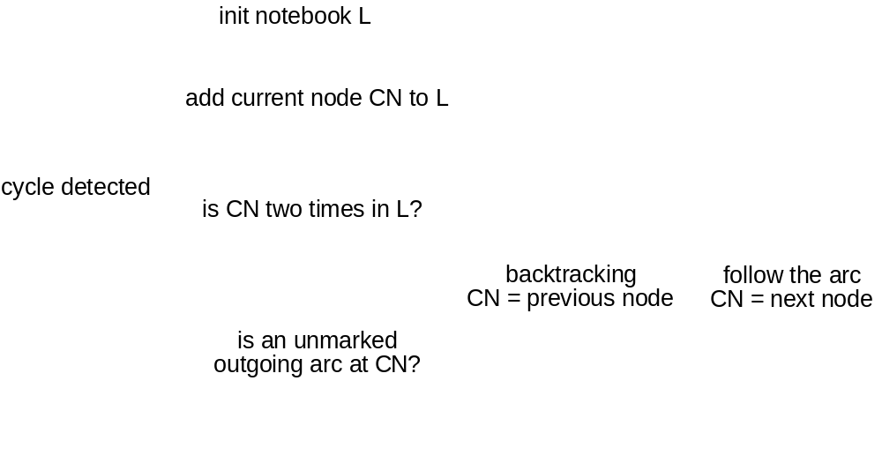
Deadlock Detection and Recovery
One Resource of Each Type, do for each node
Notes:
Flowchart not complete.
Left arrow out of first test is “Yes.” Down is “No.”
For second test, down arrow is “Yes,” right is “No.”
Attempt to backtrack out of first node is termination criteria when whole graph tested and no cycle detected.
Cy
Må terminere dersom det

Slide 18


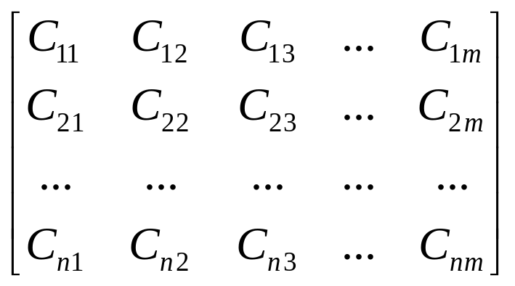
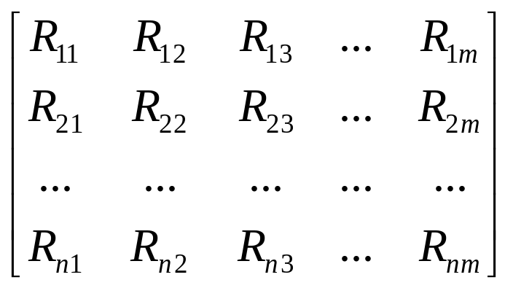
Deadlock Detection and Recovery
Multiple Resources of Each Type
Existing resources
Available resources
C - Current allocation matrix
R - Request matrix
Notes:
Look for processes that can run to completion, i.e. resource demand can be met by available resources

Slide 19
Deadlock Detection and Recovery
Multiple Resources of Each Type
Tape drivers
CD-Roms
Tape drivers
CD-Roms
Plotters
Scanners
Plotters
Scanners
E=(
4
2
3
1
)
A=(
2
1
0
0
)
Current allocation matrix
Request matrix
0
0
1
0
2
0
0
1
C=
2
0
0
1
R=
1
0
1
0
0
1
2
0
2
1
0
0
Notes:
P1 cannot run, there is no CD-Rom avalable
P2 cannot run, no scanner available
P3 can run, runs, returns it resources, A = (2,2,2,0)
P2 now can run, does returns everything, A = (4,2,2,1)
P1 now can run, no deadlock

Slide 20
Deadlock Detection and Recovery
Recovery
Recovery through preemption
  Take a resource from some other process
  Depends on nature of the resource
Recovery through rollback
  Checkpoint a process periodically
  Use this saved state
  Restart the process if it is found deadlocked
Recovery through killing processes
  Crudest but simplest way to break a deadlock
  Kill one of the processes in the deadlock cycle
  The other processes get its resources
  Choose process that can be rerun from the beginning

Slide 21
Deadlock Avoidance
Resource Trajectories
B
finished
release
Printer
release
Plotter
request
request
start
A
request
request
release
release
Two process
resource trajectories
Printer
Plotter

Slide 22
Deadlock Avoidance
Safe and Unsafe States, example 1
has
max
has
max
has
max
has
max
has
max
A
3
9
A
3
9
A
3
9
A
3
9
A
3
9
B
2
4
B
4
4
B
0
B
0
B
0
C
2
7
C
2
7
C
2
7
C
7
7
C
0
Free: 3
Free: 1
Free: 5
Free: 0
Free: 7
state is safe
Notes:
Run B to completion
Run C to completion
Run A to completion

Slide 23
Deadlock Avoidance
Safe and Unsafe States, example 2
has
max
has
max
has
max
has
max
A
3
9
A
4
9
A
4
9
A
3
9
B
2
4
B
2
4
B
4
4
B
0
C
2
7
C
2
7
C
2
7
C
2
7
Free: 3
Free: 2
Free: 0
Free: 4
state is safe here
but unsafe here
We goofed allocating one more to A!
Notes:
Run A, request and grant one more

Slide 24
Deadlock Avoidance
Banker’s Algorithm for a Single Resource
Each process has a credit
  System knows how many resources a process requests at most before releasing resources
Total resources may not satisfy all credits
Keep track of resources assigned and needed
Check on each allocation whether it is safe
  Safe: there exists a sequence of other states that all processes can terminate correctly

Slide 25
Deadlock Avoidance
Banker's Algorithm for a Single Resource
Resource allocation state
has
max
has
max
has
max
A
6
0
0
6
6
A
1
3
5
6
1
6
6
A
1
1
6
B
0
5
B
1
5
B
2
5
5
0
5
3
5
1
5
2
C
4
0
0
4
4
C
2
4
2
4
4
C
2
2
4
D
0
7
D
4
7
D
4
7
7
0
7
7
4
7
4
Free: 10
Free: 2
Free: 1
Free: 4
Free: 5
Free: 6
Free: 2
Safe
Unsafe

Slide 26
Deadlock Detection and Recovery
Banker’s Algorithm for Multiple Resources
Tape drivers
CD-Roms
Plotters
Scanners
E=(
6
3
4
2
)
P=(
5
3
2
2
)
Assigned resources
Resources still needed
A=(
1
0
2
0
)
A
3
0
1
1
A
1
1
0
0
B
0
1
0
0
B
0
1
1
2
C
1
1
1
0
C
3
1
0
0
D
1
1
0
1
D
0
0
1
0
E
0
0
0
0
E
2
1
1
0
An example for the deadlock
detection algorithm
Notes:
E: Existing resources
P: Possessed (!) resources, i.e. resources that are currently allocated (granted)
A: Available resources

Slide 27
Deadlock Detection and Recovery
Banker’s Algorithm for Multiple Resources
Tape drivers
CD-Roms
Plotters
Scanners
E=(
6
3
4
2
)
P=(
4
2
2
1
)
Assigned resources
Resources still needed
A=(
2
1
2
1
)
A
3
0
1
1
A
1
1
0
0
B
0
1
0
0
B
0
1
1
2
C
1
1
1
0
C
3
1
0
0
D
0
0
0
0
D
-
-
-
-
E
0
0
0
0
E
2
1
1
0
An example for the deadlock
detection algorithm

Slide 28
Deadlock Detection and Recovery
Banker’s Algorithm for Multiple Resources
Tape drivers
CD-Roms
Plotters
Scanners
E=(
6
3
4
2
)
P=(
1
2
1
0
)
Assigned resources
Resources still needed
A=(
5
1
3
2
)
A
0
0
0
0
A
-
-
-
-
B
0
1
0
0
B
0
1
1
2
C
1
1
1
0
C
3
1
0
0
D
0
0
0
0
D
-
-
-
-
E
0
0
0
0
E
2
1
1
0
An example for the deadlock
detection algorithm

Slide 29
Deadlock Detection and Recovery
Banker’s Algorithm for Multiple Resources
Tape drivers
CD-Roms
Plotters
Scanners
E=(
6
3
4
2
)
P=(
1
1
1
0
)
Assigned resources
Resources still needed
A=(
5
2
3
2
)
A
0
0
0
0
A
-
-
-
-
B
0
0
0
0
B
-
-
-
-
C
1
1
1
0
C
3
1
0
0
D
0
0
0
0
D
-
-
-
-
E
0
0
0
0
E
2
1
1
0
An example for the deadlock
detection algorithm

Slide 30
Deadlock Detection and Recovery
Banker’s Algorithm for Multiple Resources
Tape drivers
CD-Roms
Plotters
Scanners
E=(
6
3
4
2
)
P=(
0
0
0
0
)
Assigned resources
Resources still needed
A=(
6
3
4
2
)
A
0
0
0
0
A
-
-
-
-
B
0
0
0
0
B
-
-
-
-
C
0
0
0
0
C
-
-
-
-
D
0
0
0
0
D
-
-
-
-
E
0
0
0
0
E
2
1
1
0
An example for the deadlock
detection algorithm

Slide 31
Deadlock Detection and Recovery
Banker’s Algorithm for Multiple Resources
Tape drivers
CD-Roms
Plotters
Scanners
SAFE
E=(
6
3
4
2
)
P=(
5
3
2
2
)
Assigned resources
Resources still needed
A=(
1
0
2
0
)
A
3
0
1
1
A
1
1
0
0
B
0
1
0
0
B
0
1
1
2
C
1
1
1
0
C
3
1
0
0
D
1
1
0
1
D
0
0
1
0
E
0
0
0
0
E
2
1
1
0
An example for the deadlock
detection algorithm

Slide 32
Deadlock Avoidance
Practical Avoidance
Two Phase Locking
  Phase I
    Process tries to lock all resources it needs, one at a time
    If needed resources found locked, release everything and start over
    (no real work done in phase one)
  Phase II
    Run
    Releasing locks
Note similarity to requesting all resources at once
Algorithm works where programmer can arrange

Slide 33
Deadlock Prevention
R: Conditions for Deadlock
Mutual exclusion condition
  Each resource assigned to 1 process or is available
Hold and wait condition
  Process holding resources can request additional
No preemption condition
  Previously granted resources cannot forcibly taken away
Circular wait condition
  Must be a circular chain of 2 or more processes
  Each is waiting for resource held by next member of the chain

Slide 34
Deadlock Prevention
Mutual Exclusion Condition
Some resources are not sharable
  Printer, tape, etc
Some resources can be made sharable
Some resources can be made virtual
  Spooling - Printer
    Does spooling apply to all non-sharable resources?
  Mixing - Soundcard
Principle:
  Avoid assigning resource when not absolutely necessary
  A few processes as possible actually claim the resource

Slide 35
Deadlock Prevention
Hold and Wait Condition
Require processes to request resources before starting
  A process never has to wait for what it needs
  Telephone companies do this
Problems
  May not know required resources at start of run
  Also ties up resources other processes could be using
Variation:
  Process must give up all resources
  Then request all immediately needed

Slide 36
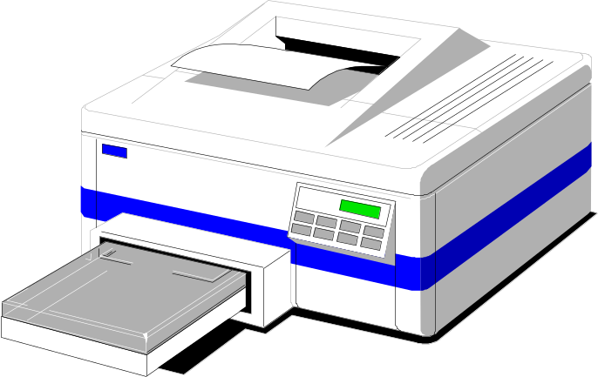
Deadlock Prevention
No Preemption Condition
This is not a viable option
Consider a process given the printer
  Halfway through its job
  No forcibly take away printer
  !!??

Slide 37
Deadlock Prevention
Circular Wait Condition
A
CD Rom drive
Tape drive
Plotter
Scanner
Imagesetter
1
2
3
4
5
Normally ordered resources
A resource graph

Slide 38
Deadlock Prevention
Circular Wait Condition
Impose an order of requests for all resources
Method
  Assign a unique id to each resource
  All resource requests must be in an ascending order of the ids
  Release resources in a descending order
Can you prove this method has no circular wait?
Is this generally feasible?

Slide 39
Deadlock Prevention
Overview
Condition | Approach
Mutual exclusion | Spool everything
Hold and wait | Request all resource initially
No preemption | Take resources away
Circular wait | Order resources numerically

Slide 40
Which is your favorite?
Ignore the problem
  It’s the user’s fault
Detection and recovery
  Fix the problem afterwards
Dynamic avoidance
  Careful allocation
Prevention (Negate one of four conditions)
  Avoid mutual exclusion
  Avoid hold and wait
  No preemption
  No circular wait

Slide 41
Tradeoffs and applications
Ignore the problem for applications
  I’s the application developer’s job to deal with their deadlocks
  OS provides mechanism to break application’s deadlocks
Kernel should not have any deadlocks
  Use prevention
  Most popular is preventing circular wait

Slide 42
Non-resource Deadlocks
Possible for two processes to deadlock
  Each is waiting for the other to do some task
Can happen with semaphores
  Each process required to do a down() on two semaphores (mutex and another)
  If done in wrong order, deadlock results

Slide 43
Preempting Scheduler Activations
Scheduler activations are completely preemptable
User
space
Kernel
space

Slide 44
Preempting Scheduler Activations
Maintaining the run queue needs to be a protected critical section
Let’s use spin locks for protection
Thread 1
Upcall
Acquire spin lock
Start queue maintenance
Interrupt Thread 1
Acquire spin lock -> block

Slide 45
Preempting Scheduler Activations
So how do they handle this deadlock?
Thread 1
Upcall
Acquire spin lock
Start queue maintenance
Interrupt Thread 1
Acquire spin lock -> block

Slide 46
Preempting Scheduler Activations
Detection and recovery (like in Mach)
Basic idea:
  Upcall handler checks first the state of each interrupted thread
  If it is in a critical section allow it to finish this
Implementation:
  Protect critical sections with spin locks
  Acquire_spin_lock() increments a counter in the thread’s descriptor
  Upcall handler checks spin lock count of all interrupted threads
  If there are threads that hold spin locks set flag
  Switch to the context of these threads
  Afterwards switch back to upcall handler

Slide 47
Summary
Modelling resource allocations
Introduction to deadlocks
Strategies
  Ostrich algorithm
  Deadlock detection and recovery
  Deadlock avoidance
  Deadlock prevention
Non-resource deadlocks

