Slide 1
Case: iterativ utvikling av global helse-informasjonsinfrastruktur
HISP
Johan Sæbø

Slide 2
Overview
Health Information Systems Programme (HISP) overview
What is the real life problem HISP is addressing?
The approach outlined in the paper «Developing health information systems in developing countries: The Flexible Standards Strategy», by Braa et al
Various examples of how this approach was applied, and the results
Summing up key learnings

Slide 3
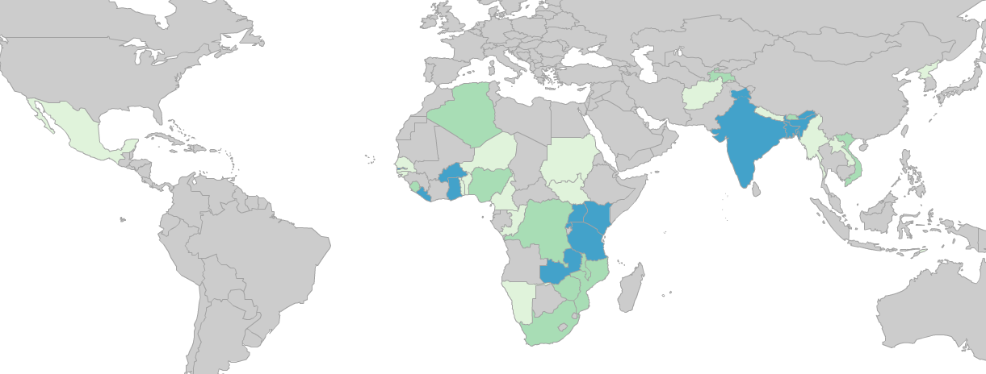
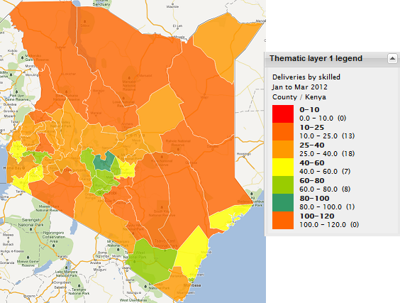
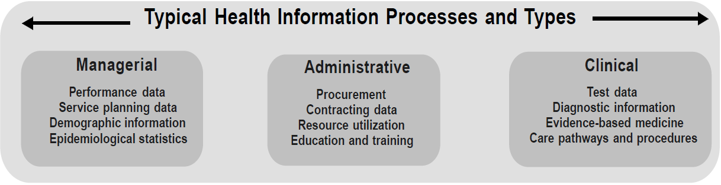
HISP at a glance
hisp.uio.no
dhis2.org
Global reach of activities
University of Oslo
Research, development, implementation
DHIS2, open source software
Routine health statistics
Deliveries by skilled birth attendant, Kenya
Norris, A. C. (2002). "Current trends and challenges in health informatics." Health Informatics Journal 8(4): 205-213.

Slide 4
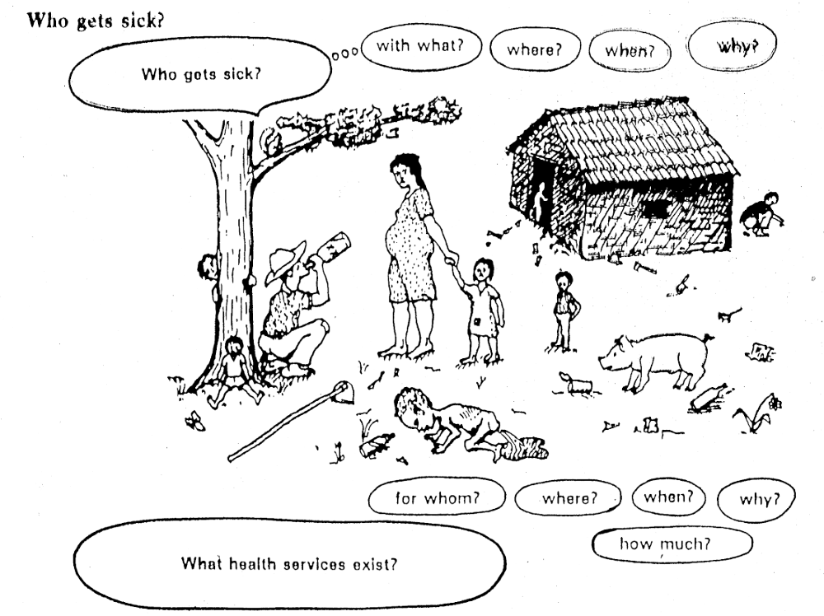

Slide 5
The goal of the HMIS (Health Management Information System)
“is to produce relevant information that health system stakeholders can use for making transparent and evidence-based decisions for health system interventions” (HMN)
The challenges here are many:
  You need access to data
  You need quality data
  You need to know what to do with it

Slide 6
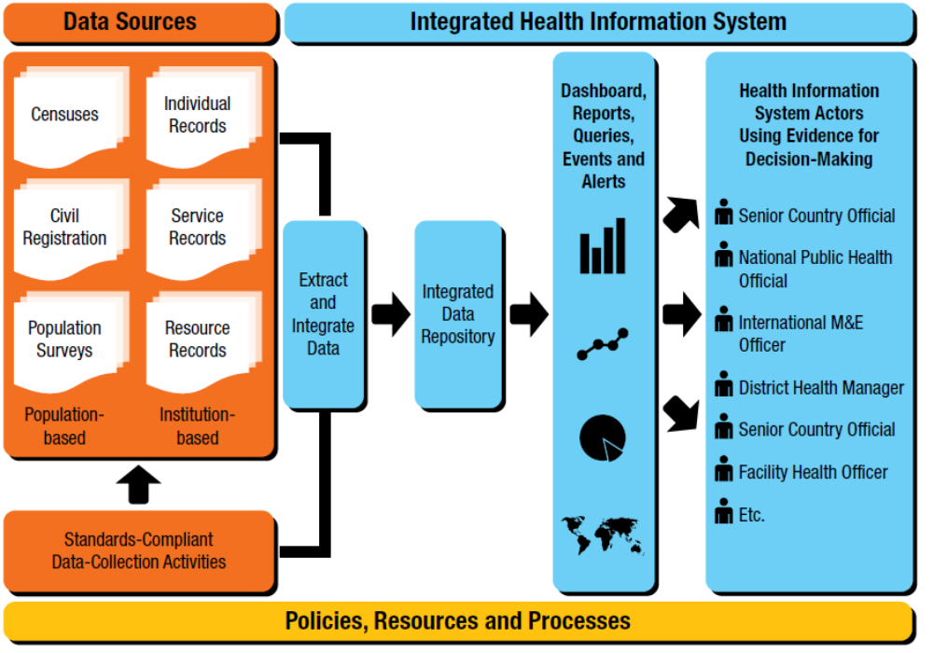
The ideal

Slide 7
The common reality
Fragmentation: South Africa in mid 90s
DNHDP
Western Cape
City Health
Births
Deaths
Notifiable
diseases
New /emerging
flow of information
Groote Schuur
Hospital
City Health
Clinic 1
City Health
Clinic 3
Outside
hospitals
City Health
Clinic 2
City Health
Clinic 4
School
Health
Geriatric
Services
PAWC
MOU
(Midwife&
obstetric unit)
PAWC
Day Hospital
DNHPD
City Health
Clinic 5
DNHDP
Pretoria
Psyciatric
hospital
PAWC
Private hospital:
31 medical specialists
Environmental
office
Dental unit 1
PAWC
54 private medical pract.
Dental unit 2
PAWC
23 private dental pract.
RSC
UWC Oral
Health Centre
Dental unit 3
PAWC
12 private pharmacies
12-15 NGOs
Mandalay
Mobile clinic
RSC
Youth
Health
Services
MITCHELL’S PLAIN

Slide 8
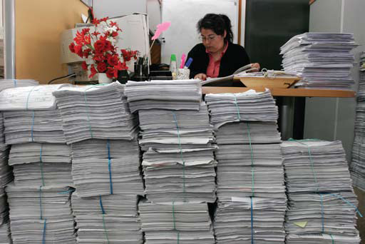
Picture: HMN

Slide 9
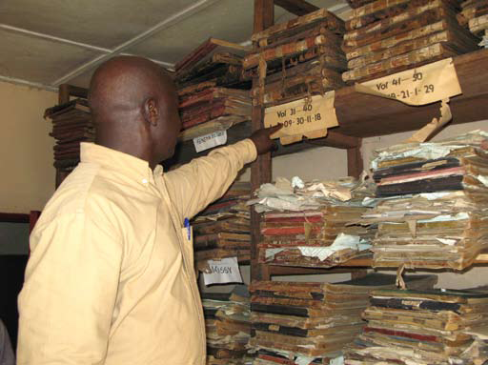
Picture: HMN

Slide 10
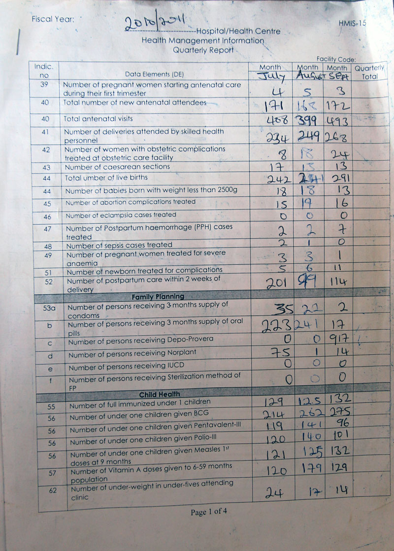
The ideal:
Collect what you need
Feedback at all levels
One place where you can find all data
The common situation
Too much is collected
Little or no feedback
Data not available in one place

Slide 11
The HISP general approach to HMIS strengthening
Focus on the health district (decentralized primary health care)
Routine reporting for management
All aspects of the Information cycle
DHIS2 software
Participation
Integration
Collection
Processing
Presentation
Action

Slide 12
Data collection
Collection
Processing
Presentation
Action
Input: Using data sources and tools to collect quality data
Common problems:
Too much to collect
Poor understanding of data collection tools
Timeliness of reporting
Low data quality
Output: relevant data

Slide 13
Processing
Collection
Processing
Presentation
Action
Input: Relevant data
Processes:
Quality checks
Aggregation to relevant levels
Calculation of indicators
Analysis of data => information
Common problems:
Much irrelevant data
Low data quality
Limited knowledge of data needs and analysis
Output: data converted to information

Slide 14
Presentation
Collection
Processing
Presentation
Action
Input: Analysed information, to be presented to communicate meaning
Common problems:
Importance of information is lost through poor presentation
Data can be misrepresented or misinterpreted
Output: various information products
Charts
Tables
Maps

Slide 15
Action
Collection
Processing
Presentation
Action
Input: Information products
Process: Interpretation of information, prioritizing action, making action plan, and execute action through budgets and plans with goals and targets
Common problems:
Incomplete information
Lack of good targets
No plan for evaluation
Output: Decision-making for health management

Slide 16
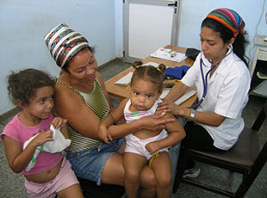
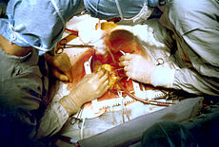
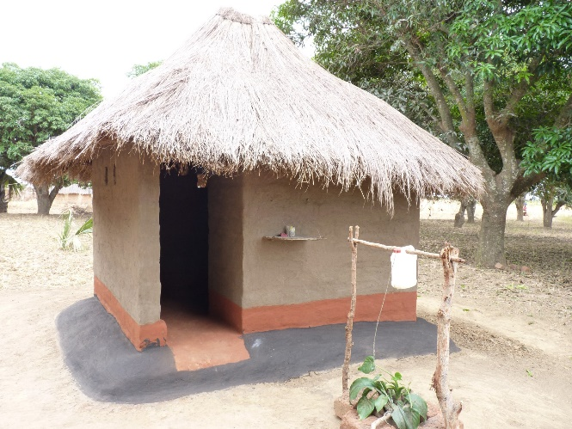
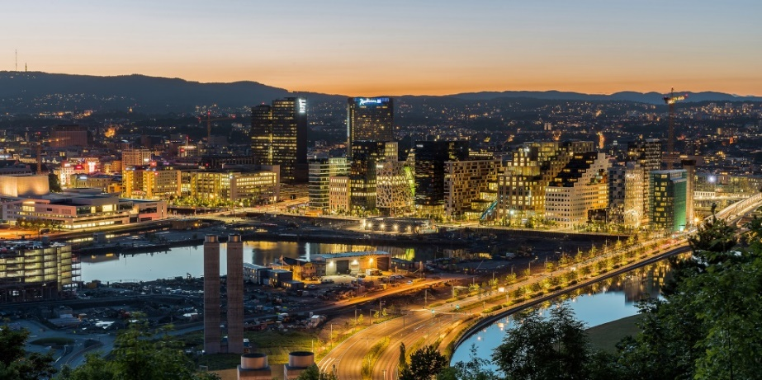
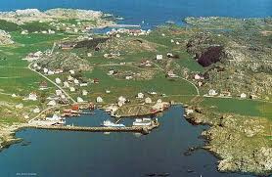
How to improve the situation?
The health sector is inherently complex.
  Specialized care, many agencies, historical development of fragmented systems
Existing «installed bases»
Uneven needs
Uneven physical infrastructure

Slide 17
The HISP approach (from flexible standards paper)
Creating attractors
The principle of flexible standards
Integrated independence
  Rich information from minimal data
  Radical change through small steps
  Scaling information systems in developing countries
Will show some example of each, from various countries.

Slide 18
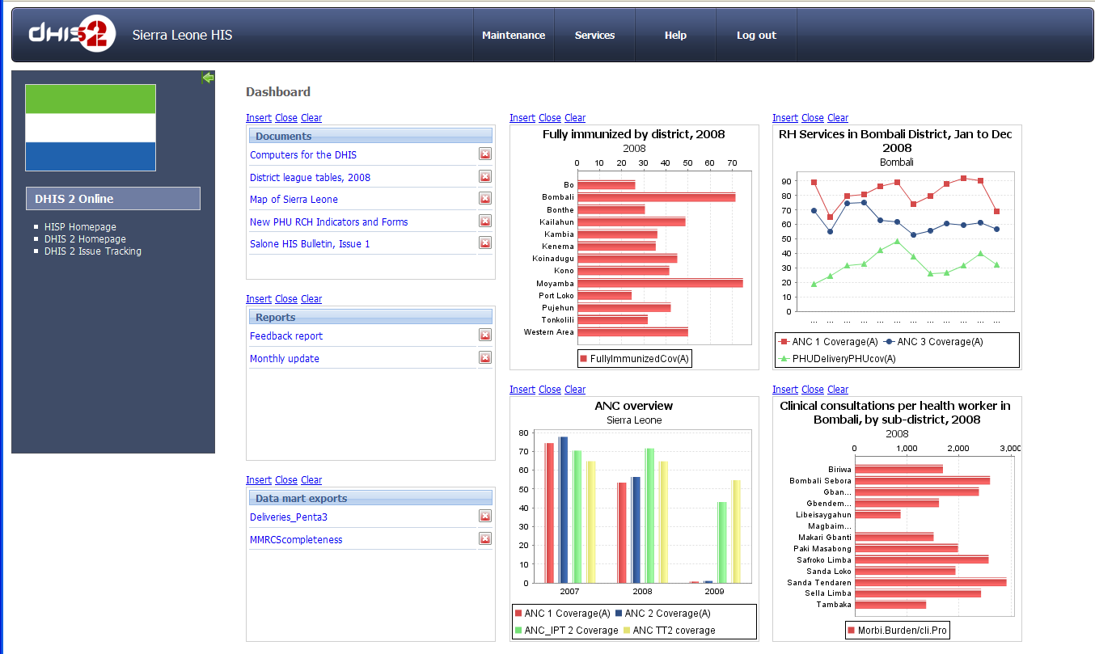
Creating attractors – an integrated data warehouse

Slide 19
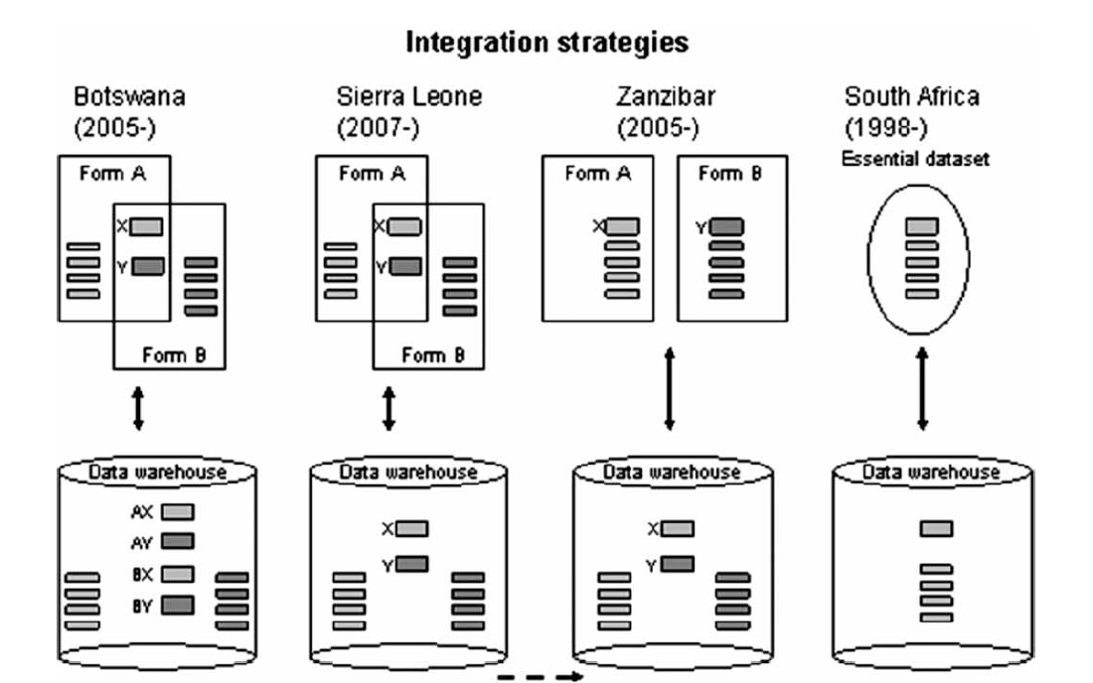
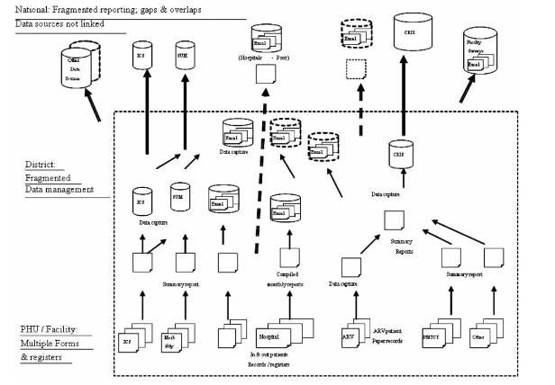
How to integrate in a contested environment?
(How to make integration attractive?)
Previous situation
Integrate behind the scenes
Outcome: everyone benefit, nobody lose

Slide 20
The principle of flexible standards
The problem: All health levels have different information needs, but (almost) all information is collected where nurses attend to patients
The nurses cannot collect everything for everyone! Too much work
How to agree on what to collect?

Slide 21
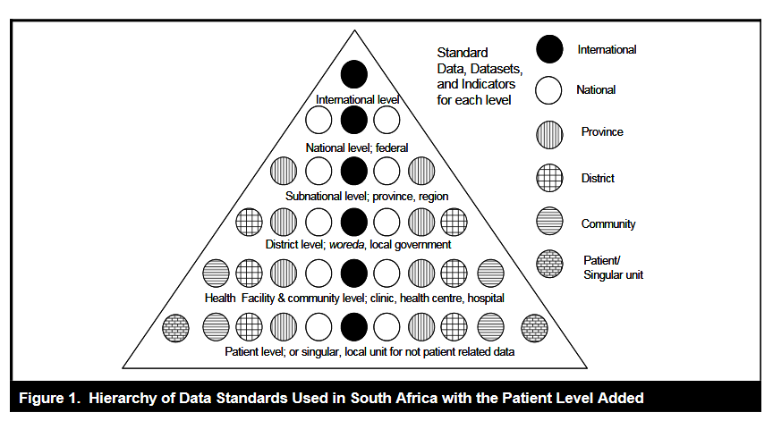
Flexible standards: allowing each level to define their own needs as long as they comply with the above level

Slide 22
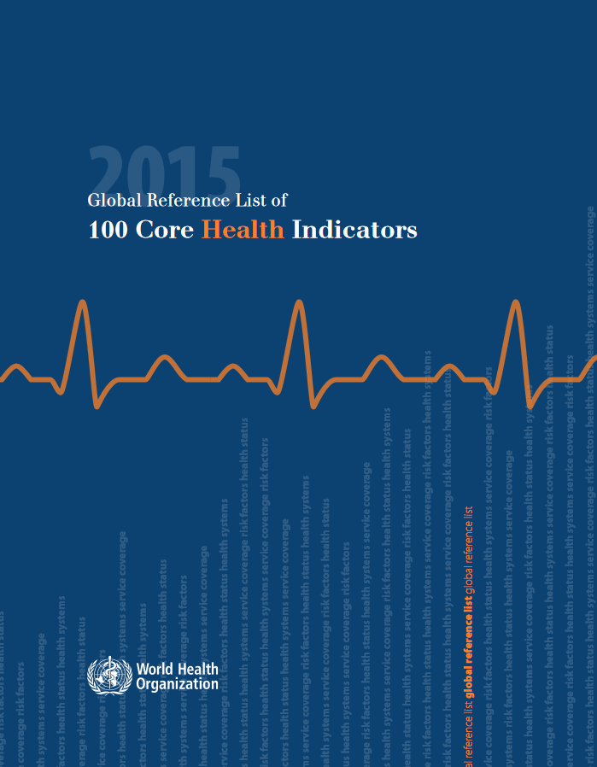
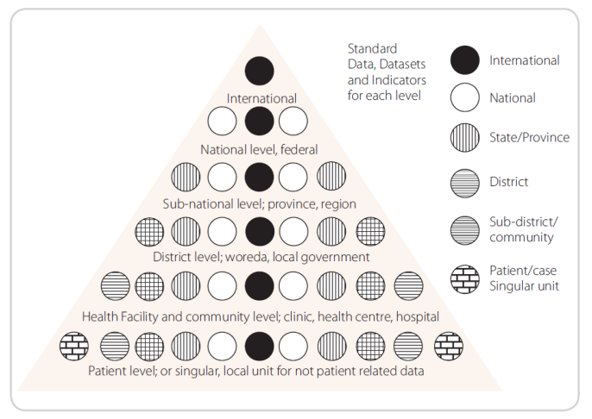
Example: vaccination data
international
  Decreased mortality, healthier children
national
  Decreased incidence of vaccine preventable diseases
province
  Coverage of child immunization
district
  # Children Vaccinated
community and facility levels
  Staff attendence, vaccines, to whom, when, where

Slide 23
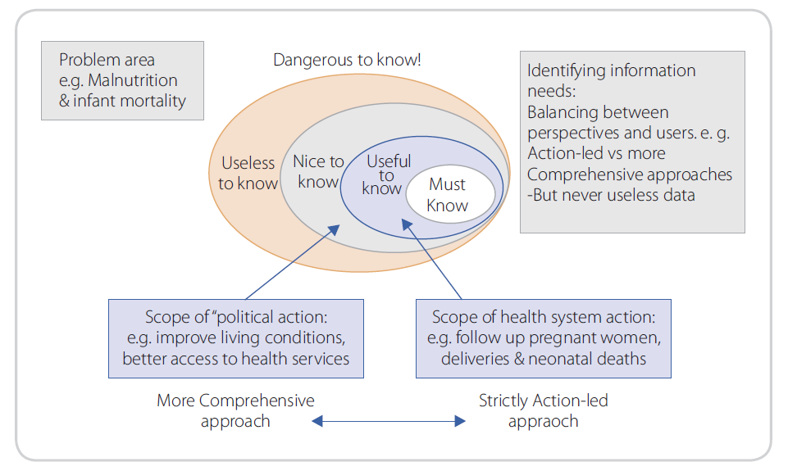
Rich information from minimal data
Start small (in sense of scope): essential indicator set
Example
Must know % children under one-year fully immunized
Useful Drop out rate DPT 1-3; measles coverage
Nice Other program vaccines given
Dangerous All doses given over 1 year; vaccine wastage rate; DPT2, polio 2; non-program vaccines (MMR, flu,etc).

Slide 24
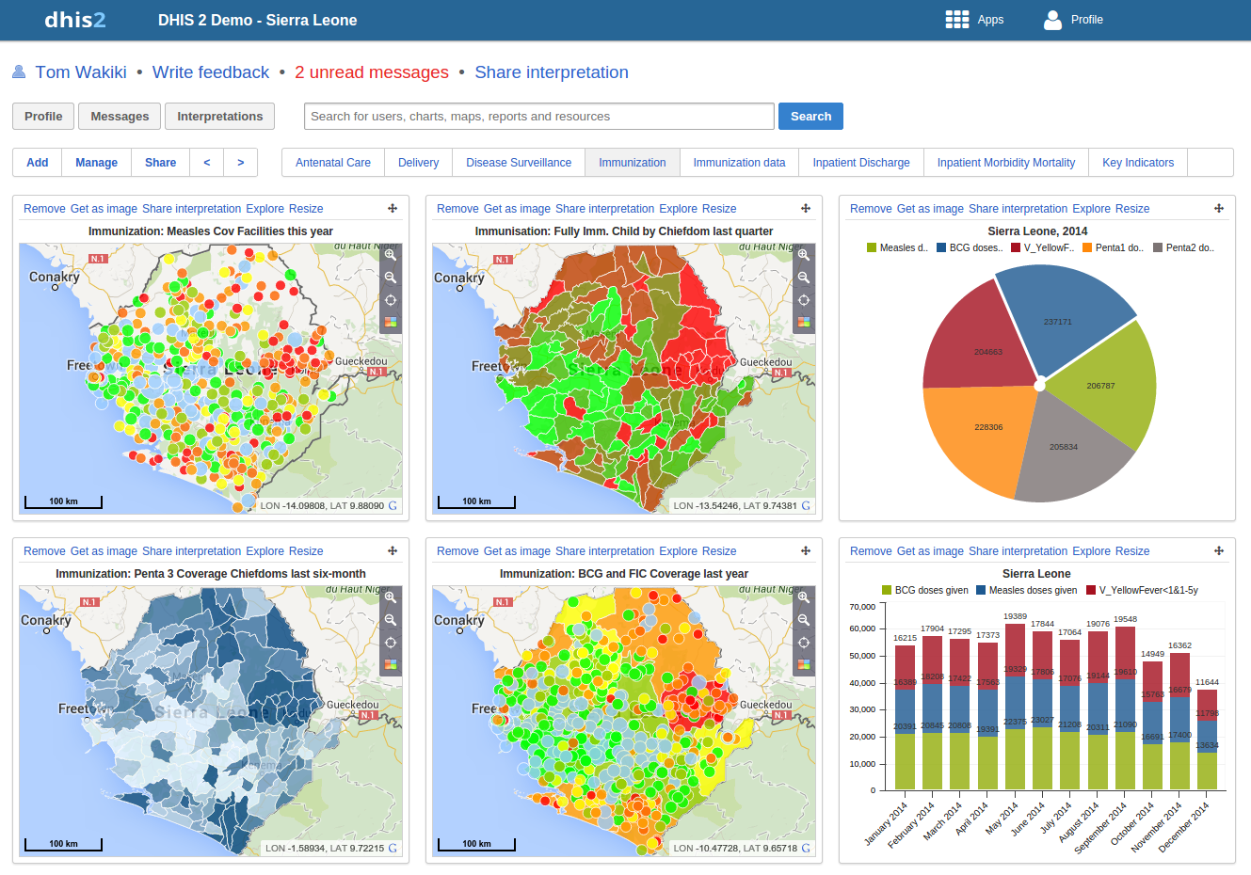
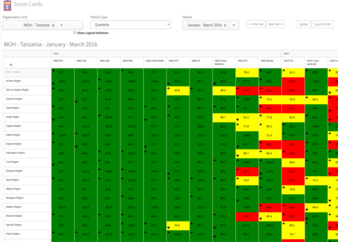
Rich information from minimal data: outputs
Provide powerful outputs from this minimal data

Slide 25
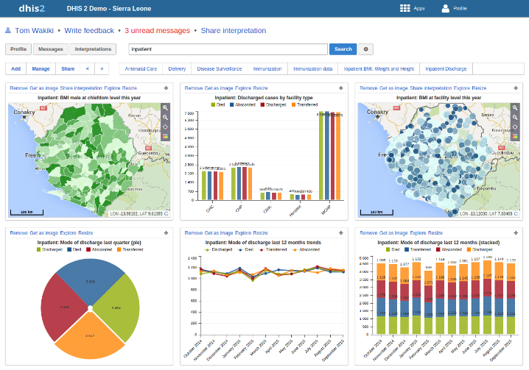
Radical change through small steps
Radical change is often the aim when introducing IT solutions into organizations. But does not work to replace all with something new!
Technology, standards, systems, etc. need to support existing practices so that these practices can be modified incrementally
In real-life: HISP supports what is there now, but with added flexibility
Integration without upsetting current practices enables an integrated dashboard

Slide 26
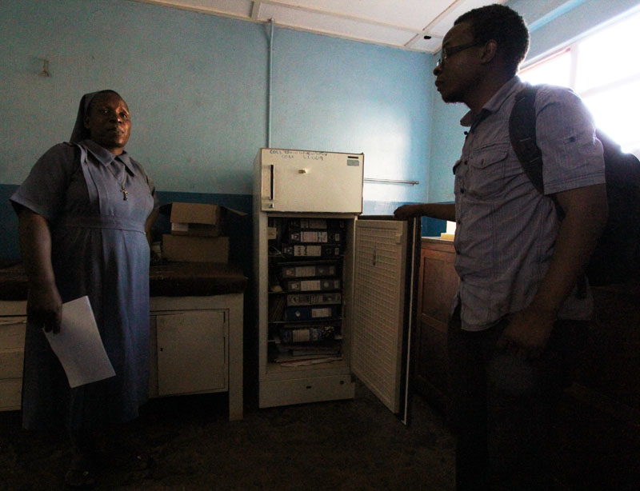
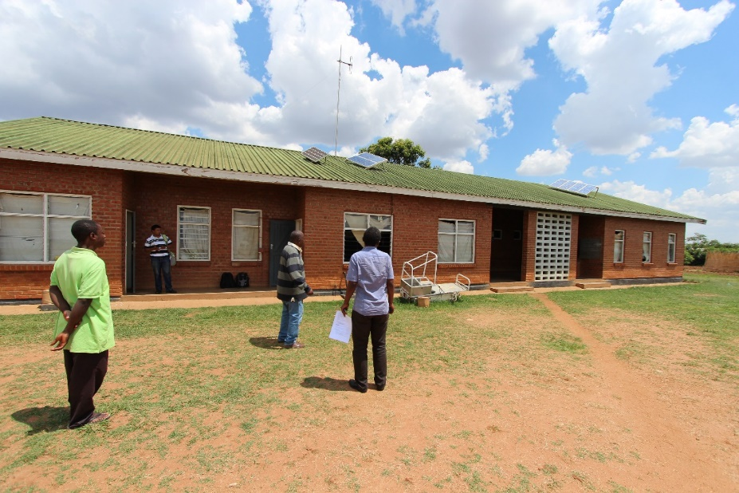
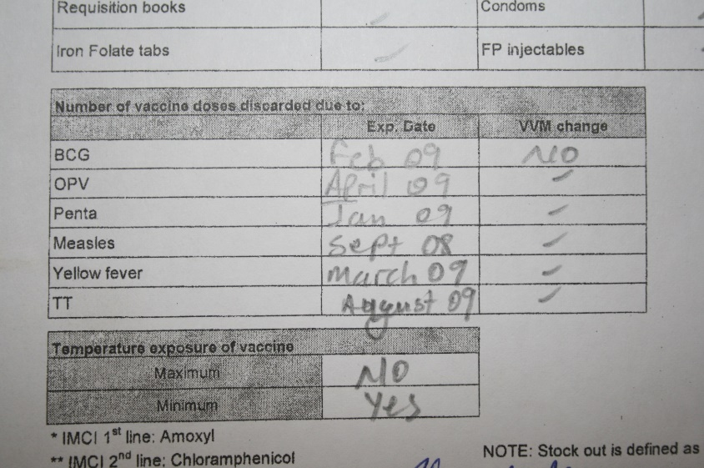
Uneven scaling
Paper, computers, tablets, mobile phones will co-exist
Focus on data standards and information rather than techical standards

Slide 27
Conclusion
HISP has successfully helped build complex information infrastructures in a range of countries (also some failures), through a strategy of combining flexibility and incremental, small steps
  Make the system useful from the start (create an attractor)
  Allow flexibility: enforcement often leads to resistance
  Start small in scope (content) and scale (focus on key users)
  Focus on data standards and information, not technology
    Gateways between paper and electronic format will continue to exist for a long time
This approach is in many senses similar to the «bootstrapping» approach. But success can take 10-15 years…

