Slide 1
BM25, BM25F, and User Behavior
Chris Manning, Pandu Nayak and
Prabhakar Raghavan

Slide 2
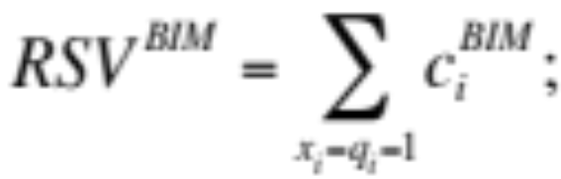
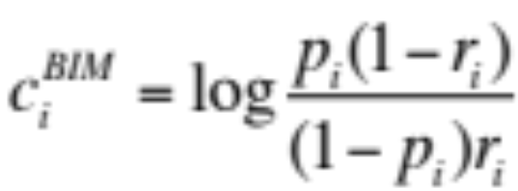
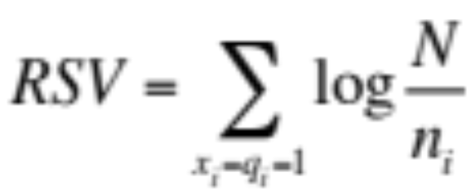
Summary - BIM
Boils down to
where
Simplifies to (with constant p_{i} = 0.5)
Log odds
ratio
 | document | relevant (R=1) | not relevant (R=0)
term present | x_{i} = 1 | p_{i} | r_{i}
term absent | x_{i} = 0 | (1 – p_{i}) | (1 – r_{i})

Slide 3

Graphical model for BIM
R
tf_{i}
Binary
variables

Slide 4
A key limitation of the BIM
BIM – like much of original IR – was designed for titles or abstracts, and not for modern full text search
We want to pay attention to term frequency and document lengths, just like in other models we’ve discussed.

Slide 5
Okapi BM25
BM25 “Best Match 25” (they had a bunch of tries!)
  Developed in the context of the Okapi system
  Started to be increasingly adopted by other teams during the TREC competitions
  It works well
Goal: be sensitive to these quantities while not adding too many parameters
  (Robertson and Zaragoza 2009; Spärck Jones et al. 2000)

Slide 6
Eliteness
Model term frequencies using eliteness
What is eliteness?
  Hidden variable for each document-term pair, denoted as E_{i} for term i
  Represents aboutness: a term is elite in a document if, in some sense, the document is about the concept denoted by the term
  Eliteness is binary
  Term occurrences depend only on eliteness…
  … but eliteness depends on relevance

Slide 7
Elite terms
Text from the Wikipedia page on the NFL draft showing elite terms
The National Football League Draft is an annual event in which the National Football League (NFL) teams select eligible college football players. It serves as the league’s most common source of player recruitment. The basic design of the draft is that each team is given a position in the draft order in reverse order relative to its record …

Slide 8
Graphical model with eliteness
R
E_{i}
Binary
variables
tf_{i}
Frequencies

Slide 9
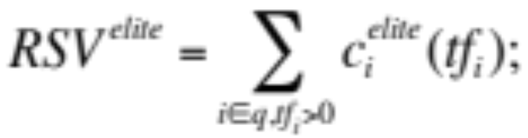
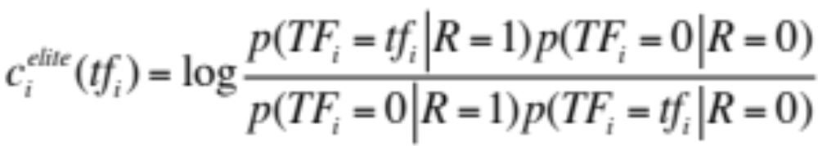
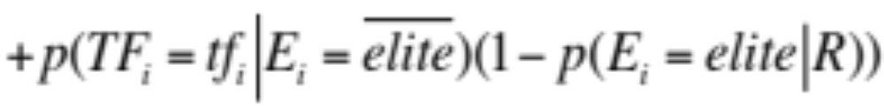
Retrieval Status Value
Similar to the BIM derivation, we have
where
and using eliteness, we have:

Slide 10
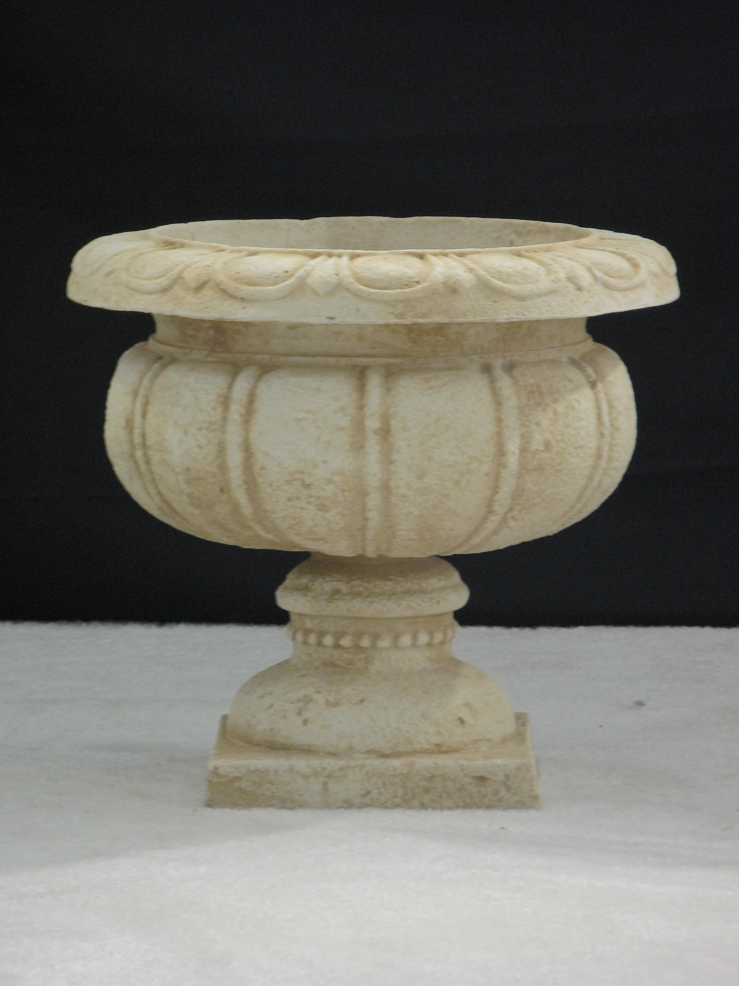
Generative model for documents
Words are drawn independently from the vocabulary using a multinomial distribution
... the draft is that each team is given a position in the draft …
basic
team
the
given
draft
each
nfl
annual
team
of
draft
nfl
football
design
is
that
football
…

Slide 11

Generative model for documents
Distribution of term frequencies (tf) follows a binomial distribution --- approximates to a Poisson
... the draft is that each team is given a position in the draft …
draft
…
…

Slide 12
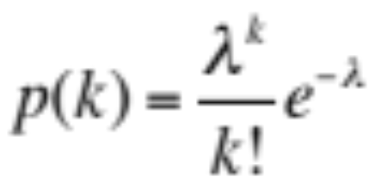
Poisson distribution
  The Poisson distribution models the probability of the number of events occurring in a fixed interval of time/space with known average rate and independently of the last event
Examples
  Number of cars arriving at the toll booth per minute
  Number of typos in a sentence

Slide 13
2-Poisson model
Assume that term frequencies in a document (tf_{i}) follow a Poisson distribution
  Approximates a binomial distribution
  “Fixed interval” implies fixed document length …
    … will fix later
“2-Poisson” because the distribution is different depending on whether the term is elite or not

Slide 14
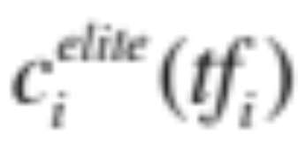
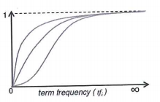
Graphing for different parameter values of the 2-Poisson

Slide 15
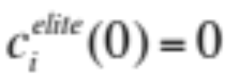


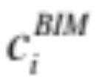
Qualitative properties
increases monotonically with tf_{i}
… but asymptotically approaches a maximum value as
… with the asymptotic limit being
Weight of
eliteness
feature

Slide 16
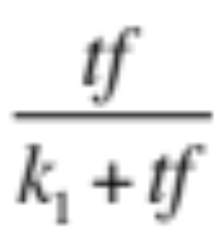
Approximating the saturation function
Estimating parameters for the 2-Poisson model is not easy
… So approximate it with a simple parametric curve that has the same qualitative properties

Slide 17
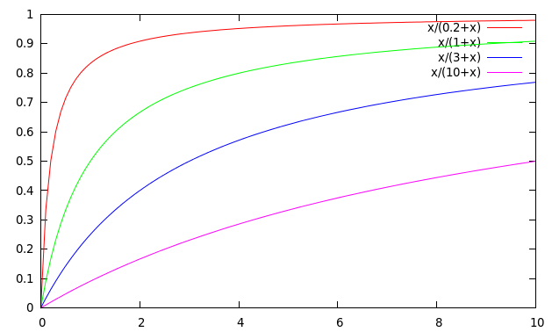
Saturation function
For high values of k₁, increments in tf_{i} continue to contribute significantly to the score
Contributions tail off quickly for low values of k₁

Slide 18
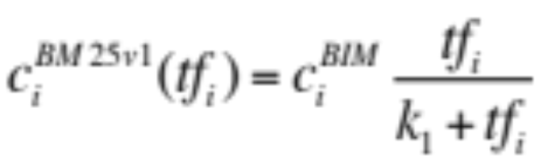
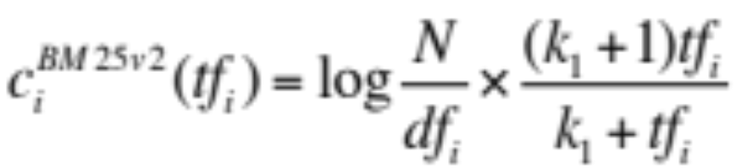
“Early” versions of BM25
Version 1: using the saturation function
Version 2: BIM simplification to IDF
  (k₁+1) factor doesn’t change ranking, but makes
  term score 1 when tf_{i} = 1
  Similar to tf-idf, but terms scores are bounded

Slide 19
Document length normalization
Longer documents are likely to have larger tf_{i} values
Why might documents be longer?
  Verbosity: suggests observed tf_{i} too high
  Larger scope: suggests observed tf_{i} may be right
A real document collection probably has both effects
… so should apply some kind of normalization

Slide 20
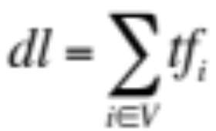
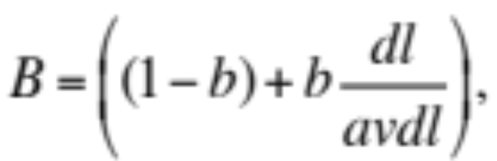

Document length normalization
Document length:
avdl: Average document length over collection
Length normalization component
  b = 1 full document length normalization
  b = 0 no document length normalization

Slide 21
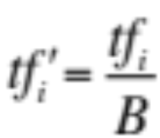
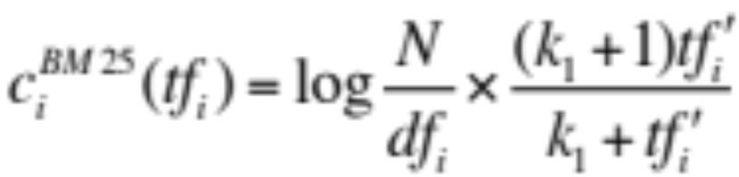
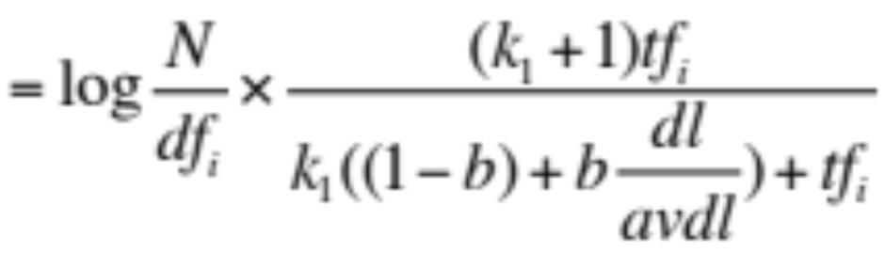
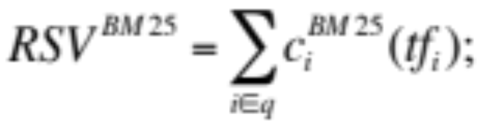
Okapi BM25
Normalize tf using document length
BM25 ranking function

Slide 22
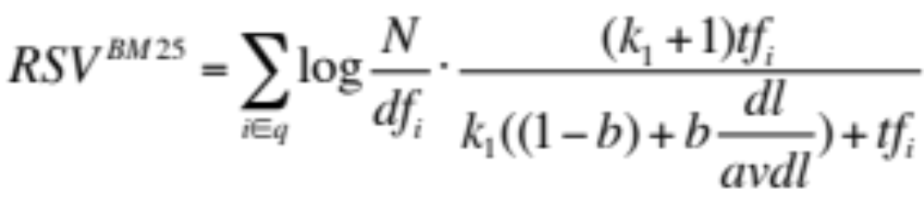
Okapi BM25
k₁ controls term frequency scaling
  k₁ = 0 is binary model; k₁ = large is raw term frequency
b controls document length normalization
  b = 0 is no length normalization; b = 1 is relative frequency (fully scale by document length)
Typically, k₁ is set around 1.2–2 and b around 0.75
IIR sec. 11.4.3 discusses incorporating query term weighting and (pseudo) relevance feedback

Slide 23
Ranking with features
Textual features
  Zones: Title, author, abstract, body, anchors, …
  Proximity
  …
Non-textual features
  File type
  File age
  Page rank
  …

Slide 24
Ranking with zones
Straightforward idea:
  Apply your favorite ranking function (BM25) to each zone separately
  Combine zone scores using a weighted linear combination
But that seems to imply that the eliteness properties of different zones are different and independent of each other
  …which seems unreasonable

Slide 25
Ranking with zones
Alternate idea
  Assume eliteness is a term/document property shared across zones
  … but the relationship between eliteness and term frequencies are zone-dependent
Consequence
  First combine evidence across zones for each term
  Then combine evidence across terms

Slide 26
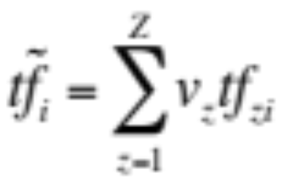
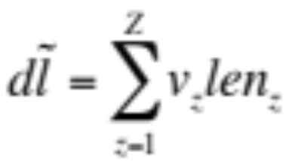


BM25F with zones
Calculate a weighted variant of total term frequency
… and a weighted variant of document length
where
    v_{z} is zone weight
    tf_{zi} is term frequency in zone z
    len_{z} is length of zone z
    Z is the number of zones
Average
across all
documents

Slide 27
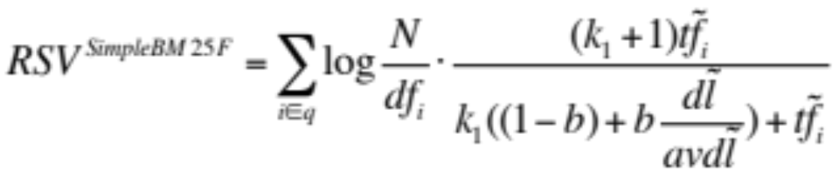
Simple BM25F with zones
Simple interpretation: zone z is “replicated” v_{z} times
But we may want zone-specific parameters (k₁, b, IDF)

Slide 28
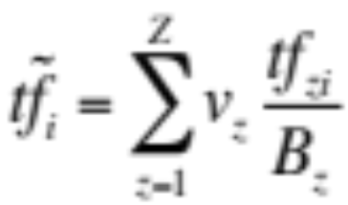
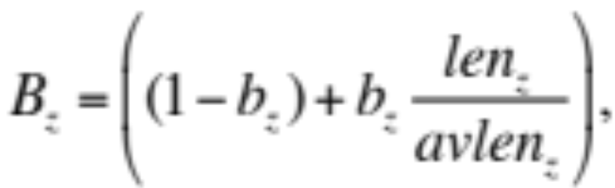

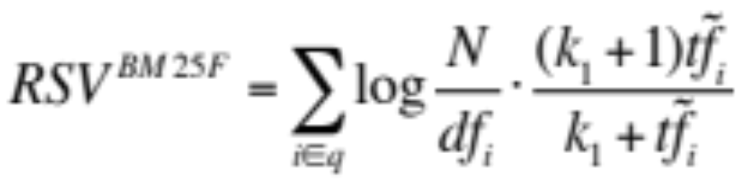
BM25F
Empirically, zone-specific length normalization (i.e., zone-specific b) has been found to be useful

Slide 29
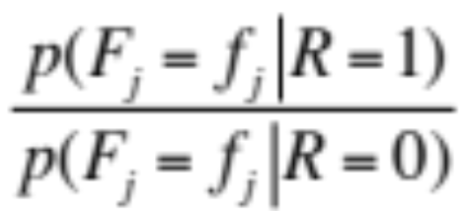
Ranking with non-textual features
Assumptions
  Usual independence assumption
    Independent of each other and of the textual features
    Allows us to factor out in BIM-style derivation
  Relevance information is query independent
    Usually true for features like page rank, age, type, …
    Allows us to keep all non-textual features in the BIM-style derivation where we drop non-query terms

Slide 30
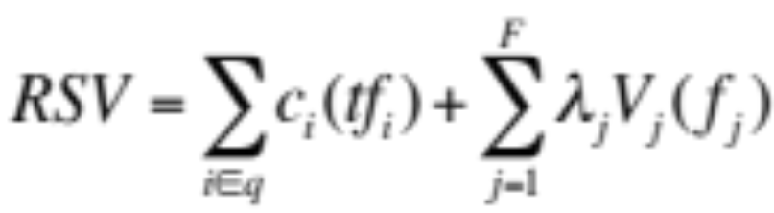
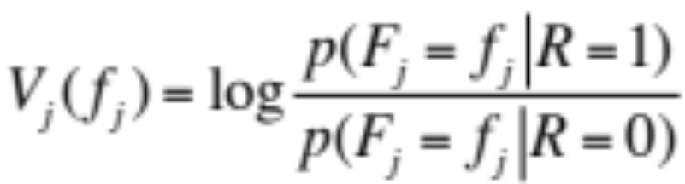

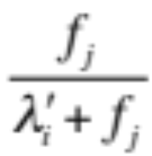
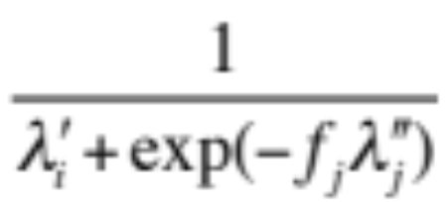
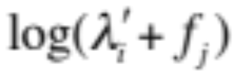
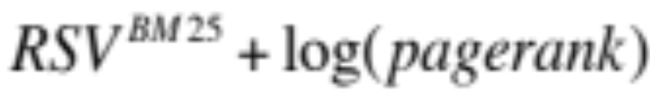
Ranking with non-textual features
where
and is an artificially added free parameter to account for rescalings in the approximations
Care must be taken in selecting V_{j}. Some possibilities:
has worked well in practice

Slide 31
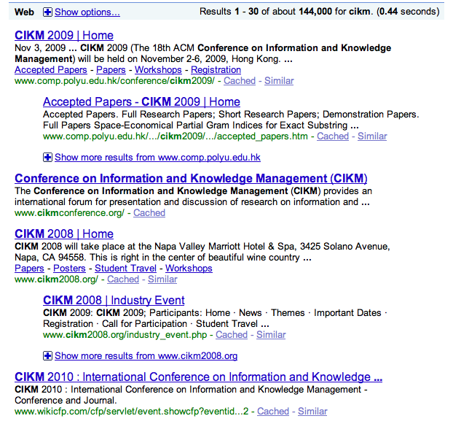
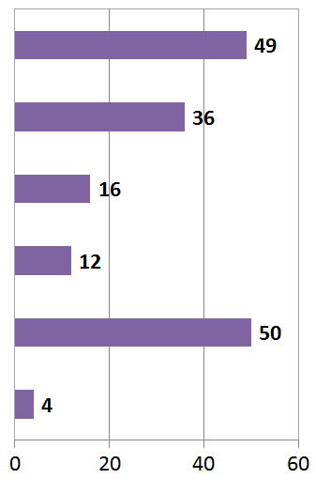

User Behavior
Taken with slight adaptation from Fan Guo and Chao Liu’s 2009 CIKM tutorial: Statistical Models for Web Search: Click Log Analysis
Search Results for “CIKM”
# of clicks received
Notes:
Does this show that our results are wrong?

Slide 32
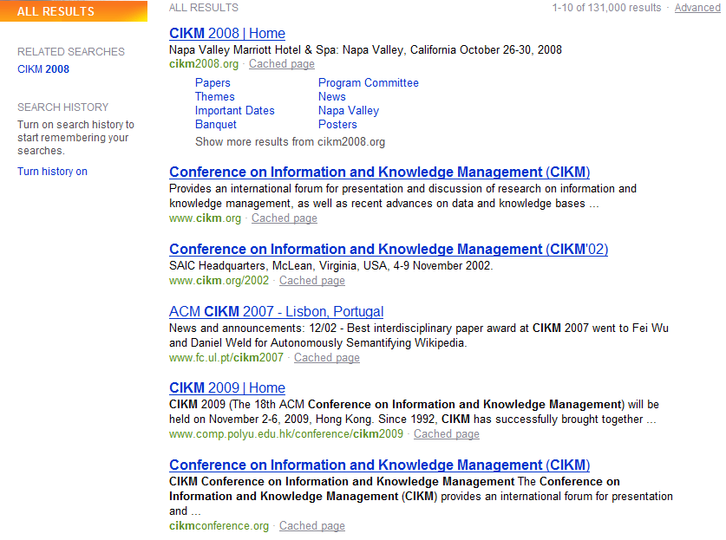
User Behavior
Adapt ranking to user clicks?
# of clicks received

Slide 33
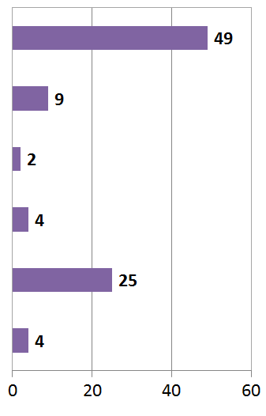

User Behavior
Tools needed for non-trivial cases
# of clicks received

Slide 34
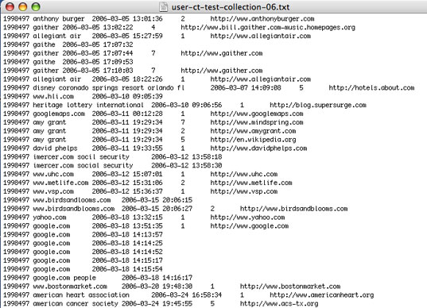
Web search click log
An example

Slide 35

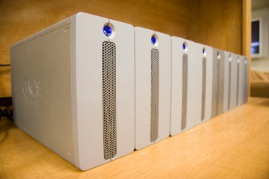
Web Search Click Log
How large is the click log?
  search logs: 10+ TB/day
  In existing publications:
    [Craswell+08]: 108k sessions
    [Dupret+08] : 4.5M sessions (21 subsets * 216k sessions)
    [Guo +09a] : 8.8M sessions from 110k unique queries
    [Guo+09b]: 8.8M sessions from 110k unique queries
    [Chapelle+09]: 58M sessions from 682k unique queries
    [Liu+09a]: 0.26PB data from 103M unique queries

Slide 36
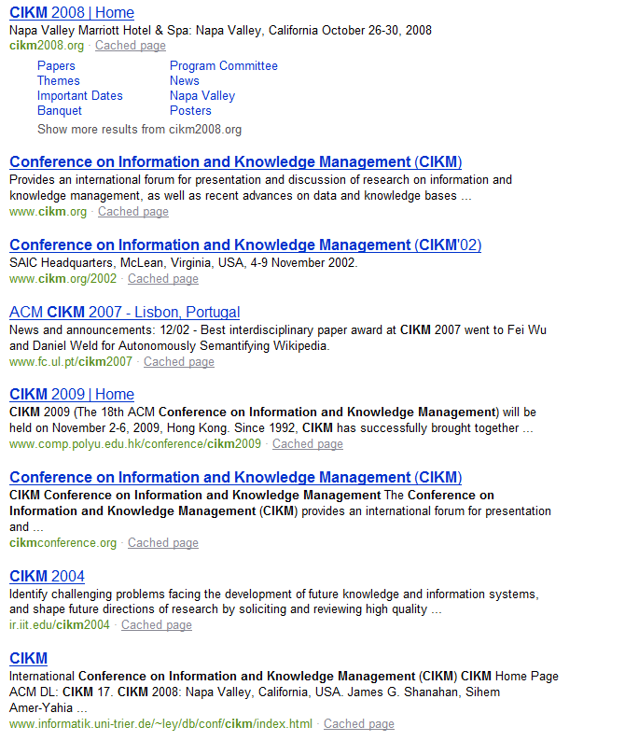


Interpret Clicks: an Example
Clicks are good…
  Are these two clicks equally “good”?
Non-clicks may have excuses:
  Not relevant
  Not examined

Slide 37
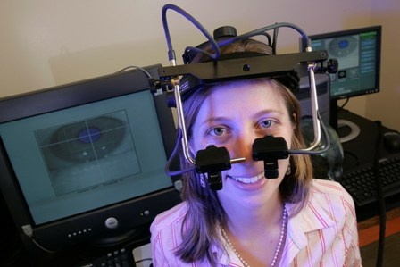
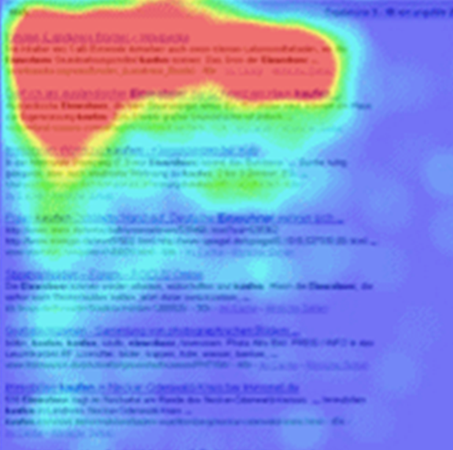
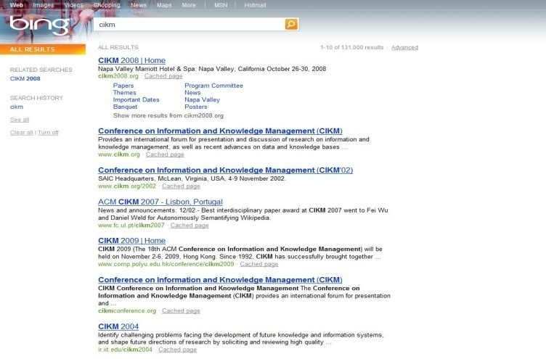
Eye-tracking User Study

Slide 38
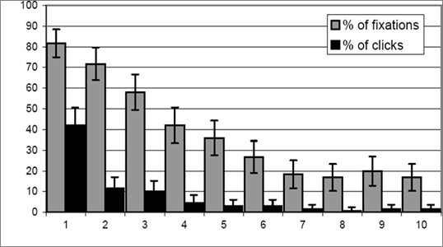
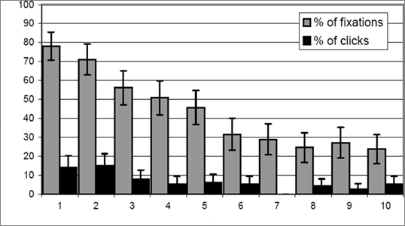
Click Position-bias
Higher positions receive more user attention (eye fixation) and clicks than lower positions.
This is true even in the extreme setting where the order of positions is reversed.
“Clicks are informative but biased”.
Percentage
Normal Position
Percentage
[Joachims+07]
Reversed Impression

Slide 39
User behavior
User behavior is an intriguing source of relevance data
  Users make (somewhat) informed choices when they interact with search engines
  Potentially a lot of data available in search logs
But there are significant caveats
  User behavior data can be very noisy
  Interpreting user behavior can be tricky
  Spam can be a significant problem
  Not all queries will have user behavior

Slide 40
Features based on user behavior
From [Agichtein, Brill, Dumais 2006; Joachims 2002]
Click-through features
  Click frequency, click probability, click deviation
  Click on next result? previous result? above? below>?
Browsing features
  Cumulative and average time on page, on domain, on URL prefix; deviation from average times
  Browse path features
Query-text features
  Query overlap with title, snippet, URL, domain, next query
  Query length

Slide 41
Incorporating user behavior into ranking algorithm
Incorporate user behavior features into a ranking function like BM25F
  But requires an understanding of user behavior features so that appropriate V_{j} functions are used
Incorporate user behavior features into learned ranking function
Either of these ways of incorporating user behavior signals improve ranking

Slide 42
Resources
S. E. Robertson and H. Zaragoza. 2009. The Probabilistic Relevance Framework: BM25 and Beyond. Foundations and Trends in Information Retrieval 3(4): 333-389.
K. Spärck Jones, S. Walker, and S. E. Robertson. 2000. A probabilistic model of information retrieval: Development and comparative experiments. Part 1. Information Processing and Management 779–808.
T. Joachims. Optimizing Search Engines using Clickthrough Data. 2002. SIGKDD.
E. Agichtein, E. Brill, S. Dumais. 2006. Improving Web Search Ranking By Incorporating User Behavior Information. 2006. SIGIR.

