Slide 1
IXP:
Bump in the Wire
INF5063:
Programming Asymmetric Multi-Core Processors
August 26, 2011

Slide 2
Question:
Which is growing faster?
  network bandwidth
  processing power
Note: if network bandwidth is growing faster
  CPU may be the bottleneck
  need special-purpose hardware
Note: if processing power is growing faster
  no problems with processing
  network/busses will be bottlenecks

Slide 3
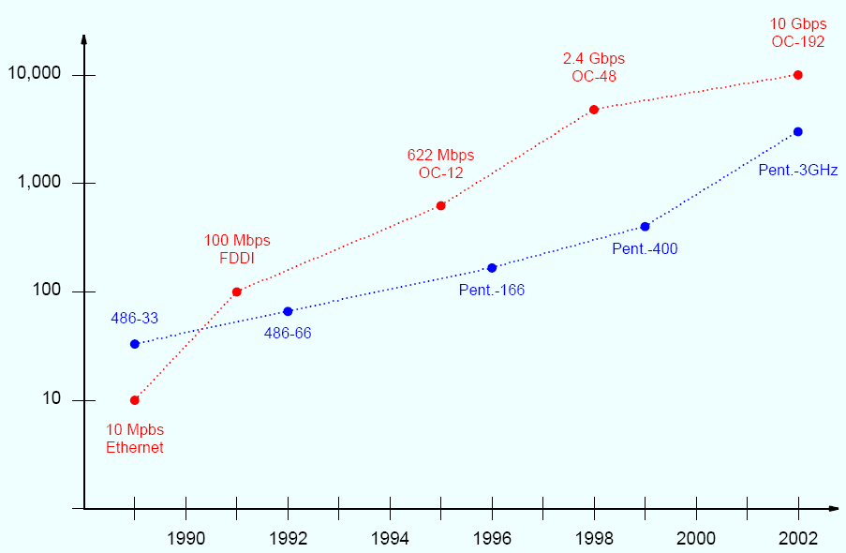
Growth Of Technologies
Engineering rule:
1GHz general purpose CPU = 1Gbps network data rate
Mbps
Thus, software running on a general-purpose processor is
insufficient to handle high-speed networks because the
aggregate packet rate exceeds the capabilities of the CPU
year

Slide 4
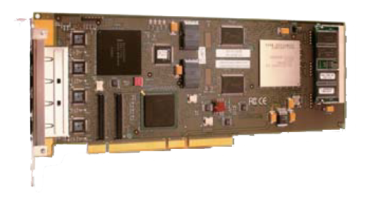
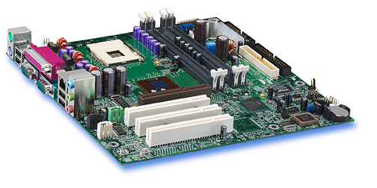
Network Processors: Main Idea
Traditional system:
- slow
- resource demanding
- shared with other operations
Network processors:
- a computer within the computer
- special, programmable hardware
- offloads host resources

Slide 5
Explosion of Commercial Products
1990 → 2000: network processors transformed from
interesting curiosity to mainstream product
  reduction in both overall costs and time to market
  2002: over 30 vendors with a vide range of architectures
  e.g.,
    Multi-Chip Pipeline (Agere)
    Augmented RISC Processor (Alchemy)
    Embedded Processor Plus Coprocessors (Applied Micro Circuit Corporation)
    Pipeline of Homogeneous Processors (Cisco)
    Pipeline of Heterogeneous Processors (EZchip)
    Configurable Instruction Set Processors (Cognigine)
    Extensive And Diverse Processors (IBM)
    Flexible RISC Plus Coprocessors (Motorola)
    Internet Exchange Processor (Intel)
    …

Slide 6
Intel IXP1200 / 2400:
A Very Short Overview

Slide 7
IXA: Internet Exchange Architecture
IXA is a broad term to describe the Intel network architecture (HW & SW, control- & data plane)
IXP: Internet Exchange Processor
  processor that implements IXA
  IXP1200 is the first IXP chip
  (4 versions)
  IXP2xxx has now replaced the first version
IXP1200 basic features
  1 embedded 232 MHz StrongARM
  6 packet 232 MHz µengines
  onboard memory
  4 x 100 Mbps Ethernet ports
  multiple, independent busses
  low-speed serial interface
  interfaces for external memory
  and I/O busses
  …
IXP2400 basic features
  1 embedded 600 MHz XScale
  8 packet 600 MHz µengines
  3 x 1 Gbps Ethernet ports
  …

Slide 8
IXP2400 Architecture
Coprocessors
hash unit
4 timers
general purpose I/O pins
external JTAG connections (in-circuit tests)
several bulk cyphers (IXP2850 only)
checksum (IXP2850 only)
…
PCI bus
IXP2400
SRAM
bus
RISC processor:
- StrongArm → XScale
- 233 MHz → 600 MHz
SRAM
SRAM
access
PCI
access
Embedded
RISK CPU
(XScale)
coprocessor
microengine 1
SCRATCH
memory
multiple
independent
internal
buses
microengine 2
microengine 3
FLASH
slowport
access
Slowport
shared inteface to external units
used for FlashRom during bootstrap
Media Switch Fabric
forms fast path for transfers
interconnect for several IXP2xxx
microengine 4
Microengines
- 6 → 8
- 233 MHz → 600 MHz
microengine 5
SDRAM
access
MSF
access
…
DRAM
microengine 8
DRAM
bus
Receive/transmit buses
shared bus → separate busses
receive bus
transmit bus

Slide 9
IXP2400 Basic Packet Processing
PCI bus
SRAM
bus
SRAM
SRAM
access
PCI
access
Embedded
RISK CPU
(XScale)
coprocessor
microengine 1
SCRATCH
memory
multiple
independent
internal
buses
microengine 2
microengine 3
FLASH
slowport
access
microengine 4
microengine 5
SDRAM
access
MSF
access
…
DRAM
microengine 8
DRAM
bus
receive bus
transmit bus

Slide 10
Using IXP2400

Slide 11

Intel IXP2400 Hardware Reference Manual

Slide 12
Programming Model
SRAM
SDRAM
head
tail
logical mapping
linked list
metadata
queue
data buffers
core
component
Scratch rings
XScale
microengines
input
ports
RX
microblock
process
microblock
TX
microblock
output
ports

Slide 13
Programming Model
Threads
core
component
XScale
microengines
input
ports
RX
microblock
process
microblock
TX
microblock
output
ports
Hardware contexts

Slide 14
Framework
uclo
  Microengine loader
  Necessary to load your microengine code into the microengines at runtime
hal
  Hardware abstraction layer
  Mapping of physical memory into XScale processes’ virtual address space
  Functions starting with hal
ossl
  Operating system service layer
  Limited abstraction from hardware specifics
  Functions starting with ix_
rm
  Resource manager
  Layered on top of uclo and ossl
  Memory and resource management
    all memory types and their features
    IPC, counters, hash
  Functions starting with ix_

Slide 15
Bump in the Wire:
Deep Packet Inspection

Slide 16
Bump in the Wire
Count web packets, count ICMP packets
Internet

Slide 17
Packet Headers and Encapsulation

Slide 18
Ethernet
48 bit address configured to an
interface on the NIC on the receiver
0 1 2 3
0 1 2 3 4 5 6 7 8 9 0 1 2 3 4 5 6 7 8 9 0 1 2 3 4 5 6 7 8 9 0 1
+-+-+-+-+-+-+-+-+-+-+-+-+-+-+-+-+-+-+-+-+-+-+-+-+-+-+-+-+-+-+-+-+
| Destination Address |
+ +-+-+-+-+-+-+-+-+-+-+-+-+-+-+-+-+
| | |
+-+-+-+-+-+-+-+-+-+-+-+-+-+-+-+-+ +
| Source address |
+-+-+-+-+-+-+-+-+-+-+-+-+-+-+-+-+-+-+-+-+-+-+-+-+-+-+-+-+-+-+-+-+
| Frame type |
+-+-+-+-+-+-+-+-+-+-+-+-+-+-+-+-+
48 bit address configured to an
interface on the NIC on the sender
describes content of ethernet frame,
e.g., 0x0800 indicates an IP datagram,
0x0806 indicates an ARP packet

Slide 19
Internet Protocol version 4 (IPv4)
indication of the abstract parameters of the
quality of service desired – somehow treat
high precedence traffic as more important –
tradeoff between low-delay, high-reliability, and
high-throughput – NOT used, bits now reused for differential services code point
indicates the format of the internet header, i.e., version 4
length of the internet header in 32 bit words, and thus
points to the beginning of the data (minimum value of 5)
first zero, fragments allowed and last fragment
datagram length
(octets) including
header and data -
allows the length
of 65,535 octets
0 1 2 3
0 1 2 3 4 5 6 7 8 9 0 1 2 3 4 5 6 7 8 9 0 1 2 3 4 5 6 7 8 9 0 1
+-+-+-+-+-+-+-+-+-+-+-+-+-+-+-+-+-+-+-+-+-+-+-+-+-+-+-+-+-+-+-+-+
|Version| IHL |Type of Service| Total Length |
+-+-+-+-+-+-+-+-+-+-+-+-+-+-+-+-+-+-+-+-+-+-+-+-+-+-+-+-+-+-+-+-+
| Identification |Flags| Fragment Offset |
+-+-+-+-+-+-+-+-+-+-+-+-+-+-+-+-+-+-+-+-+-+-+-+-+-+-+-+-+-+-+-+-+
| Time to Live | Protocol | Header Checksum |
+-+-+-+-+-+-+-+-+-+-+-+-+-+-+-+-+-+-+-+-+-+-+-+-+-+-+-+-+-+-+-+-+
| Source Address |
+-+-+-+-+-+-+-+-+-+-+-+-+-+-+-+-+-+-+-+-+-+-+-+-+-+-+-+-+-+-+-+-+
| Destination Address |
+-+-+-+-+-+-+-+-+-+-+-+-+-+-+-+-+-+-+-+-+-+-+-+-+-+-+-+-+-+-+-+-+
| Options | Padding |
+-+-+-+-+-+-+-+-+-+-+-+-+-+-+-+-+-+-+-+-+-+-+-+-+-+-+-+-+-+-+-+-+
identifying value to aid assembly of fragments
indicate where this fragment belongs in datagram
disable a packet to circulate forever,decrease value by at least 1 in each node – discarded if 0
checksum on the header only – TCP, UDP over payload. Since some header fields change(TTL), this is recomputed and verified at each point
indicates used transport
layer protocol
32-bit address fields. May be configured differently from small to large networks
options may extend the header – indicated by IHL. If the options do not end on a 32-bit boundary, the remaining fields are padded in the padding field (0’s)

Slide 20
Internet Control Message Protocol (ICMPv4)
Type of the control msg, including
echo request (8) and echo reply (0)
Checksum for the
ICMP header only
Refinement
0 1 2 3
0 1 2 3 4 5 6 7 8 9 0 1 2 3 4 5 6 7 8 9 0 1 2 3 4 5 6 7 8 9 0 1
+-+-+-+-+-+-+-+-+-+-+-+-+-+-+-+-+-+-+-+-+-+-+-+-+-+-+-+-+-+-+-+-+
| Type | Code | header checksum |
+-+-+-+-+-+-+-+-+-+-+-+-+-+-+-+-+-+-+-+-+-+-+-+-+-+-+-+-+-+-+-+-+
| data |
+-+-+-+-+-+-+-+-+-+-+-+-+-+-+-+-+-+-+-+-+-+-+-+-+-+-+-+-+-+-+-+-+
type-specific arbitrary length data
ICMP Echo Request
0 1 2 3
0 1 2 3 4 5 6 7 8 9 0 1 2 3 4 5 6 7 8 9 0 1 2 3 4 5 6 7 8 9 0 1
+-+-+-+-+-+-+-+-+-+-+-+-+-+-+-+-+-+-+-+-+-+-+-+-+-+-+-+-+-+-+-+-+
| 8 | 0 | header checksum |
+-+-+-+-+-+-+-+-+-+-+-+-+-+-+-+-+-+-+-+-+-+-+-+-+-+-+-+-+-+-+-+-+
| identifier | sequence number |
+-+-+-+-+-+-+-+-+-+-+-+-+-+-+-+-+-+-+-+-+-+-+-+-+-+-+-+-+-+-+-+-+
| data |
+-+-+-+-+-+-+-+-+-+-+-+-+-+-+-+-+-+-+-+-+-+-+-+-+-+-+-+-+-+-+-+-+
Optional identifier,
chosen by sender, echoed by receiver
Optional sequence number,
chosen by sender, echoed by receiver

Slide 21
UDP
port to identify the
sending application
port to identify
receiving application
0 1 2 3
0 1 2 3 4 5 6 7 8 9 0 1 2 3 4 5 6 7 8 9 0 1 2 3 4 5 6 7 8 9 0 1
+-+-+-+-+-+-+-+-+-+-+-+-+-+-+-+-+-+-+-+-+-+-+-+-+-+-+-+-+-+-+-+-+
| Source Port | Destination Port |
+-+-+-+-+-+-+-+-+-+-+-+-+-+-+-+-+-+-+-+-+-+-+-+-+-+-+-+-+-+-+-+-+
| Length | Checksum |
+-+-+-+-+-+-+-+-+-+-+-+-+-+-+-+-+-+-+-+-+-+-+-+-+-+-+-+-+-+-+-+-+
specifies the total length of the UDP
datagram in octets
contains a 1’s complement checksum over
UDP packet and an IP pseudo header with
source and destination address

Slide 22
TCP
code bits: urgent, ack, push, reset, syn, fin
sequence number
for data in payload
port to identify the
sending application
port to identify
receiving application
acknowledgement
for data received
0 1 2 3
0 1 2 3 4 5 6 7 8 9 0 1 2 3 4 5 6 7 8 9 0 1 2 3 4 5 6 7 8 9 0 1
+-+-+-+-+-+-+-+-+-+-+-+-+-+-+-+-+-+-+-+-+-+-+-+-+-+-+-+-+-+-+-+-+
| Source Port | Destination Port |
+-+-+-+-+-+-+-+-+-+-+-+-+-+-+-+-+-+-+-+-+-+-+-+-+-+-+-+-+-+-+-+-+
| Sequence Number |
+-+-+-+-+-+-+-+-+-+-+-+-+-+-+-+-+-+-+-+-+-+-+-+-+-+-+-+-+-+-+-+-+
| Acknowledgment Number |
+-+-+-+-+-+-+-+-+-+-+-+-+-+-+-+-+-+-+-+-+-+-+-+-+-+-+-+-+-+-+-+-+
| Header| |U|A|P|R|S|F| |
| length| Reserved |R|C|S|S|Y|I| Window |
| | |G|K|H|T|N|N| |
+-+-+-+-+-+-+-+-+-+-+-+-+-+-+-+-+-+-+-+-+-+-+-+-+-+-+-+-+-+-+-+-+
| Checksum | Urgent Pointer |
+-+-+-+-+-+-+-+-+-+-+-+-+-+-+-+-+-+-+-+-+-+-+-+-+-+-+-+-+-+-+-+-+
| Options | Padding |
+-+-+-+-+-+-+-+-+-+-+-+-+-+-+-+-+-+-+-+-+-+-+-+-+-+-+-+-+-+-+-+-+
header length in
32 bit units
receiver’s buffer
size for
additional data
pointer to urgent data in segment
contains a 1’s complement checksum over
UDP packet and an IP pseudo header with
source and destination address
options may extend the header. If the options do not end on a 32-bit boundary, the remaining fields are padded in the padding field (0’s)

Slide 23
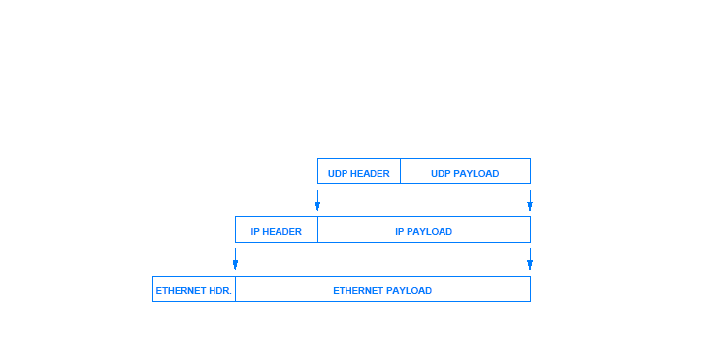
Encapsulation

Slide 24
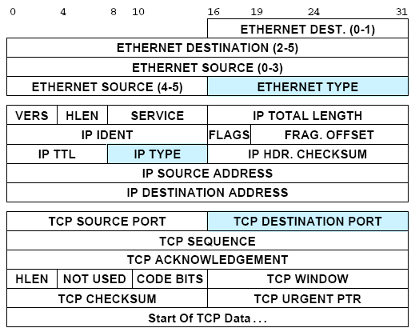
Identifying Web Packets
These are the header
fields you need for
the web bumper:
Ethernet type 0x800
IP type 6
TCP port 80

Slide 25
Lab Setup

Slide 26


Lab Setup
IXP lab
switch
Internet
ssh connection
…
Student lab
switch

Slide 27
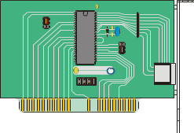
Lab Setup – Data Path
SSH connection to IFI: 129.240.66.50
IXP lab
PCI
IO
hub
switch
hub interface
memory
hub
…
192.168.1.1
system
bus
CPU
192.168.1.5
RAM
interface
IXP2400
memory
web bumper
(counting web packets and forwarding
all packets from one interface to another)

Slide 28
Lab Setup – Data Path
SSH connection to IFI: 129.240.66.50
IXP lab
IO
hub
switch
10.0.40.3
10.0.40.1
memory
hub
…
192.168.1.1
CPU
192.168.1.5
IXP2400
memory
web bumper
(counting web packets and forwarding
all packets from one interface to another)

Slide 29
The Web Bumper
the wwbump core components checks a packet forwarded by the wwbump microblock
count ping packet - add 1 to icmp counter
send back to wwbump microblock
the wwbump microblock checks all packets from rx block: if it is a ping or web packet:
if web packet, add 1 to web counter and
forward to tx block
if ping packet, forward to wwbump core component
if neither, forward to tx block
The wwbump microblock forwards all packets from the wwbump core component to the tx block
web bumper
wwbump
(core)
XScale
microengines
IXP 2400
input
port
rx
microblock
wwbump
(microblock)
tx
microblock
output
port
rx block processing encompasses all
operations performed as packets arrive
web bumper
(counting web packets and forwarding
all packets from one interface to another)
tx block processing encompasses all
operations applied as packets depart

Slide 30
Starting and Stopping
On the host machine
  Location of the example: /root/wwpingbump
  Rebooting the IXP card: make reset
  Installing the example: make install
  Telnet to the card:
    telnet 192.168.1.5
    minicom
    screen /dev/ttyS0 57600
On the card
  To start the example: ./wwbump
  To stop the example: CTRL-C
Let’s look at an example...

