Slide 1
x86 and M-JPEG
INF5063:
Programming heterogeneous multi-core processors
September 13, 2011

Slide 2
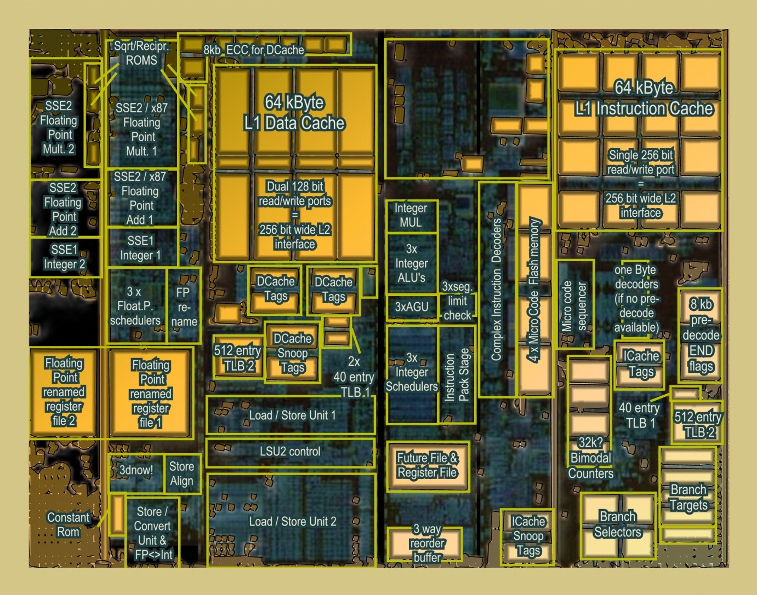
AMD K8

Slide 3
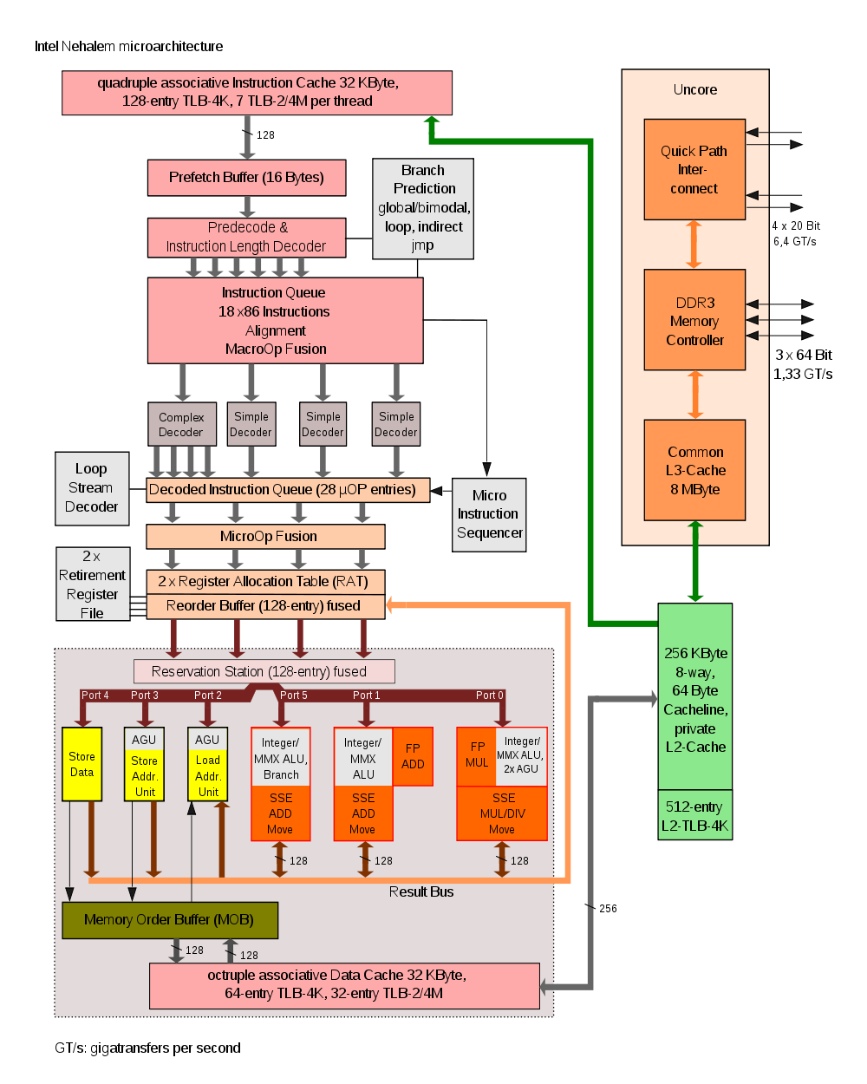
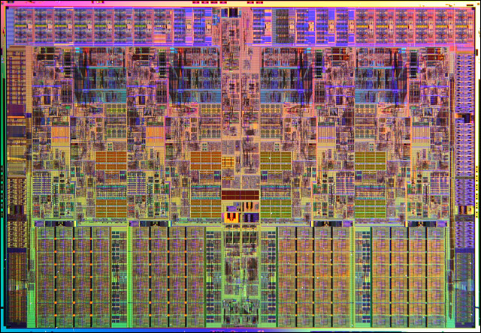
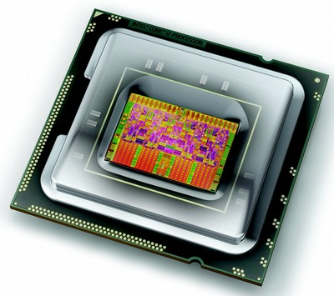
Intel Nehalem
Nehalem

Slide 4
Intel Nehalem

Slide 5
Special instructions…
MMX
  MMX is officially a meaningless initialism trademarked by Intel; unofficially,
    MultiMedia eXtension
    Multiple Math eXtension
    Matrix Math eXtension
  SIMD (Single Instruction, Multiple Data) computation processes multiple data in parallel with a single instruction, resulting in significant performance improvement;
  MMX gives 2 32-bit computations at once.
  MMX defined 8 “new” 64-bit integer registers (mm0 ~ mm7), which were aliases for the existing x87 FPU registers – reusing 64 (out of 80) bits in the floating point registers.

Slide 6

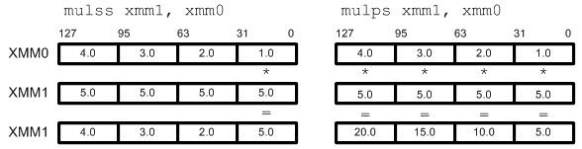
Special instructions…
SSE
  Streaming SIMD Extensions (SSE)
  SIMD; 4 computations at once.
  SSE defines 8 new 128-bit registers (xmm0 ~ xmm7) for single-precision floating-point computations. Since each register is128-bit long, we can store total 4 of 32-bit floating-point numbers (1-bit sign, 8-bit exponent, 23-bit mantissa).
  Single or packed scalar operations: __SS vs __PS

Slide 7
Example: Matrix Multiplication
1 | 1 | 1 | 1
2 | 2 | 2 | 2
3 | 3 | 3 | 3
4 | 4 | 4 | 4
1
2
3
4
1
2
3
4
10
2
4
6
8
20
3
6
9
12
30
4
8
12
16
40

Slide 8
Example: Matrix Multiplication - C
#include <stdio.h>
float elts[4][4] = {1,1,1,1,2,2,2,2,3,3,3,3,4,4,4,4};
float vin[4] = {1,2,3,4};
float vout[4];
void main(void)
{
vout[0] = elts[0][0] * vin[0] + elts[0][1] * vin[1] +
elts[0][2] * vin[2] + elts[0][3] * vin[3];
vout[1] = elts[1][0] * vin[0] + elts[1][1] * vin[1] +
elts[1][2] * vin[2] + elts[1][3] * vin[3];
vout[2] = elts[2][0] * vin[0] + elts[2][1] * vin[1] +
elts[2][2] * vin[2] + elts[2][3] * vin[3];
vout[3] = elts[3][0] * vin[0] + elts[3][1] * vin[1] +
elts[3][2] * vin[2] + elts[3][3] * vin[3];
printf("%f %f %f %f\n", vout[0], vout[1], vout[2], vout[3]);
}

Slide 9
Example: Matrix Multiplication – SSE
__asm {
mov esi, VIN
mov edi, VOUT
// load columns of matrix into xmm4-7
mov edx, ELTS
movups xmm4, [edx]
movups xmm5, [edx + 0x10]
movups xmm6, [edx + 0x20]
movups xmm7, [edx + 0x30]
// load v into xmm0.
movups xmm0, [esi]
// we'll store the final result in xmm2; initialize it
// to zero
xorps xmm2, xmm2
// broadcast x into xmm1, multiply it by the first
// column of the matrix (xmm4), and add it to the total
movups xmm1, xmm0
shufps xmm1, xmm1, 0x00
mulps xmm1, xmm4
addps xmm2, xmm1
// repeat the process for y, z and w
movups xmm1, xmm0
shufps xmm1, xmm1, 0x55
mulps xmm1, xmm5
addps xmm2, xmm1
movups xmm1, xmm0
shufps xmm1, xmm1, 0xAA
mulps xmm1, xmm6
addps xmm2, xmm1
movups xmm1, xmm0
shufps xmm1, xmm1, 0xFF
mulps xmm1, xmm7
addps xmm2, xmm1
// write the results to vout
movups [edi], xmm2
}
#include <stdio.h>
float elts[4][4] = {1,1,1,1,2,2,2,2,3,3,3,3,4,4,4,4};
float vin[4] = {1,2,3,4};
float vout[4];
void main(void)
{
vout[0] = elts[0][0] * vin[0] + elts[0][1] * vin[1] +
elts[0][2] * vin[2] + elts[0][3] * vin[3];
vout[1] = elts[1][0] * vin[0] + elts[1][1] * vin[1] +
elts[1][2] * vin[2] + elts[1][3] * vin[3];
vout[2] = elts[2][0] * vin[0] + elts[2][1] * vin[1] +
elts[2][2] * vin[2] + elts[2][3] * vin[3];
vout[3] = elts[3][0] * vin[0] + elts[3][1] * vin[1] +
elts[3][2] * vin[2] + elts[3][3] * vin[3];
printf("%f %f %f %f\n", vout[0], vout[1], vout[2], vout[3]);
}
Assuming elts in a COLUMN-MAJOR order:
a | b | c | d
e | f | g | h
i | j | k | l
m | n | o | p
a | e | i | n | b | f | j | n | c | g | k | o | d | h | l | p

Slide 10
Example: Matrix Multiplication – SSE
__asm {
mov esi, VIN
mov edi, VOUT
// load columns of matrix into xmm4-7
mov edx, ELTS
movups xmm4, [edx]
movups xmm5, [edx + 0x10]
movups xmm6, [edx + 0x20]
movups xmm7, [edx + 0x30]
// load v into xmm0.
movups xmm0, [esi]
// we'll store the final result in xmm2; initialize it
// to zero
xorps xmm2, xmm2
// broadcast x into xmm1, multiply it by the first
// column of the matrix (xmm4), and add it to the total
movups xmm1, xmm0
shufps xmm1, xmm1, 0x00
mulps xmm1, xmm4
addps xmm2, xmm1
// repeat the process for y, z and w
movups xmm1, xmm0
shufps xmm1, xmm1, 0x55
mulps xmm1, xmm5
addps xmm2, xmm1
movups xmm1, xmm0
shufps xmm1, xmm1, 0xAA
mulps xmm1, xmm6
addps xmm2, xmm1
movups xmm1, xmm0
shufps xmm1, xmm1, 0xFF
mulps xmm1, xmm7
addps xmm2, xmm1
// write the results to vout
movups [edi], xmm2
}

Slide 11
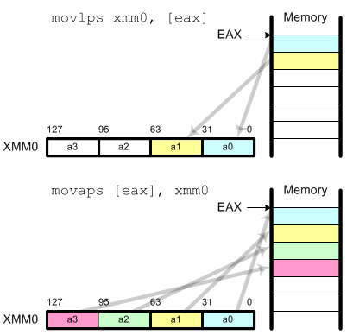
Example: Matrix Multiplication – SSE
__asm {
mov esi, VIN
mov edi, VOUT
// load columns of matrix into xmm4-7
mov edx, ELTS
movups xmm4, [edx]
movups xmm5, [edx + 0x10]
movups xmm6, [edx + 0x20]
movups xmm7, [edx + 0x30]
// load v into xmm0.
movups xmm0, [esi]
// we'll store the final result in xmm2; initialize it
// to zero
xorps xmm2, xmm2
// broadcast x into xmm1, multiply it by the first
// column of the matrix (xmm4), and add it to the total
movups xmm1, xmm0
shufps xmm1, xmm1, 0x00
mulps xmm1, xmm4
addps xmm2, xmm1
// repeat the process for y, z and w
movups xmm1, xmm0
shufps xmm1, xmm1, 0x55
mulps xmm1, xmm5
addps xmm2, xmm1
movups xmm1, xmm0
shufps xmm1, xmm1, 0xAA
mulps xmm1, xmm6
addps xmm2, xmm1
movups xmm1, xmm0
shufps xmm1, xmm1, 0xFF
mulps xmm1, xmm7
addps xmm2, xmm1
// write the results to vout
movups [edi], xmm2
}
Notes:
Data Movements
The first things that you should know are how to copy data from memory to xmm registers and how to get the results back to your application from xmm registers after SIMD operation. The data movement instructions move scalar and packed data between memory and xmm registers.
movss: copy a single floating-point data movlps: copy 2 floating-point data (low packed) movhps: copy 2 floating-point data (high packed) movaps: copy aligned 4 floating-point data (fast) movups: copy unaligned 4 floating-point data (slow) movhlps: copy 2 high elements to low position movlhps: copy 2 low elements to high position
movaps requires that the data in memory must be aligned 16 byte boundary for better performance.

Slide 12
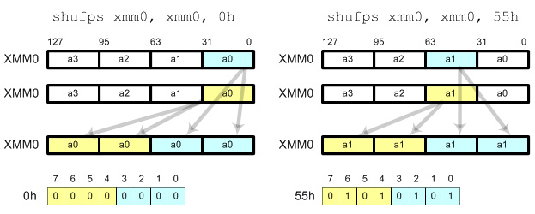
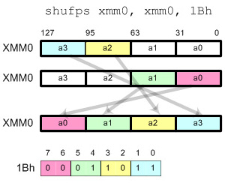
Example: Matrix Multiplication – SSE
__asm {
mov esi, VIN
mov edi, VOUT
// load columns of matrix into xmm4-7
mov edx, ELTS
movups xmm4, [edx]
movups xmm5, [edx + 0x10]
movups xmm6, [edx + 0x20]
movups xmm7, [edx + 0x30]
// load v into xmm0.
movups xmm0, [esi]
// we'll store the final result in xmm2; initialize it
// to zero
xorps xmm2, xmm2
// broadcast x into xmm1, multiply it by the first
// column of the matrix (xmm4), and add it to the total
movups xmm1, xmm0
shufps xmm1, xmm1, 0x00
mulps xmm1, xmm4
addps xmm2, xmm1
// repeat the process for y, z and w
movups xmm1, xmm0
shufps xmm1, xmm1, 0x55
mulps xmm1, xmm5
addps xmm2, xmm1
movups xmm1, xmm0
shufps xmm1, xmm1, 0xAA
mulps xmm1, xmm6
addps xmm2, xmm1
movups xmm1, xmm0
shufps xmm1, xmm1, 0xFF
mulps xmm1, xmm7
addps xmm2, xmm1
// write the results to vout
movups [edi], xmm2
}
Notes:
Shuffle Instruction
shufps requires 2 operands and 1 mask. shufps selects 2 elements from each operand (register) based on the mask. 2 elements from the first operand are copied to the lower 2 elements in destination register and 2 elements from the second operand are copied to the higher 2 elements in the destination register.Using shufps instruction, you can shuffle any 4 data elements with any order. The frequent usages of shufps are broadcast, swap and rotate.BroadcastIt copies all 4 fields with a single data element. The possible masks are
00h: Broadcast the least significant data element 55h: Broadcast the second data element AAh: Broadcast the third data element FFh: Broadcast the most significant data element

Slide 13
Example: Matrix Multiplication – SSE
__asm {
mov esi, VIN
mov edi, VOUT
// load columns of matrix into xmm4-7
mov edx, ELTS
movups xmm4, [edx]
movups xmm5, [edx + 0x10]
movups xmm6, [edx + 0x20]
movups xmm7, [edx + 0x30]
// load v into xmm0.
movups xmm0, [esi]
// we'll store the final result in xmm2; initialize it
// to zero
xorps xmm2, xmm2
// broadcast x into xmm1, multiply it by the first
// column of the matrix (xmm4), and add it to the total
movups xmm1, xmm0
shufps xmm1, xmm1, 0x00
mulps xmm1, xmm4
addps xmm2, xmm1
// repeat the process for y, z and w
movups xmm1, xmm0
shufps xmm1, xmm1, 0x55
mulps xmm1, xmm5
addps xmm2, xmm1
movups xmm1, xmm0
shufps xmm1, xmm1, 0xAA
mulps xmm1, xmm6
addps xmm2, xmm1
movups xmm1, xmm0
shufps xmm1, xmm1, 0xFF
mulps xmm1, xmm7
addps xmm2, xmm1
// write the results to vout
movups [edi], xmm2
}
1 | 2 | 3 | 4
1 | 2 | 3 | 4
1 | 4 | 9 | 16

Slide 14
Example: Matrix Multiplication – SSE
__asm {
mov esi, VIN
mov edi, VOUT
// load columns of matrix into xmm4-7
mov edx, ELTS
movups xmm4, [edx]
movups xmm5, [edx + 0x10]
movups xmm6, [edx + 0x20]
movups xmm7, [edx + 0x30]
// load v into xmm0.
movups xmm0, [esi]
// we'll store the final result in xmm2; initialize it
// to zero
xorps xmm2, xmm2
// broadcast x into xmm1, multiply it by the first
// column of the matrix (xmm4), and add it to the total
movups xmm1, xmm0
shufps xmm1, xmm1, 0x00
mulps xmm1, xmm4
addps xmm2, xmm1
// repeat the process for y, z and w
movups xmm1, xmm0
shufps xmm1, xmm1, 0x55
mulps xmm1, xmm5
addps xmm2, xmm1
movups xmm1, xmm0
shufps xmm1, xmm1, 0xAA
mulps xmm1, xmm6
addps xmm2, xmm1
movups xmm1, xmm0
shufps xmm1, xmm1, 0xFF
mulps xmm1, xmm7
addps xmm2, xmm1
// write the results to vout
movups [edi], xmm2
}
1 | 2 | 3 | 4
1 | 2 | 3 | 4
2 | 4 | 6 | 8

Slide 15
Example: Matrix Multiplication – SSE
xmm0:
__asm {
mov esi, VIN
mov edi, VOUT
// load columns of matrix into xmm4-7
mov edx, ELTS
movups xmm4, [edx]
movups xmm5, [edx + 0x10]
movups xmm6, [edx + 0x20]
movups xmm7, [edx + 0x30]
// load v into xmm0.
movups xmm0, [esi]
// we'll store the final result in xmm2; initialize it
// to zero
xorps xmm2, xmm2
// broadcast x into xmm1, multiply it by the first
// column of the matrix (xmm4), and add it to the total
movups xmm1, xmm0
shufps xmm1, xmm1, 0x00
mulps xmm1, xmm4
addps xmm2, xmm1
// repeat the process for y, z and w
movups xmm1, xmm0
shufps xmm1, xmm1, 0x55
mulps xmm1, xmm5
addps xmm2, xmm1
movups xmm1, xmm0
shufps xmm1, xmm1, 0xAA
mulps xmm1, xmm6
addps xmm2, xmm1
movups xmm1, xmm0
shufps xmm1, xmm1, 0xFF
mulps xmm1, xmm7
addps xmm2, xmm1
// write the results to vout
movups [edi], xmm2
}
4 | 3 | 2 | 1
xmm1:
1 | 1 | 1 | 1
2 | 2 | 2 | 2
3 | 3 | 3 | 3
4 | 4 | 4 | 4
1
2
3
4
4 | 3 | 2 | 1
1 | 1 | 1 | 1
4 | 3 | 2 | 1
4 | 3 | 2 | 1
2 | 2 | 2 | 2
8 | 6 | 4 | 2
4 | 3 | 2 | 1
3 | 3 | 3 | 3
12 | 9 | 6 | 3
4 | 3 | 2 | 1
4 | 4 | 4 | 4
16 | 12 | 8 | 4
xmm2:
0 | 0 | 0 | 0
4 | 3 | 2 | 1
12 | 9 | 6 | 3
24 | 18 | 12 | 6
40 | 30 | 20 | 10
xmm4:
4 | 3 | 2 | 1
xmm5:
4 | 3 | 2 | 1
xmm6:
4 | 3 | 2 | 1
xmm7:
4 | 3 | 2 | 1

Slide 16
Intrinsic SSE functions
Intrinsic SSE instructions exist,
e.g., for gcc on Intel Linux:
  src1 = _mm_mul_ps(src1, src2) →
  mulps src1, src2
  src1 = _mm_add_ps(src1, src2) →
  addps src1, src2
…which can be used without any (large/noticeable) performance loss

Slide 17
(M-) JPEG
The very short, turbo fast introduction

Slide 18
High data volumes: Need for compression
PAL video sequence
  25 images per second
  3 bytes per pixel
    RGB (red-green-blue values)
    YUV (luminance + 2 chrominance values), usually often a compression already
  Uncompressed data rate depending on resolution:
    VGA: 640 * 480 * 3 Byte * 25/s = 23.040.000 byte/s = ~ 22 MByte/s
    HD 720p: 1280 * 720 * 3 Byte * 25/s = 69.120.000 byte/s = ~ 66 Mbyte/s
    HD 1080p: 1920 * 1080 * 3 Byte * 25/s = 155.520.000 byte/s = ~ 148 Mbyte/s
Network rates
  5 Mbps ADSL: 4% of 1 HD1080p
  1 Gbps Ethernet: 84% of 1 HD1080p
  add 1000s of concurrent users
Need for compression

Slide 19
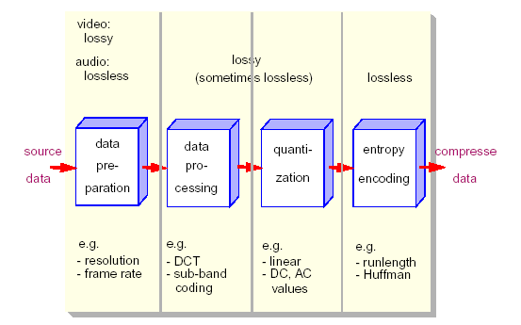
Basic Encoding Steps

Slide 20
JPEG
“JPEG”: Joint Photographic Expert Group
International Standard:
  For digital compression and coding of continuous-tone still images
  Gray-scale and color
Compression rate of 1:10 yields reasonable results
  Lossless mode: reasonable compression rate approx. 1:1.6
Independence of
  Image resolution
  Image and pixel aspect ratio
  Color representation
  Image complexity and statistical characteristics

Slide 21


1 - Color conversion: RGB to YCbCr
The 24-bit RGB (red, green, blue) value is often converted to YCbCr consisting of
  one luma component (Y) representing brightness:
  two chroma components representing color (Cb-BlueDifference and
  Cr-RedDifference), or of the Pb and Pr:
  Kb and Kr are ordinarily derived from the definition of the corresponding RGB space, e.g.,
  Kb = 0.114 and Kr = 0.299 defined for standard-definition television
  the prime (') symbols mean gamma correction is being used - resulting luma (Y) value will then have a nominal range from 0 to 1, and the chroma (Cb and Cr) values will have a nominal range from -0.5 to +0.5
  in digital form, the results are scaled and rounded, and offsets are typically added

Slide 22
1 - Color conversion: RGB to YCbCr
JPEG File Interchange Format (JFIF) allows Y'CbCr where Y', Cb and Cr have the full 256 values:
  Y' = + 0.299 * R’ + 0.587 * G’ + 0.114 * B’
  Cb = 128 - 0.168736 * R’ - 0.331264 * G’ + 0.5 * B’
  Cr = 128 + 0.5 * R’ - 0.418688 * G’ - 0.081312 * B’
… allowing values [0, 255]
Downsampling (first compression step)
  humans can see considerably more fine detail in the brightness,
  i.e., can reduce the spatial resolution of the Cb and Cr components
  4:4:4 (no downsampling)
  4:2:2 (reduce by factor of 2 in horizontal direction)
  4:2:0 (reduce by factor of 2 in horizontal and vertical directions)
  resolution of croma is usually reduced by a factor of 2 (24-bit to 16-bit in total)

Slide 23


1 - Color conversion: RGB to YCbCr
Y image is essentially a greyscale copy of the main image;
the white snow is represented as a middle value in both Cr and Cb;
the brown barn is represented by weak Cb and strong Cr;
the green grass is represented by weak Cb and weak Cr;
the blue sky is represented by strong Cb and weak Cr.
RGB
YCbCr
R
Y
G
Cb
B
Cr

Slide 24
2 - Split each picture in 8x8 blocks
Each Y, Cb and Cr picture is divided into 8x8 blocks, number depends on resolution

Slide 25

3 - Discrete cosine transform (DCT)
Each 8×8 block (Y, Cb, Cr) is converted to a frequency-domain representation, using a normalized, two-dimensional DCT

Slide 26
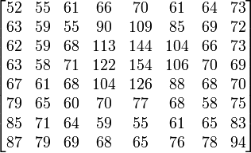
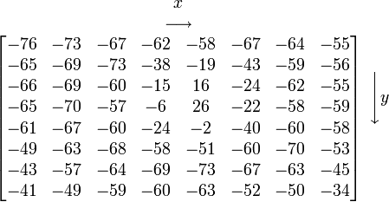
3 - Discrete cosine transform (DCT)
Each 8×8 block (Y, Cb, Cr) is converted to a frequency-domain representation, using a normalized, two-dimensional DCT
  each pixel is represented by a [0, 255]-value
  each pixel is transformed to a [-128, 127]-value

Slide 27


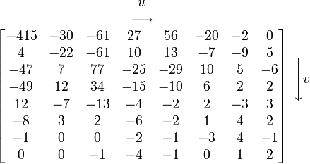
3 - Discrete cosine transform (DCT)
Each 8×8 block (Y, Cb, Cr) is converted to a frequency-domain representation, using a normalized, two-dimensional DCT
  two-dimensional DCT:
    G_{u,v} is the DCT at coordinates (u,v)
    u is the horizontal spatial frequency [0,8>
    v is the vertical spatial frequency [0,8>
    g_{x,y} is the pixel value at coordinates (x,y)
    α is a normalizing function:
Note the rather large value of the top-left corner (DC coefficient). The remaining 63 are AC coefficients. The advantage of the DCT is its tendency to aggregate most of the signal in one corner of the result, as may be seen above.
Compression possible: the following quantization step accentuates this effect while simultaneously reducing the overall size of the DCT coefficients

Slide 28
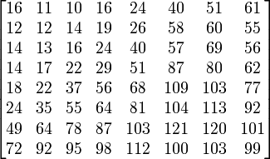
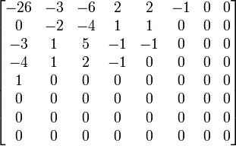
4 - Quantization
The human eye
  is good at seeing small differences in brightness over a large area
  not so good at distinguishing the exact strength of a high frequency brightness variation
  can reduce the amount of information in the high frequency components
  simply dividing each component in the frequency domain by a known constant for that component, and then rounding to the nearest integer:
  where Q_{j,k} is a quantization matrix, e.g., for JPEG
G_{0,0} = -415
= -25.9375000000 ≈ -26
Q_{0,0} = 16

Slide 29
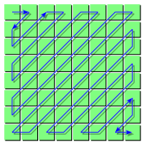
5 - Lossless compression
The resulting data for all 8×8 blocks is further compressed with a loss-less algorithm:
  organizing numbers in a zigzag pattern:
  -26, -3, 0, -3, -2, -6, 2, -4, 1, -4, 1, 1, 5, 1,
  2, -1, 1, -1, 2, 0, 0, 0, 0, 0, -1, -1, 0 , 0, 0,
  0, 0, 0, 0, 0, 0, …., 0, 0
  run-length (RLE)
  Huffman coding – own table of symbols

Slide 30
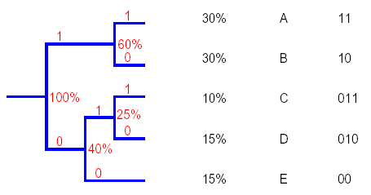
Huffman Coding
Assumption
  Some symbols are more frequent than others
Example
    Given: A, B, C, D, E
    Probability to occur: p(A)=0.3, p(B)=0.3, p(C)=0.1, p(D)=0.15, p(E)=0.15

Slide 31
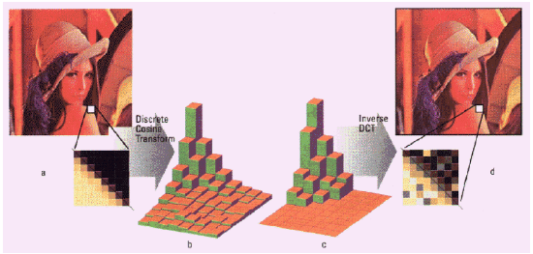
JPEG – Baseline Mode: Quantization
Use of quantization tables for the DCT-coefficients
  Map interval of real numbers to one integer number
  Allows to use different granularity for each coefficient

Slide 32
Motion JPEG
Use series of JPEG frames to encode video
Pro
  Lossless mode – editing advantage
  Frame-accurate seeking – editing advantage
  Arbitrary frame rates – playback advantage
  Arbitrary frame skipping – playback advantage
  Scaling through progressive mode – distribution advantage
  Min transmission delay = 1/framerate – conferencing advantage
  Supported by popular frame grabbers
Contra
  Series of JPEG-compressed images
  No standard, no specification
    Worse, several competing quasi-standards
  No relation to audio
  No inter-frame compression

