Slide 1
INF5063 – GPU & CUDA
Håkon Kvale Stensland
iAD-lab, Department for Informatics

Slide 2
Basic 3D Graphics Pipeline
Application
Host
Scene Management
Geometry
Rasterization
Frame
Buffer
Memory
GPU
Pixel Processing
ROP/FBI/Display
Notes:
Geometry = Setter opp vertexer (kanter i triangler), og lager triangler
Rasterization = Finne ut hvilke pixler som hører hjemme i trianglet
Pixel = Manipulere, gjøre effekter med pixler
ROP = Render Out Put = Siste ”touch” på triangler, eller på AA, osv. Finner også ut om vi trenger pixlen (er den synlig (Hidden Surface Removal))

Slide 3
PC Graphics Timeline
Challenges:
  Render infinitely complex scenes
  And extremely high resolution
  In 1/60th of one second (60 frames per second)
Graphics hardware has evolved from a simple hardwired pipeline to a highly programmable multiword processor
DirectX 6
DirectX 7
DirectX 8
DirectX 9
DirectX 9.0c
DirectX 9.0c
DirectX 10
DirectX 5
Multitexturing
T&L TextureStageState
SM 1.x
SM 2.0
SM 3.0
SM 3.0
SM 4.0
Riva 128
Riva TNT
GeForce 256
GeForce 3
Cg
GeForceFX
GeForce 6
GeForce 7
GeForce 8
1998
1999
2000
2001
2002
2003
2004
2005
2006
Notes:
Spill driver markedet

Slide 4
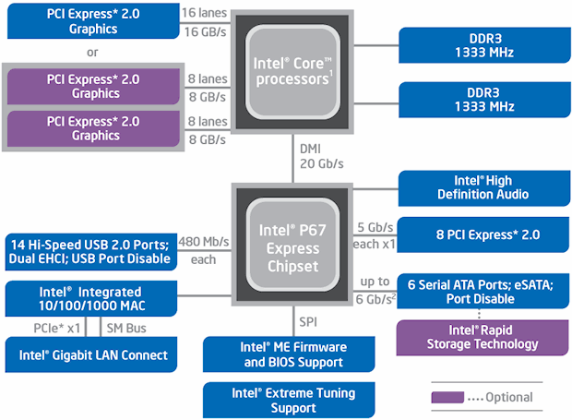
Graphics in the PC Architecture
DMI (Direct Media Interface) between processor and chipset
  Memory Control now integrated in CPU
The old “Northbridge” integrated onto CPU
  PCI Express 2.0 x16 bandwidth at 16 GB/s (8 GB in each direction)
Southbridge (P67) handles all other peripherals
Notes:
PCI Express = Seriel bus, flere kanaler…. 0,5 GB/sec hver vei
Mer strøm!
Snart PCI Express 3.0

Slide 5
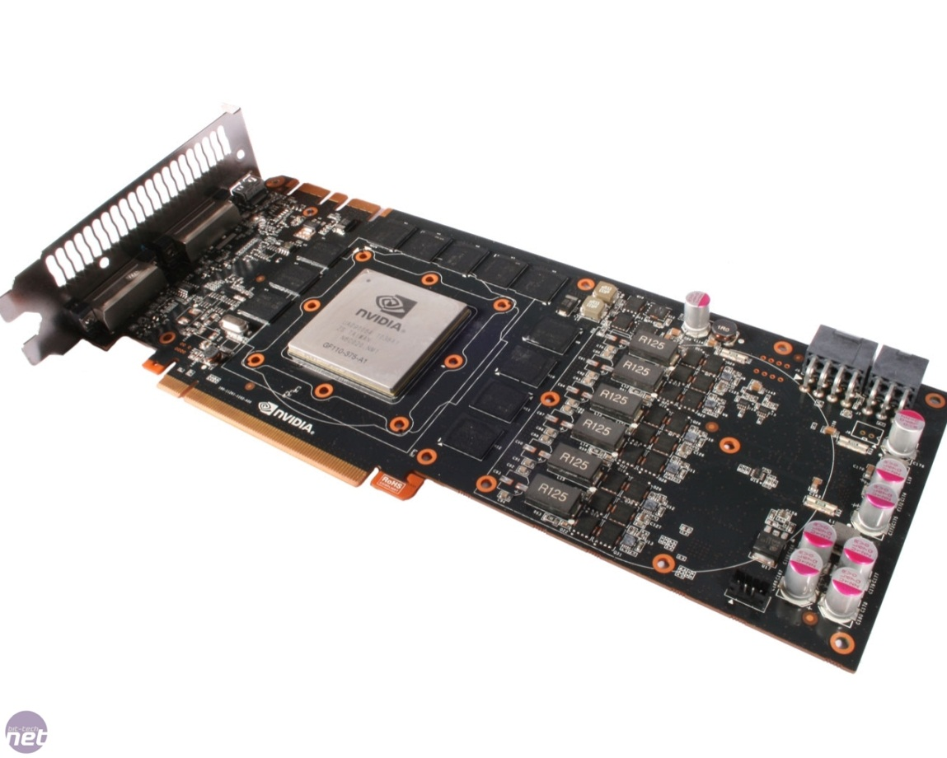
High-end Hardware
nVIDIA Fermi Architecture
The latest generation GPU, codenamed GF110
3,1 billion transistors
512 Processing cores (SP)
  IEEE 754-2008 Capable
  Shared coherent L2 cache
  Full C++ Support
  Up to 16 concurrent kernels
Notes:
40nm største hos TSMC

Slide 6
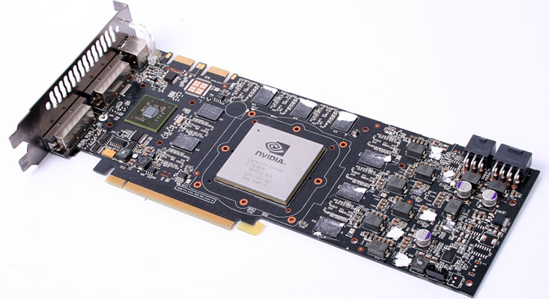
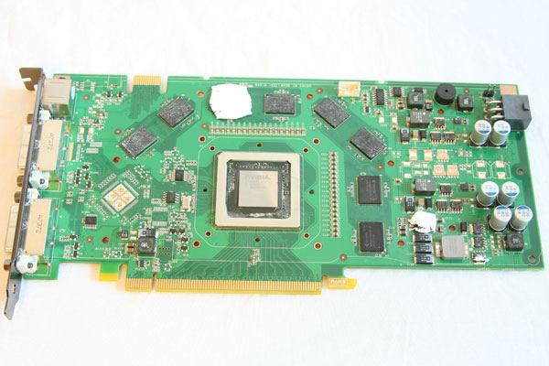
Lab Hardware
nVidia GeForce GTX 280
  Clinton, Bush
Based on the GT200 chip
  1400 million transistors
  240 Processing cores (SP) at 1476MHz
  1024 MB Memory with 159 GB/sec bandwidth
  Compute version 1.3
nVidia GeForce 8800GT
  GPU-1, GPU-2, GPU-3, GPU-4
Based on the G92 chip
  754 million transistors
  112 Processing cores (SP) at 1500MHz
  256 MB Memory with 57.6GB/sec bandwidth
  Compute version 1.1
Notes:
Begge er Compute 1.1
En maskin med 8800GTX – Compute 1.0

Slide 7
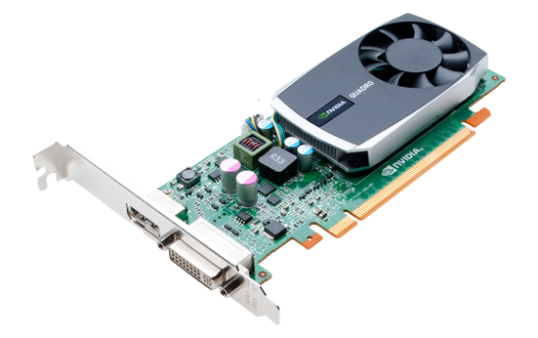
Lab Hardware #2
nVidia Quadro 600
  GPU-5, GPU-6, GPU7, GPU-8
Based on the GF108(GL) chip
  585 million transistors
  96 Processing cores (CC) at 1280MHz
  1024 MB Memory with 25,6 GB/sec bandwidth
  Compute version 2.1

Slide 8
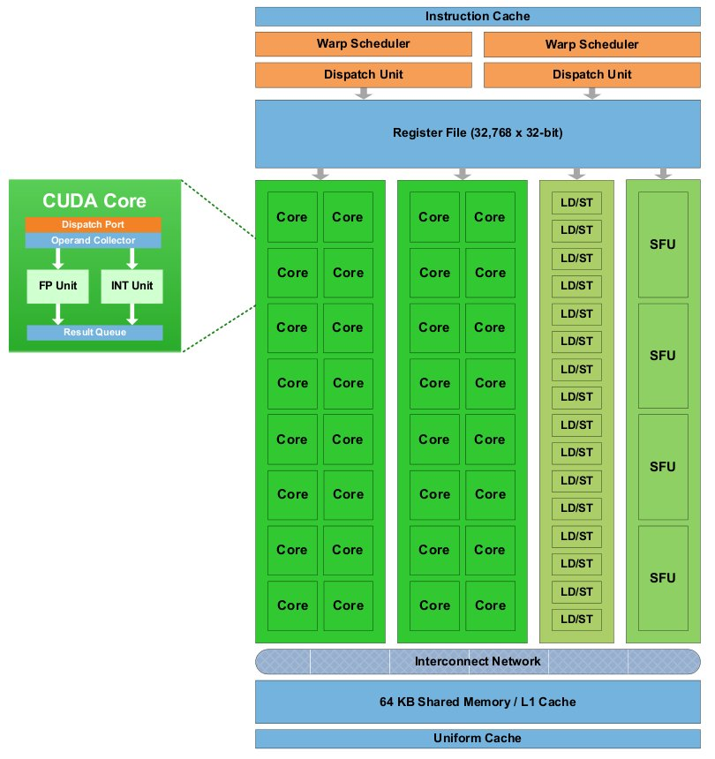
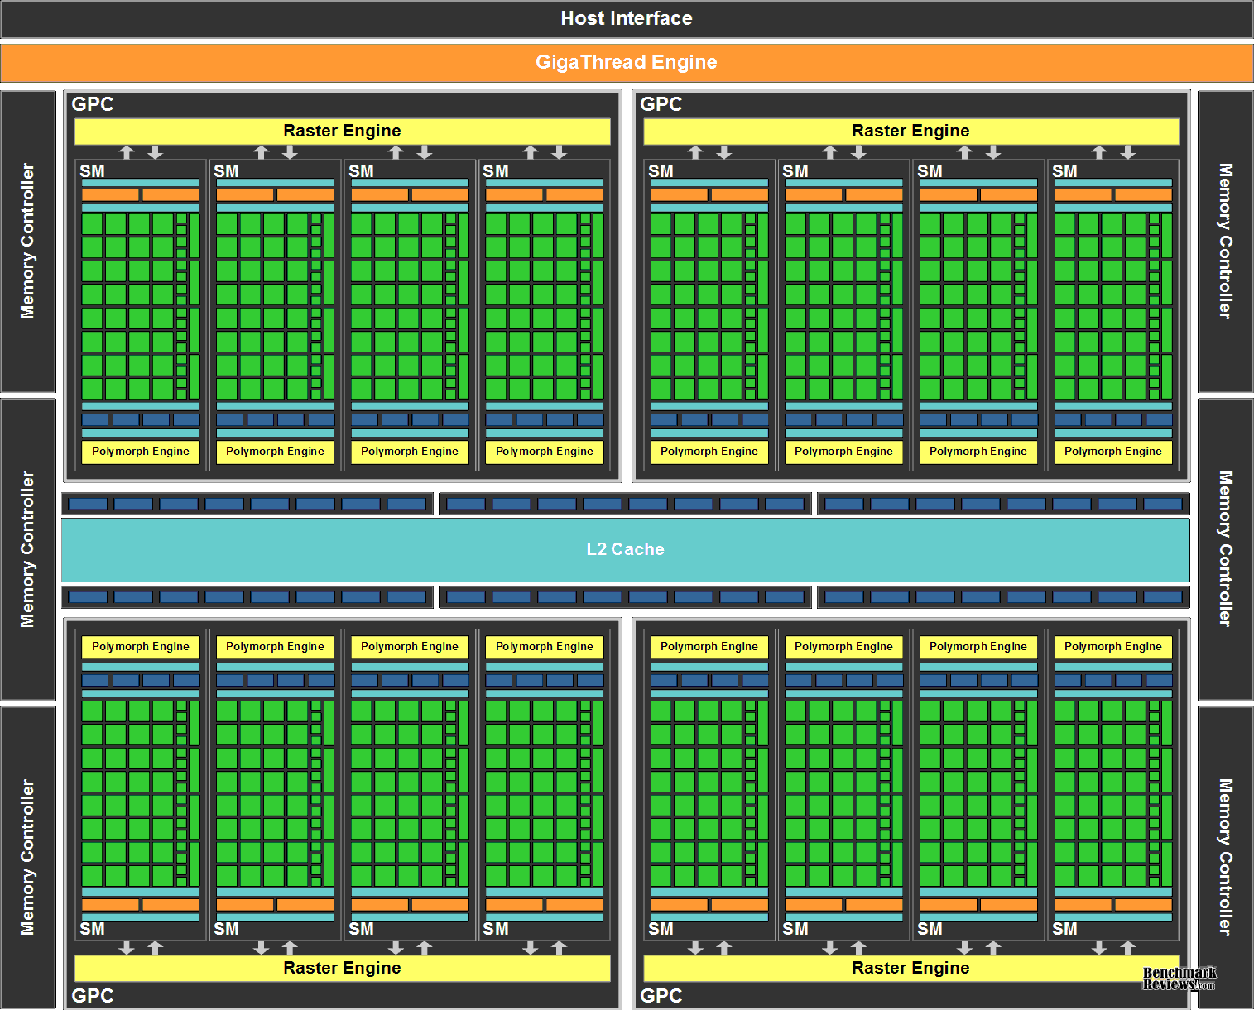
GeForce GF100 Architecture
Notes:
A ”mile-high” overview

Slide 9
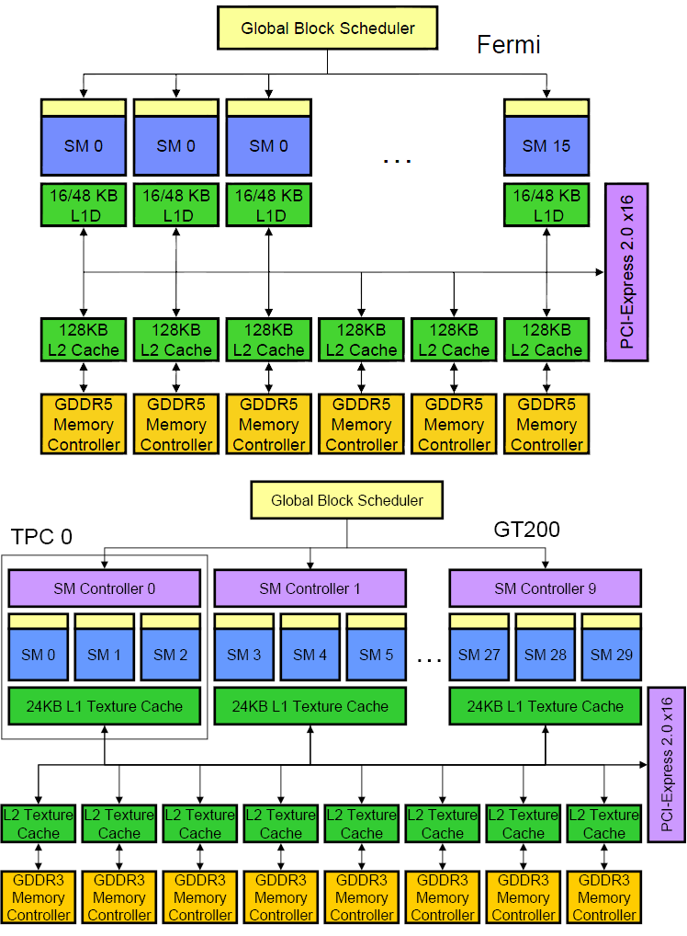
nVIDIA GF100 vs. GT200 Architecture
Notes:
TPC = Texture Processor Cluster
SM = Streaming Multiprocessor
SP = Stream Processor (Oppererer med Scalar-verdier)
SFU = Special Function Unit
TEX = Texturing Unit

Slide 10
TPC… SM… SP… Some more details…
TPC
  Texture Processing Cluster
SM
  Streaming Multiprocessor
  In CUDA: Multiprocessor, and fundamental unit for a thread block
TEX
  Texture Unit
SP
  Stream Processor
  Scalar ALU for single CUDA thread
SFU
  Super Function Unit
TPC
TPC
TPC
TPC
TPC
TPC
TPC
TPC
Texture Processor Cluster
Streaming Multiprocessor
Instruction L1
Data L1
SM
SM
Instruction Fetch/Dispatch
Shared Memory
TEX
SM
SP
SP
SP
SP
SM
SFU
SFU
SP
SP
SP
SP

Slide 11
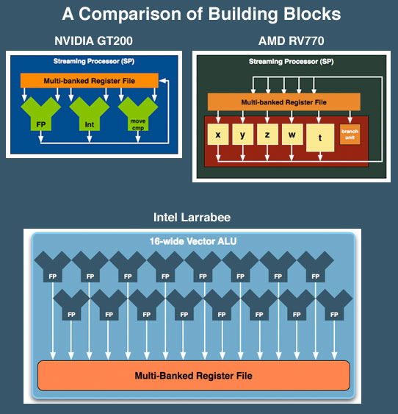
SP: The basic processing block
The nVIDIA Approach:
  A Stream Processor works on a single operation
AMD GPU’s work on up to five or four operations, new architecture in works.
Now, let’s take a step back for a closer look!

Slide 12
Streaming Multiprocessor (SM) – 1.0
Streaming Multiprocessor (SM)
  8 Streaming Processors (SP)
  2 Super Function Units (SFU)
Multi-threaded instruction dispatch
  1 to 1024 threads active
  Try to Cover latency of texture/memory loads
Local register file (RF)
16 KB shared memory
DRAM texture and memory access
Streaming Multiprocessor
(
SM
)
Instruction Fetch
Instruction L
1
Cache
L
1
Fill
Thread
/
Instruction Dispatch
Work
Shared Memory
Control
SP
0
RF
0
RF
4
SP
4
Results
S
SP
1
RF
1
RF
5
SP
5
S
F
F
U
SP
2
RF
2
RF
6
SP
6
U
SP
3
RF
3
RF
7
SP
7
Load Texture
Constant L
1
Cache
L
1
Fill
Load from Memory
Store to
Store to Memory
Foils adapted from nVIDIA

Slide 13
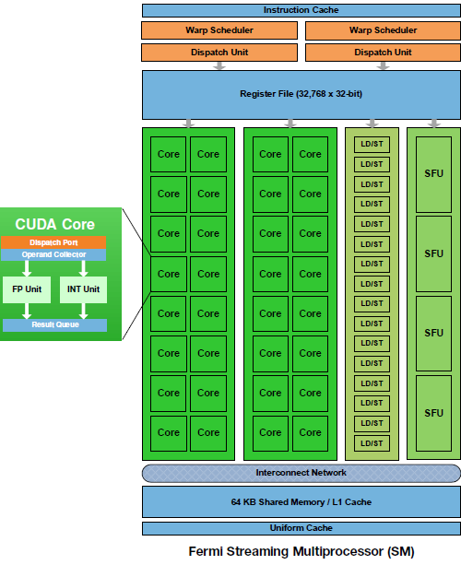
Streaming Multiprocessor (SM) – 2.0
Streaming Multiprocessor (SM) on the Fermi Architecture
  32 CUDA Cores (CC)
  4 Super Function Units (SFU)
Dual schedulers and dispatch units
  1 to 1536 threads active
  Try to optimize register usage vs. number of active threads
Local register (32k)
64 KB shared memory
DRAM texture and memory access

Slide 14
SM Register File
Register File (RF)
  32 KB
  Provides 4 operands/clock
TEX pipe can also read/write Register File
  3 SMs share 1 TEX
Load/Store pipe can also read/write Register File
I
$
L
1
Multithreaded
Instruction Buffer
R
C
$
Shared
F
L
1
Mem
Operand Select
MAD
SFU
Notes:
TEX er mer viktig for grafikk

Slide 15
Constants
Immediate address constants
Indexed address constants
Constants stored in memory, and cached on chip
  L1 cache is per Streaming Multiprocessor
I
$
L
1
Multithreaded
Instruction Buffer
R
C
$
Shared
F
L
1
Mem
Operand Select
MAD
SFU

Slide 16
Shared Memory
Each Stream Multiprocessor has 16KB of Shared Memory
  16 banks of 32bit words
CUDA uses Shared Memory as shared storage visible to all threads in a thread block
  Read and Write access
I
$
L
1
Multithreaded
Instruction Buffer
R
C
$
Shared
F
L
1
Mem
Operand Select
MAD
SFU

Slide 17
Execution Pipes
Scalar MAD pipe
  Float Multiply, Add, etc.
  Integer ops,
  Conversions
  Only one instruction per clock
Scalar SFU pipe
  Special functions like Sin, Cos, Log, etc.
    Only one operation per four clocks
TEX pipe (external to SM, shared by all SM’s in a TPC)
Load/Store pipe
  CUDA has both global and local memory access through Load/Store
I
$
L
1
Multithreaded
Instruction Buffer
R
C
$
Shared
F
L
1
Mem
Operand Select
MAD
SFU
Notes:
FMUL = Floating point multipler, FADD = Floating point add,
Hot clock/shader clock

Slide 18
GPGPU
Foils adapted from nVIDIA

Slide 19

What is really GPGPU?
General Purpose computation using GPU
in other applications than 3D graphics
  GPU can accelerate parts of an application
Parallel data algorithms using the GPUs properties
  Large data arrays, streaming throughput
  Fine-grain SIMD parallelism
  Fast floating point (FP) operations
Applications for GPGPU
  Game effects (physics): nVIDIA PhysX, Bullet Physics, etc.
  Image processing: Photoshop CS4, CS5, etc.
  Video Encoding/Transcoding: Elemental RapidHD, etc.
  Distributed processing: Stanford Folding@Home, etc.
  RAID6, AES, MatLab, BitCoin-mining, etc.
Notes:
Mark Harris, of Nvidia, runs the gpgpu.org website

Slide 20
Previous GPGPU use, and limitations
Working with a Graphics API
  Special cases with an API like Microsoft Direct3D or OpenGL
Addressing modes
  Limited by texture size
Shader capabilities
  Limited outputs of the available shader programs
Instruction sets
  No integer or bit operations
Communication is limited
  Between pixels
per thread
per Shader
per Context
Input Registers
Fragment Program
Texture
Constants
Temp Registers
Output Registers
FB Memory

Slide 21

nVIDIA CUDA
“Compute Unified Device Architecture”
General purpose programming model
  User starts several batches of threads on a GPU
  GPU is in this case a dedicated super-threaded, massively data parallel co-processor
Software Stack
  Graphics driver, language compilers (Toolkit), and tools (SDK)
Graphics driver loads programs into GPU
  All drivers from nVIDIA now support CUDA
  Interface is designed for computing (no graphics ☺)
  “Guaranteed” maximum download & readback speeds
  Explicit GPU memory management

Slide 22
Khronos Group OpenCL
Open Computing Language
Framework for programing heterogeneous processors
  Version 1.0 released with Apple OSX 10.6 Snow Leopard
  Current version is version OpenCL 1.1
Two programing models. One suited for GPUs and one suited for Cell-like processors.
  GPU programing model is very similar to CUDA
Software Stack:
  Graphics driver, language compilers (Toolkit), and tools (SDK).
  Lab machines with nVIDIA hardware support both CUDA & OpenCL.
  OpenCL also supported on all new AMD cards.
You decide what to use for the home exam!

Slide 23
Outline
The CUDA Programming Model
  Basic concepts and data types
An example application:
  The good old Motion JPEG implementation!
Tomorrow:
  More details on the CUDA programming API
  Make a small example program!
Notes:
I dag skal skjelettet frem…. Om to uker blir det mer kjøtt på bena

Slide 24
The CUDA Programming Model
The GPU is viewed as a compute device that:
  Is a coprocessor to the CPU, referred to as the host
  Has its own DRAM called device memory
  Runs many threads in parallel
Data-parallel parts of an application are executed on the device as kernels, which run in parallel on many threads
Differences between GPU and CPU threads
  GPU threads are extremely lightweight
    Very little creation overhead
  GPU needs 1000s of threads for full efficiency
    Multi-core CPU needs only a few

Slide 25
Thread Batching: Grids and Blocks
A kernel is executed as a grid of thread blocks
  All threads share data memory space
A thread block is a batch of threads that can cooperate with each other by:
  Synchronizing their execution
    Non synchronous execution is very bad for performance!
  Efficiently sharing data through a low latency shared memory
Two threads from two different blocks cannot cooperate
Host
Device
Grid 1
Kernel 1
Block
(0, 0)
Block
(1, 0)
Block
(2, 0)
Block
(0, 1)
Block
(1, 1)
Block
(2, 1)
Grid 2
Kernel 2
Block (1, 1)
Thread
(0, 0)
Thread
(1, 0)
Thread
(2, 0)
Thread
(3, 0)
Thread
(4, 0)
Thread
(0, 1)
Thread
(1, 1)
Thread
(2, 1)
Thread
(3, 1)
Thread
(4, 1)
Thread
(0, 2)
Thread
(1, 2)
Thread
(2, 2)
Thread
(3, 2)
Thread
(4, 2)
Notes:
1 kernel eksekverer 1 grid…
1 block kjører på 1 SM (Multiprosessor)

Slide 26
CUDA Device Memory Space Overview
Each thread can:
  R/W per-thread registers
  R/W per-thread local memory
  R/W per-block shared memory
  R/W per-grid global memory
  Read only per-grid constant memory
  Read only per-grid texture memory
The host can R/W global, constant, and texture memories
(Device) Grid
Block (0, 0)
Block (1, 0)
Shared Memory
Shared Memory
Registers
Registers
Registers
Registers
Thread (0, 0)
Thread (1, 0)
Thread (0, 0)
Thread (1, 0)
Local
Memory
Local
Memory
Local
Memory
Local
Memory
Host
Global
Memory
Constant
Memory
Texture
Memory
Notes:
Global, constant, and texture memory spaces are persistent across kernels called by the same application.

Slide 27
Global, Constant, and Texture Memories
Global memory:
  Main means of communicating R/W Data between host and device
  Contents visible to all threads
Texture and Constant Memories:
  Constants initialized by host
  Contents visible to all threads
(Device) Grid
Block (0, 0)
Block (1, 0)
Shared Memory
Shared Memory
Registers
Registers
Registers
Registers
Thread (0, 0)
Thread (1, 0)
Thread (0, 0)
Thread (1, 0)
Local
Memory
Local
Memory
Local
Memory
Local
Memory
Host
Global
Memory
Constant
Memory
Texture
Memory

Slide 28
Terminology Recap
device = GPU = Set of multiprocessors
Multiprocessor = Set of processors & shared memory
Kernel = Program running on the GPU
Grid = Array of thread blocks that execute a kernel
Thread block = Group of SIMD threads that execute a kernel and can communicate via shared memory
Memory | Location | Cached | Access | Who
Local | Off-chip | No | Read/write | One thread
Shared | On-chip | N/A - resident | Read/write | All threads in a block
Global | Off-chip | No | Read/write | All threads + host
Constant | Off-chip | Yes | Read | All threads + host
Texture | Off-chip | Yes | Read | All threads + host

Slide 29
Access Times
Register – Dedicated HW – Single cycle
Shared Memory – Dedicated HW – Single cycle
Local Memory – DRAM, no cache – “Slow”
Global Memory – DRAM, no cache – “Slow”
Constant Memory – DRAM, cached, 1…10s…100s of cycles, depending on cache locality
Texture Memory – DRAM, cached, 1…10s…100s of cycles, depending on cache locality

Slide 30
The CUDA Programming Model
The GPU is viewed as a compute device that:
  Is a coprocessor to the CPU, referred to as the host
  Has its own DRAM called device memory
  Runs many threads in parallel
Data-parallel parts of an application are executed on the device as kernels, which run in parallel on many threads
Differences between GPU and CPU threads
  GPU threads are extremely lightweight
    Very little creation overhead
  GPU needs 1000s of threads for full efficiency
    Multi-core CPU needs only a few

Slide 31
Terminology Recap
device = GPU = Set of multiprocessors
Multiprocessor = Set of processors & shared memory
Kernel = Program running on the GPU
Grid = Array of thread blocks that execute a kernel
Thread block = Group of SIMD threads that execute a kernel and can communicate via shared memory
Memory | Location | Cached | Access | Who
Local | Off-chip | No | Read/write | One thread
Shared | On-chip | N/A - resident | Read/write | All threads in a block
Global | Off-chip | No | Read/write | All threads + host
Constant | Off-chip | Yes | Read | All threads + host
Texture | Off-chip | Yes | Read | All threads + host

Slide 32
Access Times
Register – Dedicated HW – Single cycle
Shared Memory – Dedicated HW – Single cycle
Local Memory – DRAM, no cache – “Slow”
Global Memory – DRAM, no cache – “Slow”
Constant Memory – DRAM, cached, 1…10s…100s of cycles, depending on cache locality
Texture Memory – DRAM, cached, 1…10s…100s of cycles, depending on cache locality

Slide 33
Some Information on the Toolkit

Slide 34
Compilation
Any source file containing CUDA language extensions must be compiled with nvcc
nvcc is a compiler driver
  Works by invoking all the necessary tools and compilers like cudacc, g++, etc.
nvcc can output:
  Either C code
    That must then be compiled with the rest of the application using another tool
  Or object code directly

Slide 35
Linking & Profiling
Any executable with CUDA code requires two dynamic libraries:
  The CUDA runtime library (cudart)
  The CUDA core library (cuda)
Several tools are available to optimize your application
  nVIDIA CUDA Visual Profiler
  nVIDIA Occupancy Calculator
Windows users: NVIDIA Parallel Nsight 2.0 for Visual Studio

Slide 36
Debugging Using Device Emulation
An executable compiled in device emulation mode (nvcc -deviceemu):
  No need of any device and CUDA driver
When running in device emulation mode, one can:
  Use host native debug support (breakpoints, inspection, etc.)
  Call any host function from device code
  Detect deadlock situations caused by improper usage of __syncthreads
nVIDIA CUDA GDB
printf is now available on the device! (cuPrintf)

Slide 37
Before you start…
Four lines have to be added to your group users .bash_profile or .bashrc file
  PATH=$PATH:/usr/local/cuda/bin
  LD_LIBRARY_PATH=$LD_LIBRARY_PATH:/usr/local/cuda/lib64
  export PATH
  export LD_LIBRARY_PATH
SDK is downloaded in the /opt/ folder
Copy and build in your users home directory

Slide 38
Some usefull resources
nVIDIA CUDA Programming Guide 4.0
http://developer.download.nvidia.com/compute/DevZone/docs/html/C/doc/CUDA_C_Programming_Guide.pdf
nVIDIA OpenCL Programming Guide
http://developer.download.nvidia.com/compute/cuda/3_2_prod/toolkit/docs/OpenCL_Programming_Guide.pdf
nVIDIA CUDA C Programming Best Practices Guide http://developer.download.nvidia.com/compute/DevZone/docs/html/C/doc/CUDA_C_Best_Practices_Guide.pdf
nVIDIA OpenCL Programming Best Practices Guide
http://developer.download.nvidia.com/compute/cuda/3_2_prod/toolkit/docs/OpenCL_Best_Practices_Guide.pdf
nVIDIA CUDA Reference Manual 4.0
http://developer.download.nvidia.com/compute/DevZone/docs/html/C/doc/CUDA_Toolkit_Reference_Manual.pdf

Slide 39
Example:
Motion JPEG Encoding

Slide 40
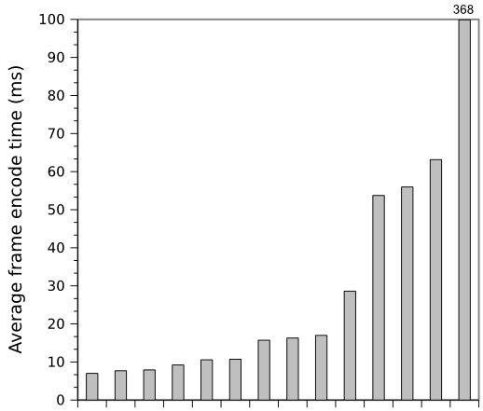
14 different MJPEG encoders on GPU
Nvidia GeForce GPU
Problems:
Only used global memory
To much synchronization between threads
Host part of the code not optimized
Notes:
Results from the course INF5063: Advanced course in programming heterogeneous architectures
Two assignments (home exams) on MJPEG (on Cell and GPU)
Y axis IS NOT at the SAME SCALE
one assignment “I/O bound” on the Cell
Looks like it was easy to get better performance on Nvidia GPU (more about this later)

Slide 41
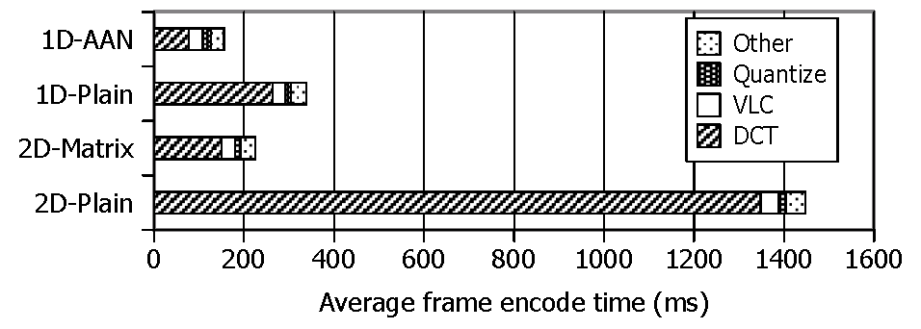
Profiling a Motion JPEG encoder on x86
A small selection of DCT algorithms:
  2D-Plain: Standard forward 2D DCT
  1D-Plain: Two consecutive 1D transformations with transpose in between and after
  1D-AAN: Optimized version of 1D-Plain
  2D-Matrix: 2D-Plain implemented with matrix multiplication
Single threaded application profiled on a Intel Core i5 750

Slide 42
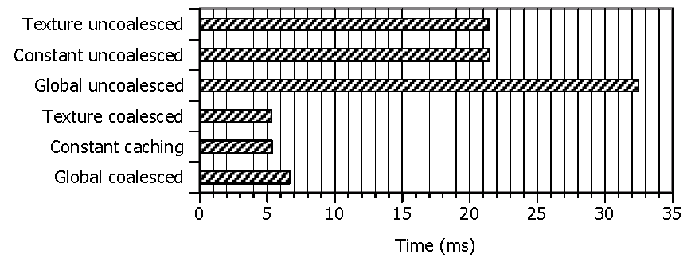
Optimizing for GPU, use the memory correctly!!
Several different types of memory on GPU:
  Global memory
  Constant memory
  Texture memory
  Shared memory
First Commandment when using the GPUs:
  Select the correct memory space, AND use it correctly!

Slide 43
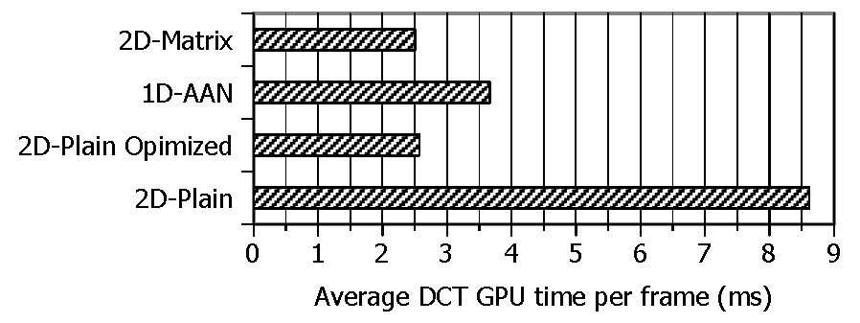
How about using a better algorithm??
Used CUDA Visual Profiler to isolate DCT performance
2D-Plain Optimized is optimized for GPU:
  Shared memory
  Coalesced memory access
  Loop unrolling
  Branch prevention
  Asynchronous transfers
Second Commandment when using the GPUs:
  Choose an algorithm suited for the architecture!

Slide 44
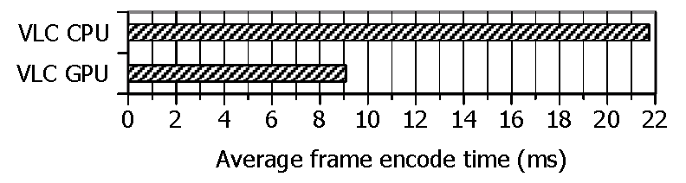
Effect of offloading VLC to the GPU
VLC (Variable Length Coding) can also be offloaded:
  One thread per macro block
  CPU does bitstream merge
Even though algorithm is not perfectly suited for the architecture, offloading effect is still important!

