Slide 1
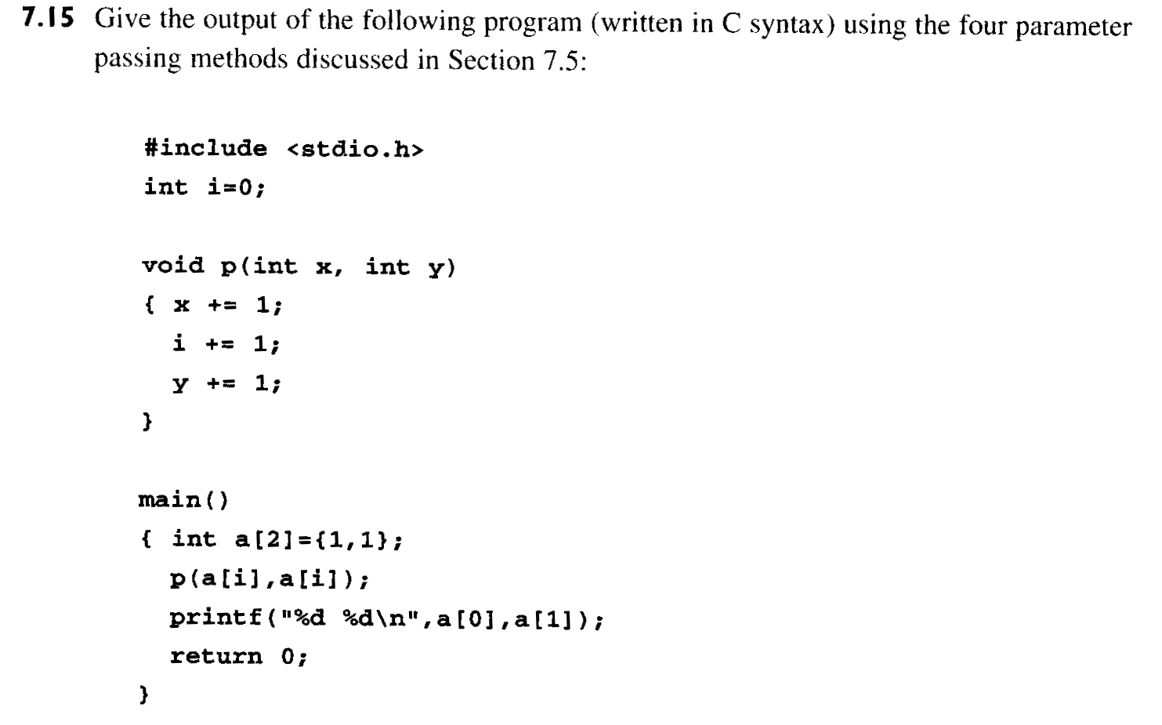
7.15
by value | by reference
by value-result | by name
? ?
? ?
? ?
? ?

Slide 2
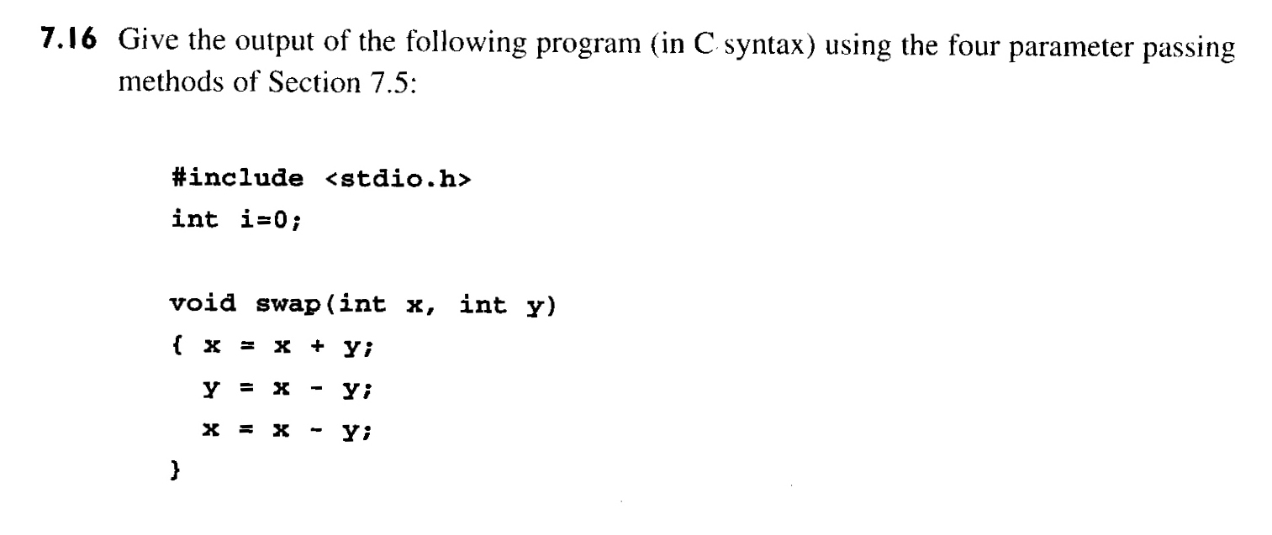
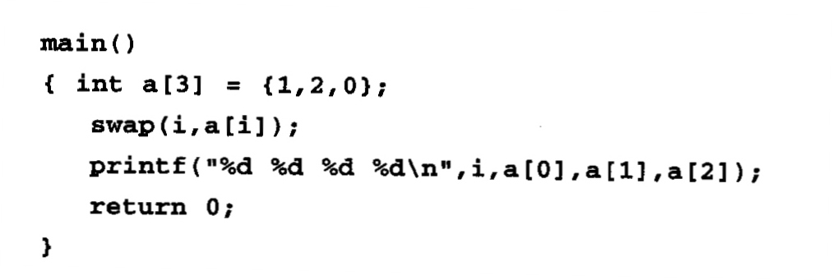
7.16
by value | by reference
by value-result | by name
? ? ? ?
? ? ? ?
? ? ? ?
? ? ? ?

