Slide 1
Rådvill
Trine, Roger, Johannes, Bjørnar and Thomas
Notes:
«Clueless»
Trine: Innledning til konseptet med en situasjonsbeskrivelse som publikum kan sette seg inn i. Bytur-eksempel. Deretter: «Løsningen vår går ut på å få hjelp i slike situasjoner, ved å kunne stille spørsmål til andre helt anonymt, og får svar raskt.»

Slide 2
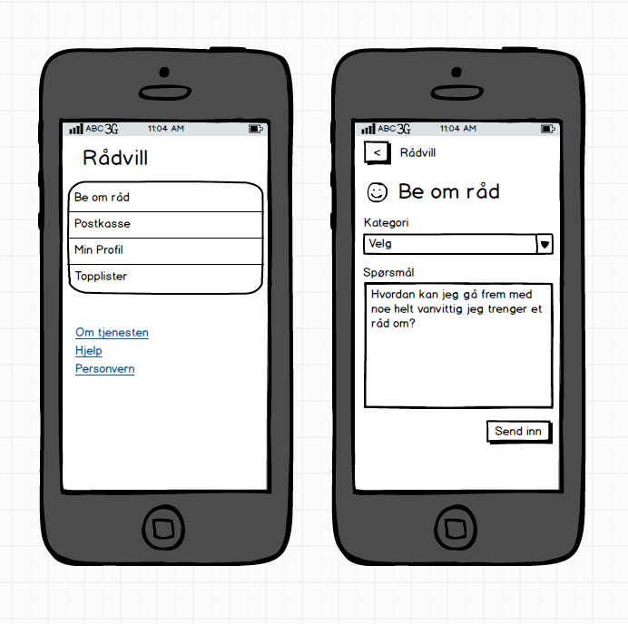
The concept
Ask question within a specific category
Notes:
Our prototype allows users to pose a question to a stranger anonymously

Slide 3
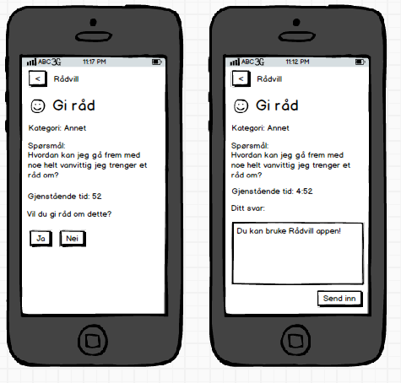
The concept
Ask question within a specific category
Answer questions from other users if you want to
Notes:
If you recive the question you can choose to pass it to someone else, or answer it yourself
Select categories you wish to answer

Slide 4
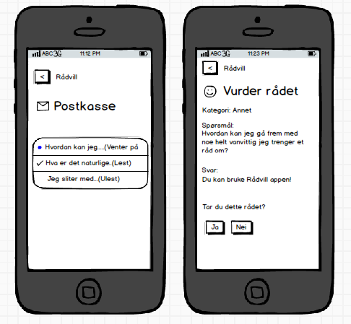
The concept
Ask question within a specific category
Answer questions from other users if you want to
Keep track of questions asked and answered
Choose to accept an answer, or get a new one
Notes:
Overview of (atleast) the most recent questions
By getting your answer accepted you receive points. If its declined you loose points. Pass does not affect your points.
Highscore list which will link to your advisorprofile that you manage yourself (Nickname, description, categories, rank and points)

Slide 5
The prototype
HTML5 App
WebAPI
Modularized
Ajax
WebSockets
Asp.Net C#
nTier architecture
SQL Database
Notes:
Advantage of seperation:
- Can reuse the API (and thereby all business logic ) for future applications.
- Html app can be used as documentation of how to use the api
- Phonegap
- Native, reduces requests since all html, css and js files is present on the mobile -> Increased performance on low bandwidth

Slide 6
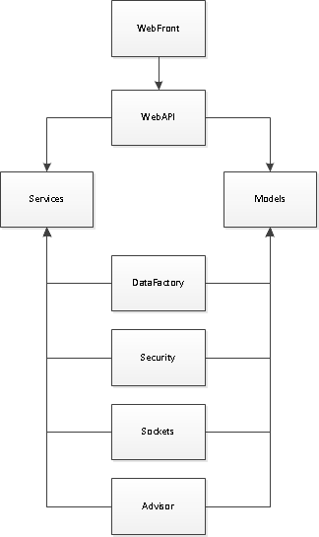
Architecture and flow
A: Submit question
B: Receive question
B: Pass question
C: Receives question
C: Accept to answer question
C: Submit answer
A: Receive answer
A: Accept answer
C: Receives notification of accepted
Notes:
Log in -> Api -> Services -> Authenticate -> Return true and pass along a cookie -> Api -> Sockets -> Switch protocols -> Display home module
Submit question -> Advisor -> ( Locator -> DataFactory ) -> Assign question -> Sockets/EventManager -> Push the question id to the user -> Api -> Get question with deadline
Pass question -> Advisor -> Reassign question and push again
Accept -> API -> (Advisor -> DataFactory -> Update) - Return new deadline -> Display answer form
Submit answer -> API -> Advisor (-> DataFactory) -> EventManager -> Push answer id to user who asked question -> Get answer
Rate answer
-> Yes -> Update database
-> No -> Resend question

Slide 7
DEMO
The code is available at: https://github.com/Elfdalia/Radvill/
(Feel free to fork and play, or stay tuned for the WebAPI cleanup and new features)

