Slide 1
INF5261
Smartwatch
Can smartwatch help users save time by making processes efficient and easier?
Dipesh Pradhan
Nugroho Sujatmiko
3rd December 2014

Slide 2
Content
  Motivation
  Research Questions
  Method
  Preliminary Research Analysis: Smartphone and Smartwatch
  Design Considerations
  Case-studies
  Findings
  Conclusion

Slide 3
Motivation
People have considerable more activities today compared to before.
More demanding activities are typically done with smartphone. Is it practical? Can smartwatch work as an alternative?
Promising various technologies to overcome today’s smartwatch shortcomings.
Accessibility and capability to be used in rough environment.
Various smartwatch products on market from different vendors with various capabilities.

Slide 4
Research Questions
Research Question 1
Are there daily activities that cumulatively take long time to perform using smartphone? E.g. measured by how many manual steps to perform and the daily usage frequency.
The purpose of this research question is to understand the problem domain and identify some case studies to demonstrate the possible solution.
Research Question 2
Can smartwatch make the process more efficient (shorten the steps) and easier? What kind of “human-to-smartwatch” interaction design could be done to exploit the advantage of smartwatch compared to smartphone?
This question helps us to understand if the problem identified by research question 1 can be solved or minimized with smartwatch.

Slide 5
Method
Preliminary research analysis of smartphone and smartwatch
Literature review
Perform potential case-studies
  Notification Management (Doing single activity with less steps)
  Appointment Booking (Saving time by enabling us doing multiple activities in the same time)
Note: We do not develop application in this project

Slide 6
Preliminary Research Analysis- Smartphone
Smartphone usage characteristics
Notification management aspect: not ‘glance-able’ ie. how many times do we need to pick our phones to check SMS, phone call, email, instant messaging (Facebook, Twitter, etc) ?
Interaction aspect: heavily reliant on visual interactions ie. how many touch/tap is required to do things like booking appointment? Not convenient to operate while moving.
Other time-taking aspect eg. finding misplaced phone due to being carried not being worn

Slide 7
Preliminary Research Analysis- Smartwatch
Barriers to use
Cost : typically pricier than smartphone
Battery life
Computing power : less powerfull than smartphone
Screen size : relatively small
Connectivity
Variety of apps : limited due to hardware constraint
Size/style: can be bulky, looks geeky

Slide 8
Interaction design considerations from literature review
Simplify UI by minimizing number of menus/steps required to execute smartwatch function
  Pascoe et al. : mobile users needs simple UI/less menu [8], AndroidWear: contecxt-stream/card-to-card and makes precision not required
Explore alternative input method to run app in addition to screen touch like gesture based, voice based, peripheral based (input on wristband, watch bracelet, programmable button) etc
  Perrault: gesture-based bracelet [3] , Paik: gesture, audio [4] , Chen: gesture sensor input [5] , Bieber: gesture sensor, tactile feedback , acoustic interface [9] , Sawhney: audio [11], AndroidWear: Cue-card
Minimize eyes interaction demand as output modality
  Paik: audio/voice, haptic [4] , Sawhney: audio [11] , Pascoe: minimal attention UI /MAUI [8]
Explore possibility to link smartwatch to other device for the smart home/office
  Bernaerts: smart watch to support & augment office interactions eg. lock/unlock doors, acquire room, virtual knock, [5] Chen: joint interaction of smartwatch & smartphone to simplify smartphone usage [10]
Explore context-awareness capability
  Pascoe: context-awareness to automatically discover and offer resources to the user based on their current environment [8, 12], AndroidWear: provide right-information at just right time e.g. suggest vs demand concept based on context [1]
Universal Design Ornella: user-centric design to improve usability and image of product for all users inclusive of disabled/elderly [14]

Slide 9
Observation
RQ1: Daily tasks commonly performed using smartphone, broken down by number of steps and frequency
Based on the above finding, we are looking at two study cases on how smartwatch can help to improve situation
Tasks | Number of steps ^{(a)} | Average daily frequency
Checking or reading email | 6 | 75 emails [6]
Sending or writing email | 7 - 8 ^{(b,c)}
Making appointment booking | 16 | N/A – unable to find source of data
Checking or reading Twitter/ Whatsapp/ Facebook message | 6 | 75 messages[13]
Sending or writing Twitter/ Whatsapp/ Facebook message | 7 ^{(b)}
Checking or reading SMS | 6 | 61 SMS [2]
Sending or writing SMS | 7 ^{(b)}
Typical steps using smartphone
Take out smartphone from the pocket
Unlock the smartphone
Check and click on the notification to open the message
Read the message.
Close the message
Put smartphone back into pocket
Typical steps using smartwatch
Get notification (sound/vibration)
Read/hear/dictate message
Close message
Notes:
Based on assumption that smartphone is kept in pocket/bag when not used by default
Sending/writing task has one additional step to choose recipient compared to reading task
Sending email may have additional step in case attachment is involved

Slide 10
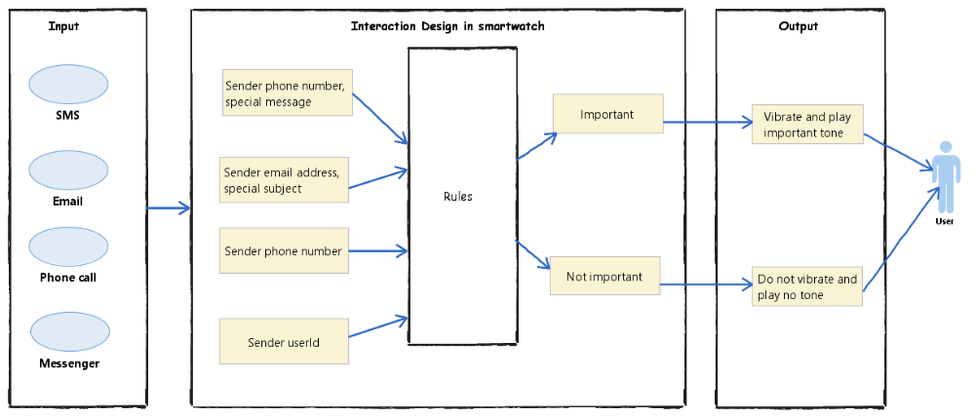
Case study1: Notification Management
High level process design to reduce demand for user attention
Figure 1. How notification can be prioritized based on open rules (user context based), reducing demands for attention and manual steps

Slide 11
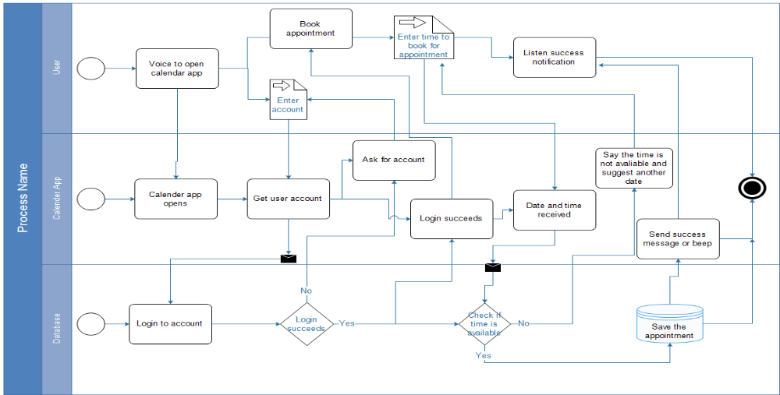
Case study2: Appointment booking
High level process design for appointment booking by voice
Driving,
Walking,
Jogging,
Other mobile activities
Figure 2. How appointments can be booked with voice, allowing us to do it even while moving without interrupting primary activity in parallel

Slide 12
Findings
RQ2: Can smartwatch help to make the aforementioned processes in RQ1 more efficient?
Daily task, frequency & importance/relevancy |  | Number of steps |  |  | Steps saved
 |  | Smartphone without rules (baseline-1) | Smartphone with rules (baseline-2) | Smartwatch | Against baseline-1 | Against baseline-2
One SMS or email |  | 6 | 6 | 3 | 3 | 3
61 SMS | 100% (=61) important/ relevant – worst case | 366 | 366 | 183 | 183 | 183
 | 50% (=31) important/relevant | 366 | 186 | 93 | 273 | 93
 | 10% (=6) important/ relevant – best case | 366 | 36 | 18 | 348 | 18
75 email | 100% (=75) important/ relevant – worst case | 450 | 450 | 225 | 225 | 225
 | 50% (=38) important/relevant | 450 | 228 | 114 | 336 | 114
 | 10% (=6) important/ relevant – best case | 450 | 48 | 24 | 426 | 24

Slide 13
Conclusion
Performing daily tasks using smartphone may take significant number of cumulative steps to execute, as described in RQ1 observation
The usage of smartwatch to perform similar tasks with suggested design may reduce the cumulative number of steps and therefore saving user time, as described in RQ2 finding
The usage of non-visual input/output modality allows user to continue doing his/her primary activity in parallel while interacting with smartwatch, as described in appointment booking by voice case-study. To this extent, the smartwatch usage is less interruptive to the primary activity and therefore provides more time allowance to user in completing the primary activity.

Slide 14
References
1 Creative Vision for Android Wear. [cited 2014 12 November 2014]; Available from: https://developer.android.com/design/wear/creative-vision.html.
2 Cocotas, A. Chart of the day: Kids send a mind boggling number of texts every month. 2013 [cited 2014; Available from: http://www.businessinsider.com/chart-of-the-day-number-of-texts-sent-2013-3.
3 Perrault, S.T., et al. Watchit: simple gestures and eyes-free interaction for wristwatches and bracelets. in Proceedings of the SIGCHI Conference on Human Factors in Computing Systems. 2013. ACM.
4 Paik, K.Y., Eyes-Free interaction method in SmartWatch.
5 Chen, X.A., et al. Duet: exploring joint interactions on a smart phone and a smart watch. in Proceedings of the 32nd annual ACM conference on Human factors in computing systems. 2014. ACM.
6 Radicati, S. Email Statistics Report, 2014-2018. 2014 [cited 2014; Available from: http://www.radicati.com/wp/wp-content/uploads/2014/01/Email-Statistics-Report-2014-2018-Executive-Summary.pdf.
7 Rhodes, B.J., N. Minar, and J. Weaver. Wearable computing meets ubiquitous computing: Reaping the best of both worlds. in Wearable Computers, 1999. Digest of Papers. The Third International Symposium on. 1999. IEEE.

Slide 15
References
8 Jason Pascoe et al. Using While Moving: HCI Issues in Fieldwork Environments. 2000.
9 Bieber, G., T. Kirste, and B. Urban. Ambient interaction by smart watches. in Proceedings of the 5th International Conference on PErvasive Technologies Related to Assistive Environments. 2012. ACM.
10. Bernaerts, Y., et al. The office smartwatch: development and design of a smartwatch app to digitally augment interactions in an office environment. in Proceedings of the 2014 companion publication on Designing interactive systems. 2014. ACM.
11. Sawhney, N. et al. Speaking and Listeing on the Run: Design for Wearable Audio Computing. 1998. IEEE
12. Pascoe, J. The Smartwatch.
13. Petronzio, M. Average whatsapp user sends more than 1200 messages each month. 2014 [cited 2014; Available from: http://mashable.com/2014/02/21/whatsapp-user-chart/.
14. Plos, O. and S. Buisine. Universal design for mobile phones: a case study. in CHI'06 extended abstracts on Human factors in computing systems. 2006. ACM.

Slide 16
Thanks for listening. Any Questions?

