Slide 1
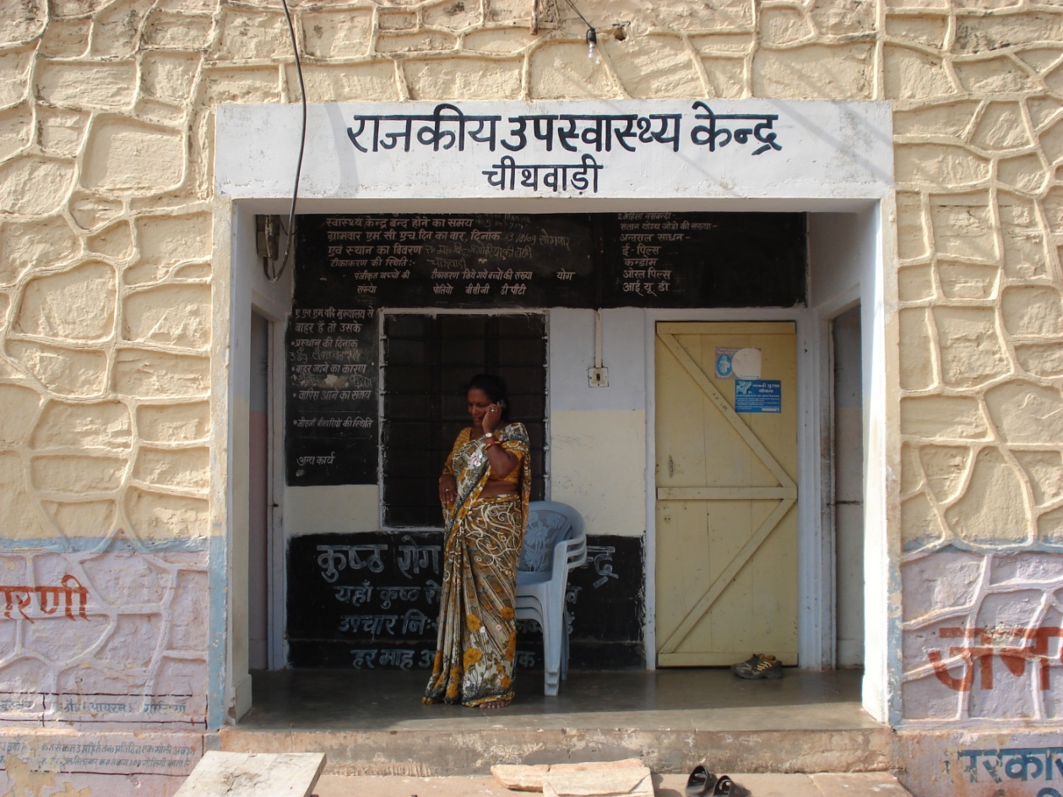
Action Research workshop

Slide 2
The research process
Values,
world view
Value claims
Epistemology
Research
question
Knowledge claims
Research
review
Discussion
Theories
Interpretations
explanations
Concepts
Results
External
validity
Episte-
mological
lens
Method
Findings
Research
design
Data
analysis
Constructs,
variables
Records
Investi-
gative
lens
Internal
validity
Observed events
and objects
Data
collection

Slide 3
Research method
The research method: A strategy of enquiry
A way of finding empirical data about the world
Each research method build on a set of underlying philosphical assumptions, the choice of method influence the way researchers collect the data. Specific research methods imply different set of skills and practices.

Slide 4
 | Positivist Paradigm | Phenomenological Paradigm
Basic beliefs | The world is external and objective Observer is independent Science is value free | The world is socialy constructed and subjective Observer is part of what observed Science is driven by human interest
Researcher should | Focus on facts Lookforcausalities and fundamental laws Reduse phenomena to simples elements Formulate hypothesis and then test them | Focus on meanings Try to understand what is happening Look at the totality of each situation Developideas from induction of data
Preferred methods include | Operatinalising consepts so that they can be measured Large samples | Using multiple methods to establish diferent views of phenomena Small samples invest-igeted in depth over time

Slide 5
Research Design
Values,
world view
Value claims
Epistemology
Research
question
Knowledge claims
Research
review
Discussion
Theories
Interpretations
explanations
Concepts
Results
External
validity
Episte-
mological
lens
Method
Findings
Research
design
Data
analysis
Constructs,
variables
Records
Investi-
gative
lens
Internal
validity
Observed events
and objects
Data
collection
5

Slide 6
Research design
Is about organizing research activity
- including the collection of data
- in ways that are most likely to achieve the research aim.

Slide 7
Research Design
Input: Research Question, Theory, Epistemological lens
Process steps
  Identify key concepts
  Choose and justify method
  Choose unit of analyis and level of investigation
  Connect research interest and problem solving interest
  Construct instruments
  Create high-level plan for intervention
  Validate against research question
Output: Research Design (Investigative lens)

Slide 8
Key choises of research design
Researcher is independent vs Researcher is involved
Large samples vs Small numbers
Testing theories vs Generating thories
Experiemental design vs Fieldwork methods

Slide 9
Qualitative research
Qualitative research allows the researchers to see and understand the context within which decissions and actions take place. It is the context that helps explain why someone acted as they did. And this context (or multiple context) is best understood by talking to people.

Slide 10
What is happening here?
Why is it happening?
How has it come to happen this way?
When did it happen?

Slide 11
Model for qualitive research design
Philosophical assumptions
Research method
Data collection technique
Data analysis approach
Written record

Slide 12
The role of the research questions
They organize the project and give it direction and coherence
They delimit the project, showing its boundaries
They keep the researcher focused
They provide a framework when you write up your research
They point to the methods and data that will be needed

Slide 13
Deductive reasoning
Inductive reasoning
The researcher starts top down
Starts with a theory or some hypothesisshe wants to test
Confirmatory
The researcher starts dottom up
Starts with empirical data from whish she wants to build a theory
Explanatory

Slide 14
Focusing Research
Scrutinizing and clarifying our research – what are we really doing?
Research without focus is inefficient
  We don’t do the things that really matters to us
  We get isolated as we do not communicate what we are doing
The 7 steps on the next page:
  Should make sense when writing a paper or a thesis
  Should be done in the given sequence
  Must result in no more than a title and 6 sentences
  Must be aligned, e.g. the method must fit the research question
  Can be repeated at any time
  Will not in it self lead to excellent research

Slide 15
The 7 Steps
State your main research problem motivating the research (one sentence)
State your main research question addressing the problem (one sentence)
Define the key concept used in the thesis (one sentence)
State your unit of analysis and empirical setting (one sentence)
State your research approach/method (one sentence)
State your main (expected) contribution (one sentence)
Write a title that communicates the essence of the research

Slide 16
Qualitative research: A focus on text
Quantitative research: A focus on numbers
Action research
Case study research
Etnography
Grounded Theory
Semiotics
Discurse analysis
Narrative and metaphor
Surveys
Laboratory experiments
Simulations
Mathematical modeling
Structured equation modeling
Statistical analysis
Econometrics

Slide 17
Action research
Action research aims to solve current practical problems while expanding scientific knowledge-
The action resercher is concerned to create organizational change and simultaneously to study the process.

Slide 18
Action Research
«Action research aims to contibute to the practical concerns of people in an intermediate problematic situation and to the goals of social science by joint collaboration within a mutually acceptable ethical framework» Rappoport (1970)

Slide 19
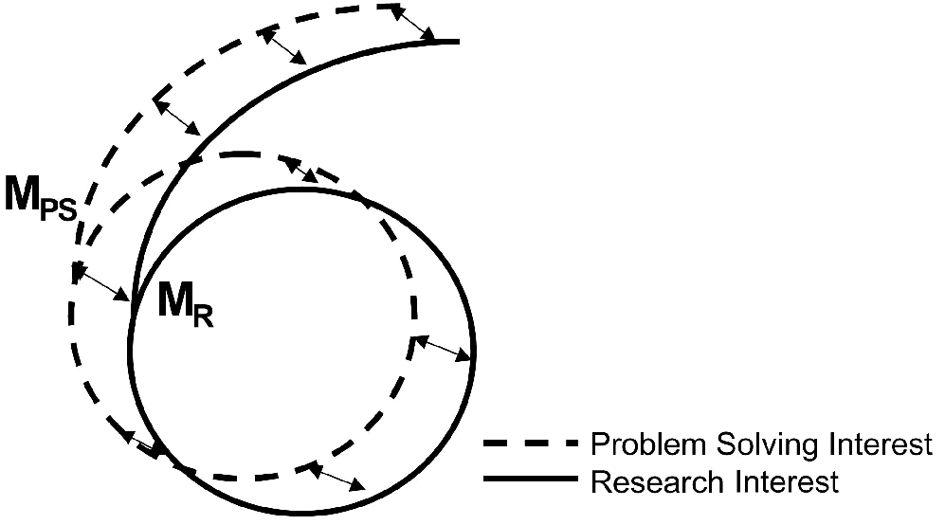
Connecting research interest and problem solving: Integrated model
Kay and Marshall (2001) The dual imperatives of action research.

Slide 20
Connecting research interest and problem solving: Parallell model
Diagnosis
Planning
Action
Evaluation
Findings
Themes
Consepts
Mechanisms
Theory formulation
Action
research
Theory
building

Slide 21
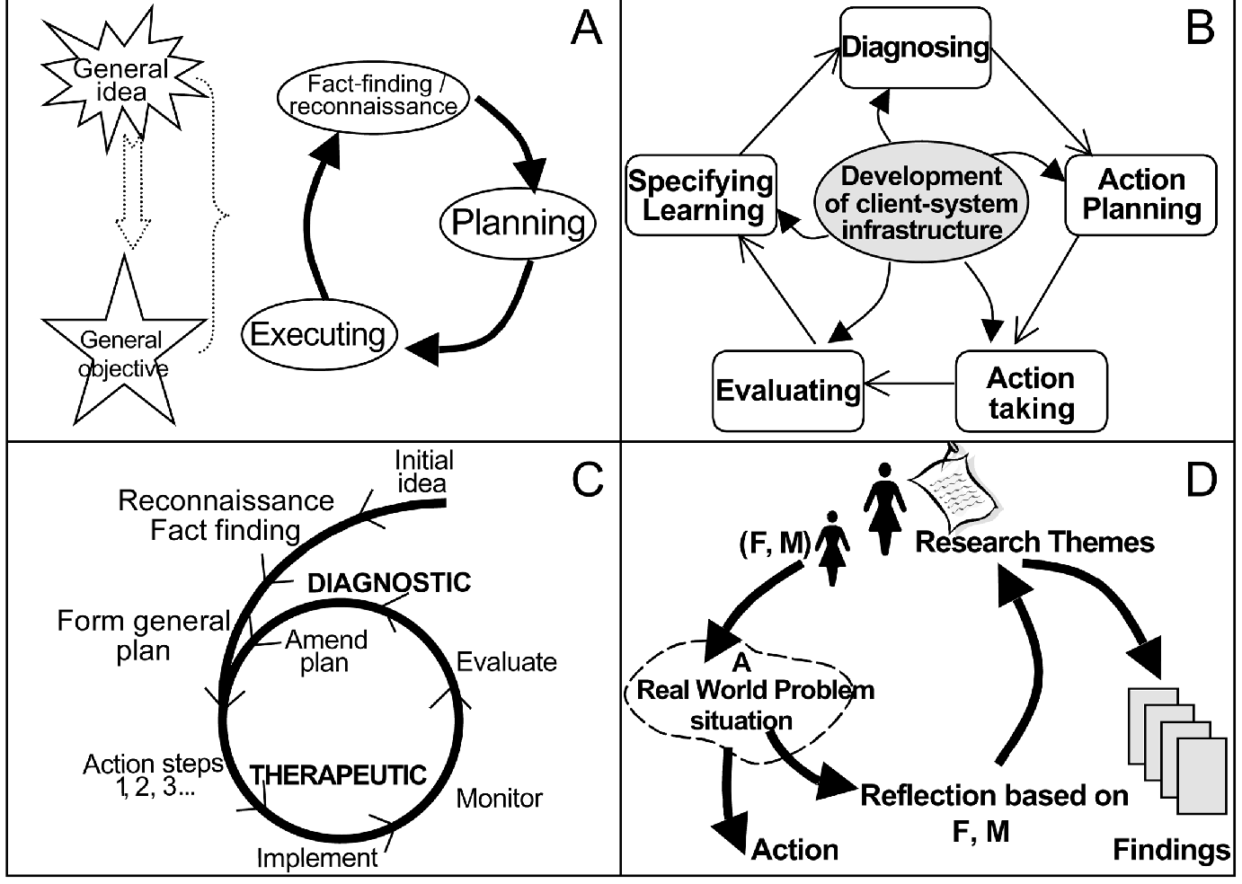
Representations of the action research cycle
(A: McKay, 2000; B: Susman and Evered, 1978; C: Burns, 1994; D: Checkland,
1991)

Slide 22
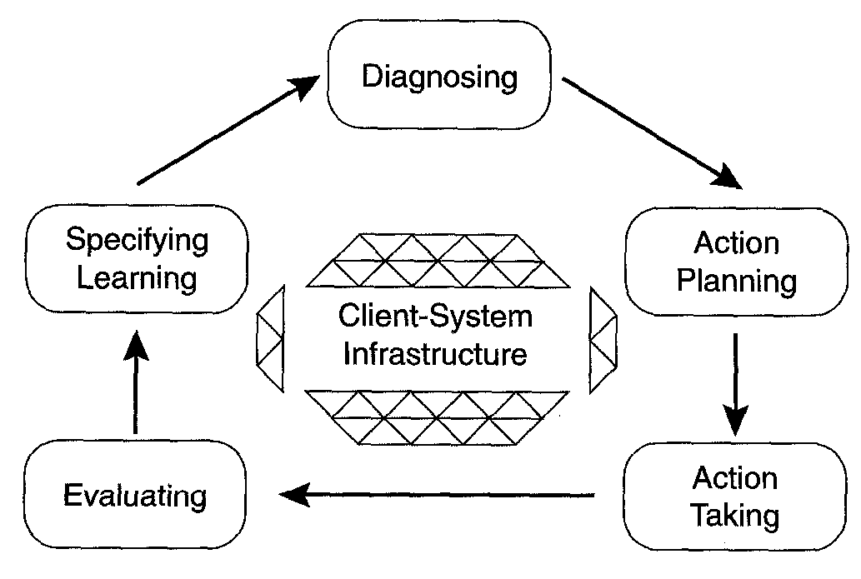
The Action Research Cycle

Slide 23
Action Research cycle
Diagnosing refers to the joint (researcher and practitioner) identification of situated problems and their underlying causes.
  During this phase, researchers and practitioners jointly formulate a working hypothesis of the research phenomenon to be used in the subsequent phases of the action research cycle.
Action planning is the process of specifying the actions that can improve the problem situation.
  Typically, this process includes specifications of IT-prototypes based on problems discovered in the diagnosing phase.
Intervention refers to the implementation of the intervention specified in the action planning phase.

Slide 24
AR cycle continue
Evaluation entails the joint assessment of the intervention by practitioners and researchers.
  This is typically done in the practical problem situation in which the initial diagnosis was conducted.
Specifying learning denotes the ongoing process of documenting and summing up the learning outcomes of the action research cycle.
  These learning outcomes should constitute knowledge contributions to both theory and practice, but they are also recognized as temporary understandings that serve as the starting point for a new cycle of inquiry.

Slide 25
Principles for Canonical Action Research (Davison et al (2004)
AR praised for the relevance of its results
  Depending of context
  To whom and what is the study relevant
Criticized for lacking rigor
  To be informed by principles that are accepted by a research community based on a theoretically base
CAR iterative, rigorous and collaborative, involving a focus on both organizational development and the generation of knowledge

Slide 26
Principles for Cannonical action Research
the Principle of the Researcher–Client Agreement (RCA)
the Principle of the Cyclical Process Model (CPM)
the Principle of Theory
the Principle of Change through Action
the Principle of Learning through Reflection.

Slide 27
Criteria for the Principle of the Researcher–Client Agreement (RCA)
Did both the researcher and the client agree that CAR was the appropriate approach for the organizational situation?
Was the focus of the research project specified clearly and explicitly?
Did the client make an explicit commitment to the project?
Were the roles and responsibilities of the researcher and client organization members specified explicitly?
Were project objectives and evaluation measures specified explicitly?
Were the data collection and analysis methods specified explicitly?

Slide 28
Criteria for the Principle of the Cyclical Process Model (CPM)
Did the project follow the CPM or justify any deviation from it?
Did the researcher conduct an independent diagnosis of the organizational situation?
Were the planned actions based explicitly on the results of the diagnosis?
Were the planned actions implemented and evaluated?
Did the researcher reflect on the outcomes of the intervention?
Was this reflection followed by an explicit decision on whether or not to proceed through an additional process cycle?
Were both the exit of the researcher and the conclusion of the project due to either the project objectives being met or some other clearly articulated justification?

Slide 29
Criteria for the Principle of Theory
Were the project activities guided by a theory or set of theories?
Was the domain of investigation, and the specific problem setting, relevant and significant to the interests of the researcher’s community of peers as well as the client?
Was a theoretically based model used to derive the causes of the observed problem?
Did the planned intervention follow from this theoretically based model?
Was the guiding theory, or any other theory, used to evaluate the outcomes of the intervention?

Slide 30
Criteria for the Principle of Change through Action
Were both the researcher and client motivated to improve the situation?
Were the problem and its hypothesized cause(s) specified as a result of the diagnosis?
Were the planned actions designed to address the hypothesized cause(s)?
Did the client approve the planned actions before they were implemented?
Was the organization situation assessed comprehensively both before and after the intervention?
Were the timing and nature of the actions taken clearly and completely documented?

Slide 31
Criteria for the Principle of Learning through Reflection
Did the researcher provide progress reports to the client and organizational members?
Did both the researcher and the client reflect upon the outcomes of the project?
Were the research activities and outcomes reported clearly and completely?
Were the results considered in terms of implications for further action in this situation?
Were the results considered in terms of implications for action to be taken in related research domains?
Were the results considered in terms of implications for the research community (general knowledge, informing/re-informing theory)?
Were the results considered in terms of the general applicability of CAR?

Slide 32
Case study
A detailed study of a single social unit
The social unit is usually located in one physical space, the people making up the unit being differentiated from others who are not part of it. The unit has clear boundaries which make it easy to identify
A case study can be of a social process, an organization, or any social process

Slide 33
When case studies?
When what and why is the question
When you have little control over the «action»
A contemporary problem in a real life context

Slide 34
Case study research uses empirical evidence from one or more organizations where an attempt is made to study the subject matter in context, Multiple sources of evidence are used, although most of the evidence comes from interviews and documents. Michal Myers 2009

Slide 35
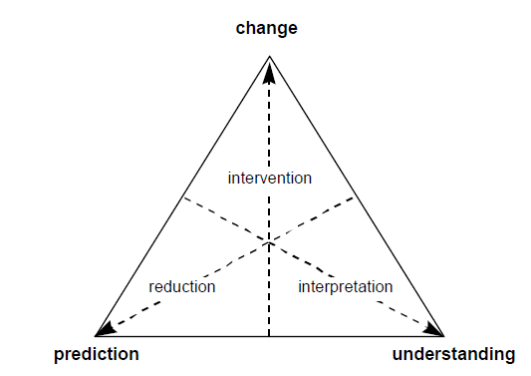
When the organization is your laboratory

Slide 36
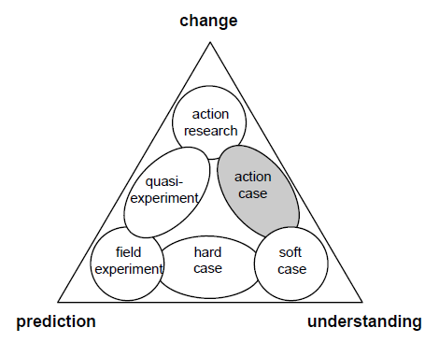
Field research methods

Slide 37
The problem statement
The purpose statement
The research questions

Slide 38
Case study
Empirical studies that:
«investigating a contemporary phenomenon
within a real life context
when the boundaries between the phenomenon and context is not clearly evident
I n which multiple sources of evidence are used»(Yin 1989:23)
They can be used in three modes: Explanatory, descriptive and exploratory

Slide 39
Vee heuristic
CONCEPTUAL
METHODOLOGICAL
Values,
world view
Value claims
Research
question
Epistemology
Knowledge claims
Theories
Interpretations
explanations
Concepts
Results
Method
Findings
Constructs,
variables
Records
Observed events
and objects
After Novak, J.D. and Gowin, D.B. (2004).
Learning how to Learn. Cambridge University Press

Slide 40
