Slide 1
INF5820/INF9820
Language technological applications
Jan Tore Lønning, Lecture 4, 14 Sep. 2016
jtl@ifi.uio.no

Slide 2
Today
Statistical machine translation:
  The noisy channel model
    Word-based
      IBM model 1
Training

Slide 3
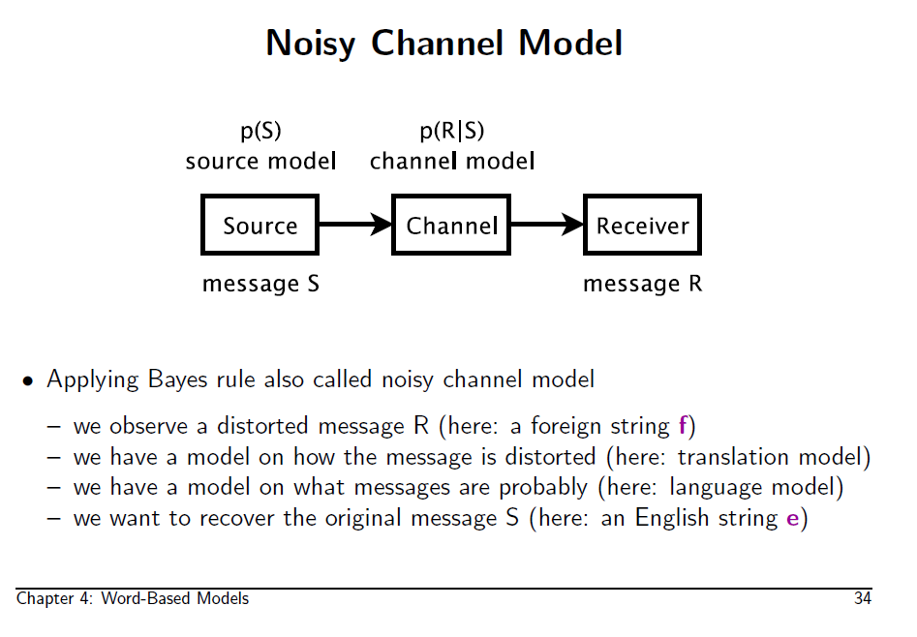

Slide 4
SMT example
En | kokk | lagde | en | rett | med | bygg | .
a 0.9 | chef 0.6 | made 0.3 | a 0.9 | right 0.19 | with 0.4 | building 0.45
… | cook 0.3 | created 0.25 | … | straight 0.17 | by 0.3 | construction 0.33
 | … | prepared 0.15 |  | court 0.12 | of 0.2 | barley 0.11
 |  | constructed 0.12 |  | dish 0.11 | … | …
 |  | cooked 0.05 |  | course 0.07
 |  | … |  | …
Pos4 – pos 6 (1x3x3 many) |  | Pos5 – pos 7 (5x3x3 many)
a right with | 2.7x10⁻¹² | right with building | 1.7x10⁻¹⁸
a right of | 1.5x10⁻¹⁰ | right with construction | 5.4x10⁻¹⁸
a right by | 9.7x10⁻¹² | right with barley | 8.7x10⁻¹⁹
… |  | …
a course of | 1.5x10⁻¹⁴ | course of barley | 1.5x10⁻¹⁶
Similarly for:
pos 0-2 (2x3)
pos 1-3
pos 2-4
pos 3-5 (4x5)
pos 6-8

Slide 5

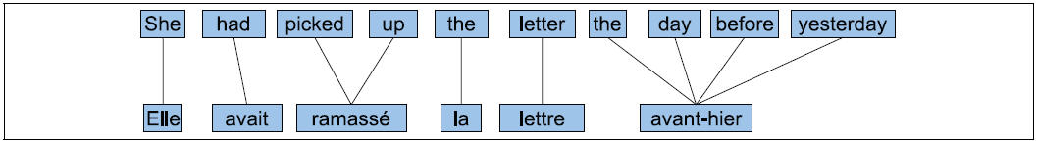


Slide 6
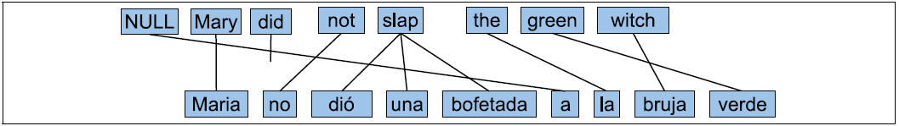
Alignment
Length of English string: k (=7)
Length of foreign string: m (=9)
An alignment is a vector of length m, each entry a number between 0 and k
The example:
  <a₁, a₂, …, a₉,> = <1, 3, 4, 4, 4, 0, 5, 7, 6>

Slide 7
Alignment
Artificial restrictions:
  Several foreign words may be aligned with the same E word
  A foreign word cannot be aligned to more than one E word

Slide 8
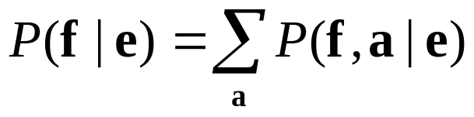
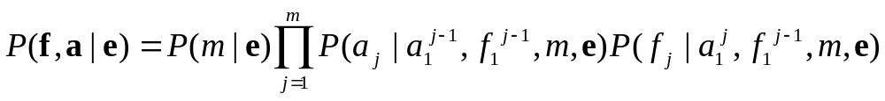
IBM Model 1
Consider all possible alignments a:
For each alignment use the generative model:
Simplify the model – make assumptions

Slide 9
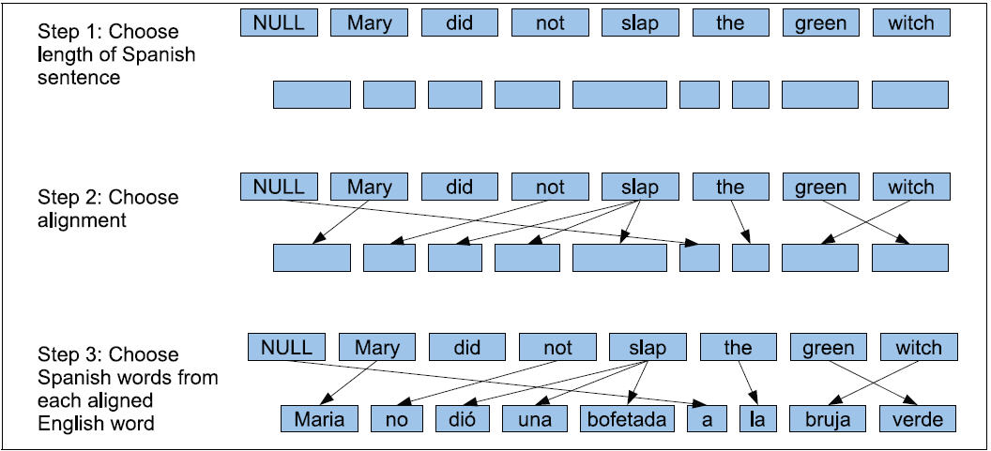
Figure 25.23

Slide 10



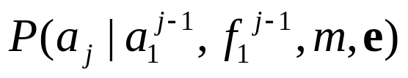
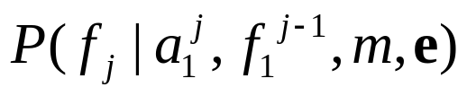
NULL
Mary
did
not
slap
the
green
witch
Maria
no
dio
una
bofetada
a
la
bruja
verde
  Choose the length of the foreign string
  Which E word translates to the first F word?
  What is the translation of this word?
  Which E word translates to the j-th
  F word given the choices so far?
  What is the translation of this word given the choices so far?

Slide 11
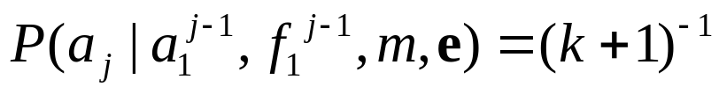
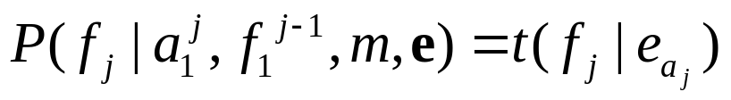
Assumptions, approximations
is a constant, independent of m and E
  all alignments the same probability (adds to 1)
  the word translation probability only depends on source word

Slide 12
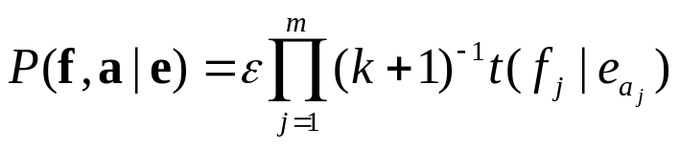
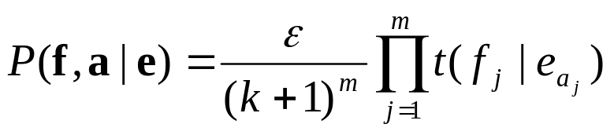
IBM model 1
Simplifies to
  ε is a normalisation factor
  Formula 4.7 in the SMT book
    (The book goes f→ e, not e → f)

Slide 13
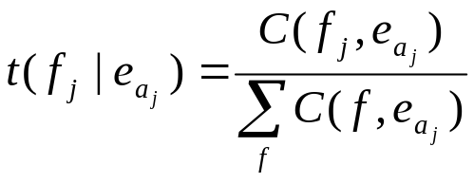
Parameter estimation
If the training corpus was aligned, the model could be learned by counting:
If we had known the translation probabilities, we could have found the most probable alignment.
We neither know word probabilities nor alignment: Chicken and egg problem
EM-algorithm: we may learn the two simultaneously

Slide 14
Training – the idea
From the translation probabilities, we may estimate probabilities for the various alignments
  (We do not choose only the best alignment)
From alignment probabilities, we may recalculate translation probabilities
By alternating between (1) and (2), the numbers converge towards better results
For IBM Model 1 it may be proved that they converge towards a global optimum

Slide 15
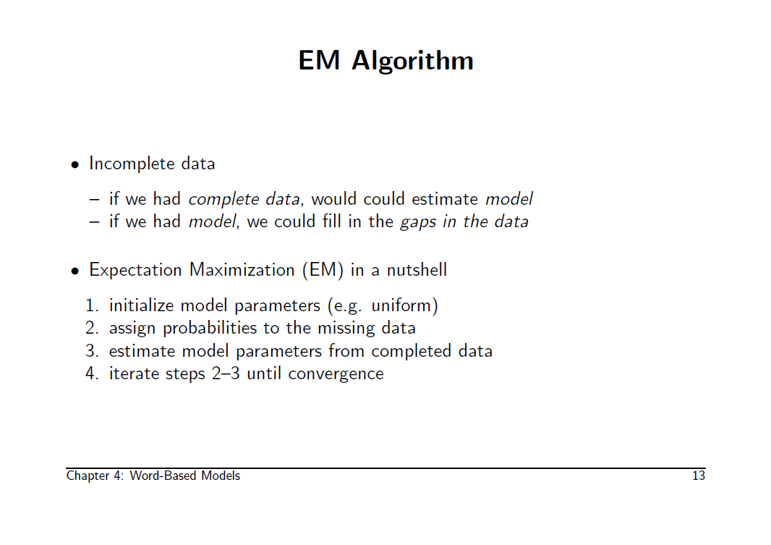

Slide 16
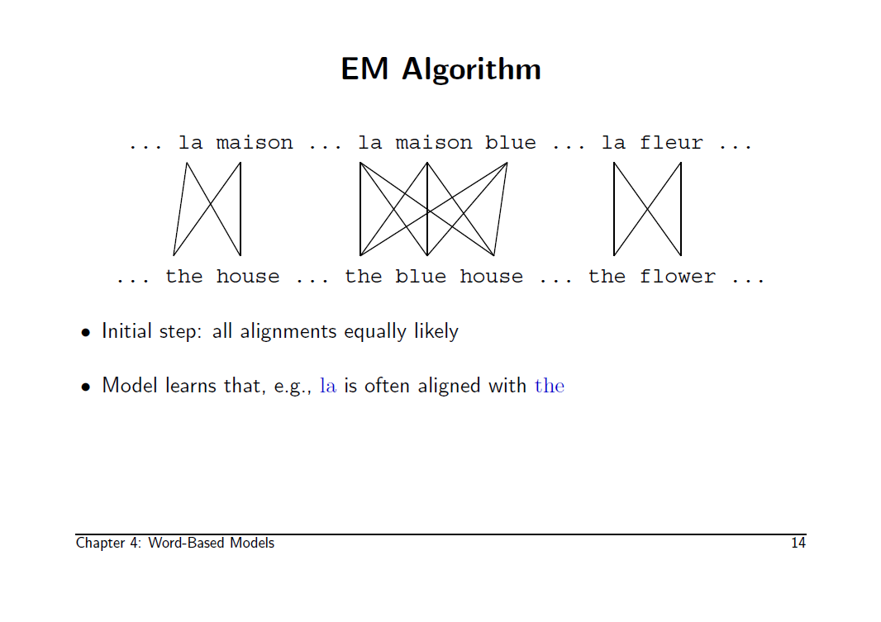

Slide 17
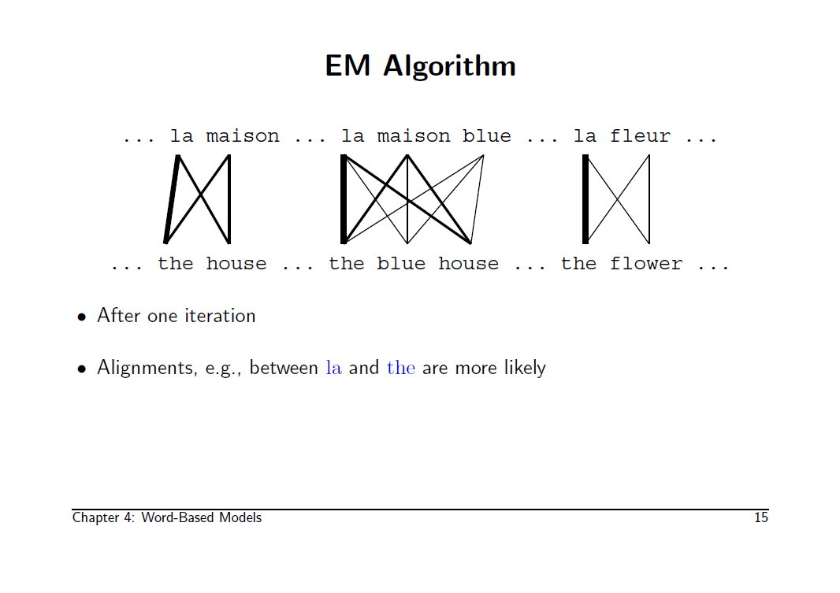

Slide 18
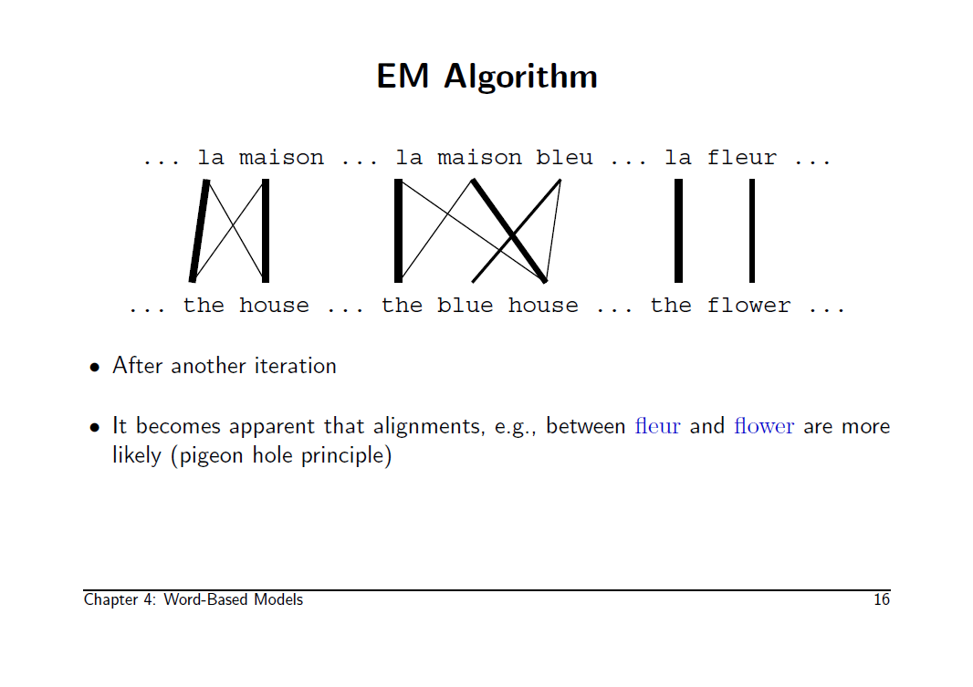

Slide 19
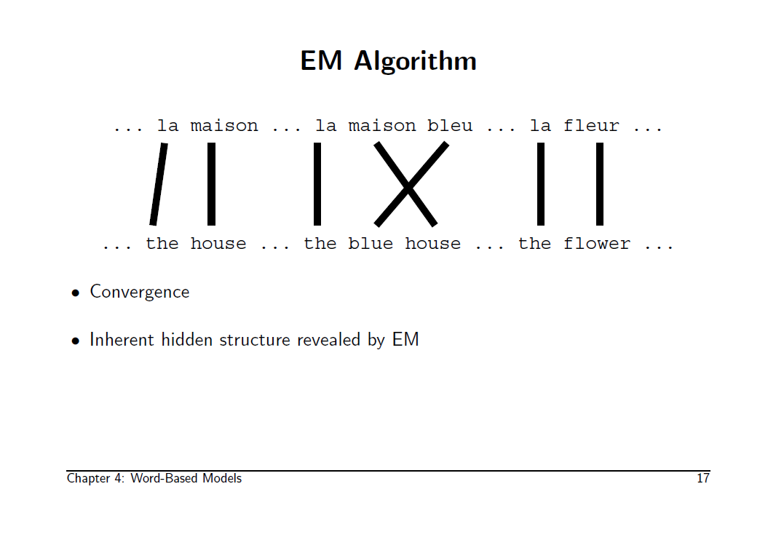

Slide 20
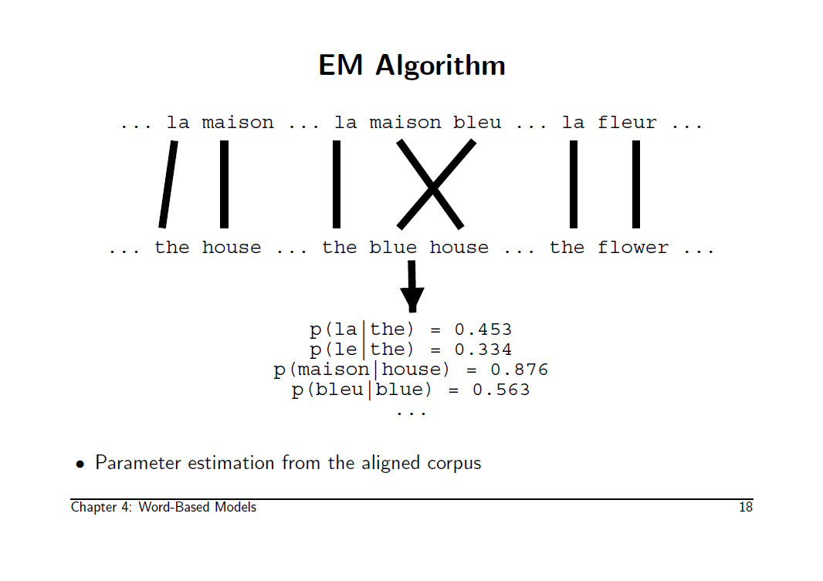

Slide 21
Two ways to describe the algorithm
Intuitive
Efficient
Proceed
  1. Translation prob
  1. Alignment prob
  2. Translation prob
  2. Alignment prob
  3. Translation prob
  Etc
J&M, sec 25.6.1, example
Intractable in practice
Sidestep alignment probs:
  1. Translation prob
  2. Translation prob
  3. Translation prob
  Etc
K:SMT, sec 4.2.3, example
This is how it gets implemented

Slide 22
Training – the intuitive approach
Initalize the parameter values t(f |e) for pairs of words f and e .
  With no info, initalize them uniformly:
  Each word f in the foreign language is an equally likely translation of the word e.
For each pair f, e of sentences in the corpus, use t to calculate the probabilities P(a | f, e) to all possible alignments a of the two sentences.
  (Called the expectation step, apply model to data)

Slide 23
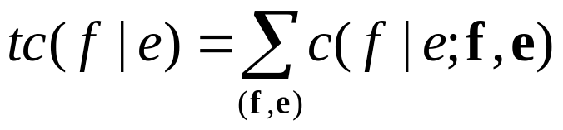
Training – the intuitive approach
Collect fractional counts, tc(f |e):
  («How many times e is translated as f» )
  First, calculate this, c(f |e ; f, e) for each sentence f, e, where we count:
    how many times e is aligned to f by each alignment,
    weighed by the probability of the alignment.
  Then add over all sentences
  to get

Slide 24
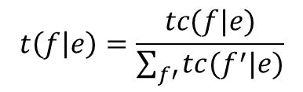
Training – the intuitive approach
Calculate the new translation probabilities
  where f’ varies over all foreign words
  (Called the maximization step, estimate model from counts)
Repeat from 2 as long as you like
$$t\left(f | e\right)=\frac{tc(f|e)}{\sum_{f′}{tc(f^{′}|e)}}$$
Errors in formula 4.14 in K:SMT

Slide 25


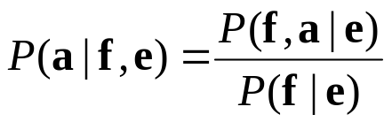
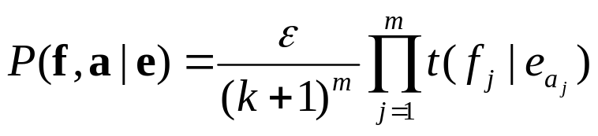
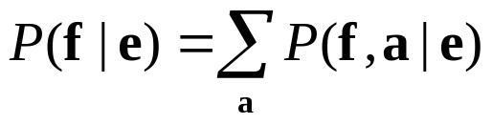
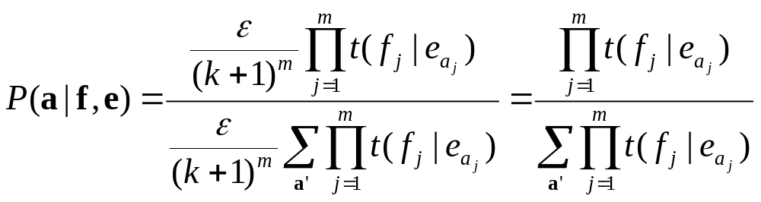
Assign probabilities to alignments
Goal: compute
Since
  we have
We know
Hence:

Slide 26
Example – the intuitive way
Corpus
e₁: Dog barked
f₁: Hund bjeffet
3 English words: dog bit barked
3 foreign words: hund bjeffet bet
e₂: Dog bit dog
f₂: Hund bet hund

Slide 27
Step 1 initialization
t(hund|dog) = 1/3 | t(bet|dog) = 1/3 | t(bjeffet|dog) = 1/3
t(hund|bit) = 1/3 | t(bet|bit) = 1/3 | t(bjeffet|bit) = 1/3
t(hund|barked) = 1/3 | t(bet|barked) = 1/3 | t(bjeffet|barked) = 1/3
t(hund|0) = 1/3 | t(bet|0) = 1/3 | t(bjeffet|0) = 1/3
Uniform
Observe that we include the last line since an f-word may be aligned to 0.

Slide 28
Step 2: Alignment probabilities
Sentence pair 1:
  9 possible alignments:
    <0,0>, <0,1>, <0,2>, <1,0>, <1,1>, <1,2>,<2,0>,<2,1>, <2,2>
  Each equally probable: 1/9
  (call this a₁: e.g. a₁(<0,1>)=1/9)
Sentence pair 2:
  64 possible alignments:
    <0,0,0>, <0,0,1>, … <3,3,3>
    Each equally probable: 1/64
    (call this a₂.)
    Or, the hard way (next slide)
e₁: Dog barked
f₁: Hund bjeffet
e₂: Dog bit dog
f₂: Hund bet hund

Slide 29
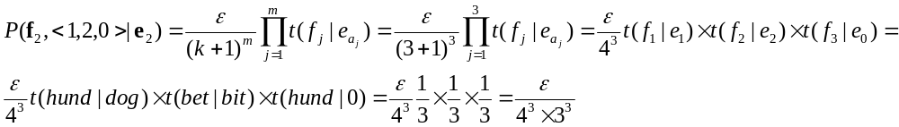
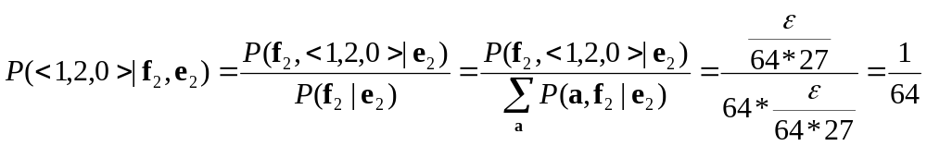
Step 2: The hard way
Sentence pair 2:
  64 possible alignments:
    <0,0,0>, <0,0,1>, … <3,3,3>
  Each translation probability: 1/27
e₂: Dog bit dog
f₂: Hund bet hund

Slide 30
Step 3.1: Collect fractional counts
Calculate c(f |e ; f, e) for each sentence f, e:
Example: f =hund, e = dog, f₁, e₁:
  There are 3 alignments that connect them:
  <1,0>, <1,1>, <1,2>
  c(hund|dog; f₁, e₁) =
  a₁(<1,0>)+ a₁(<1,1>)+ a₁(<1,2>)=3*(1/9) = 1/3
e₁: Dog barked
f₁: Hund bjeffet
c(hund|dog; f₁, e₁)= 1/3 | c(bjeffet|dog; f₁, e₁) = 1/3
c(hund|barked; f₁, e₁) = 1/3 | c(bjeffet|barked; f₁, e₁) = 1/3
c(hund|0; f₁, e₁) = 1/3 | c(bjeffet|0; f₁, e₁) = 1/3

Slide 31
Step 3.1: Collect frac. counts ctd
e₂: Dog bit dog
f₂: Hund bet hund
f₂, e₂:
f =bet, e = bit
  16 alignments connect them: <x,2,z> for x,z in {0,1,2,3}
  c(bet|bit; f₂, e₂) = 16/64 = 1/4
f =bet, e = dog
  all alignments <x,1,z> and <x,3,z> for x,z in {0,1,2,3}
  c(bet|dog; f₂, e₂) = 2*16/64 = 1/2
c(hund|dog; f₂, e₂)= 1 | c(bet|dog; f₂, e₂) = 1/2
c(hund|bit; f₂, e₂) = 1/2 | c(bet|bit; f₂, e₂) = 1/4
c(hund|0; f₂, e₂) = 1/2 | c(bet|0; f₂, e₂) = 1/4

Slide 32
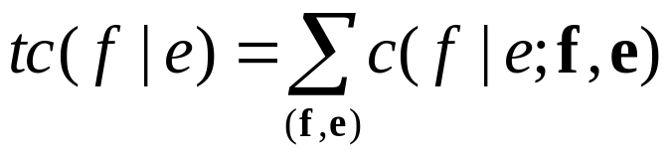
Step 3.2: Total counts
tc(hund|dog) = 1+1/3 | tc(bet|dog) = 1/2 | tc(bjeffet|dog) = 1/3 | tc(*|dog)=4/3+1/2+1/3=13/6
tc(hund|bit) = ½ | tc(bet|bit) = ¼ | tc(bjeffet|bit) = 0 | tc(*|bit)=3/4
tc(hund|barked) = 1/3 | tc(bet|barked) = 0 | tc(bjeffet|barked) = 1/3 | tc(*|barked) =2/3
tc(hund|0) = ½+1/3 | tc(bet|0) = 1/4 | tc(bjeffet|0) = 1/3 | tc(*|0)=17/12

Slide 33
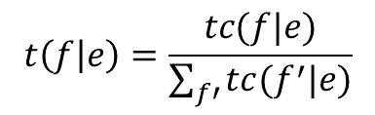
Step 4: new trans. probabilities
$$t\left(f | e\right)=\frac{tc(f|e)}{\sum_{f′}{tc(f^{′}|e)}}$$
e | f | t(f|e) | exact | decimal
0 | hund | (5/6)/(17/12) | 10/17 | 0.588235
0 | bet | (1/4)/(17/12) | 3/17 | 0.176471
0 | bjeffet | (1/3)/(17/12) | 4/17 | 0.235294
dog | hund | (4/3)/(13/6) | 8/13 | 0.615385
dog | bet | (1/2)/(13/6) | 3/13 | 0.230769
dog | bjeffet | (1/3)/(13/6) | 2/13 | 0.153846
bit | hund | (1/2)/(3/4) | 2/3 | 0.666667
bit | bet | (1/4)/(3/4) | 1/3 | 0.333333
barked | hund | (1/3)/(2/3 | 1/2 | 0.5
barked | bjeffet | (1/3)/(2/3) | 1/2 | 0.5

Slide 34
Repeat: Step 2, sentence 1
9 different alignments
P’(a) = c P(a, f₁ | e₁ )
P(a) = P(a| e₁, f₁)
e₁: Dog barked
f₁: Hund bjeffet
 |  |  | P’ | P=P’/1,4145436
P’(<0,0>) = | t(hund|0)*t(bjeffet|0)= | (10/17)*(3/17)= | 0,103806 | 0,0733848
P’(<0,1>)= | t(hund|0)*t(bjeffet|dog)= | (10/17)*(2/13)= | 0,0904977 | 0,0639766
P’(<0,2>)= | t(hund|0)*t(bjeffet|barked)= | (10/17)*(1/2)= | 0,294118 | 0,207924
P’(<1,0>) = | t(hund|dog)*t(bjeffet|0)= | (8/13)*(3/17)= | 0,108597 | 0,0767718
P’(<1,1>) = | t(hund|dog)*t(bjeffet|dog)= | (8/13)*(2/13)= | 0,0946746 | 0,0669294
P’(<1,2>) = | t(hund|dog)*t(bjeffet|barked)= | (8/13)*(1/2)= | 0,307692 | 0,217520
P’(<2,0>) = | t(hund|barked)*t(bjeffet|0)= | (1/2)*(3/17)= | 0,0882352 | 0,06237715
P’(<2,1>)= | t(hund|barked)*t(bjeffet|dog)= | (1/2)*(2/13)= | 0,0769231 | 0,05438015
P’(<2,2>)= | t(hund|barked)*t(bjeffet|barked)= | (1/2)*(1/2)= | 0,25 | 0,176735
Sum of P’s |  |  | 1,4145436

Slide 35
Repeat: Step 2, sentence 2
64 different alignments
Home work to next week! ☺
How many alignments if the sentences are 10 words long?
That’s why we need a smarter way.
To be continued …
Words, m=k | 2 | 3 | 4 |  | 6 |  | 8 |  | 10
Align. | 9 | 64 | 625 |  | 117 649 |  | 43mill |  | 25 billions

