Slide 1

Antimicrobial resistance
One world – One Health
Ernst Kristian Rødland, MD PhD
e.k.rodland@medisin.uio.no

Slide 2

Topics
What is antimicrobial resistance (AMR)
AMR in Norway
AMR globally
Future perspectives

Slide 3

One Health
Initiative to forge collaboration between physicians, veterinarians and other scientific, health and environmentally related disciplines
One Health recognizes that the health of people is connected to the health of animals and the environment

Slide 4

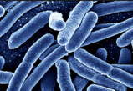
Microbial biosphere
Bacteria
  Environmental
  Pathogen
Natural antibiotics
Reservoir of antibiotic resistance genes Resistome
Notes:
Environmental microbiome. Apathogenic organisms. Infections in animals. Shared microbes. Zoonotic infections

Slide 5




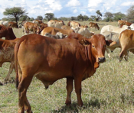

Notes:
Environmental microbiome. Apathogenic organisms. Infections in animals. Shared microbes. Zoonotic infections

Slide 6
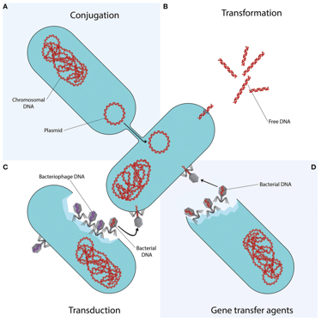
How do bacteria become resistant?
Vertical
  Spontaneous mutations
  Transferred to the bacteria`s progeny
Horizontal
  Exchange of genetic elements/plasmids
  Packages of resistance genes
Notes:
Horizontal: Exchange across strains, species and genera. Can be through conjugation, phage or via naked DNA

Slide 7
History of some antibiotics
Penicillin – 1928, regular use in human medicine from the 1940s
Chlortetracyclin (Aureomycin) – 1945, used as a growth promotor in meat production
Fluoroquinolones (Nalidixic acid) – 1962
Notes:
Tetracyclins banned as growth promoters in the US in 2017.

Slide 8
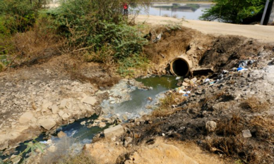
Exposure routes of antibiotics to the environment
Discharge from manufacturing
Urine and feces from users of antibiotics
Antibiotics used in agriculture and aquaculture
Discarded medicines – lack of take-back programs

Slide 9
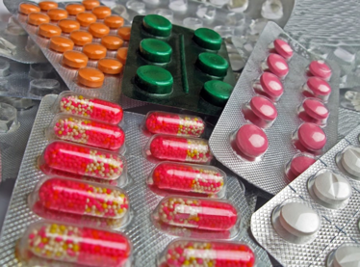
Usage of antibiotics
65% increase in human consumption (2000-2015) globally₍₁₎
Approximately 80% of a.b. consumption is in the animal sector₍₂₎
Globally: 80000 (??) tonnes in agriculture
(1) Klein et al. PNAS 2018
(2) WHO, 2017
Notes:
Agriculture: approx 80 000 tons.

Slide 10
Antibiotic selection pressure
Significant impact on the resistome
in the microbial biosphere

Slide 11
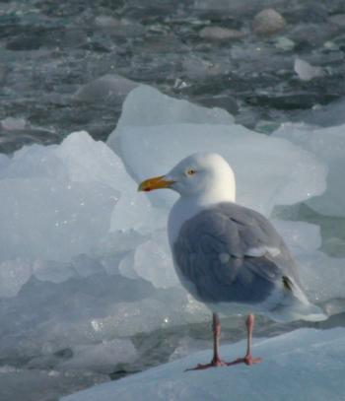
AMR is omnipresent
E.coli from arctic birds
  Siberia, Alaska, Greenland
  AMR detected in 8/97 isolates
  17 antimicrobials were tested, resistance to 14 were detected
Sjølund-Karlsson et. al. Emerging Infectious Diseases
www.cdc.gov/eid • Vol. 14, No. 1, January 2008

Slide 12
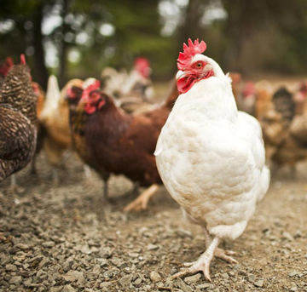
Antibiotics in agriculture
AMR transmission
«Drug resistance in Salmonella typhimurium and its implications»₍₁₎
«Changes in intestinal flora of farm personnel after introduction of a tetracycline-supplemented feed on a farm»₍₂₎
(1) ES Anderson, Br Med J., 1968
(2) Levy et al. N Eng J Med. 1976

Slide 13
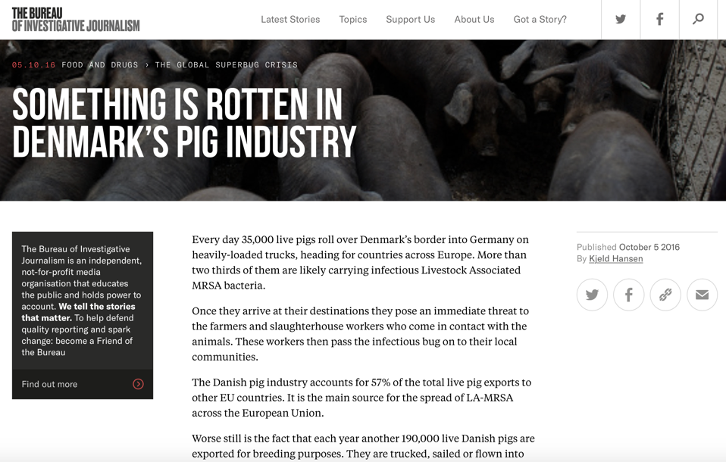

Slide 14
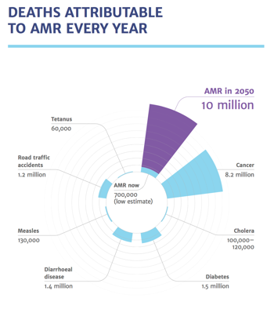
AMR, a global challenge
AMR is a global challenge₍₁₎
  Compromises treatment of common infections
  Undermines advances in modern medicine and health
Estimation by 2050₍₂₎
  10 million deaths/yr globally
  Costs: 100 trillion USD/yr
(1) WHO, 2015
(2) Jim O`Neill et.al 2016
Notes:
500 x norwegian fiscal budget (state budget)

Slide 15
What can be done?

Slide 16
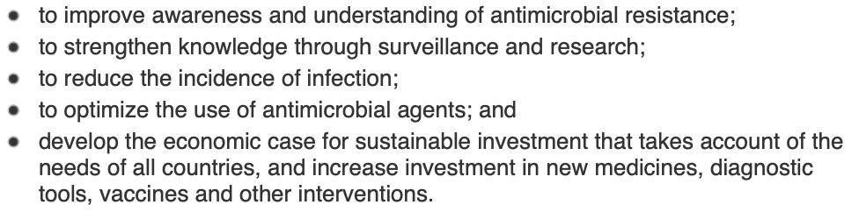

WHO Global action plan
Strenghten knowledge through surveillance and research

Slide 17
AMR in Norway

Slide 18
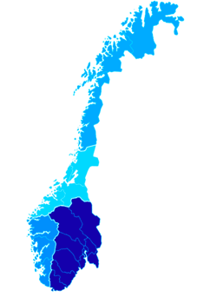
Microbiological Laboratories
Norway
  22 clinical laboratories in total
  11 referance laboratories
Different (several, 5-7) platforms to register microbiological data

Slide 19
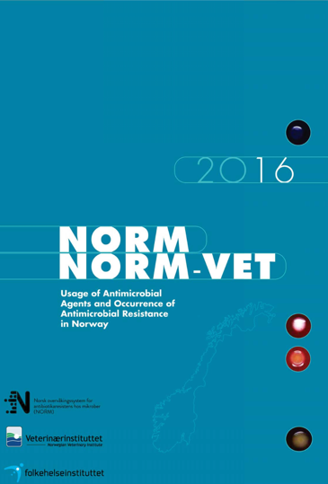
NORM/NORM-VET
Established in 1999/2000
Surveillance program for AMR in humans, animals, food and feed
Publish data on the usage of antimicrobial agents in humans and animals
Annual reports

Slide 20
Human clinical isolates
All positive blood cultures
  A patient with a given bacterial isolate is excluded from registration with a new isolate of the same species within a month from the first entry
  Bacteria which commonly infect the skin are excluded
Other samples for selected bacteria
  Urine (E.coli, Klebsiella, Proteus)
  Respiratory tract specimen (Haemophilus Infl., S. Pneumonia)
  CSF (N. Meningitidis)
  Wounds (Staph. Aureus)

Slide 21
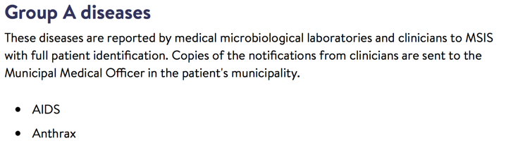
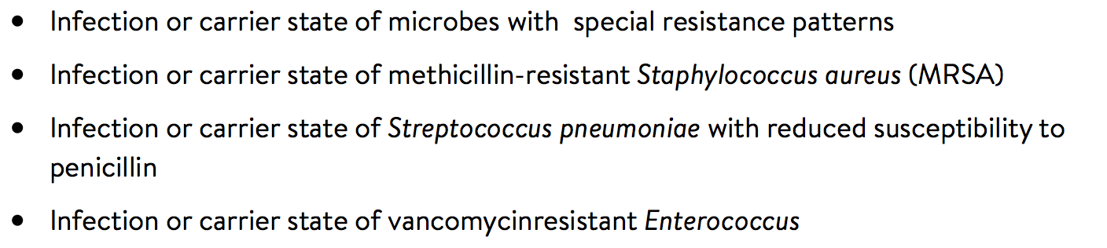
Notifiable diseases in the Norwegian Surveillance System for Communicable Diseases (MSIS)
MRSA, VRE, ESBL-carba

Slide 22
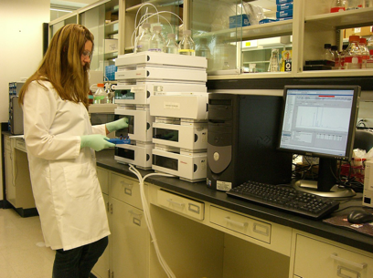

Challenges, computational
«Old» technology
Different laboratories often use different laboratory information systems
  Investment in one system -> costly to change
  Oslo University Hospital (OUS):

Slide 23
Challenges, registration of data
Manual work
  Not possible to send data directly to NORM
    Strict privacy policies
    Avoid double registration in the system
    Quality check
  Demanding and work intense for laboratory staff

Slide 24
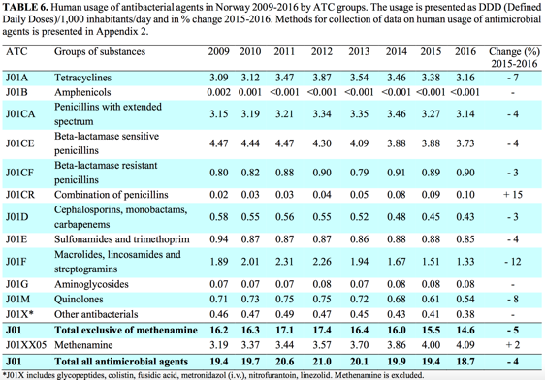
Use of antibiotics in Norway
NORM NORM-VET 2016
Notes:
Mål 30% reduksjon i bruk av a.b. i 2020

Slide 25
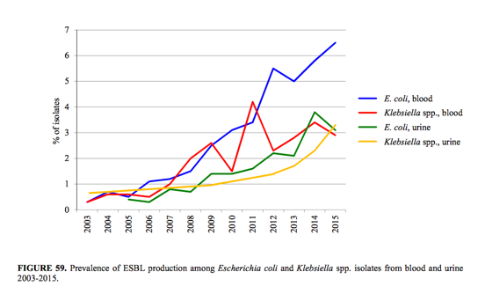
ESBL – Norway
Extended-spectrum beta-lactamases

Slide 26
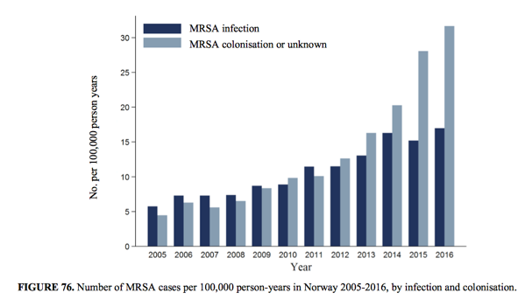
MRSA – Norway
Methicillin-resistant staphylococcus aureus

Slide 27
AMR Globally

Slide 28
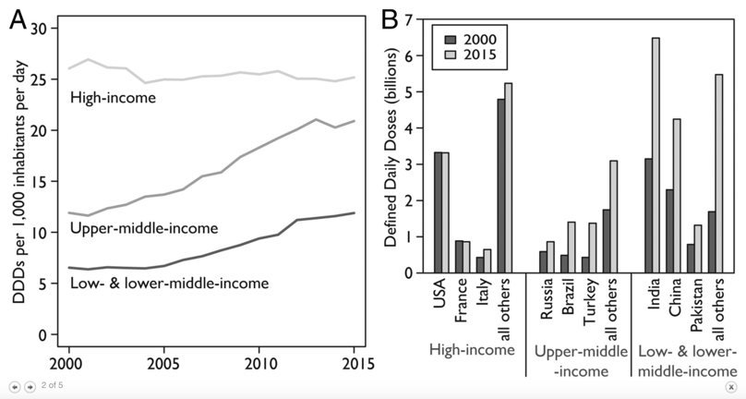
Global antibiotic consumption
Klein et al. PNAS, 2018

Slide 29
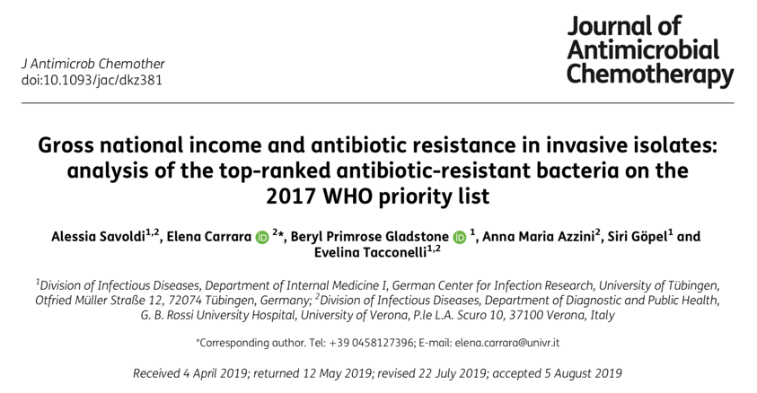

Slide 30
Results
AMR data from 22 surveillance systems
67 countries
  HICs 57%, 38 countries
  UMICs 24%, 16 countries
  LMICs 16%, 11 countries
  LICs 3%, 2 countries

Slide 31
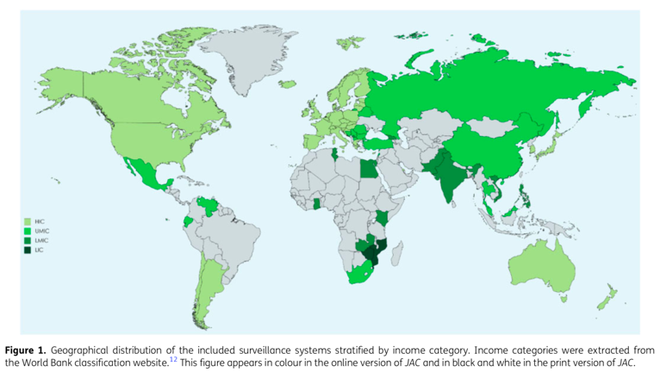

Slide 32
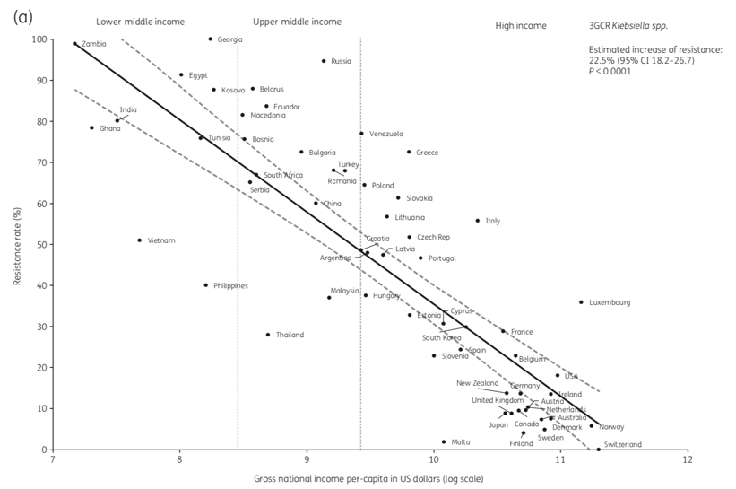

Slide 33
AMR
Developement and spread
Improper use of antimicrobials
Lack of microbiological diagnostic services
Poor sanitation and shortage of clean water
Crowding – interpersonal spread
Migration
Resource limited countries (RLCs)

Slide 34
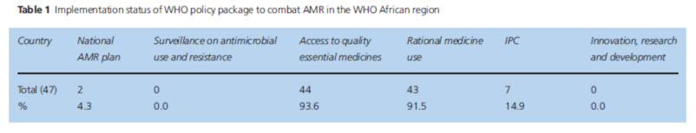
AMR in the WHO African region
High prevalence of AMR in clinical relevant bacteria
2011: WHO publishes a policy package to combat AMR
  Top priority: strenghten surveillance and laboratory capacity
No reliable data available from 42,6% of African countries ₍₁₎
(2)
(1) Tadesse, B.T., et al., BMC Infect Dis, 2017
(2) Essack, S.Y., et al.J Public Health (Oxf), 2017

Slide 35
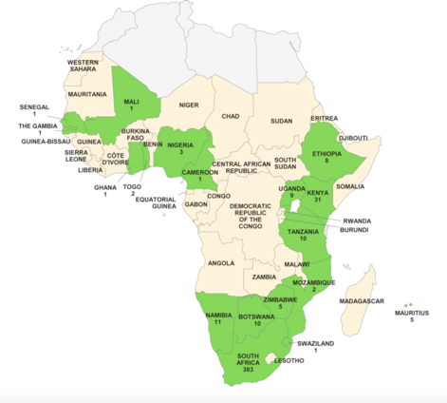
Available reference labs in Africa
Barbe`et. al, Clinical Microbiology and Infection, 2017
Notes:
485 laboratories in Africa totally

Slide 36
China
Antibiotic consumption increased from 2,3 to 4,2 (79%) billion DDDs from 2000-2015
92700 tonnes of a.b. was used in China in 2013₍₁₎
  48 % was used in human medicine
  46% was released into the environment
Antibiotics account for approx. half the drugs used in hospitals₍₁₎
(1) M Qiao et al., Environment International, 2018

Slide 37
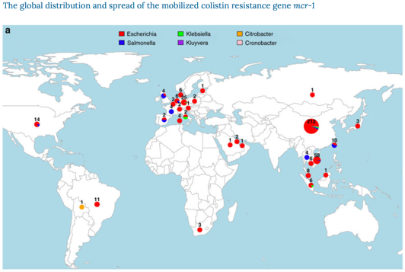
China
Colistin. «Last resort» antibiotic
2015 – Plasmid mediated colistin resistance (mcr-1) was discovered in pigs and humans in China
Wang et al. Nature 2018

Slide 38
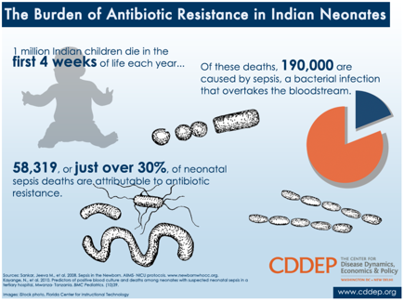
India
Antibiotic consumption increased from 3,2 to 6,5 (103%) billion DDDs from 2000-2015

Slide 39
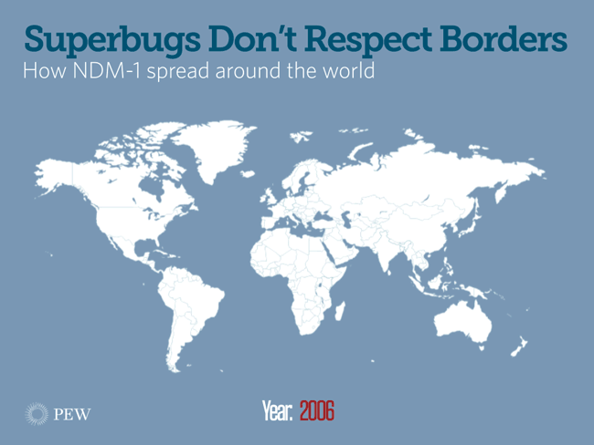
AMR migration
Approx. 2 billion people move across large distances/year and 1 billion cross international borders
20–60% of asylum seekers are colonized with resistant microbes _{(1,2)}
50-90% of tourists visiting the tropics get colonized with MDR enterobacteriacea
New Dehli Metallo-beta-lactamase-1 (NDM-1)
(1) de Smalen, A.W., et al., Travel Med Infect Dis, 2017
(2) Heudorf, U., et al.,GMS Hyg Infect Control, 2016

Slide 40
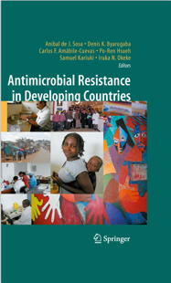
”....If walls have proven insufficient to stop migrating people, it will certainly
be so for multi-resistant microbes and their consequences.....”

Slide 41
Future perspectives

Slide 42
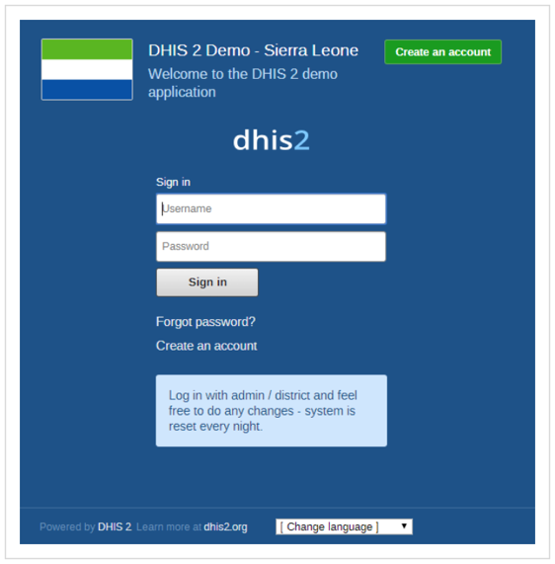

Slide 43
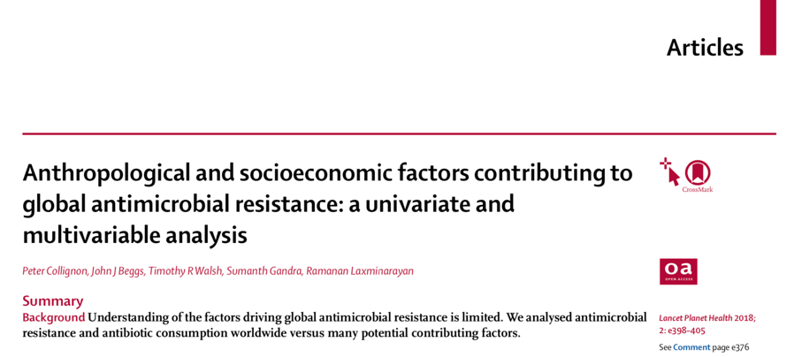

Slide 44
Interpretation Reduction of antibiotic consumption will not be sufficient to control antimicrobial resistance because contagion—the spread of resistant strains and resistance genes—seems to be the dominant contributing factor. Improving sanitation, increasing access to clean water, and ensuring good governance, as well as increasing public health-care expenditure and better regulating the private health sector are all necessary to reduce global antimicrobial resistance.
My answer has to be fighting poverty

