Slide 1
Amartya Sen: The Capabilities Approach
Sundeep Sahay

Slide 2
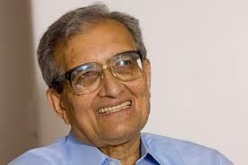
Amartya Sen

Slide 3

UNDP Human Development Index
Image source: http://hdr.undp.org/en/2016-report/
Notes:
6.1. Social Development as a Development Goal
Idea of human development and UN Human Development Index
The HDI consists of four measures but three overall development goals.
ASK – what are those three overall development goals?
>Health, Education, Wealth
>Focus on health, education, ICTs

Slide 4
Relation Between Health, Education and Economic Growth
Economic Growth
ICTs
?
Better
Health
Better Education
Notes:
Relation of wealth, health, education is two-way
Relation of health/education and ICTs is two-way

Slide 5
Key Health System Actors
Health Policy-Maker
Health Manager
Doctor
Paramedic / Health Worker / Nurse
Citizen /
Patient
Notes:
6.2. ICTs, Health and Development
Categories of e-health via actors:
- ordinary citizens via public health and patients
- healthcare professionals: more medicine-oriented professionals and more healthcare-oriented professionals;
- managers of healthcare facilities; and
- higher level policy-makers.

Slide 6
The paradox
While ICTs are all pervasive in development projects, evidence of them creating positive development impacts are extremely limited
A case in point is Health Information Systems, nearly no documented evidence of impacts on health outcomes

Slide 7
Simplified (DIKDAR) Information Value Chain
Health Knowledge
Learning
Health Data
Health Information
Health Decision
Health Action
Health Results
Notes:
EXERCISE
Review two e-health cases in Chapter 6. Where in the information value chain does the available evidence about impact focus?
>Better data
>Better decisions
>One example only of action
>No health results
>Common pattern of data/info/knowledge improvement; some decision improvement; little action/health improvement
EXERCISE
Look at the e-health challenges examples in Chapter 6. What is the common pattern?

Slide 8

One Laptop Per Child
Image source: https://en.wikipedia.org/wiki/OLPC_XO#/media/File:XO-Beta1-mikemcgregor-2.jpg
Notes:
EXERCISE
Has the OLPC project achieved what was intended? See evidence in Chapter 6
>No: it finds no or even negative impact on learning, but ...
>...there are economic and innovation benefits
ASK: why?

Slide 9
ICTs Usage Levels and Learning
“results suggest that limited use of computers at school may be better than not using computers at all, [but] using them more intensively than the current OECD average tends to be associated with significantly poorer student performance” (OECD 2015:16)
Extent of learning
Extent of use of ICTs
Notes:
ASK – this is evidence from a global study. What relation does it suggest between learning and the extent of use of ICTs?
>Inverse-U relation

Slide 10
Amartya Sen’s Capability Approach
Development can be seen as a process of expanding the real freedoms that people enjoy. […] Focusing particularly on people’s capability to choose the lives they have reason to value
(Sen 1999)
Increasing choice

Slide 11
The Capabilities Framework
Values
Choice
Individual/ Community/
Context Differences
Economic
Political
Social
Security
Informational
Opportunities: Contextual Capabilities
Specific Capabilities
Realised Functionings
Unrealised Functionings
Development Outcomes
Freedoms
Notes:
Basic idea of development as freedom: freedom in theory, freedom in practice
++Freedoms: “what the person is free to do and achieve in pursuit of whatever goals or values he or she regards as important” (Sen 1985:203)
++Capabilities: "the alternative combinations of functionings that are feasible for a person to achieve".
Realised functionings: "what a person is actually able to do".
++Individual and Situational Differences: culture, ability, context

Slide 12
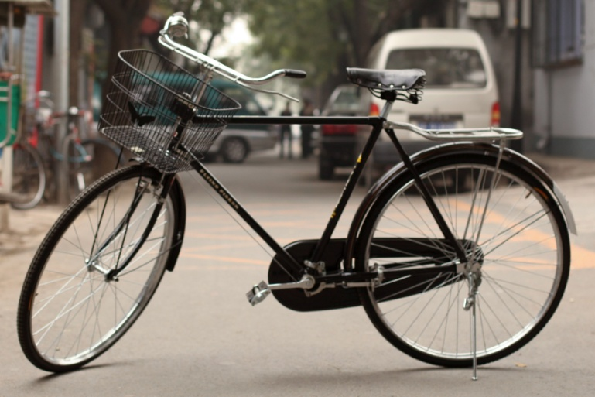
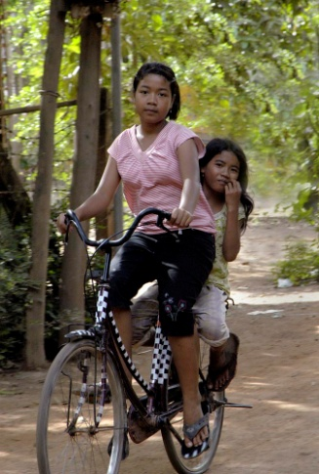
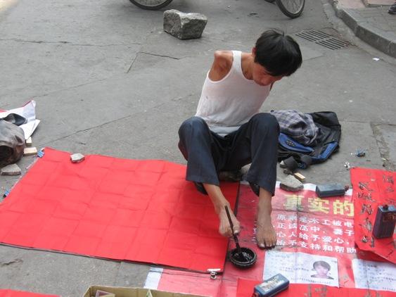
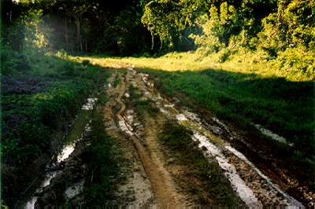
Capabilities in Practice
X
Image sources: https://en.wikipedia.org/wiki/Bicycle#/media/File:Left_side_of_Flying_Pigeon.jpg; https://en.wikipedia.org/wiki/Culture_of_Cambodia#/media/File:Cambodian_girls_on_bicycle.jpg; http://aminnesotaninchina.areavoices.com/2012/04/21/disabled-in-china/; http://www.forestsmonitor.org/fr/reports/550050/550056
Notes:
Simple developmental view of bicycles – a good thing. But Sen/capabilities:
++Wider values that stop e.g. cultural role of women
++Individual differences that stop e.g. disability
++Other context reasons

Slide 13
ICTs and Capabilities
Digital commodities e.g. hardware, software
and their functionalities
e.g. digital data processing/
communication
Differences and Opportunities
Digital capabilities
=
Vectors of
potential digital
functionings (affordances)
e.g. digital communication
Values and
Choice
Realised digitally-enabled
functionings
e.g. faster and easier access to better information
e.g. personal, social and environmental conversion factors
e.g. personal preferences, needs, or social pressures
Means to Achieve
Freedom to Achieve
Achievement
Adapted from Zheng & Walsham 2008; itself adapted from Robeyns 2005
Notes:
Two ICT implications:
Like info value chain, ICT just a means to achieve; need personal factors, wider factors, and choice to turn into digital achievements
Evaluate not “impact ICTs” but “extent ICTs help people achieve what they value”
So, return to earlier question: are video-watching, gaming, gambling things people value achieving?
And do these freedoms also contain unfreedoms?
DISCUSSION
Read Box 6.7 in Chapter 6 – what freedoms were achieved/constrained by external context?
>Issues of motivation
>Issues of censorship

Slide 14
ICTs and Capabilities
Digital commodities e.g. hardware, software
and their functionalities
e.g. digital data processing/
communication
Differences and Opportunities
Digital capabilities
=
Vectors of
potential digital
functionings (affordances)
e.g. digital communication
Values and
Choice
Realised digitally-enabled
functionings
e.g. faster and easier access to better information
e.g. personal, social and environmental conversion factors
e.g. personal preferences, needs, or social pressures
Means to Achieve
Freedom to Achieve
Achievement
Adapted from Zheng & Walsham 2008; itself adapted from Robeyns 2005
Notes:
Two ICT implications:
Like info value chain, ICT just a means to achieve; need personal factors, wider factors, and choice to turn into digital achievements
Evaluate not “impact ICTs” but “extent ICTs help people achieve what they value”
So, return to earlier question: are video-watching, gaming, gambling things people value achieving?
And do these freedoms also contain unfreedoms?
DISCUSSION
Read Box 6.7 in Chapter 6 – what freedoms were achieved/constrained by external context?
>Issues of motivation
>Issues of censorship

Slide 15
Contributions and criticisms
Has prompted important debates on issues of measurement of inequality, capital, and savings, role of nonmarket institutions
Does not provide a directly applicable and
prescriptive tool kit on “how to do it”
Provides an approach to a “mode of thinking”
Criticized for being too abstract with challenges in its operationalization

Slide 16
Key focus
On the expansion of people’s freedoms
Development focus to remove these “unfreedoms” - poverty, tyranny, poor economic opportunities, social deprivation, neglect of public facilities (schools and health), social intolerance.
Providing enhanced possibilities for individuals to pursue choices that they value (Sen, 2001).
Distinguishes between means and ends of development
Highly interdisciplinary, resulting in new development indicators, and policy paradigm based on the ‘human development approach’

Slide 17
Types of freedoms
Sen identified five instrumental freedoms:
  i) political freedoms,
  ii) economic facilities
  iii) social opportunities,
  iv) transparency guarantees
  v) protective security
All relevant to the understanding of ICT4D
Ends have intrinsic importance, whereas means are instrumental to reach the goals of development.
Freedom has both intrinsic and instrumental value

Slide 18
Basic principles of Capabilities Approach (Sen 1992)
Functionings: The various things a person may value doing or being
Capabilities: the alternative functionings which an individual is able to achieve
Focus of development: to increase an individual’s capabilities set
- Choice is both the end and a principal means of development
Too much emphasis on individual agency?
Difficulty of operationalising the approach

Slide 19
Capabilities and functionings
A functioning is an achievement, whereas a capability is the ability to achieve. Functionings are, in a sense, more directly related to living conditions, since they are different aspects of living conditions. Capabilities, in contrast, are notions of freedom, in the positive sense: what real opportunities you have regarding the life you may lead (Sen 1987: 36).

Slide 20
Conversion factors
Resources (marketable goods and services) have characteristics that make them of interest to people, the bicyle example
The relation between a good or a resource and the achievement of certain things with it represents a ‘conversion factor’: the degree to which a person can transform a resource into a functioning, and the skills needed to enable this transformation

Slide 21
Types of conversion factors
Personal conversion factors
Social conversion factors
Environmental conversion factors
For example, how much a bicycle contributes to a person's mobility depends on their physical condition (personal conversion factor), the social norms, for example whether women are socially allowed to ride a bicycle (social conversion factor), and the availability of decent roads or bike paths (environmental conversion factors) to enable effective use of the bike

Slide 22
Core aspects of Capability Approach
Not utility focus
Not resource focus
Freedom focus: poverty is capability-deprivation
Pluralistic in nature
Focus on the individual and their agencies
Encourages diversity

Slide 23
Agent
Someone who acts and brings about change, whose achievement can be evaluated in terms of his or her own values and objectives. Includes both the intention and actual actions
Concerns for:
Participation
Public debate in the public sphere
Democratic practice
Empowerment

Slide 24
Core aspects
Real freedoms central
There are individual differences in the ability to transform resources into valuable activities
Convert capabilities to functionings
Different activities can give rise to happiness
importance of materialistic and nonmaterialistic factors
Concern for the distribution of opportunities within society

Slide 25
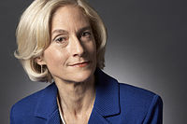
Nussbaum’s list of capabilities
1) Life
2) Bodily Health
3) Bodily Integrity
4) Senses, Imagination, and Thought
5) Emotions
6) Practical Reason
7) Affiliation
8) Other Species.
9) Play.
10) Control over one's Environment.
Capabilities not apriori determined from above. Need to be articulated by those whose freedom is at stake
Notes:
Life. Being able to live to the end of a human life of normal length; not dying prematurely, or before one's life is so reduced as to be not worth living.
Bodily Health. Being able to have good health, including reproductive health; to be adequately nourished; to have adequate shelter.
Bodily Integrity. Being able to move freely from place to place; to be secure against violent assault, including sexual assault and domestic violence; having opportunities for sexual satisfaction and for choice in matters of reproduction.
Senses, Imagination, and Thought. Being able to use the senses, to imagine, think, and reason—and to do these things in a "truly human" way, a way informed and cultivated by an adequate education, including, but by no means limited to, literacy and basic mathematical and scientific training. Being able to use imagination and thought in connection with experiencing and producing works and events of one's own choice, religious, literary, musical, and so forth. Being able to use one's mind in ways protected by guarantees of freedom of expression with respect to both political and artistic speech, and freedom of religious exercise. Being able to have pleasurable experiences and to avoid non-beneficial pain.
Emotions. Being able to have attachments to things and people outside ourselves; to love those who love and care for us, to grieve at their absence; in general, to love, to grieve, to experience longing, gratitude, and justified anger. Not having one's emotional development blighted by fear and anxiety. (Supporting this capability means supporting forms of human association that can be shown to be crucial in their development.)
Practical Reason. Being able to form a conception of the good and to engage in critical reflection about the planning of one's life. (This entails protection for the liberty of conscience and religious observance.)
Affiliation.
Being able to live with and toward others, to recognize and show concern for other humans, to engage in various forms of social interaction; to be able to imagine the situation of another. (Protecting this capability means protecting institutions that constitute and nourish such forms of affiliation, and also protecting the freedom of assembly and political speech.)
Having the social bases of self-respect and non-humiliation; being able to be treated as a dignified being whose worth is equal to that of others. This entails provisions of non-discrimination on the basis of race, sex, sexual orientation, ethnicity, caste, religion, national origin and species.
Other Species. Being able to live with concern for and in relation to animals, plants, and the world of nature.
Play. Being able to laugh, to play, to enjoy recreational activities.
Control over one's Environment.
Political. Being able to participate effectively in political choices that govern one's life; having the right of political participation, protections of free speech and association.
Material. Being able to hold property (both land and movable goods), and having property rights on an equal basis with others; having the right to seek employment on an equal basis with others; having the freedom from unwarranted search and seizure. In work, being able to work as a human, exercising practical reason and entering into meaningful relationships of mutual recognition with other workers.

Slide 26
Empowerment
Expansion of agency: key components
  Agency
  Power and choice
  Participation
Empowerment is a relational concept, where empowerment of one may contribute to disempowerment of others to whom the person is related
Power relations are inherent in shaping empowerment, as
enhancing ability to make a ‘choice’, implies that this ability was previously denied & involves changing existing power dynamics

Slide 27
Core aspects
Real freedoms central
There are individual differences in the ability to transform resources into valuable activities
Convert capabilities to functionings
Different activities can give rise to happiness
importance of materialistic and nonmaterialistic factors
Concern for the distribution of opportunities within society

Slide 28
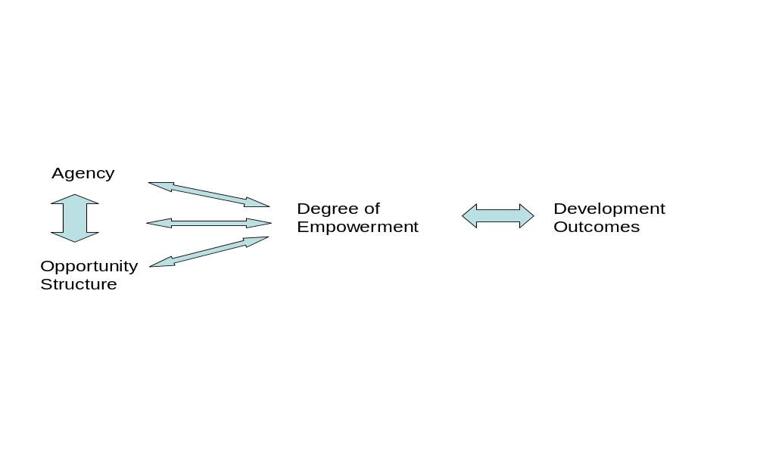
The process of empowerment (Alsop & Heinsohn 2005)

Slide 29
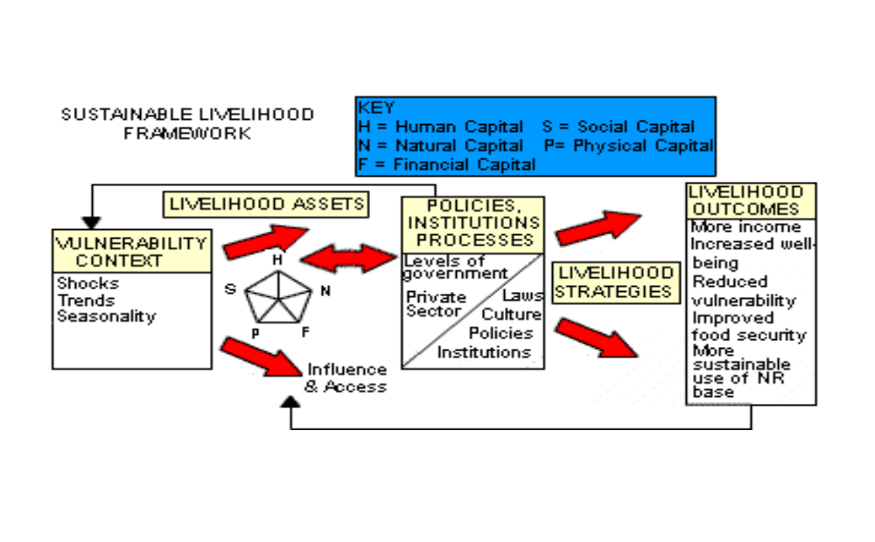
The sustainable livelihood framework
(DFID 1999)

Slide 30
The Choice Framework
STRUCTURE
institutions and organisations
discourses
policies and programmes
formal and informal laws
including:
- Norms on usage of space
- Norms on usage of time
technologies and innovations
including: access to ICTs
- availability of ICTs
- affordability of ICTs
- skills needed for ICTs
DEVELOPMENT OUTCOMES
Primary: Choice
Secondary, as chosen
by individual, e.g.:
easier communication
increased knowledge
better/more social relationships
healthy environment
increased income
increased mobility
more voice
more autonomy
etc.
DEGREES OF EMPOWERMENT
existence of choice
sense of choice
use of choice
achievement of
choice
CAPABILITIES
ACHIEVED FUNCTIONINGS
AGENCY
SR
He
CR
Age
Gender
Ethnicity
etc.
NR
ER
PsR
MR
Key:
ER = Educational Resources SR = Social Resources
PsR = Psychological Resources NR = Natural Resources
In = Information MR = Material Resources
FR = Financial Resources GR = Geographical Resources
CR = Cultural Resources He = Health
Ti = Time
In
GR
(Kleine 2007, 2011, based on Alsop & Heinsohn 2005, DFID 1999)
Ti
FR

Slide 31
Capabilities Approach allows for..
Use of a systemic and holistic approach
Further strive to operationalise the capability approach
Resist the controllability myth
Seeking out mechanisms to allow people to express choice, e.g.
participatory monitoring and evaluation
voucher schemes
participatory budgets
participatory procurement
participatory tracking & tracing

Slide 32
Critical Capabilities Approach
 | Sen’s Capability Approach | Critical Theory
Aspiration | Expansion of freedom, or removal of unfreedoms that restrict individuals from exercising their reasoned agency; | Emancipation, or removal of injustice, alienation and domination.
Human Diversity | Sensitive to diversity of and discrepancies in human conditions; questions what conversion factors are in place to generate potentials to achieve, and to allow people the freedom of choice to realize the achievement; | Special attention is given to those individuals who are oppressed or alienated. These are usually those who are least able to defend themselves and lack political and social power and representation
Individual Agency | Central to the capability approach, together with the concept of well-being, agency forms the basis of addressing deprivation; embedded in socio-cultural conditions; | Emphasis on the effect of social structures on individual agency, especially through reification, hegemony of ideology;
Technology | Regarded as commodities, i.e. goods and resources, meaningful only in terms of their contribution to people’s capabilities; means rather than ends; | Highlights ideological qualities and hegemonic functions of technology; sensitive to flexibility of technology and its role in distribution of power;
Notes:
By the same token, there is no absolute linkage between availability of technology and level of capability. Advanced technologies do not necessarily improve an individual’s quality and chances of life, because they require more complex conversion factors to be exploited. The digital divide does not lie between those have or have not access to technologies, but between those who are in a position to convert relevant and appropriate technologies into capabilities and those who are not.
For example, a participatory approach to development, which Sen himself strongly advocates and which is popular in most development projects, may disguise or even strengthen incipient articulation of power embedded in social and cultural practices, hence the “tyranny of participation” (Cooke and Kothari, 2001). It is possible that participatory methodologies may reify existing inequalities and affirm the agenda of elites and other more powerful actors (Kothari, 2001).
Critical theory of ICT (CTICT) emphasizes the importance of revealing technology’s ideological qualities and hegemonic functions. Ideologies may be socially accepted views which are part of all collective constructions of reality and therefore a necessary consequence of a social constructivist worldview. An example of ideology is pursuit of modern life in societies. It is possible that ideologies may have positive consequences when they allow for the development of positive views of experiences (McAulay et al., 2002).
Technology can serve as hegemonic means by supporting and rendering invisible such ideologies (Saravanamuthu, 2002; Feenberg, 1999). At the same time, technology itself can have an ideological status, for example when technology is equated with progress and progress is assumed to be unquestionably desirable; when technology represents “expert knowledge” that exercises “disciplinary power” (Foucault, 1980); or when technology embodies contested social regulations, for example through digital rights management. The ideological quality of technology can be upheld by hegemonic means which remove technology from questioning. Such hegemonic means may be customs, social consensus or the law.

Slide 33
Four principles of the CCA
The principle of human-centered development;
The principle of human diversity;
The principle of protecting human agency;
The principle of democratic discourses;

Slide 34
The Principle of Human-Centred Development
Who defines openness and sets standards for open development?
What are the driving forces for openness? Whose interests does openness promote?
Should there be boundaries for openness and if so, where and how should they be drawn?
Could openness become hegemonic, and if so, who will lose out?
Notes:
Neither the capability approach nor critical theory specifies or believes that it is possible or desirable to specify, an ideal society. Both focus on generating opportunities and removing barriers for emancipation, freedom and justice in specific contexts. Technology is thus means to ends but never ends in itself, hence not intrinsically desirable or beneficial. Most modern day technologies are driven by market forces, with the aim to fulfill people’s desire, comfort, or “happiness”, whereas the capability approach is concerned with what people “value” with reasoned agency. Similarly, critical theory questions individuals’ “false consciousness” and does not consider desire as a rational basis to build society, as individuals often desire things that are arguably not in their own best interest. A simple example could be Internet addiction.
Furthermore, individuals can often become complicit in the social structures that oppress and alienate them. For example, by subscribing to social media platforms that invade people’s privacy, we are to some extent complicit in the erosion of privacy in society. This phenomenon is often described under the heading of “hegemony” (Stahl 2008). It raises the question which criteria are to be applied to determine whether individual preferences are acceptable, and calls for a critical discourse on users’ preferences of openness and the contribution of openness to capabilities or emancipation.

Slide 35
The Principle of Human Diversity
What capabilities does openness contribute? Under which circumstances? What are the enabling factors and what are the barriers?
Depending on the definition of “development” in open development, who should be the preferred beneficiaries?
What are the necessary social and institutional arrangements for openness to truly bring benefits?
How do we ensure social inclusion in open development? How do we address issues of unfavorable inclusion in openness?
Notes:
The second principle of the CCAT is that of human diversity, ranging from individual characteristics, environmental conditions to social arrangements (Robeyns, 2005). It is on this basis that Sen proposes a different “evaluative space” (Sen, 1993) that consists of the plurality of functionings and capabilities. As Zheng (2009) argues, “the emphasis of human diversity of the capability approach offers a critique on the unquestioning pursuit of ICT diffusion across contexts, and a tendency to apply universal criteria on using ICTs as developmental instruments”. Human diversity includes discrepancies in conversion factors that allow people to generate capabilities from openness, given the diversity of human conditions and people’s position in social networks. Therefore, this principle will render invalid any assumption or claim about universal benefit of open development.

Slide 36
The Principle of Human-Centred Development
Who defines openness and sets standards for open development?
What are the driving forces for openness? Whose interests does openness promote?
Should there be boundaries for openness and if so, where and how should they be drawn?
Could openness become hegemonic, and if so, who will lose out?
Notes:
Neither the capability approach nor critical theory specifies or believes that it is possible or desirable to specify, an ideal society. Both focus on generating opportunities and removing barriers for emancipation, freedom and justice in specific contexts. Technology is thus means to ends but never ends in itself, hence not intrinsically desirable or beneficial. Most modern day technologies are driven by market forces, with the aim to fulfill people’s desire, comfort, or “happiness”, whereas the capability approach is concerned with what people “value” with reasoned agency. Similarly, critical theory questions individuals’ “false consciousness” and does not consider desire as a rational basis to build society, as individuals often desire things that are arguably not in their own best interest. A simple example could be Internet addiction.
Furthermore, individuals can often become complicit in the social structures that oppress and alienate them. For example, by subscribing to social media platforms that invade people’s privacy, we are to some extent complicit in the erosion of privacy in society. This phenomenon is often described under the heading of “hegemony” (Stahl 2008). It raises the question which criteria are to be applied to determine whether individual preferences are acceptable, and calls for a critical discourse on users’ preferences of openness and the contribution of openness to capabilities or emancipation.

Slide 37
The Principle of Protecting Human Agency
Whose cultural assumptions are written into openness as a discourse?
To what extent does openness enhance or undermine users’ autonomy and choices in life?
Should users always be given the possibility to opt out of openness without being significantly disadvantaged?
What might be the implications if openness become reified and taken for granted?
Notes:
As Hirchheim et al. (1995, p. 83) put it, reification “suppresses (i.e. through social ‘forgetting’ or ideology) the human authorship of certain conditions or practices which then appear indistinguishable from natural law. Emancipation proceeds by revealing the sources and causes of the distorting influences which hide alternative ways of life from us.”
Enhancing human agency is conceptually closely linked to “emancipation” that is at the core of critical theory. An important implication is the resistance to the reification of technology, namely, the process of rendering a socially malleable phenomenon into an apparently “objective” thing. For example, technologies have often been reified as productivity tools symbolizing efficiency and progress, while in practice the effects of technologies are entangled in social processes and entail emergent and unintended consequences (Orlikowski, 2007). Reification can limit agency, freedom and emancipation by obfuscating choices that users could have. Sen uses the term “agent” to refer to someone who takes action to initiate change according to his/her own values and objectives (Sen, 2009). Improvement of well-being does not automatically justify the deprivation of autonomy of individuals, and people should always retain the power as an autonomous being to be one’s own master, to make decision on one’s choice in life, whether it relates to the adoption of technology or the political arrangement of a society (Crocker, 2008).

Slide 38
The Principle of Democratic Discourse
Is any form of regulation of open development desirable?
Which democratic structures would be required to make decisions about open development?
How do we evaluate open development and how to structure democratic discussions about it?
Who are the stakeholders and how do we involve them in the discussions?
Notes:
Both critical theory and the capability approach consider democratic discourses as pivotal to any social changes. Technology is a core infrastructure of modern societies but, unlike most other aspects of modern life, they are largely removed from democratic control. In light of their potentially significant impact, one can ask whether it is appropriate to leave the development of technical systems to market forces. The importance of democratic discourses for the future of technological development is promoted by philosophers of technology (Brey, 2008) but also elsewhere, for example in the technology assessment community (Genus and Coles, 2005) and even on high policy levels, for example in the European Commission (2006). However, implementing democratic discourses in practice is extremely problematic.

