Slide 1
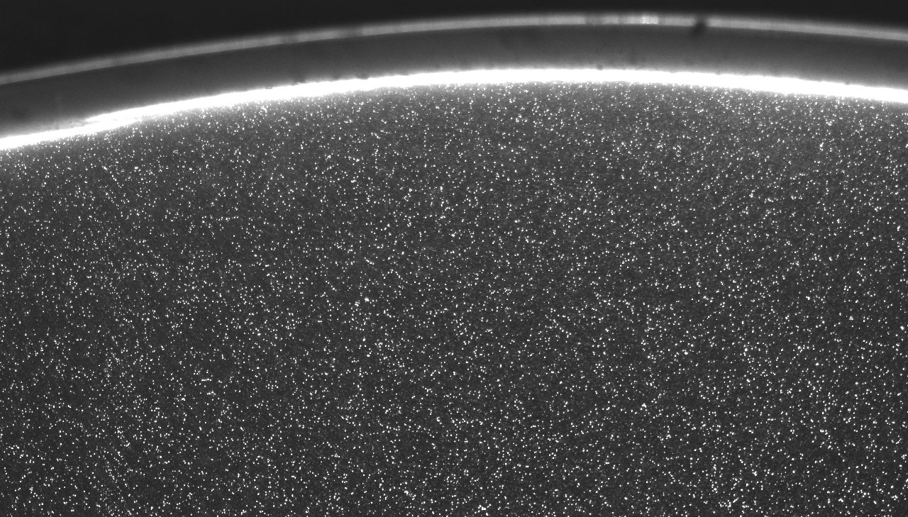
MEK4600 – Experimental methods in fluid mechanics
Particle Image Velocimetry 2 and Particle Tracking Velocimetry
(PIV and PTV)
28.2.2013
J. Kristian Sveen (IFE/FACE/UiO)

Slide 2
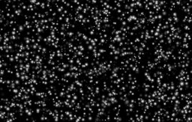
This presentation continues Tuesdays lecture on how we may use pattern matching to measure velocities
Recap Tuesdays lecture
  Basis for PIV
  Writing our own code
  Test accuracy with Monte Carlo simulations using synthetic mages
Tracking of individual particles (blobs)- Particle Tracking Velocimetry

Slide 3
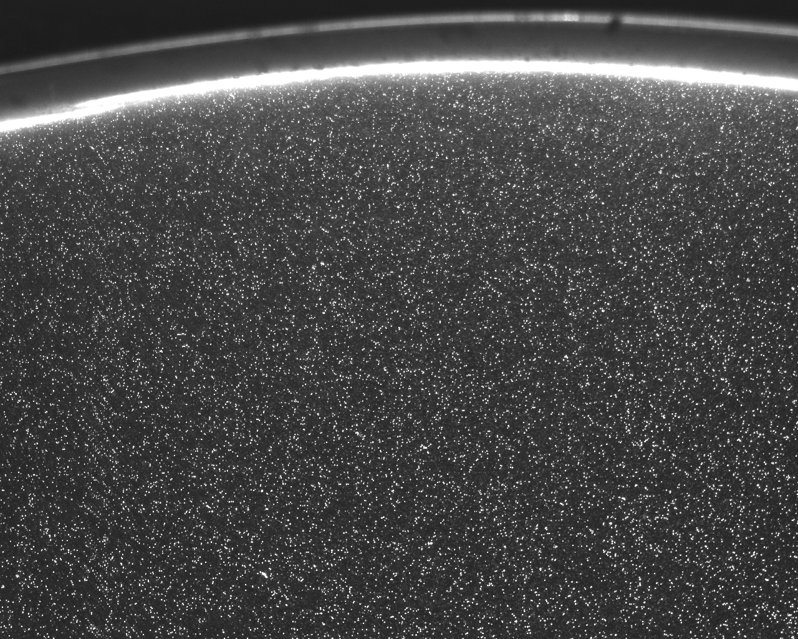
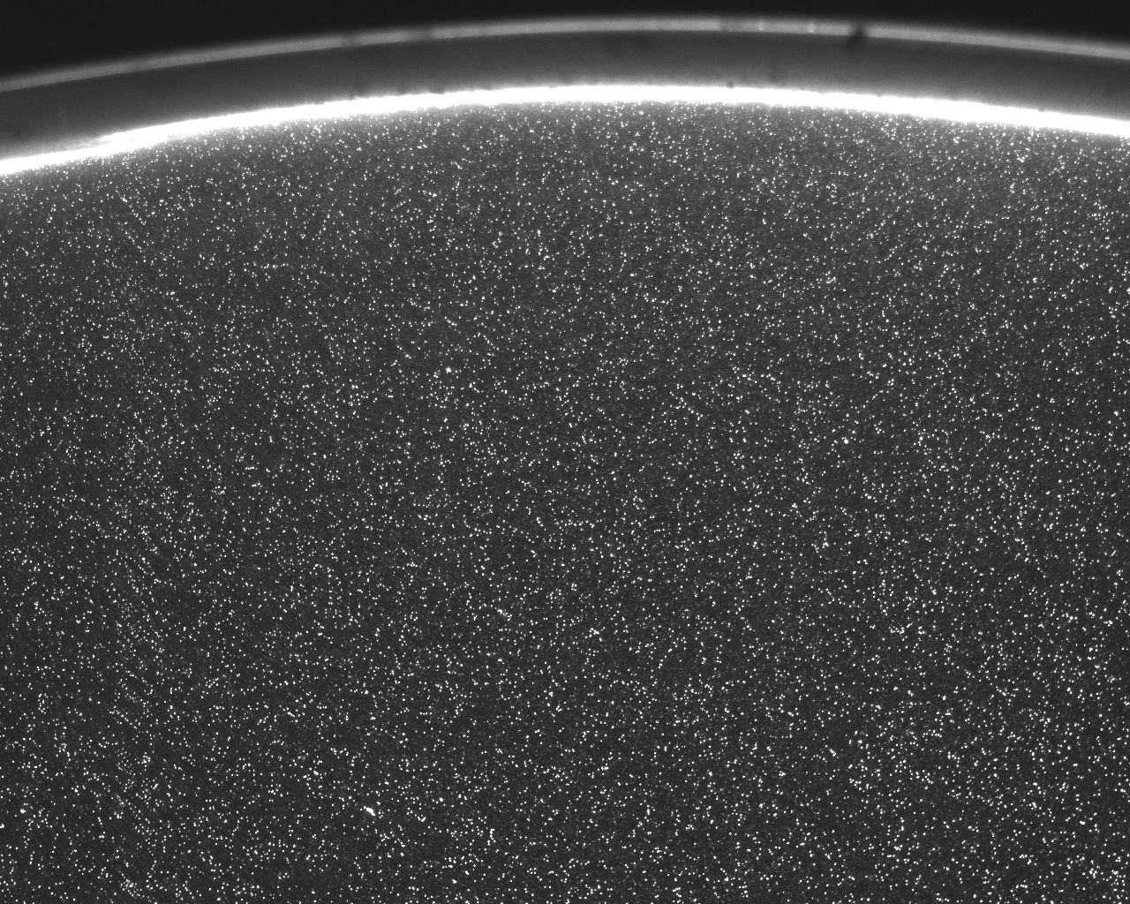
A short summary of what we talked about on Tuesday
Two consecutive images with known time spacing
Match pattern locally between corresponding grid cells
Divide into grid

Slide 4
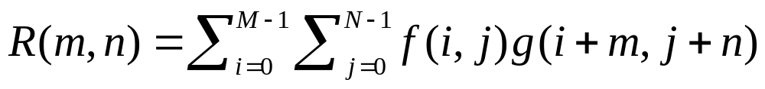
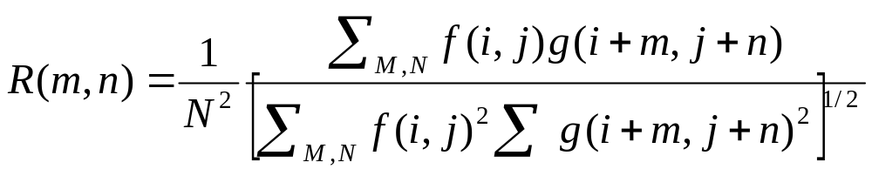
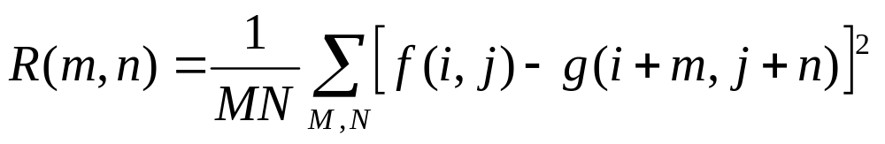
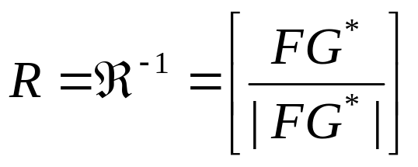
The principle of Pattern Matching in PIV is to measure similarity of a local pattern in two subsequent sub-images
Distance Metrics:
Cross correlation
Normalised
Cross correlation
Minimum Quadratic Difference
Phase Correlation

Slide 5
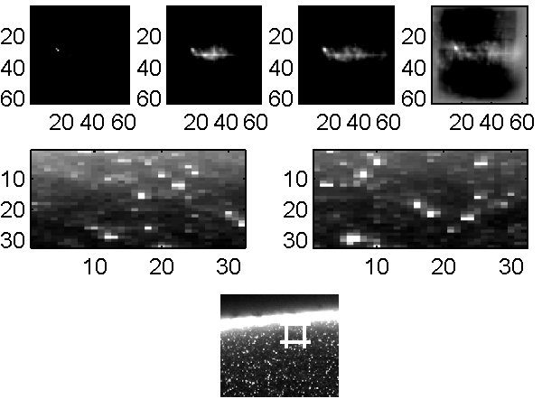
Pattern matching principles is the foundation for PIV
t₁
t₂

Slide 6
PIV in the laboratory

Slide 7
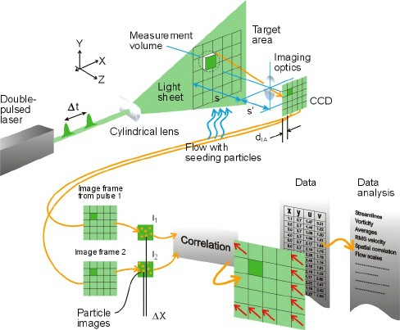
The practical aspects of PIV
So far: software principles
Next: what we do in the laboratory
From www.dantecdynamics.com

Slide 8
The practical aspects of PIV
Seeding
Illumination
Imaging
From www.dantecdynamics.com

Slide 9
Writing your own PIV code
Simple PIV
Psudo-code
Download from course-page
Read images
for i,j
calculate std of subwindows
subtract mean from subwins
R=xcorr(a,b)/ (fft based)
find max (R_{max}),
interpolate to get subpix x0,y0
find second highest peak (R₂)
U(s,t)=x0-winsize/2
V(s,t)=y0-winsize/2
SnR= R_{max} / R₂
end
Use file: simplepiv.m

Slide 10
Testing of PIV code has normally been done through Monte Carlo simulations
Need to generate artificial images
Particle images → Gaussian profile
Light sheet → Gaussian profile
Vary one parameter at a time
  Particle diameter
  Velocity/displacement
  Velocity shear
  Image noise
  Out-of-plane motion (loss of pattern)
Use file: makeimage3d.m

Slide 12
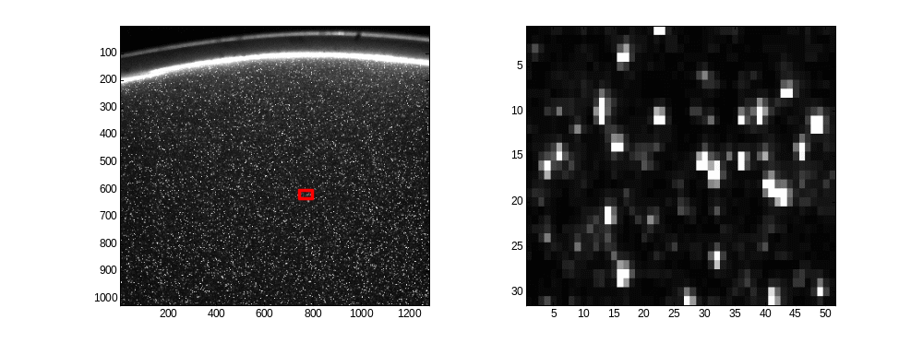
Particle Tracking Velocimetry
Identify and track individual particles from frame to frame
How can we pick out individual blobs?

Slide 13
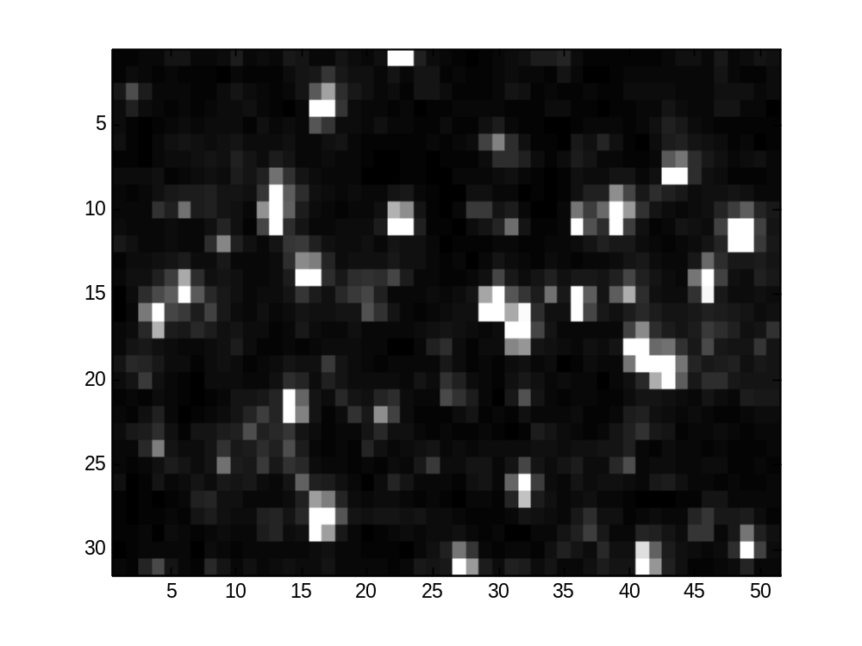
Blob recognition made easy
Set a threshold value
  Everything above is a particle
  Everything below is background or noise
…use “a few” different thresholds
Locate particles each time
Compare particle locations and store only unique ones.

Slide 14
Matlabs Image Processing toolbox has most of the tools you need to find blobs
Functions:
  regionprops.m – measures a set of properties for connected pixels (1’s) in a binary image (=thresholded)
  im2bw.m – produce binary image based on given threshold
  bwlabel.m – label each connected blob (set of connected 1’s) in an image
…the rest is “just” about matching particles between frames

Slide 15
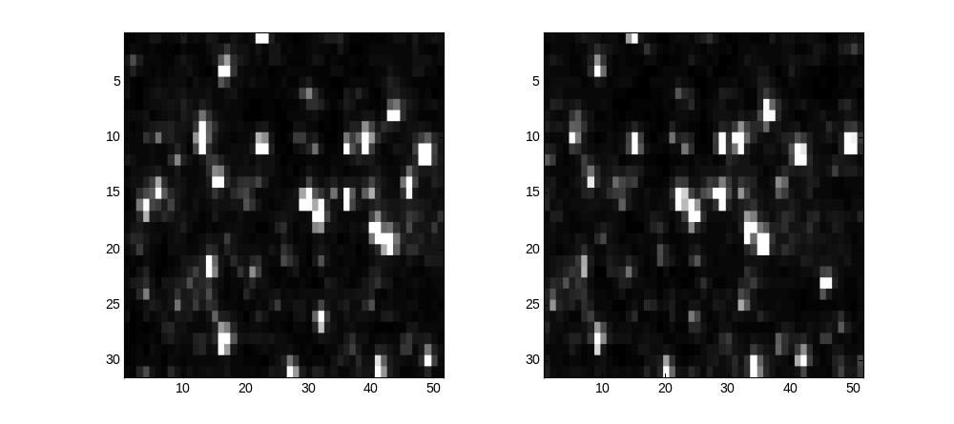
Particle matching from frame to frame
Use the nearest blob in the next image
  May work for cases with low seeding, velocities and acelleration

Slide 16
Particle matching from frame to frame
Use size information as well
  Improves predictions when there are size variations
Use velocity information (from PIV or from previous time step)

Slide 17
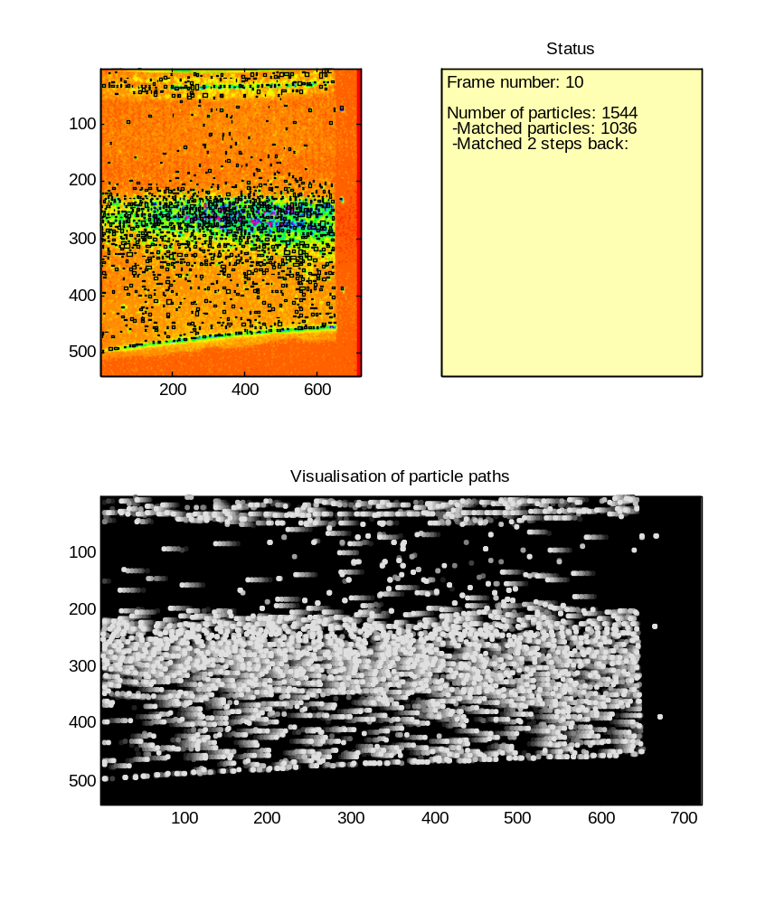
Using PIV for the first velocity estimate is a good starting point
File: matptv.m ++
Images from run-up of internal wave

Slide 18
This PTV implementation is a part of MatPIV
http://www.math.uio.no/~jks/matpiv
Free PIV package
After break – install it and try on the Demo3 images we have been using here.

