Slide 1
STK-4051/9051 Computational Statistics Spring 2024
Instructor: Odd Kolbjørnsen, oddkol@math.uio.no

Slide 2
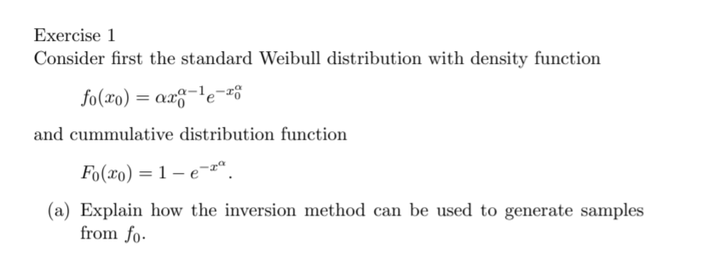
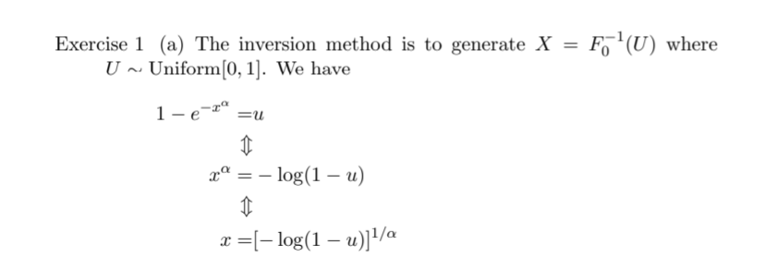

Slide 3
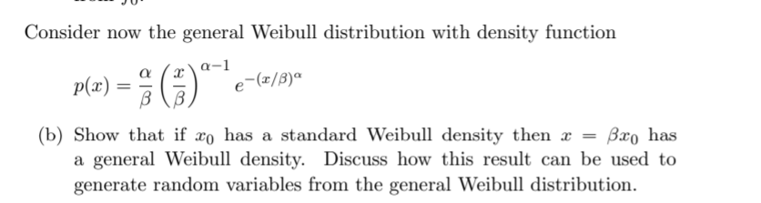
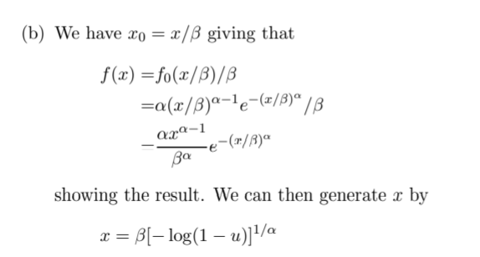

Slide 4
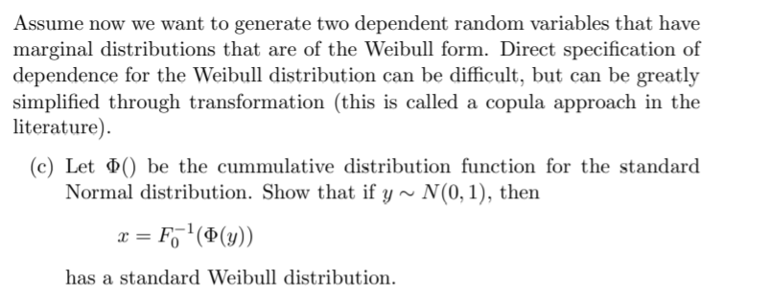
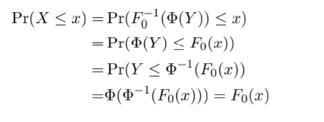

Slide 5
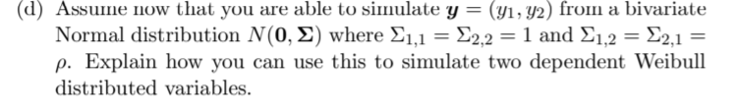
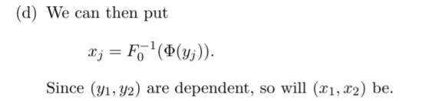
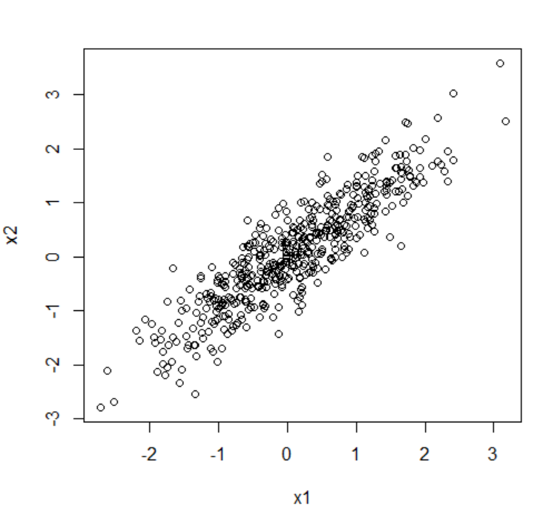
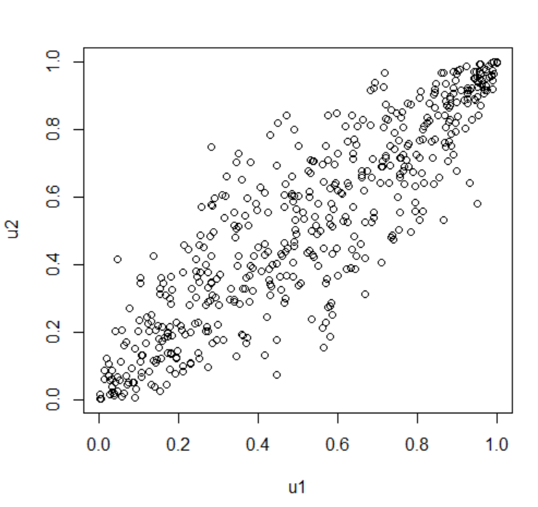
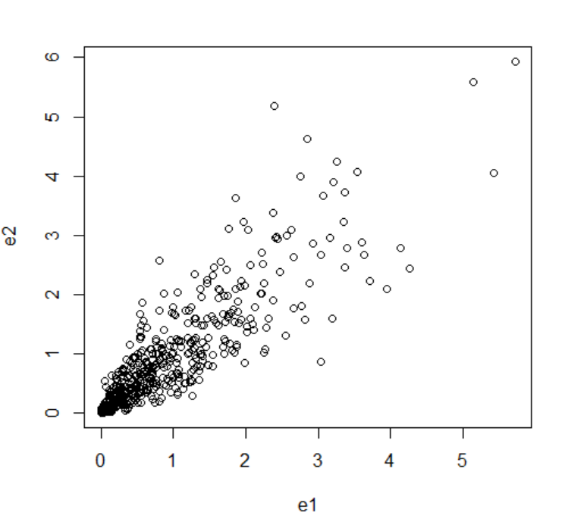
As transformations are monotone, the rank correlation will be preserved
Normal
Uniform
Weibull(1,1)
=exponential

Slide 6
N=500
n1=rnorm(N,0,1)
n2=rnorm(N,0,1)
rho=0.9
x1=n1
x2=x1*rho+sqrt(1-rho^2)*n2
u1=pnorm(x1)
u2=pnorm(x2)
e1 =-log(u1)
e2 =-log(u2)
hist(e1)
plot(x1,x2)
plot(u1,u2)
plot(e1,e2)

Slide 7
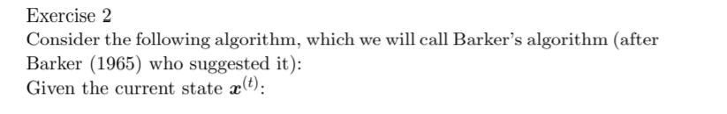
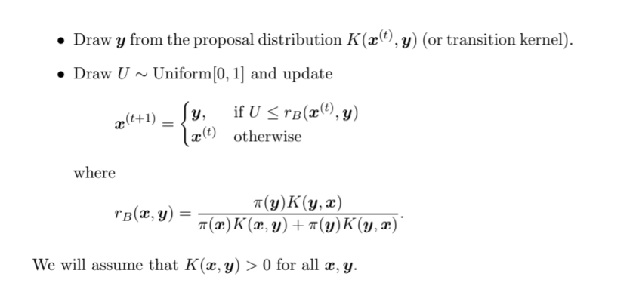

Slide 8
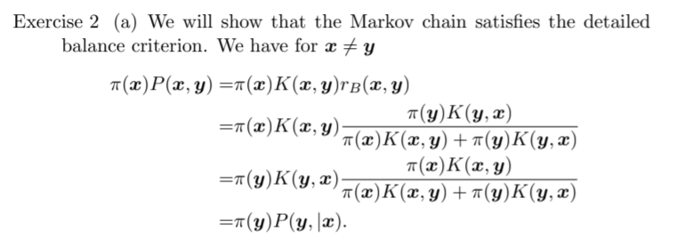

Slide 9
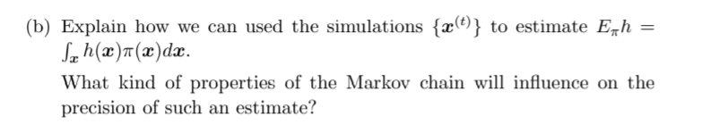
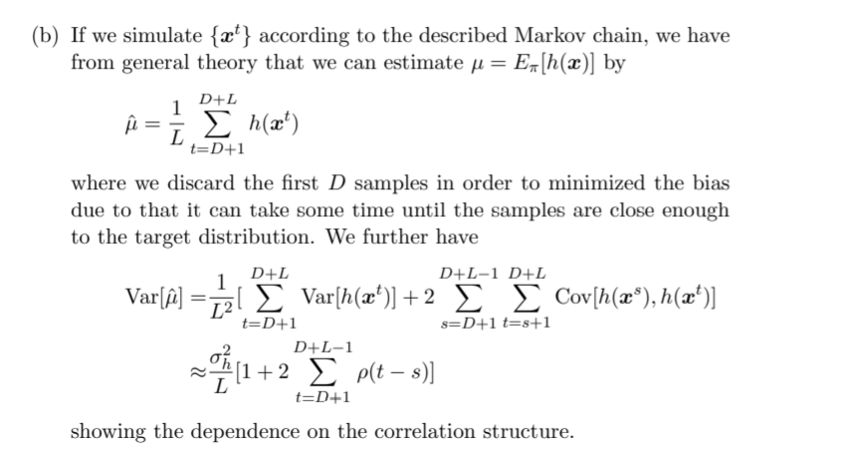

Slide 10
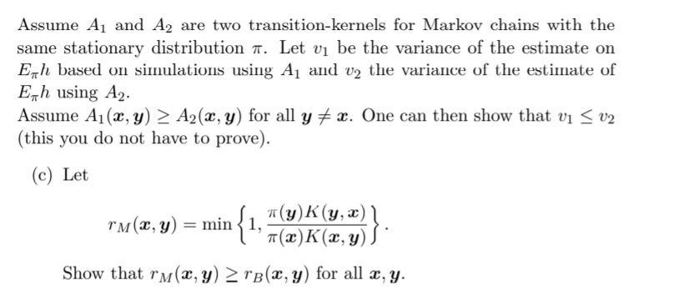
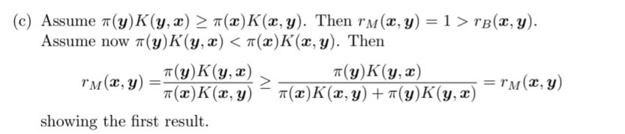

Slide 11
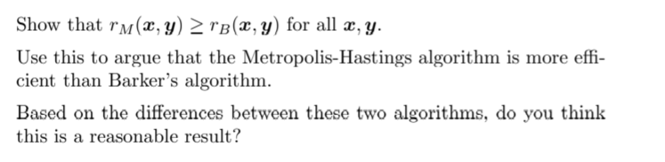

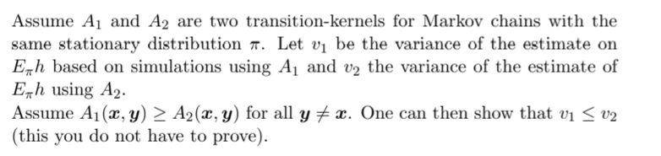
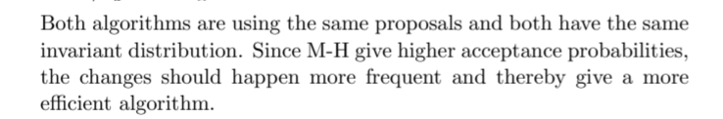
Since we have proven that:
We have proven:
The result then apply:
=
=

Slide 12
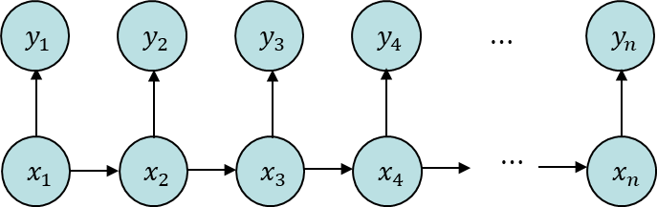
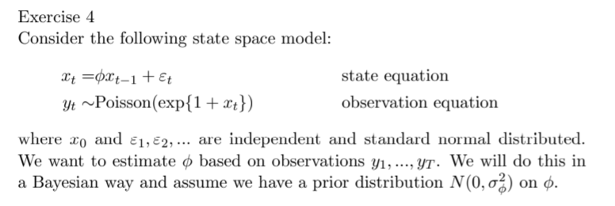
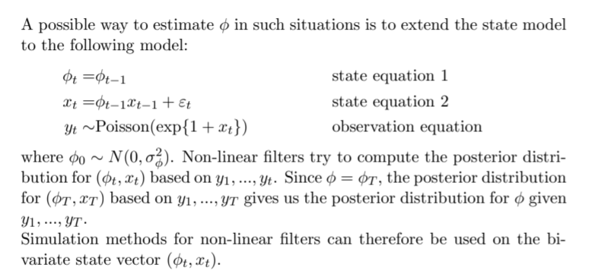

$θ$

Slide 13
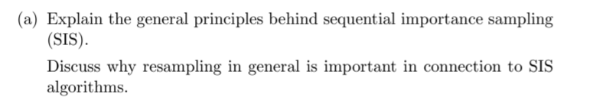
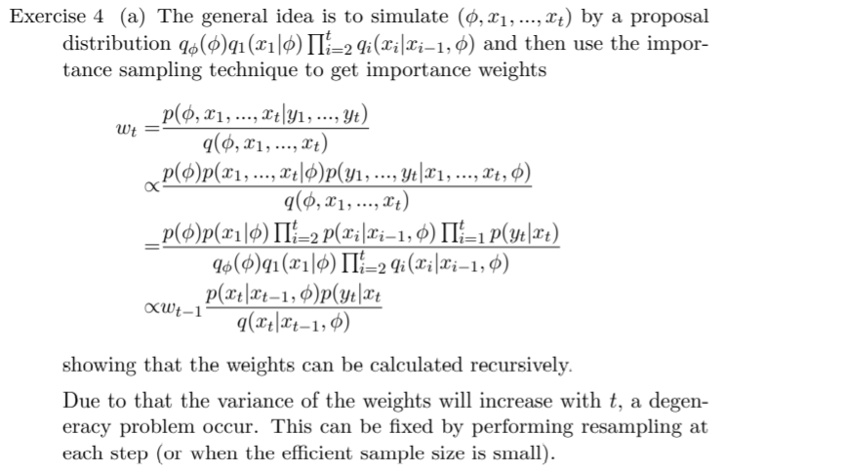

$$p(y_{i}|x_{i})$$
)

Slide 14
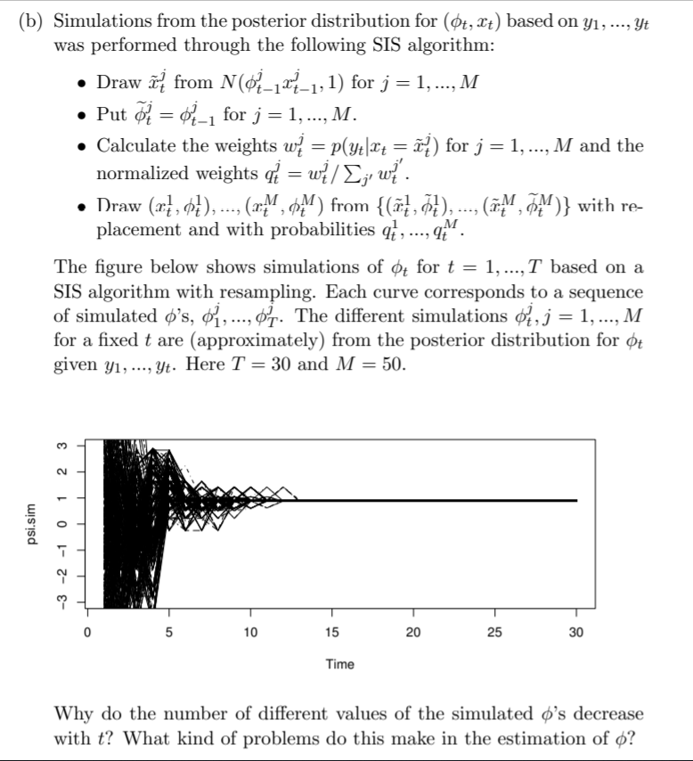
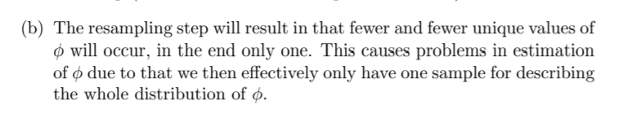

Slide 15
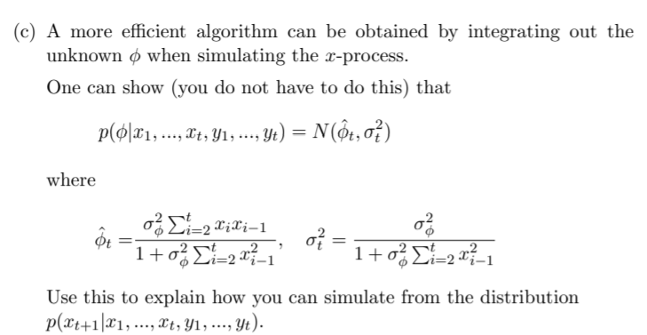
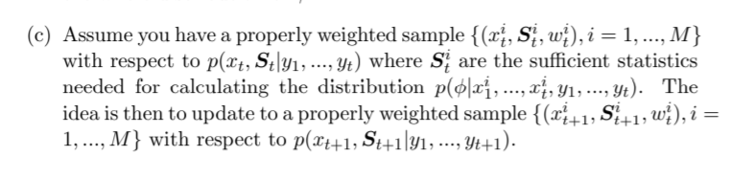
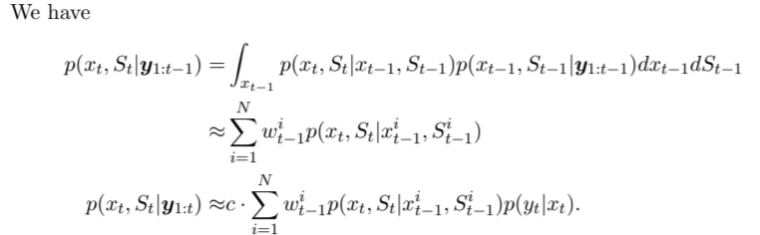
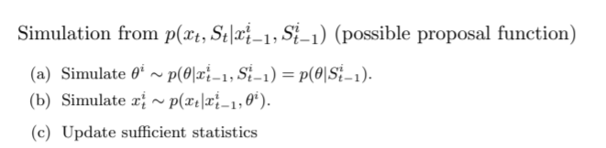

Slide 16
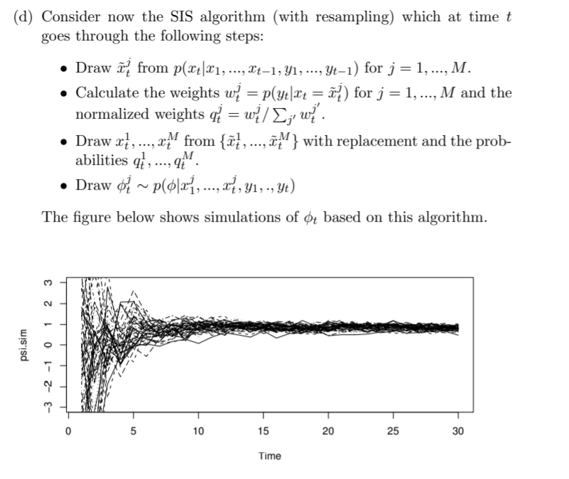
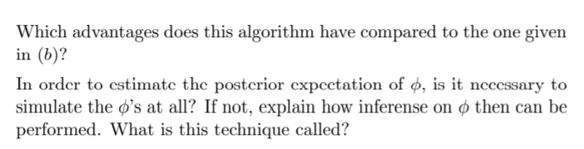
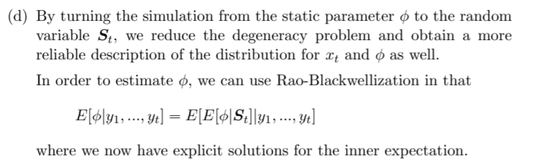
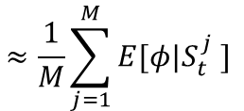
$$≈\frac{1}{M}\sum_{j=1}^{M}{E[φ|S_{t}^{j} ]}$$

Slide 17
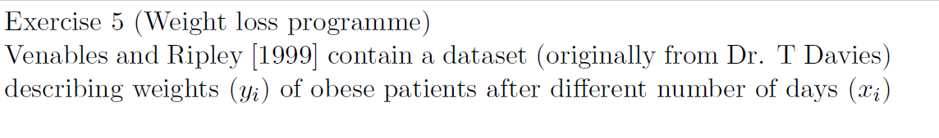
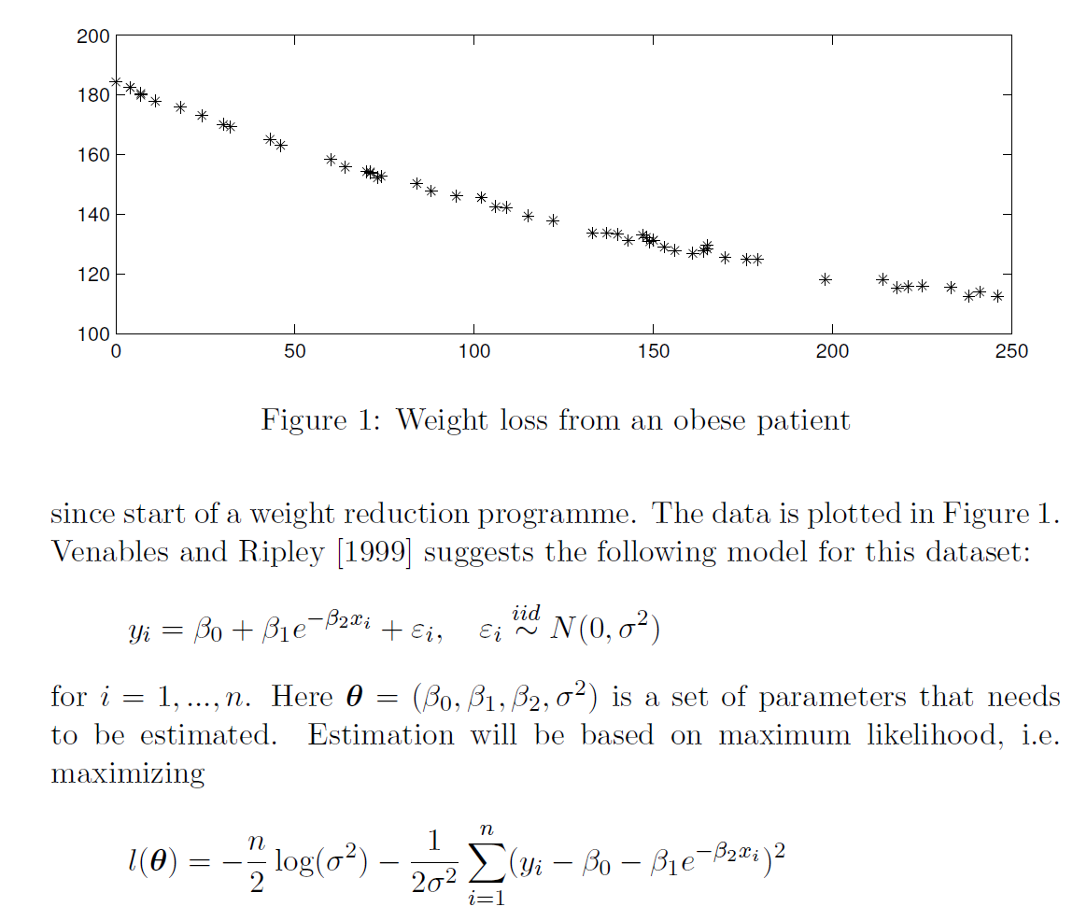

Slide 18
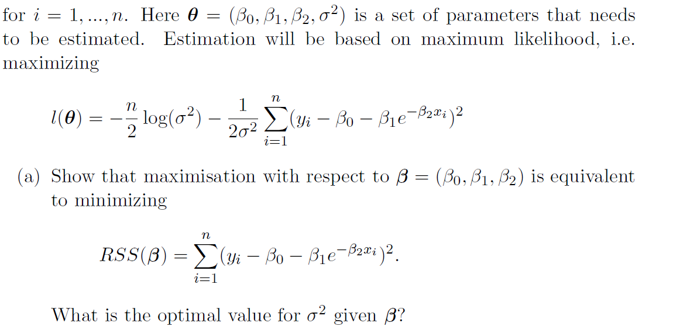
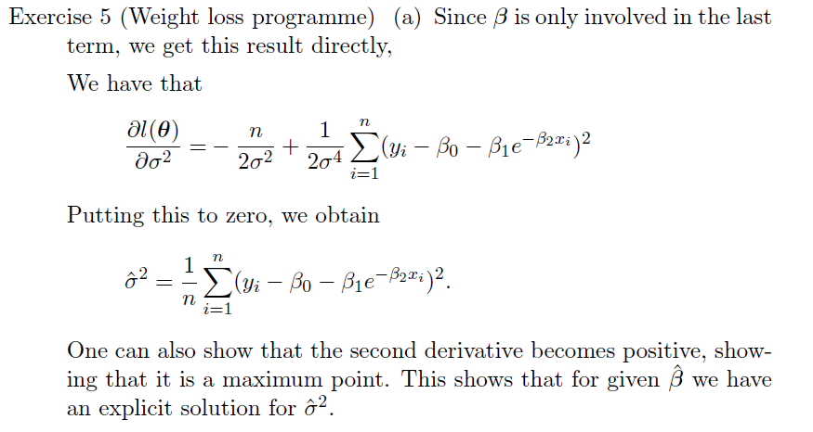
When you are asked to show something use:
Arguments
Computations
If you are not able to do so you might get points if you can provide insight to the problem

Slide 20
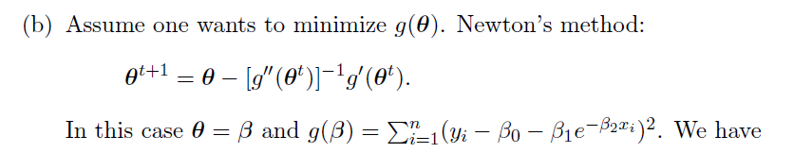
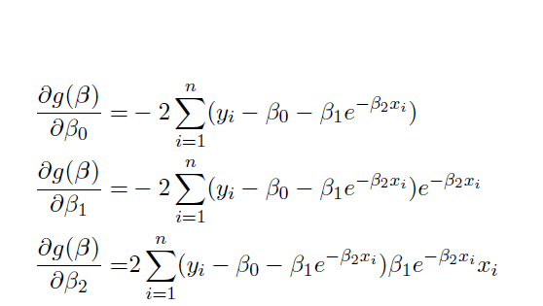

Slide 21
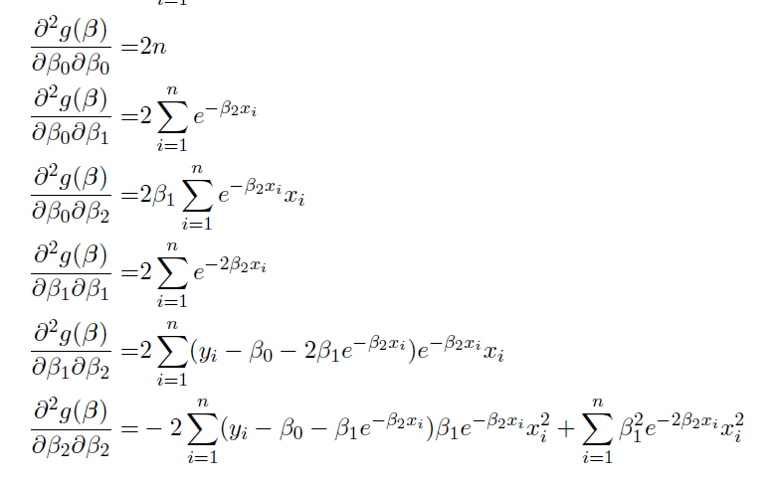

Slide 23
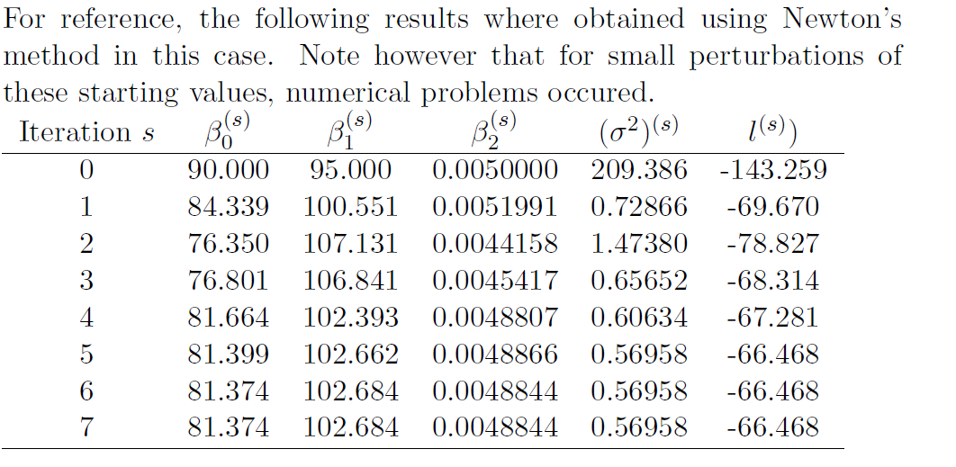
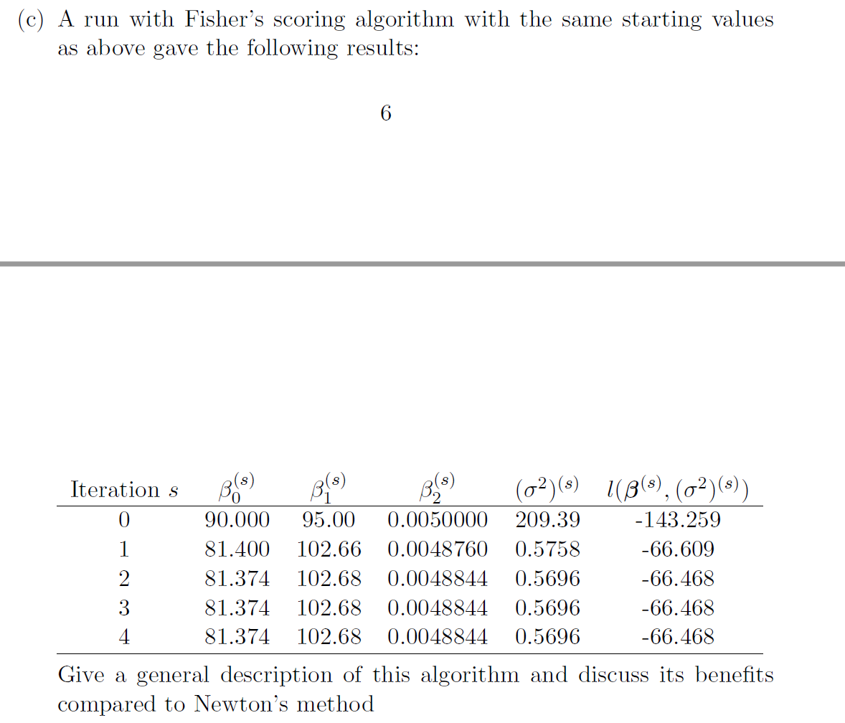
For the Fisher scoring algorithm, we replace the matrix of second
derivatives with their expectation. This guarantees that the matrix becomes positive (semi-)definite
Since this is the variance of the
scoring function.
Which in turn stabilize the solution.

Slide 24
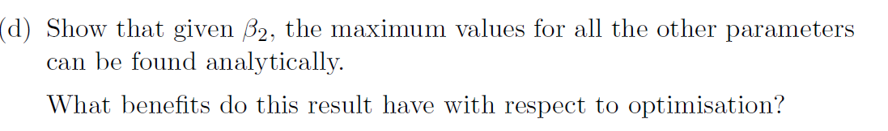
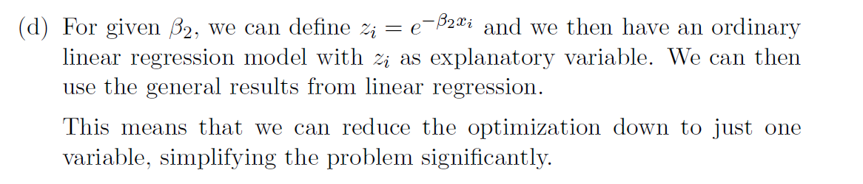

Slide 25
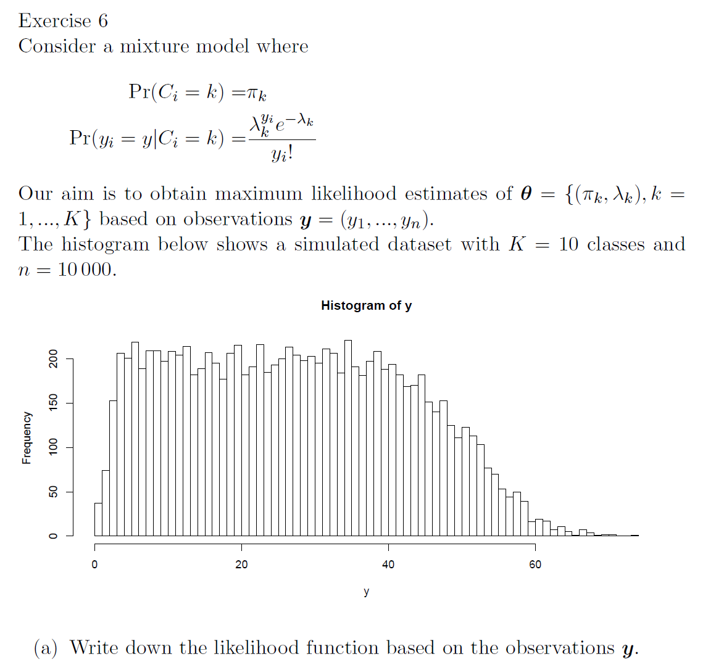
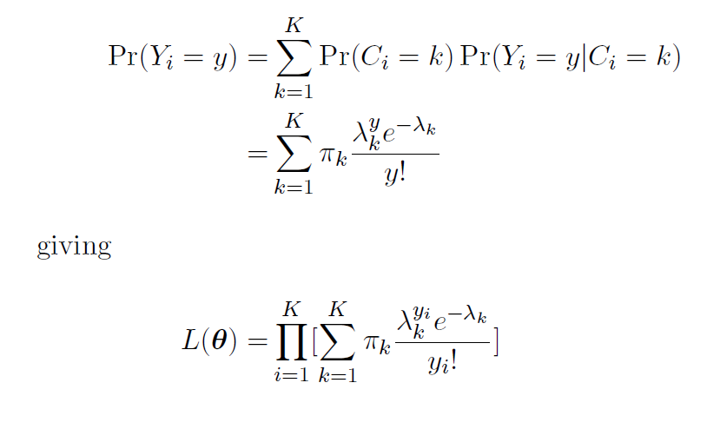

Slide 26
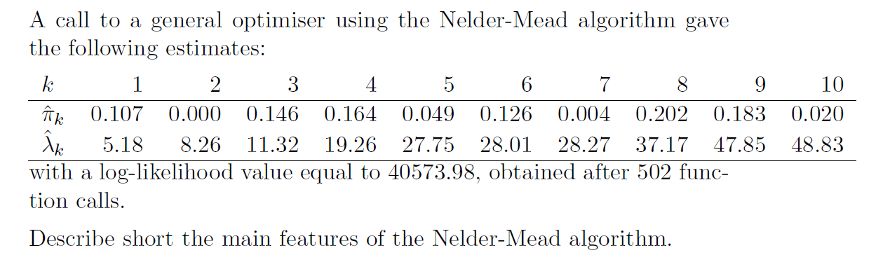


Slide 27


Slide 28



Slide 29


Slide 30


Slide 31


Slide 32



log-likelihood
40573.98,
log-likelihood 40573.98.
A problem in this case is that the
different classes are difficult to
distinguish from the data, making
several configurations of mixtures
of Poisson data possible.

Slide 33



Slide 34


Slide 35

In the figure a too fast cooling schedule has been used, the 1-Neigh is stuck before the
2-Neigh since this has less flexebility

Slide 36



