Slide 1
STK 4500
Lecture January 30th, 2012
Nils F. Haavardsson

Slide 2
Overview
Premium (P)
P
Client
Insurance company
Financial markets
Pension
Return

Slide 3
Overview
Premium (P)
P
Client
Insurance company
Financial markets
Pension
Return
Risks(actuarial)
Mortality
How long do people live?
Experience
Do people live longer than the models predict?
Disability
How many people become disabled?
Churn
Will the client resign his account?
Catastrophe
Will a major catastrophe occur?

Slide 4
Overview
Premium (P)
P
Client
Insurance company
Financial markets
Pension
Return
Risks(actuarial)
Risks(financial)
Mortality
How long do people live?
Interest rate
Minimum guarantee issues
Asset liability matching issues
Experience
Do people live longer than the models predict?
Stocks, bonds and real estate
Volatile returns
Asset allocation strategies
Disability
How many people become disabled?
Spread
Are assets sufficiently diversified?
Churn
Will the client resign his account?
Currency
Are currency risks hedged?
Catastrophe
Will a major catastrophe occur?
Illiquidity
Are the markets sufficiently liquid?

Slide 5
Overview
Premium (P)
P
Client
Insurance company
Financial markets
Pension
Return
Risks(actuarial)
Risks(administrative)
Risks(financial)
Mortality
How long do people live?
Costs
Is the bureacracy managable?
(for example, Solvency II)
Interest rate
Minimum guarantee issues
Asset liability matching issues
Experience
Do people live longer than the models predict?
Revisions
Does the game change?
(Life contracts are long term)
Stocks, bonds and real estate
Volatile returns
Asset allocation strategies
Disability
How many people become disabled?
Spread
Are assets sufficiently diversified?
Churn
Will the client resign his account?
Currency
Are currency risks hedged?
Catastrophe
Will a major catastrophe occur?
Illiquidity
Are the markets sufficiently liquid?

Slide 6
An introductory example
Imagine Mr (55) decides to invest money to secure himself financially in his old age
He deposits capital of S₀=1 and draws the entire amount with earned compound interest in 15 years, on his 70th birthday
He will then get
Suppose the likelihood of reaching 70 given that one’s age is 55 is 0.75. Then Mr(55)s expected payout is 0.75S₁₅
Suppose Mr (55) teams up with Mr (55)₁ and Mr(55)_{2,} who are in the exact same situation as Mr (55)
The expected amount at (55)s disposal after 15 years is now
Mr(55) | Mr(55)₁ | Mr(55)₂ | L₇₀ | S₁₅/L₇₀ | Probability | Possession for Mr(55) at 70
+ | + | + | 3 | S₁₅ | 0.75x0.75x0.75=0.422 | S₁₅
+ | + | - | 2 | 1.5S₁₅ | 0.75x0.75x0.25=0.141 | 1.5S₁₅
+ | - | + | 2 | 1.5S₁₅ | 0.75x0.25x0.75=0.141 | 1.5S₁₅
+ | - | - | 1 | 3S₁₅ | 0.75x0.25x0.25=0.047 | 3S₁₅
- | + | + | 2 | 1.5S₁₅ | 0.75x0.75x0.75=0.141 | 0
- | + | - | 1 | 3S₁₅ | 0.75x0.75x0.75=0.047 | 0
- | - | + | 1 | 3S₁₅ | 0.75x0.75x0.75=0.422 | 0
- | - | - | 0 | Undefined | 0.75x0.75x0.75=0.422 | 0

Slide 7
Introduction to survival analysis
Survival analysis is in statistics linked to event history analysis, that deals with data observing individuals over time
Outcome data consist of time of occurence of events and the events that occur
Frequently, an event may be considered as a transition from one state to another, and therefore multi-state models will provide a relevant framework for event history analysis
Consider the following simple model:
Alive
Dead

Slide 8
Introduction to survival analysis
Alive
Dead
The observation for a given individual will here in the most simple form consist of a random variable, say T, representing time from a given origin (time 0) to the occurence of the event ’death’
The distribution of T may be characterized by the probability function F(t)=P(T<=t) or equivalently by the survival functions S(t)=1-F(t)=P(T>t).
It is seen that S(t) and F(t), respectively, correspond to being in state 0 or 1 at time t.
If every individual is assumed to be in state 0 at time 0 then F(t) is also the transition probability from state 0 to state 1 for the time interval from 0 to t.
In continuous time the distribution of T may also be characterized by the hazard rate function
(1)

Slide 9
Introduction to survival analysis
Alive
Dead
That is
Thus, is the transition intensity from state 0 to state 1, i.e., the instantenous probability per time unit of going from state 0 to state 1.
is often referred to as the hazard rate.
In general, event history analysis deals with inference for transition intensities and transition probabilities in multi-state models.
This includes estimation and hypothesis tests for these quantities and analysis of regression models where these quantities are related to explanatory variables observed for the individuals under study
(2)

Slide 10
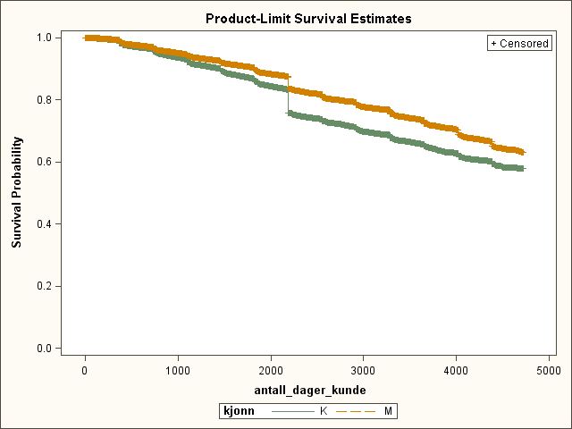
Example of survival curve (churn)
S(t) for men
S(t) for women
Number of days
Insurance
customer
Exit to competitor
Formula for expected survival (using integration by parts):
Geometric interpretation: Expected survival is area under curve above
(3)

Slide 11
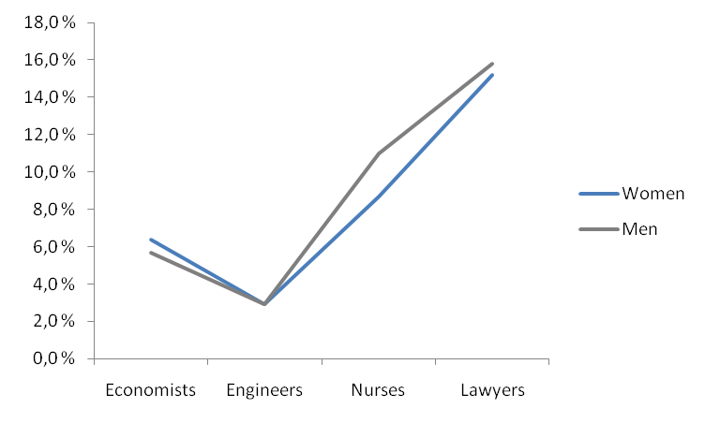
Look for significant interaction effects
The churn varies for every segment
The difference in churn between men and women varies for every segment
We say that there is an interaction effect between sex and segment related to churn
Churn per profession group and per sex

Slide 12
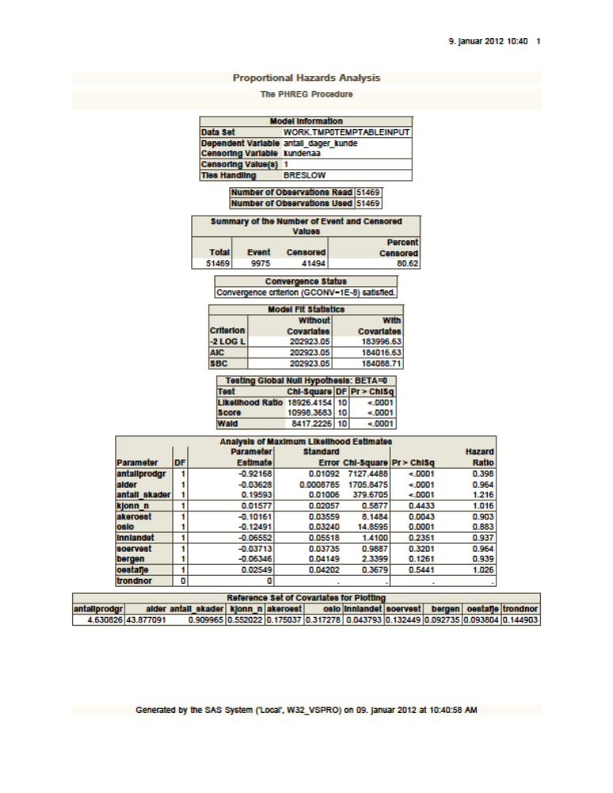
Put all important factors together in a full event history model
Variables in the model:
Number of product groups
Age of the policy holder
Sex of the policy holder
Region
…..

Slide 13
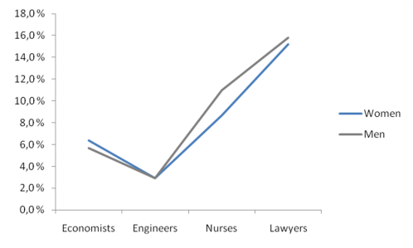
Process for event history model
Dataanalysis of each factor that may affect churn
Analysis of possible interaction effects between the factors
Development of full event history model
Number of days

Slide 14
Survival modelling: actuarial notation
Actuarial evaluation on a time increment T counts life length as Y=LT where T may be a year, quarter or month and L an integer. The probability distribution of L is known as a life table and is usually specified through the conditional probabilities
On the left the survival probability is the likelihood of living k periods longer whereas the mortality on the right is the probability that the individual dies during the last period. Both quantities depend on current age l.
Note the following recursions:
And for the mortalities
(4)
survival probabilities
mortalities
(5)
(6)

Slide 15
Survival modelling: actuarial notation
(5) and (6) can be obtained by noting that if b>a>=l+k then
(7) is used to get (5) and (6). First (5) is obtained letting
(7)
(8)

Slide 16
Survival modelling: actuarial notation
(6) is obtained inserting b=l+k+1 and a=l+k
(9)

Slide 17
Mortality intensity modelling
The occurence of death and other events may be modelled using event history analysis techniques (introduced earlier this session)
These techniques have been greatly sophisticated the last 40 years
The knowledge obtained can be very useful, since knowledge regarding the event intensities may be refined using regression techniques
Where is a vector of regression variables
Unfortunately, this technique requires a lot of data (ie survival data on individual level)
So this may be an important reason why this technique has not been widely used in the life insurance industry.
Instead, the life insurance industry has since long been using the Gomperz-Makeham model, specified as
ie a parametric curve. The parameters in (10) are estimated using ML (maximum likelihood) techniques.
Note that this method does not require data on individual level
(10)

Slide 18
A numerical algorithm for expected survival
The formula for expected survival is
see (3) for details. An algorithm for expected survival can be derived, using the approximation
Algorithm 12.1., Expected remaining survival
  0 Input {p_{l}}, h, l=y/h, l_{e}
  1 P <-1 and E <- ½
  2 For k=l,…,l_{e} do
  P<-Pp_{k} and E<-E+P
  3 Return E <-Eh
(11)
(12)

Slide 19
Applying the algorithm for expected survival
Algorithm 12.1 implemented in Excel (R is recommended). Result displayed below
Age

Slide 20
Single life arrangements
Two basic cash flows are those that persists as long as the policy holder is alive and those that are one-time upon death.
and
Agreed payment at time k
Survival probability at time k, given alive at time 0 (at age l₀)
Payments while alive
Agreed payment at time k
Death probability at time k, given alive at time 0 (at age l₀)
Payment (one-time) upon death

Slide 21
How mortality risk affects value
The equivalence principle at time k: If the present value of all payments is 0 then the present value of past payments equals the present value of future payments
k
time
Past payments
(retrospective)
Payments ahead
(prospective)
The accounts are credited
because somebody dies early
Retrospective reserve
Prospective reserve
Insured alive
Insured dies

Slide 22
Life insurance notation
Suppose one money unit is received each of K time periods, but ceases when the individual dies. The money is received at the end of each period
If the money is received in advance, the expression becomes
The expressions are related
In arrears while alive
In avance while alive

Slide 23
Computing mortality-adjusted annuities
Algorithm 12.2 The coefficients
0 input l₀, K, d=1/(1+r), {q_{l} }
1 a<-1, _{l}b<-1, l<-l₀-1
2 for k=0,…,K-1 repeat
a<-a+b and l<-l+1
b<-b(1-q_{l})d
3 Return a and a..<-a+b-1. (a and a.. are now )

Slide 24
An example: Mr(55) revisited
Consider MR (55), receiving one unit of money for K periods.
Assume the following values for the different parameters

Slide 25
Result from Mr(55) revisited
The net present value for payments in advance presented to the left. The net present value for payments in arrears presented to the right.
In both cases the cash flows are compared to cash flows without the mortality assumption
The NPV without mortality is 4% greater than the NPV in advance. The NPV without mortality is 15% greater than the NPV in arrears.
We see that the difference between the two cash flows is greater when payments are done in arrears. We see the effect of mortality accumulate more severly in the case of arrears than in advance, since the money is received at the end of the period and not in advance
In advance
In arrears
4%
15%
K
K

Slide 26
Common insurance arrangements
Life annuities Suppose an individual has saving at retirement l_{r} and purchases an annuity that lasts K periods with interruption by death. The mortality adjusted value of a unit annuity is then and the pension s received each period is determined from

Slide 27
Common insurance arrangements
Defined benefits Savings are built up to support a given pension. Suppose the individual enters the arrangement at age l₀ and retires at l_{r} to receive a fixed pension s broken off by death or after K periods. With all payments in advance the present value of the scheme at the time it is drawn up is

