Slide 1
Non-life insurance mathematics
Nils F. Haavardsson, University of Oslo and DNB Skadeforsikring

Slide 2
Main issues so far
Why does insurance work?
How is risk premium defined and why is it important?
How can claim frequency be modelled?
  Poisson with deterministic muh
  Poisson with stochastic muh
  Poisson regression

Slide 3
Insurance works because risk can be diversified away through size
The core idea of insurance is risk spread on many units
Assume that policy risks X1,…,XJ are stochastically independent
Mean and variance for the portfolio total are then
which is average expectation and variance. Then
The coefficient of variation approaches 0 as J grows large (law of large numbers)
Insurance risk can be diversified away through size
Insurance portfolios are still not risk-free because
  of uncertainty in underlying models
  risks may be dependent

Slide 4
Risk premium expresses cost per policy and is important in pricing
Risk premium is defined as P(Event)*Consequence of Event
More formally
From above we see that risk premium expresses cost per policy
Good price models rely on sound understanding of the risk premium
We start by modelling claim frequency

Slide 5
The world of Poisson (Chapter 8.2)
Poisson
Some notions
Examples
Number of claims
Random intensities
I_{k-1}
I_{k}
I_{k+1}
t₀=0
t_{k-2}
t_{k-1}
t_{k}
t_{k+1}
t_{k}=T
What is rare can be described mathematically by cutting a given time period T into K small pieces of equal length h=T/K
On short intervals the chance of more than one incident is remote
Assuming no more than 1 event per interval the count for the entire period is
N=I₁+...+I_{K} , where I_{j} is either 0 or 1 for j=1,...,K
If p=Pr(I_{k}=1) is equal for all k and events are independent, this is an ordinary Bernoulli series
where
Assume that p is proportional to h and set
is an intensity which applies per time unit

Slide 6
The world of Poisson
Poisson
Some notions
Examples
Random intensities
In the limit N is Poisson distributed with parameter

Slide 7
The world of Poisson
Poisson
Some notions
Examples
Random intensities
It follows that the portfolio number of claims N is Poisson distributed with parameter
When claim intensities vary over the portfolio, only their average counts

Slide 8
Random intensities (Chapter 8.3)
Poisson
Some notions
Examples
Random intensities
How varies over the portfolio can partially be described by observables such as age or sex of the individual (treated in Chapter 8.4)
There are however factors that have impact on the risk which the company can’t know much about
  Driver ability, personal risk averseness,
This randomeness can be managed by making a stochastic variable
0
1
2
3
0
1
2
3

Slide 9
Random intensities (Chapter 8.3)
Poisson
Some notions
Examples
Random intensities
The models are conditional ones of the form
Let
which by double rules in Section 6.3 imply
Now E(N)<var(N) and N is no longer Poisson distributed
Policy level
Portfolio level

Slide 10
The Poisson regression model (Section 8.4)
The fair price
The model
An example
Why regression?
Repetition of GLM
The idea is to attribute variation in to variations in a set of observable variables x1,...,xv. Poisson regressjon makes use of relationships of the form
(1.12)
Why and not itself?
The expected number of claims is non-negative, where as the predictor on the right of (1.12) can be anything on the real line
It makes more sense to transform so that the left and right side of (1.12) are more in line with each other.
Historical data are of the following form
  n1 T1 x11...x1x
  n2 T2 x21...x2x
  nn Tn xn1...xnv
The coefficients b0,...,bv are usually determined by likelihood estimation
Claims exposure covariates

Slide 11
The model (Section 8.4)
The fair price
The model
An example
Why regression?
Repetition of GLM
In likelihood estimation it is assumed that nj is Poisson distributed where is tied to covariates xj1,...,xjv as in (1.12). The density function of nj is then
or
log(f(nj)) above is to be added over all j for the likehood function L(b0,...,bv).
Skip the middle terms njTj and log (nj!) since they are constants in this context.
Then the likelihood criterion becomes
(1.13)
Numerical software is used to optimize (1.13).
McCullagh and Nelder (1989) proved that L(b0,...,bv) is a convex surface with a single maximum
Therefore optimization is straight forward.

Slide 12
Main steps
How to build a model
How to evaluate a model
How to use a model

Slide 13
How to build a regression model
Select detail level
Variable selection
Grouping of variables
Remove variables that are strongly correlated
Model important interactions

Slide 14
Select detail level
Poisson
Client
Some notions
Examples
Random intensities
Policies and claims
Policy
Insurable object
(risk)
Claim
Insurance cover
Cover element
/claim type
Step 1 in model building: Select detail level

Slide 15
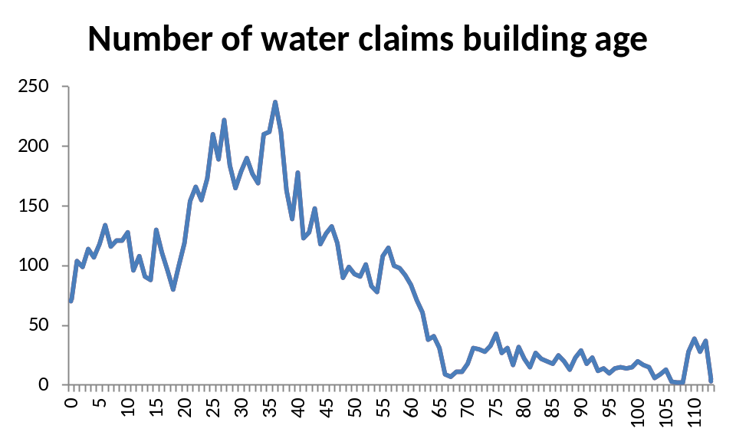
Grouping of variables
PP: Select detail level
PP: Review potential risk drivers
PP: Select groups for each risk driver
PP: Select large claims strategy
PP: identify potential interactions
PP: construct final model
Price assessment

Slide 16
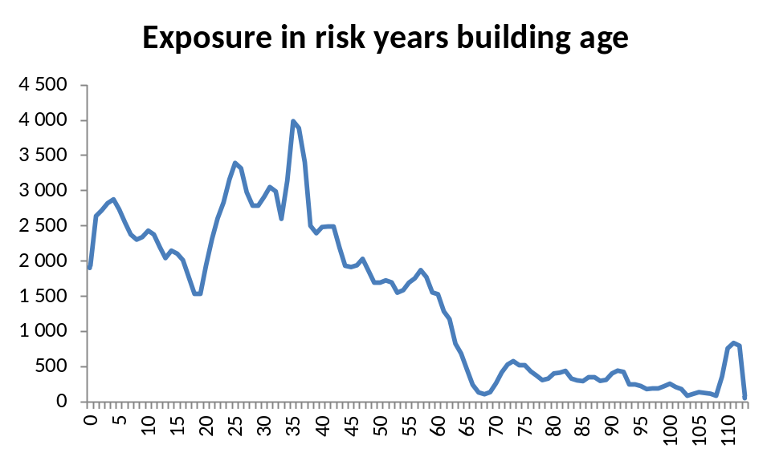
Grouping of variables
PP: Select detail level
PP: Review potential risk drivers
PP: Select groups for each risk driver
PP: Select large claims strategy
PP: identify potential interactions
PP: construct final model
Price assessment

Slide 17
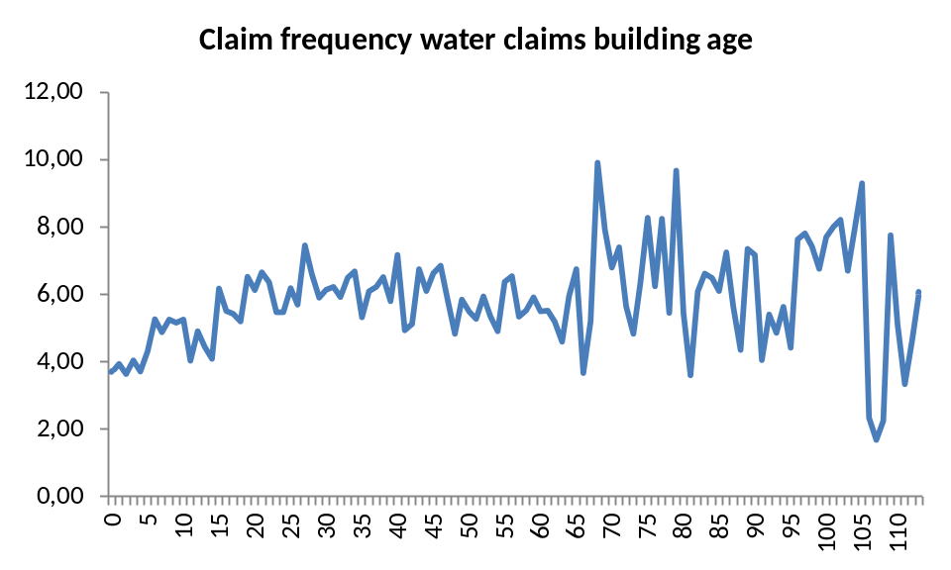
Grouping of variables
PP: Select detail level
PP: Review potential risk drivers
PP: Select groups for each risk driver
PP: Select large claims strategy
PP: identify potential interactions
PP: construct final model
Price assessment

Slide 18
Model important interactions
PP: Select detail level
PP: Review potential risk drivers
PP: Select groups for each risk driver
PP: Select large claims strategy
PP: identify potential interactions
PP: construct final model
Price assessment
Definition:
  Consider a regression model with two explanatory variables A and B and a response Y. If the effect of A (on Y) depends on the level of B, we say that there is an interaction between A and B
Example (house owner):
  The risk premium of new buildings are lower than the risk premium of old buildings
  The risk premium of young policy holders is higher than the risk premium of old policy holders
  The risk premium of young policy holders in old buildings is particularly high (higher than the effect of building and the effect of age indicate)
  Then there is an interaction between building age and policy holder age

Slide 19
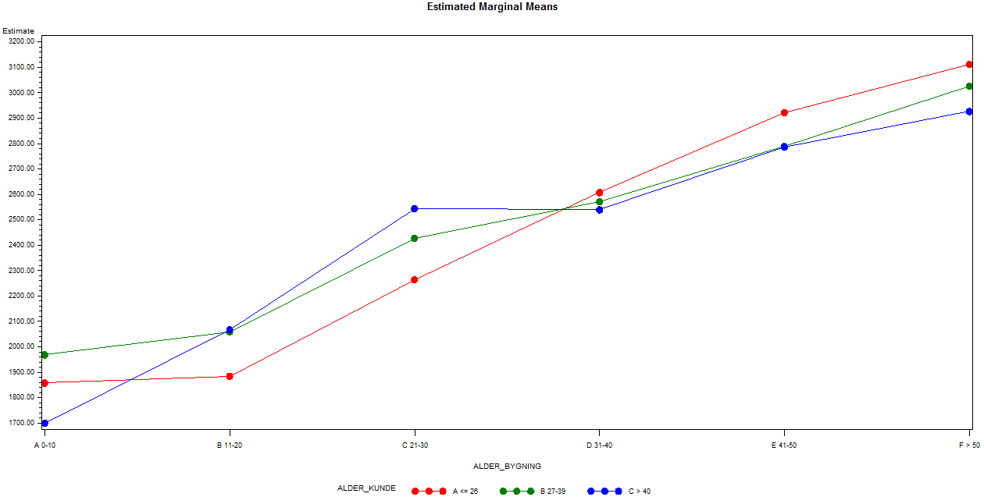
Model important interactions
PP: Select detail level
PP: Review potential risk drivers
PP: Select groups for each risk driver
PP: Select large claims strategy
PP: identify potential interactions
PP: construct final model
Price assessment

Slide 20
How to evaluate a regression model
QQplot
Akaike Information Criterion (AIC)
Scaled deviance
Cross validation
Type 3 analysis
Results interpretations

Slide 21
QQplot
The quantiles of the model are plotted against the quantiles from a standard Normal distribution
If the model is good, the point in the QQ plot will lie approximately on the line y=x

Slide 22
AIC
Akaike Information criterion is a measure of goodness of fit that balances model fit against model simplicity
AIC has the form
  AIC=-2LL+2p where
LL is the log likelihood evaluated at the value fo the estimated parameters
p is the number of parameters estimated in the model
AIC is used to compare model alternatives m1 and m2
If AIC of m1 is less than AIC of m2 then m1 is better than m2

Slide 23
Scaled deviance
Scaled deviance = 2(l(y,y)-l(y,muh)) where
  l(y,y) is the maximum achievable log likelihood and l(y,muh) is the log likelihood at the maximum estimates of the regression parameters
Scaled deviance is approximately distributed as a Chi Square random variables with n-p degrees of freedom
The expected value of a Chi Square variable with n-p d.o.f. is n-p
Scaled deviance divided by d.o.f should therefore be close to 1 if the model is good

Slide 24
Cross validation
Estimation
Validation
Model is calibrated on for example 50% of the portfolio
Model is then validated on the remaining 50% of the portfolio
For a good model that predicts well there should not be too much difference between the modelled number of claims in a group and the observed number of claims in the same group

Slide 25
Type 3 analysis
Does the degree of variation explained by the model increase significantly by including the relevant explanatory variable in the model?
Type 3 analysis tests the fit of the model with and without the relevant explanatory variable
A low p value indicates that the relevant explanatory variable improves the model significantly

Slide 26
Results interpretation
Is the intercept reasonable?
Are the parameter estimates reasonable compared to the results of the one way analyses?

Slide 27
How to use a regression model
Smoothing of estimates

